Slide 1
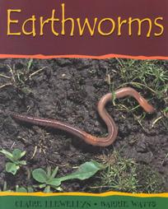
1st Grade Text Talk
Unit 2

Slide 2
I can use words I learn from a text.
Notes:
Goal-
Students need to engage with the goal- read it, repeat it, write it, etc.

Slide 3
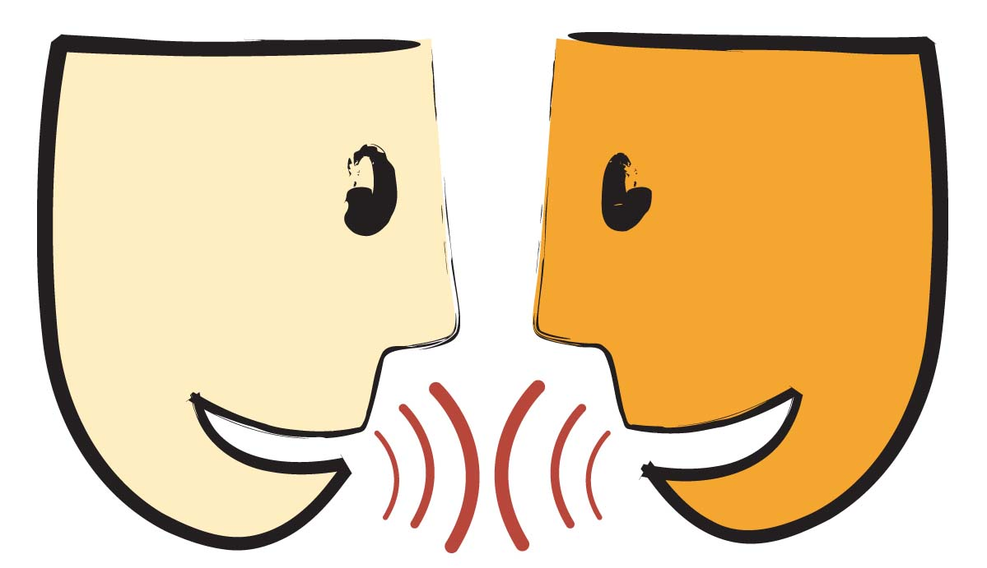
Tell your partner about a new word you learned last week.
Notes:
Access Prior Knowledge- (APK)
Turn and Talk

Slide 5
surface
Notes:
Contextualize the word- Find it in the text
Say the word together

Slide 6
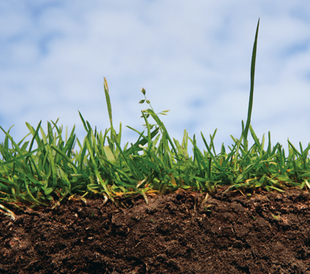
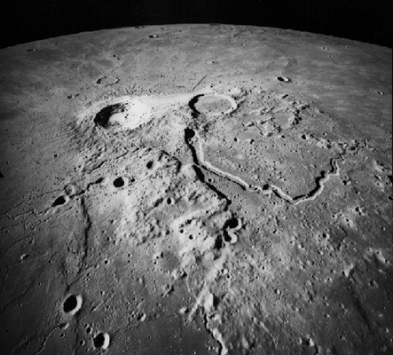
surface
The outside layer of an object
The surface of the moon
Notes:
Give student friendly definition
Use the word in other contexts

Slide 7

Thumbs up if surface is used correctly in the sentence. Thumbs down if not.
The surface of the book was happy.
The surface of the road was very bumpy and caused us to bounce a lot.
After I washed the apple, the surface of the apple was wet.
Notes:
Engage the students with the word

Slide 8
nibble
Notes:
Contextualize the word- Find it in the text
Say the word together

Slide 9
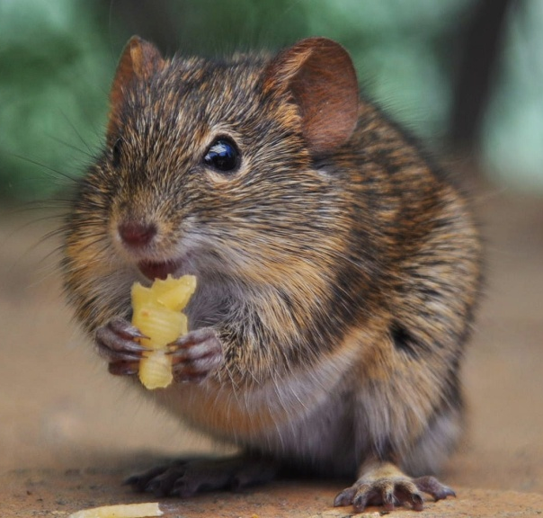
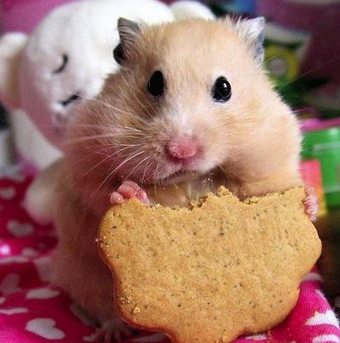
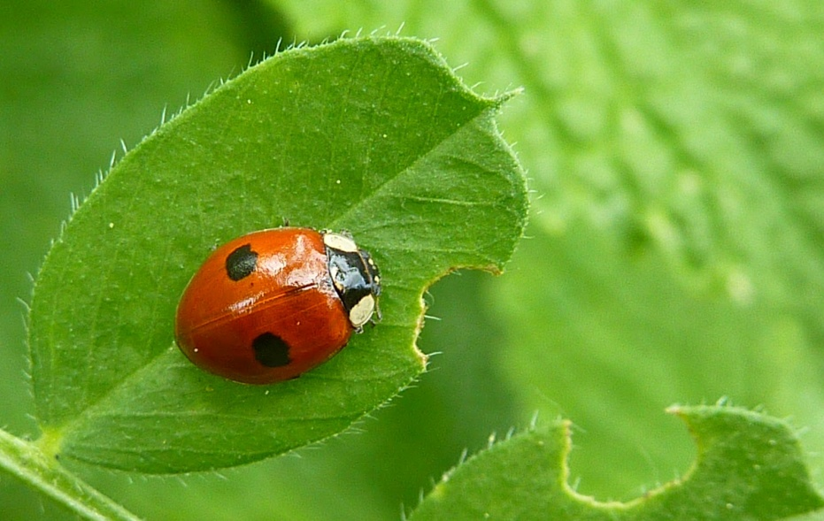
nibble
To eat in small bites
Notes:
Give student friendly definition
Use the word in other contexts

Slide 10
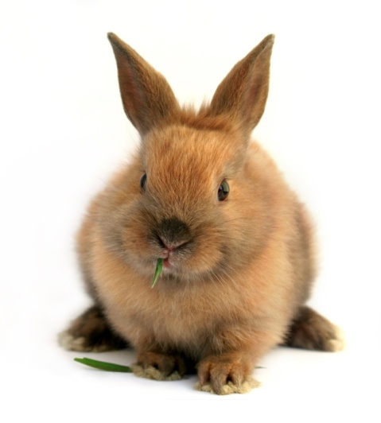
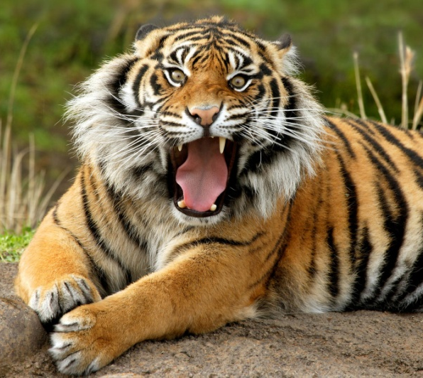
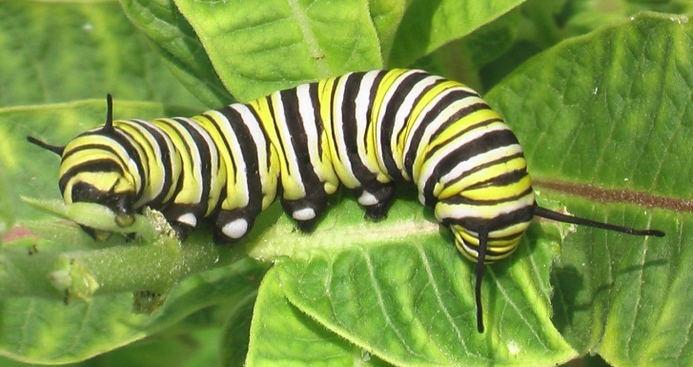
Which would most likely nibble their food?
Notes:
Engage the students with the word

Slide 11
ripen
Notes:
Contextualize the word- Find it in the text
Say the word together

Slide 12
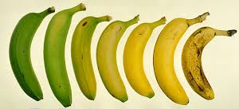
ripen
To grow to full flavor and become ready to eat.
Notes:
Give student friendly definition
Use the word in other contexts

Slide 13
What are some other fruits or vegetables that taste better when they ripen?
Notes:
Engage the students with the word

Slide 14
Who can use all 3 words in a sentence?
surface
nibble
ripen
Notes:
Read all three words and see if you can use them in one sentence.

Slide 15
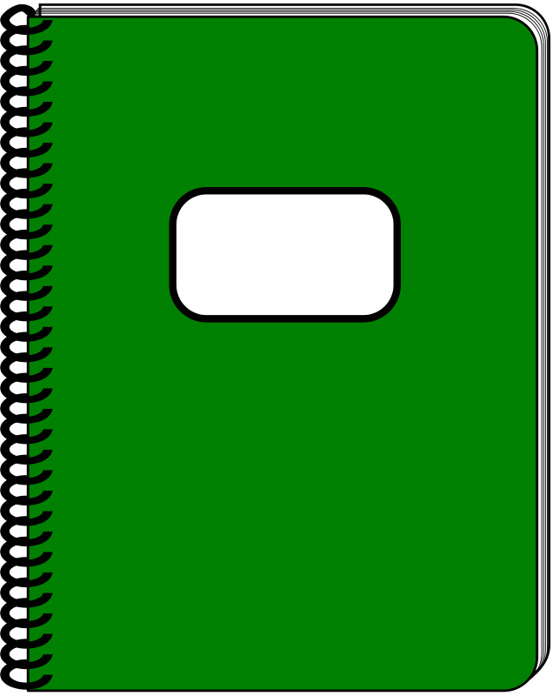
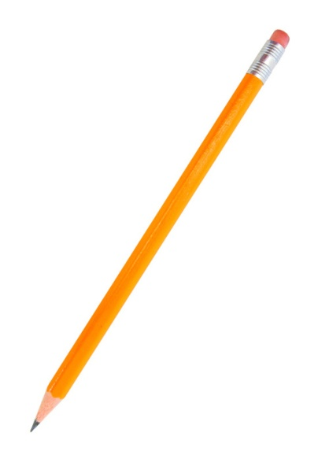
Draw a picture to show you know what these words mean.
surface
nibble
ripen
Notes:
Application-
Students need an opportunity to use the words they just learned from the text.

Slide 16
I can use words I learn from a text.
Notes:
Goal-
Revisit the Goal

