Slide 1

Name _____________________ Date ___________
Summative Assessment – Mouse Soup
RL1.2
Directions: Cut and paste the pictures /
sentences in the correct order (ex. beginning, middle, end)
Beginning
Middle
End

Slide 2
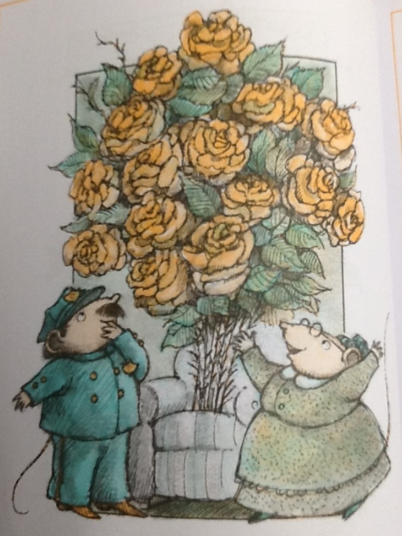
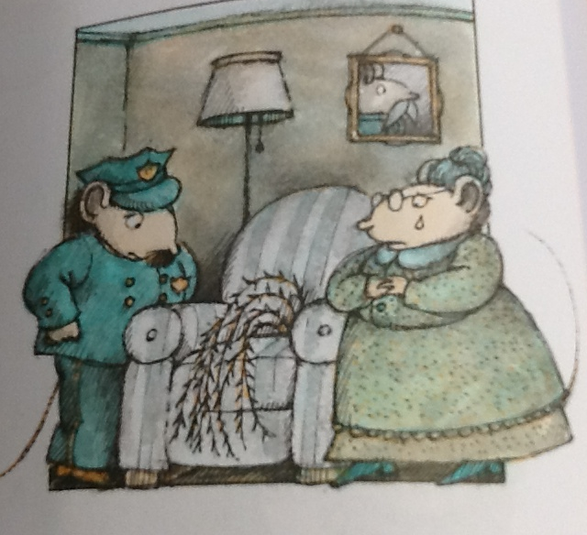
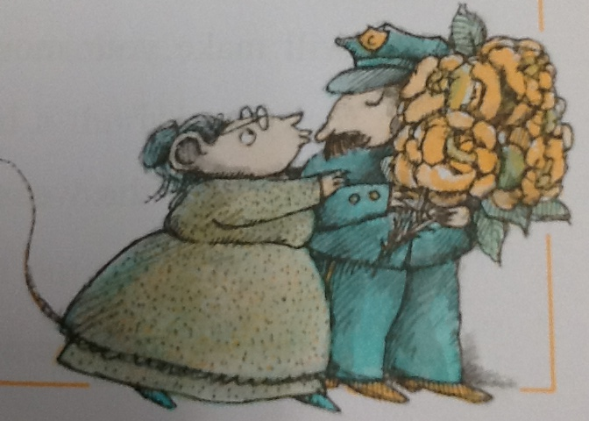
The thorn bush became large roses.
An old lady was crying because she had a thorn
bush in her chair.
She kissed the policeman and gave him roses to
take home.

