Slide 1
First Grade: Unit 2
The Amazing Animal World
Investigating Animals:
Using Nonfiction
for Inquiry-Based Research
(W.1.7)
Animal Fact Cards for Student Research

Slide 2
____________________’s Field Guide
Animal Name:
COVERING
I Look like this:
DIET
I eat this:
HABITAT
I live here:
INTERESTING FACTS
Something else about me:
HABITAT I live here:
INTERESTING FACTS Something else about me:
about me:

Slide 3
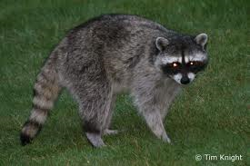
Raccoons have a black mask and a ringed tail. They can live almost anywhere in the United States, because they will eat almost anything—fish, mice, insects, eggs, and trash. Raccoons sometimes "wash" their food very fast by dunking it in water before eating. They are nocturnal which means they go out at night.
Raccoon

Slide 4
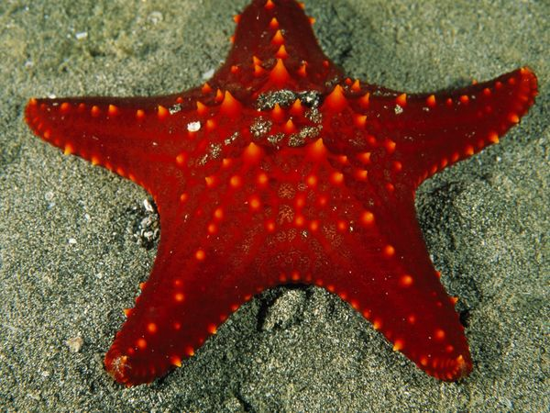
Starfish
The Starfish, also called the sea star has five arms and looks like a star. Starfish can be many colors—white, green blue or red. They live in the ocean like fish, but they are not a fish at all. They eat clams and oysters. Sea stars have no brains and no blood.

Slide 5
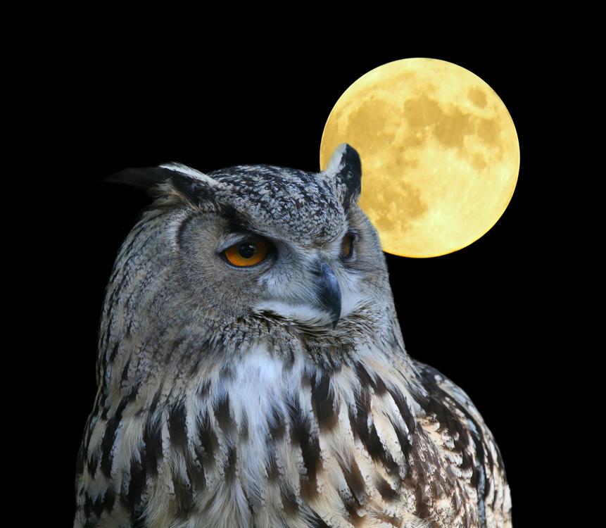
Owl
Owls are strong birds with flat faces, large eyes, and small beaks. They live all over North and South America and build their nests in trees. Owls hunt small mammals, insects, and other birds at night. They can be heard singing, "Hoo hoo!"

Slide 6
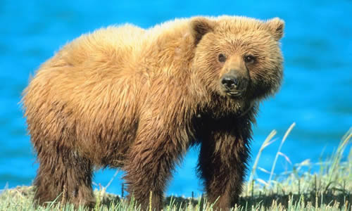
Grizzly Bear
Grizzly bears are large bears with brown or black fur. They can stand up to 8 feet tall. Grizzly bears live in the forests, tundra, and river valleys of North America. Grizzly bears have a great sense of smell. They smell food from miles away.

Slide 7
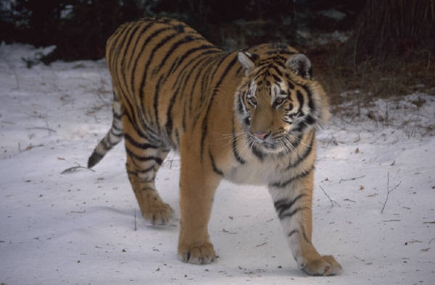
Tiger
The tiger is a cat with an orange body and black stripes. Tigers are very strong and weigh up to 420 pounds. They live in Asia. Tigers are carnivores that hunt and eat other animals. But, they can survive up to three weeks without food.

Slide 8
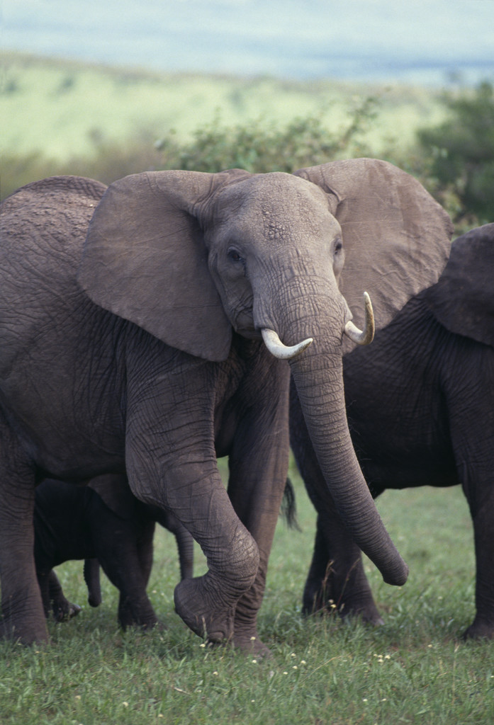
African Elephant
African Elephants live in Africa and weigh more than six tons. They can eat 300 pounds of roots, leaves, fruit, grass, and bark every day. Elephants tusks help them like a tool. The elephant uses it’s nose to take a bath.

Slide 9
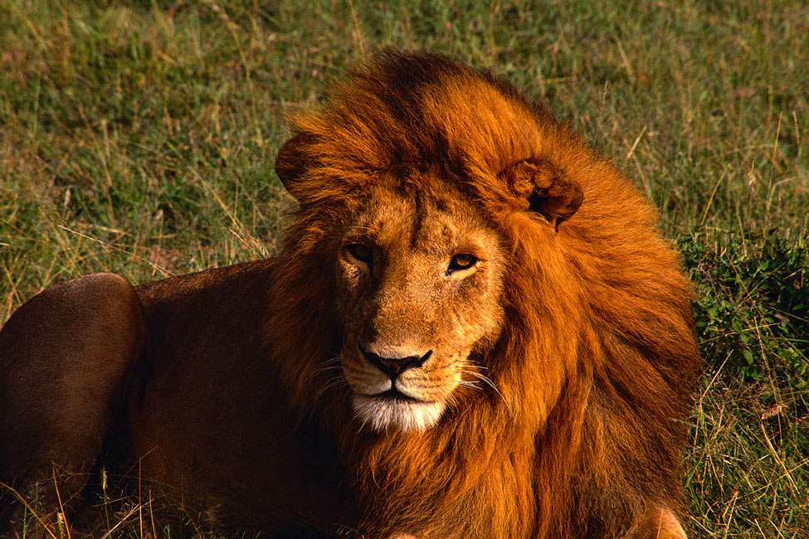
Lion
Lions are cats who live together in groups called prides. They live in Africa. A lion will eat 15 pounds of meat each day. The male lion has the mane and the female does not. A male lion’s roar can be heard up to five miles away.

Slide 10
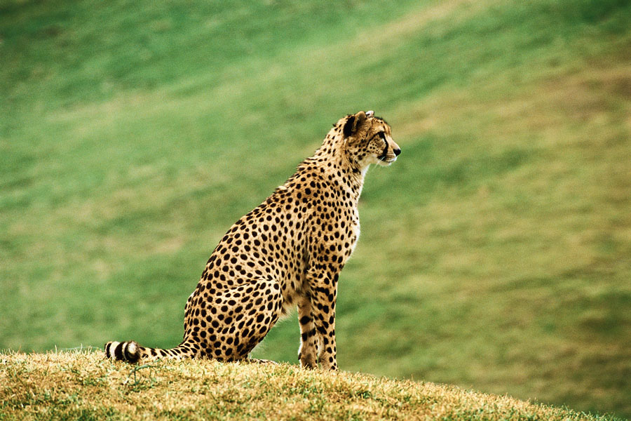
Cheetah
A cheetah is a spotted cat with a long tail. Cheetahs live and hunt in Africa and the Middle East. Cheetahs are carnivores who eat other small animals. Cheetahs can run 70 miles per hour. They are the fastest mammals on earth.

Slide 11
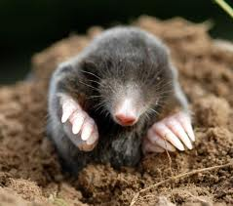
Mole
Moles live in tunnels under the ground. They have soft fur and small eyes. They have no ears and cannot see very well, but can hear and touch. Moles live in the woods. Moles eat earthworms, bugs, and flies. They use their nose to travel underground.

Slide 12
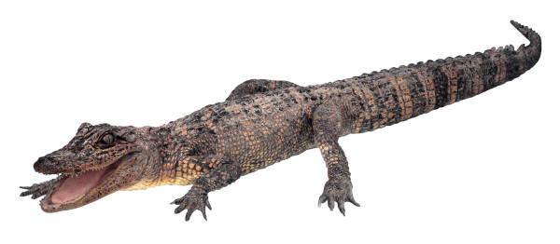
Alligator
Alligators are large reptiles with four small legs and a long tail. Most alligators are found in the Southeast part of the United States. They are nocturnal and eat fish, birds, and turtles. They use their nose to breathe under the water.

Slide 13
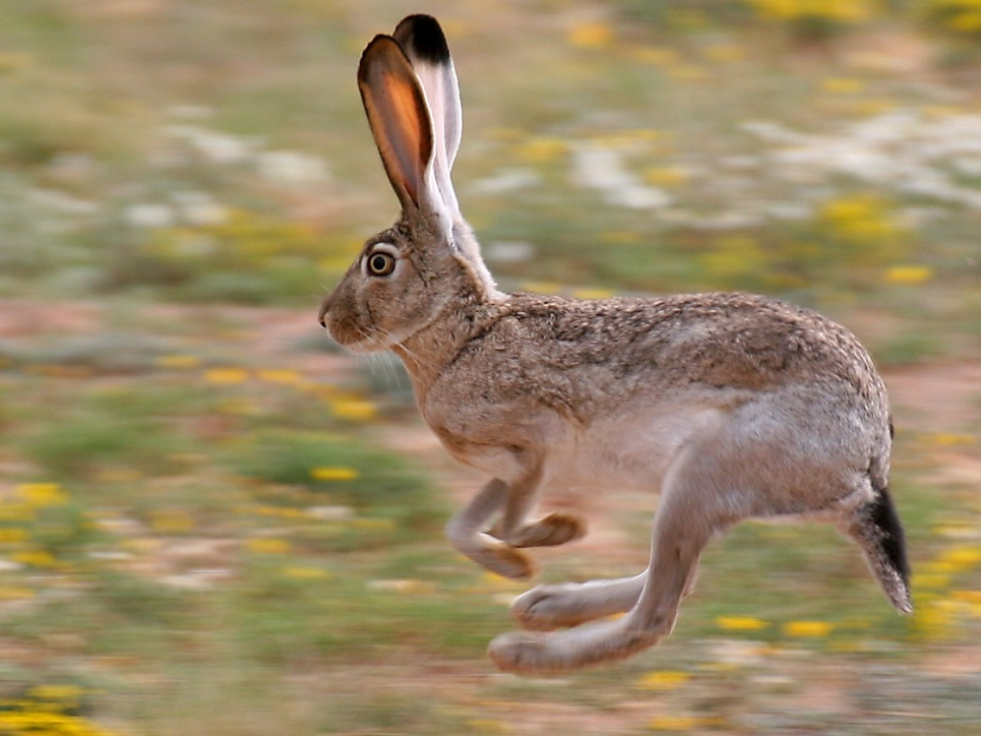
Jackrabbit
Jackrabbits are not rabbits, but are hares. They have tall back legs and long ears. Jackrabbits live in the western United States in deserts, forests, and farms. They eat grass and vegetables. The jackrabbit can use its ears to keep it cool.

Slide 14
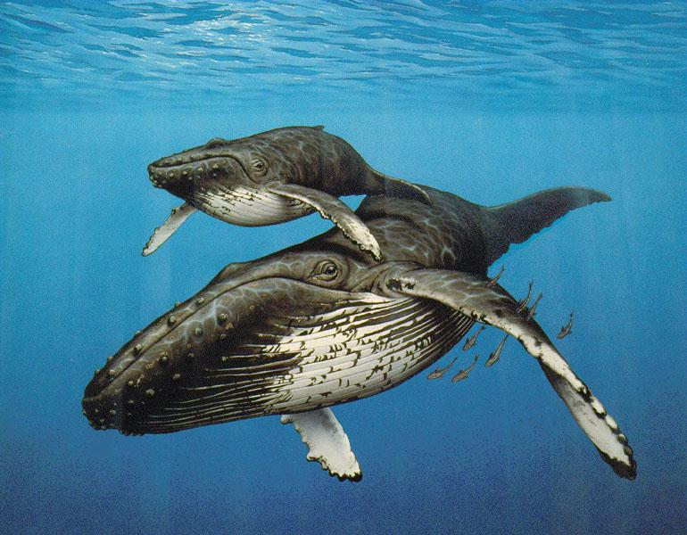
Humpback Whale
The humpback whale is a large black whale. It weighs 70,000 pounds. It has large flippers and a fin that looks like a hump when they dive. They are found in oceans around the world. Humpback whales eat krill and small fish. They can hear sounds hundreds of miles away.

Slide 15
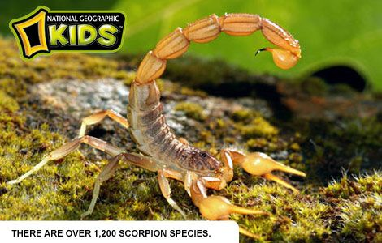
Scorpion
Scorpions are have eight legs. They live in the desert and eat insects. Scorpions can sting with their tail. They use their poison to kill prey and to defend themselves from predators. They are nocturnal and can survive being in a freezer overnight.

Slide 16
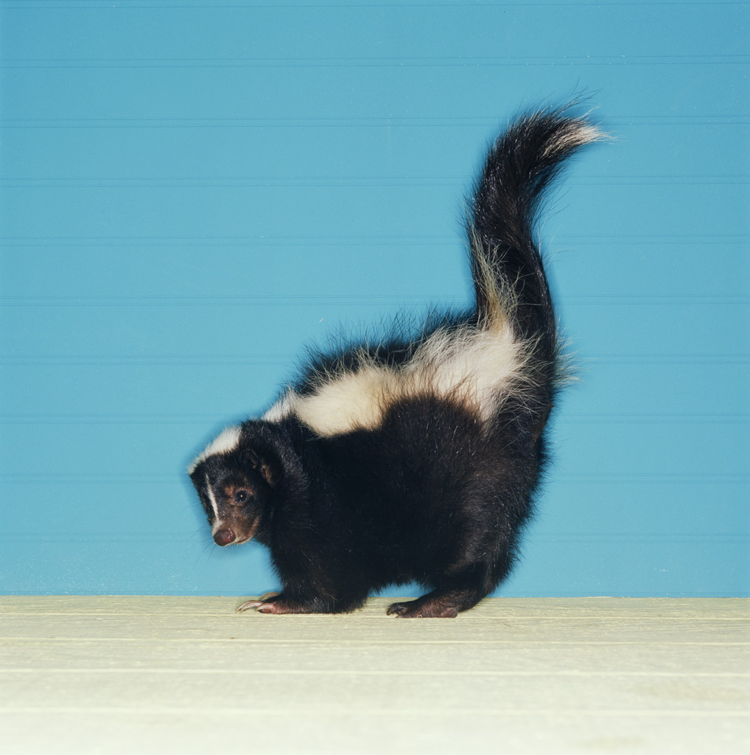
Skunk
Skunks are small black and white mammals. They eat fruit and plants, insects, worms, eggs, reptiles, and fish. Skunks live in North and South America. They spray a bad smell.

Slide 17
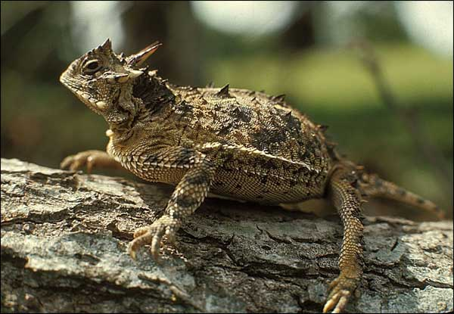
Horned Lizard
The Horned Lizard has horns all over its body. If they are scared, they squirt blood out of their eyes. They eat ants. Horned Lizards live in the desert in North America and Mexico.

Slide 18
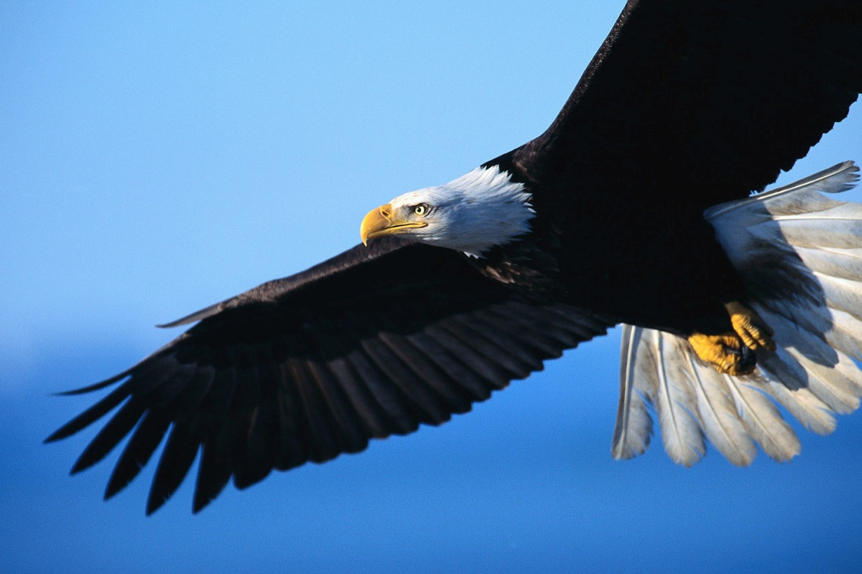
Eagle
Bald Eagles are not really bald. They live in North America. Baby eagles are called eaglets. They are born gray then turn brown. The eagle can stretch it’s wings to 8 feet. It hunts small animals with it’s feet called talons.

Slide 19
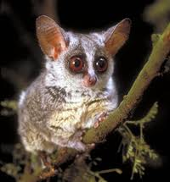
Bush Baby
The Bush Baby lives in the African forests. They are gray or brown animals with large eyes and ears, long back legs, soft fur, and long tails. They have very big eyes to see clearly at night. The Bush Baby eats fruits, insects, and small birds.

Slide 20
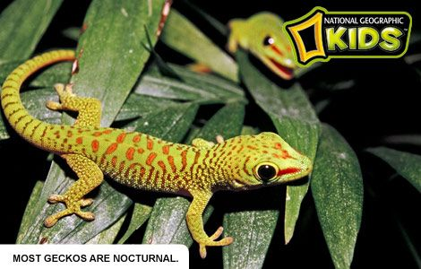
Gecko
Geckos are reptiles and can live on all the continents except Antarctica. These colorful lizards can live almost anywhere. They eat insects, fruit, and flower nectar. Geckos have sticky feet that help them climb.

Slide 21
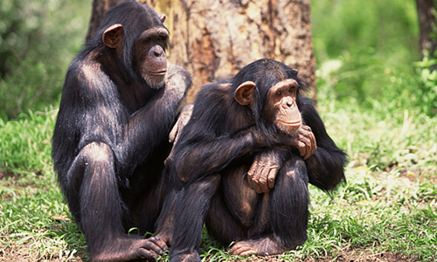
Chimpanzee
Chimpanzees are mammals who live in Africa. They are omnivores—they eat both plants and animals. They use things like sticks, stones, and leaves to help them get food and water. Chimpanzees feed themselves with their feet.

Slide 22
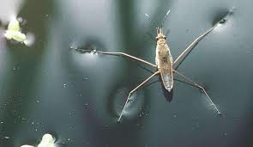
Water Strider
The Water Strider (also known as the pond skater) is an insect that can run across the top of water. It lives on ponds and streams. Water striders eat small insects that fall on top of the water.

Slide 23
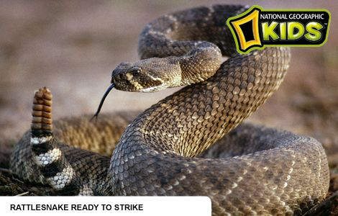
Rattlesnake
All rattlesnakes are brown, gray, or tan. They live in deserts in the Western United States. Rattlesnakes eat small animals, mice, and birds. They can eat something bigger than its head. They do not have ears and cannot hear most sounds.

Slide 24
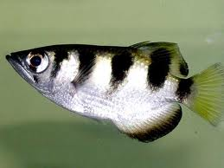
Archerfish
Archerfish are silver fish with black stripes and can grow 8 inches long. They shoot insects with a stream of water before they eat them. Archerfish live in oceans or lakes in India and Southeast Asia.

Slide 25
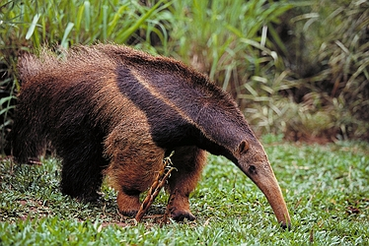
Anteater
Anteaters are nocturnal mammals who live in South America. They have a long snout, a long tongue and claws for hunting ants and termites. They can eat over 30,000 bugs a day.

Slide 26
Helpful Websites:

