Slide 1
Tomas and the Library Lady by Pat Mora
First grade
Unit 1
L.1.4b

Slide 2
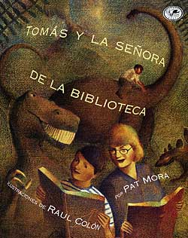
I can determine the meaning of unknown words.
1 2 3 4

Slide 3
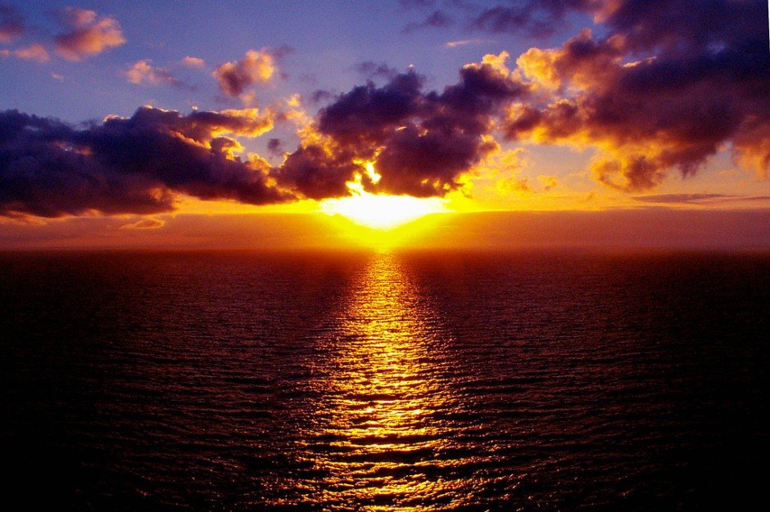

Slide 4
shine

Slide 5
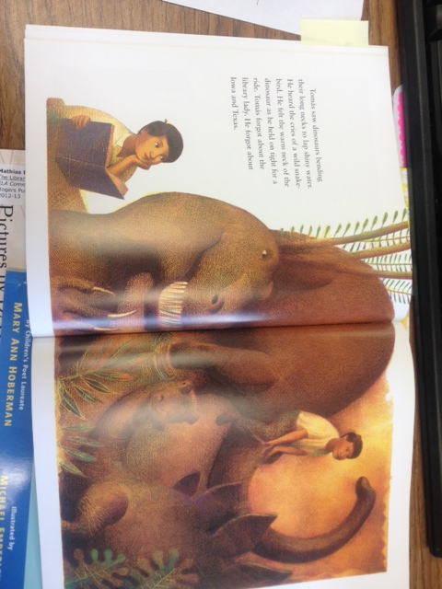
Tomas saw dinosaurs bending their long necks to lap shiny water.

Slide 6
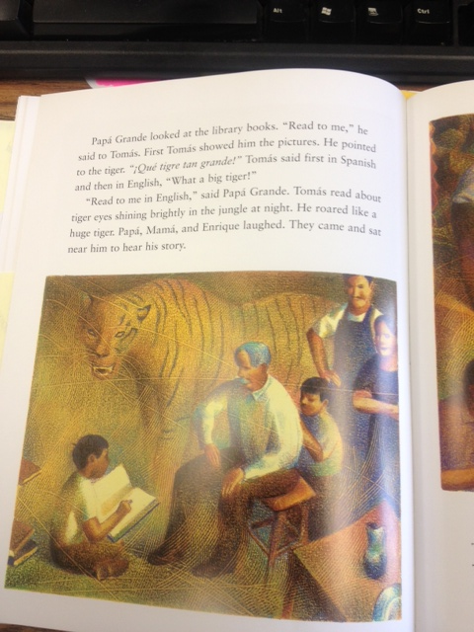
Tomas read about tiger eyes shining brightly in the jungle at night.

Slide 7
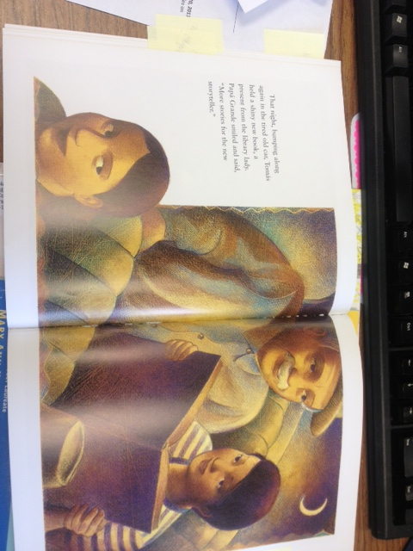
That night, bumping along in the tired old car, Tomas held a shiny new book, a present from the library lady.

Slide 8
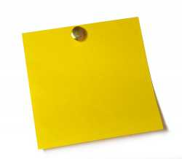

Your Turn!!!

Slide 9
I can determine the meaning of unknown words.
1 2 3 4

