Slide 1

1st Grade Text Talk
Unit 1

Slide 2
I can use words I learn from a text.
Notes:
Goal-
Students need to engage with the goal- read it, repeat it, write it, etc.

Slide 3
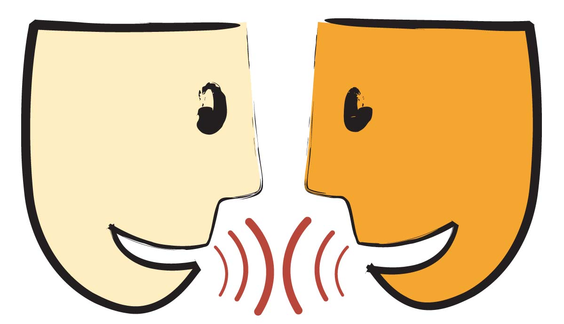
Tell your partner about a new word you learned last week.
Notes:
Access Prior Knowledge- (APK)
Turn and Talk

Slide 4
Notes:
New Information-
Read the book- provide a brief explanation of any words that may be new or unfamiliar to the students.

Slide 5
eager
Notes:
Contextualize the word- Find it in the text
Say the word together

Slide 6


eager
To show excitement
about something
Notes:
Give student friendly definition
Use the word in other contexts

Slide 7

Thumbs up if this is an example of eager. Thumbs down if not.
The dogs were so eager to go for a walk that they were jumping up and down with excitement!
The children couldn’t wait to get to Disney World.
I was dragging my feet at the doctor’s office because I knew I had to get a shot today.
Notes:
Engage the students with the word

Slide 8
glaring
Notes:
Contextualize the word- Find it in the text
Say the word together

Slide 9
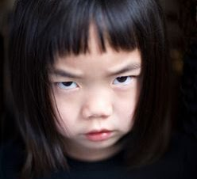
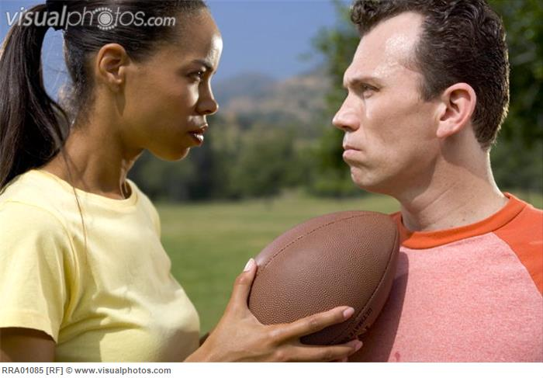
glaring
To stare with anger
Notes:
Give student friendly definition
Use the word in other contexts

Slide 10
What would your face look like if you were
glaring at me?
Notes:
Engage the students with the word

Slide 11
howling
Notes:
Contextualize the word- Find it in the text
Say the word together

Slide 12
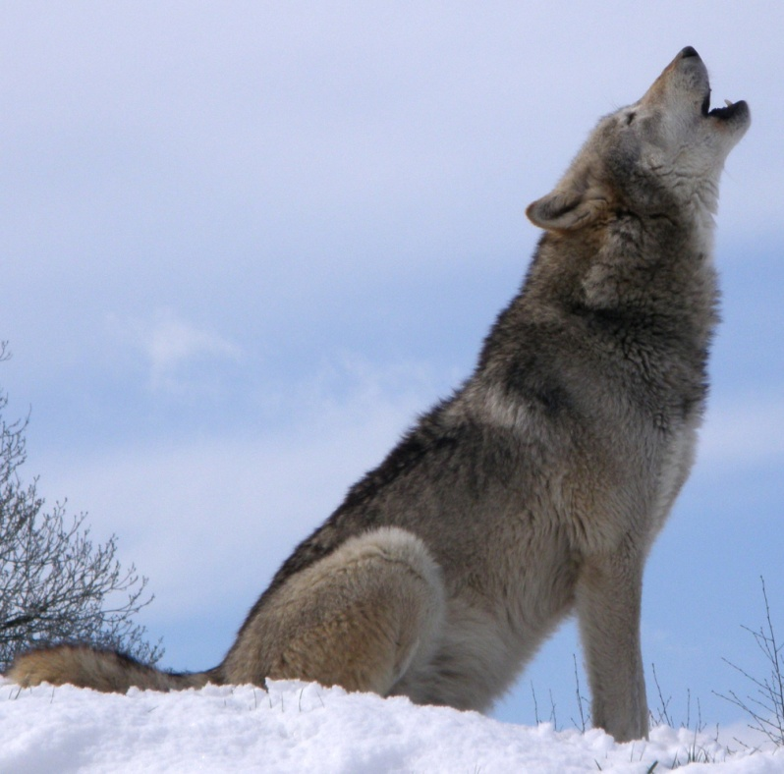
howling
To cry out loudly; sounding like a dog
Notes:
Give student friendly definition
Use the word in other contexts

Slide 13
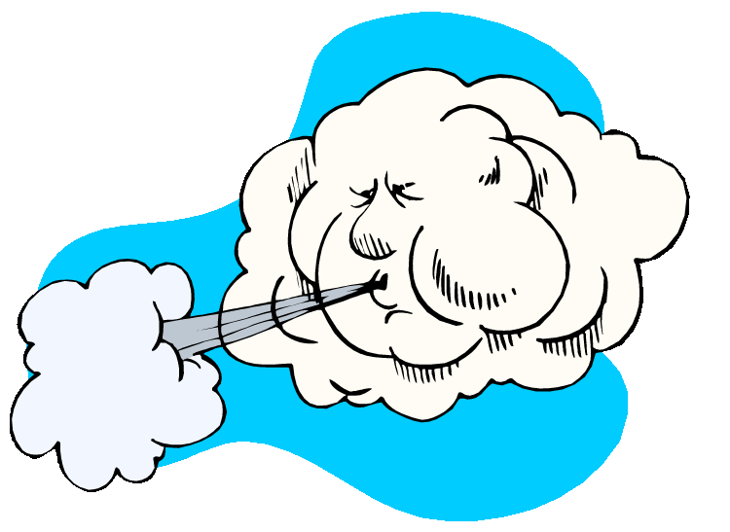
Touch the picture to hear the sound
of wind howling.
Can you howl like the wind?
Can you howl like a wolf?
Notes:
Engage the students with the word

Slide 14
Who can use all 3 words in a sentence?
eager
glaring
howling
Notes:
Read all three words and see if you can use them in one sentence.

Slide 15


Draw a picture to show you know what these words mean.
eager
glaring
howling
Notes:
Application-
Students need an opportunity to use the words they just learned from the text.

Slide 16
I can use words I learn from a text.
Notes:
Goal-
Revisit the Goal

