Slide 1

1st Grade Text Talk
Unit 1

Slide 2
I can use words I learn from a text.
Notes:
Goal-
Students need to engage with the goal- read it, repeat it, write it, etc.

Slide 3

Tell your partner about a new word you learned last week.
Notes:
Access Prior Knowledge- (APK)
Turn and Talk

Slide 4
Notes:
New Information-
Read the book- provide a brief explanation of any words that may be new or unfamiliar to the students.

Slide 5
ignorant
Notes:
Contextualize the word- Find it in the text
Say the word together

Slide 6
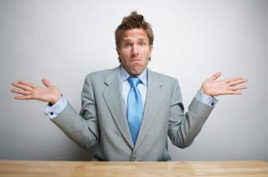

ignorant
Not knowing
Notes:
Give student friendly definition
Use the word in other contexts

Slide 7

Thumbs up if this is an example of ignorant. Thumbs down if not.
The girls knew everything about playing soccer so they were able to teach their friends how to play.
I want to bake a cake, but I don’t know anything about baking.
The children were eager to hear the new story, but none of them knew how to read.
Notes:
Engage the students with the word

Slide 8
grumpy
Notes:
Contextualize the word- Find it in the text
Say the word together

Slide 9
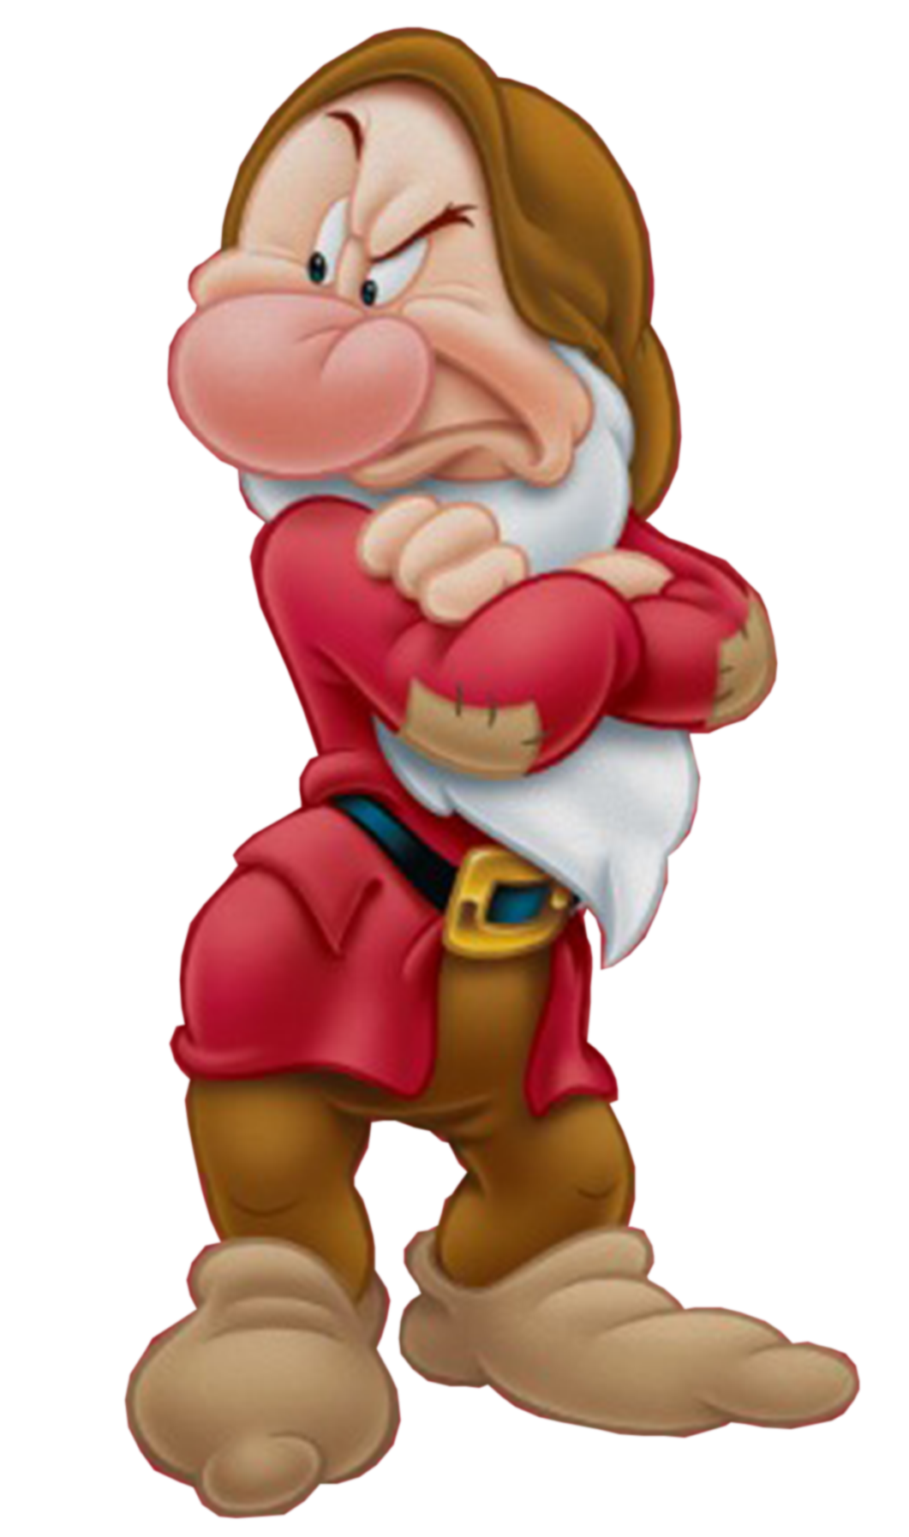
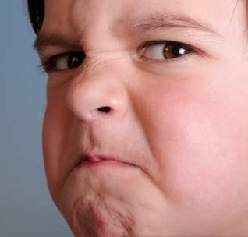
grumpy
Unhappy or cranky
Notes:
Give student friendly definition
Use the word in other contexts

Slide 10
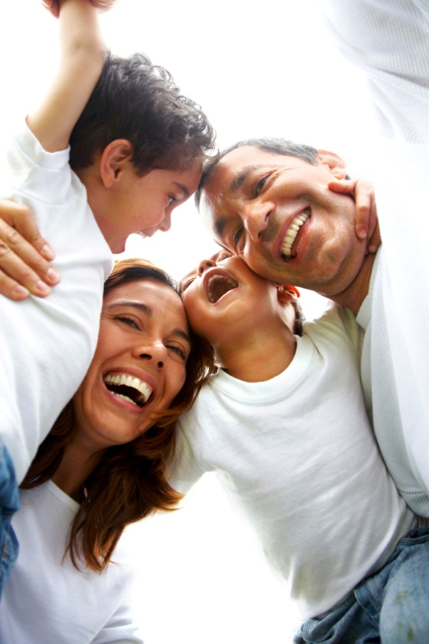
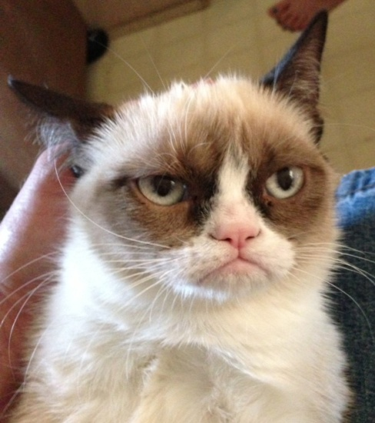
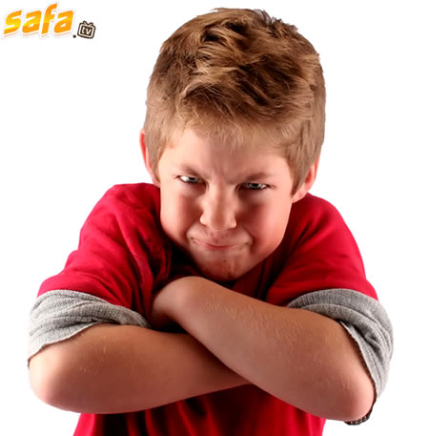
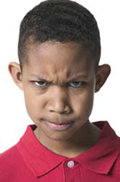
Which pictures show grumpy faces?
Notes:
Engage the students with the word

Slide 11
determined
Notes:
Contextualize the word- Find it in the text
Say the word together

Slide 12

determined
Deciding to do
something
no matter what
Notes:
Give student friendly definition
Use the word in other contexts

Slide 13
What is something you have worked hard at and have been determined to do?
Notes:
Engage the students with the word

Slide 14
Who can use all 3 words in a sentence?
ignorant
grumpy
determined
Notes:
Read all three words and see if you can use them in one sentence.

Slide 15


Draw a picture to show you know what these words mean.
ignorant
grumpy
determined
Notes:
Application-
Students need an opportunity to use the words they just learned from the text.

Slide 16
I can use words I learn from a text.
Notes:
Goal-
Revisit the Goal

