Slide 1
+
Identify Words and Phrases to Describe Feelings
By: Kenley Smith’s 1st Grade Class
Eastside Elementary
Rogers, AR
January 20,2012

Slide 2


GANAG is a lesson structure that allows teachers to plan for student use of research based instructional strategies.
G= goal
A= access prior knowledge
N= new information
A= application
G= generalize the goal

Slide 3
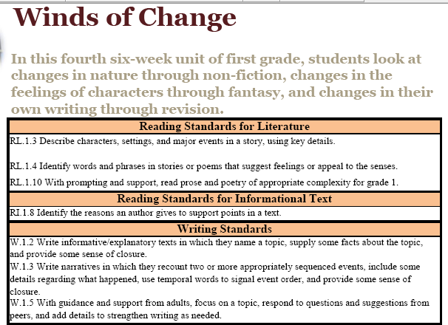
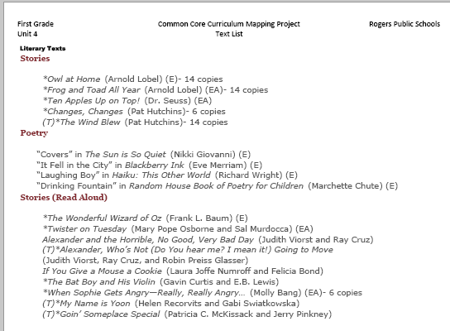

Ms. Smith began her planning with the pacing guide. She selected a standard.
Standard RL.1.4.
Identify words and phrases in stories or poems that suggest feelings or appeal to the senses.
Next she selected a text from the suggested works listed in Unit 4.

Slide 4
The purpose of the GANAG structure is
To give students the opportunity to actively use the nine high-yield strategies:
(2) Identifying Similarities and Differences
(7) Cooperative Learning
(8) Setting Objectives and Providing Feedback
(3) Summarizing and Note Taking
(4) Reinforcing Effort and Providing Recognition
(9) Generating and Testing Hypotheses
(5) Homework and Practice
(10) Cues, Questions and Advance Organizers
(6) Nonlinguistic Representations

Slide 5
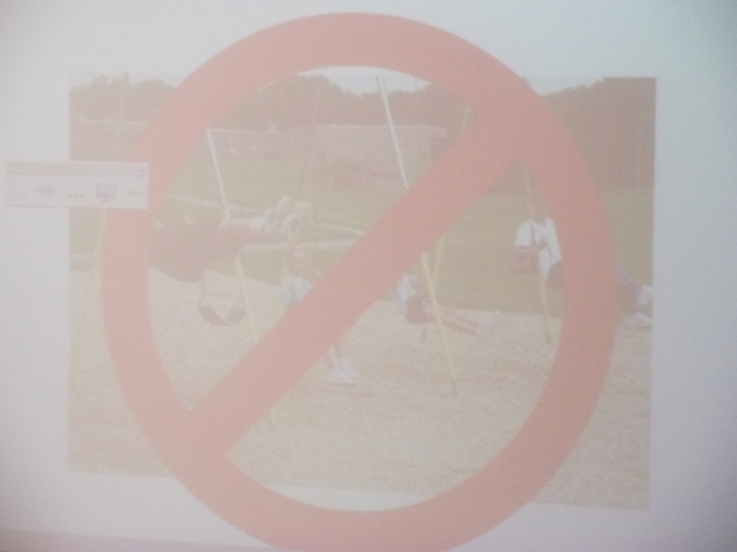

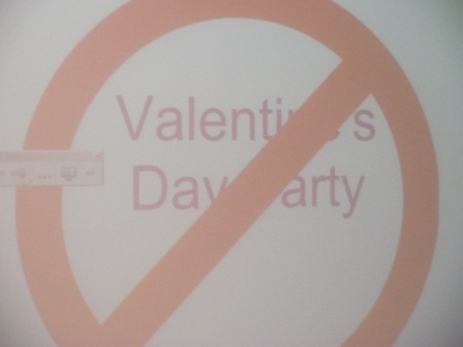
A
Accessing Prior Knowledge
Teacher showed slides and asked students to share how the picture made them feel
(6) Nonlinguistic Representations

Slide 6
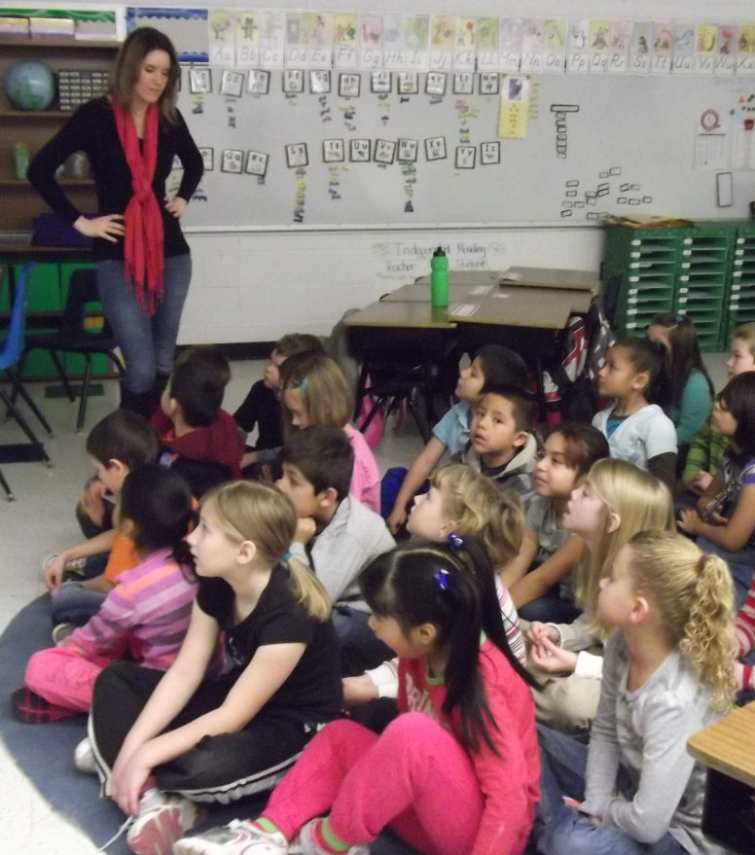
Teacher listened for words and phrases that described how they felt when looking at three pictures.
She listened for the level of intensity of the words and phrases that students were using to describe how they felt.
(Sad, mad vs. angry, furious, or livid) Then asked students if some words described how they felt better than others.

Slide 7
Standard RL.1.4: Identify words and phrases in stories or poems that suggest feelings or appeal to the senses.
Ms. Smith derived a student goal from the standard.
G
Goal: I can find words and phrases that describe feelings
Students read the goal with the teacher.
(8) Setting Objectives and Providing Feedback

Slide 8
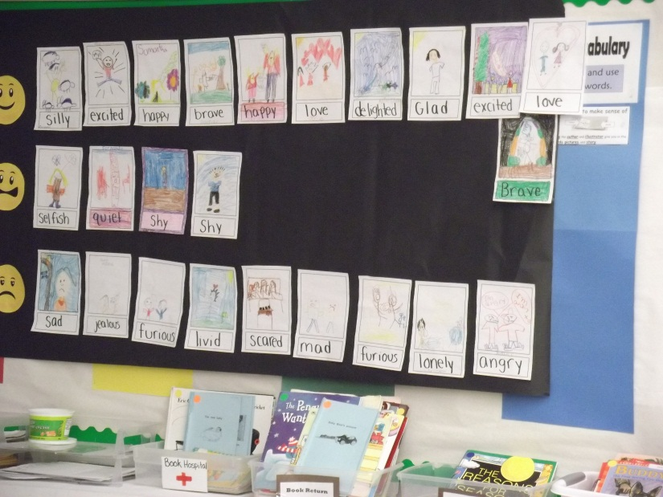

N
New Information
Students looked at the anchor chart they had created the previous day and discussed the words that they knew that described how they felt.
Mrs. Smith had students act out and discuss levels of intensity for mad and had students give examples of when they might feel that way (Angry vs. Livid)
(2) Identifying Similarities and Differences
(6) Nonlinguistic Representations

Slide 9
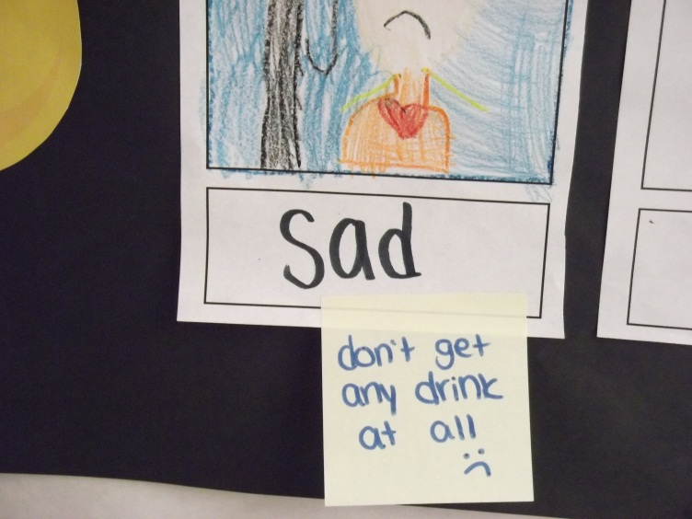
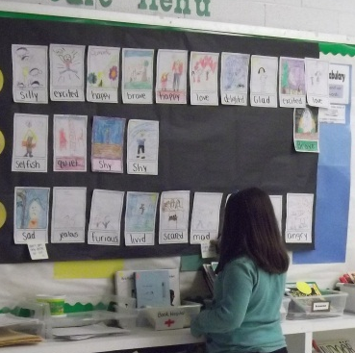
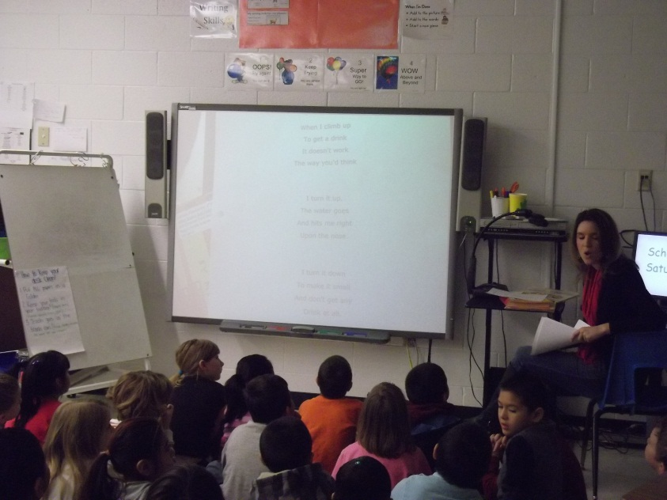
The class read the poem “The Drinking Fountain and Mrs. Smith dictated on post-it notes how the poem made them feel using their anchor chart and evidence from the poem
(10) Cues, Questions and Advance Organizers
(3) Summarizing and Note Taking
(6) Nonlinguistic Representations

Slide 10
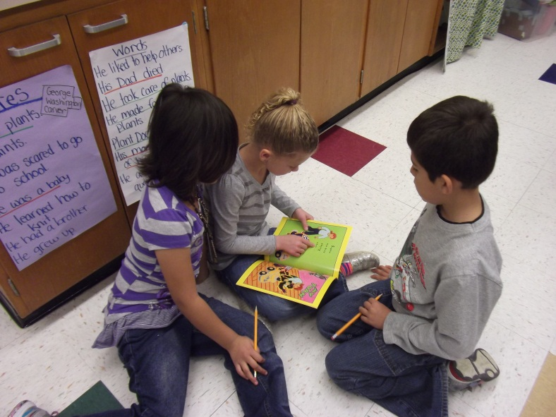
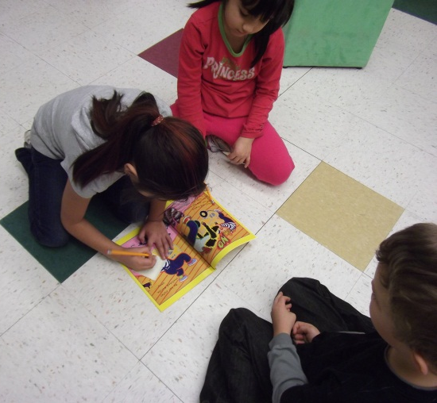
A
Application
Students read the story together and wrote the words and phrases that described Sophie’s feelings
(2) Identifying Similarities and Differences
(7) Cooperative Learning
(3) Summarizing and Note Taking

Slide 11
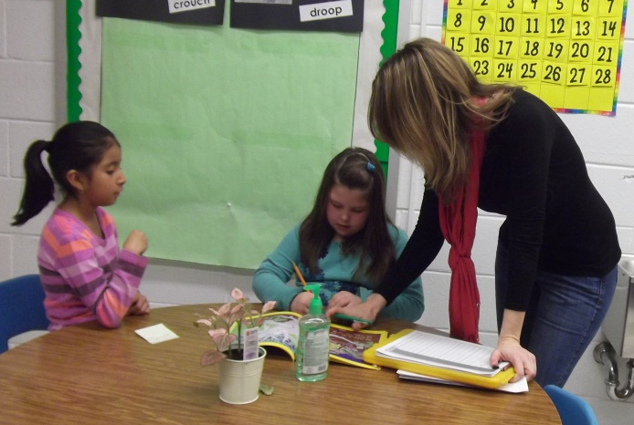
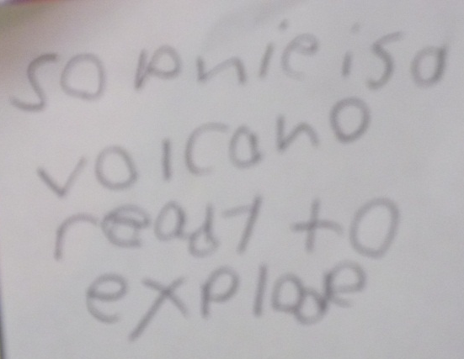
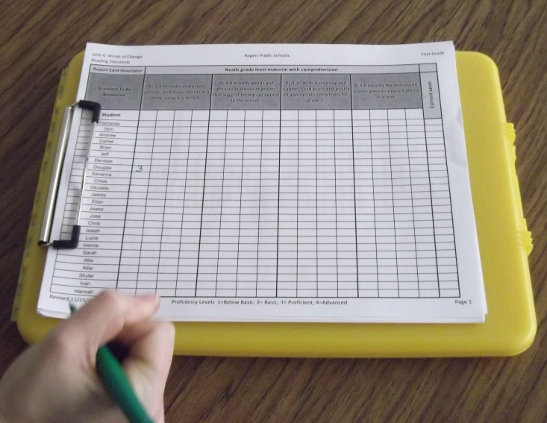
A
As students were working in their groups, Mrs. Smith used her scoring guide to assess her students’ ability to use words with varying degrees of feelings.
(4) Reinforcing Effort and Providing Recognition
(5) Homework and Practice

Slide 12
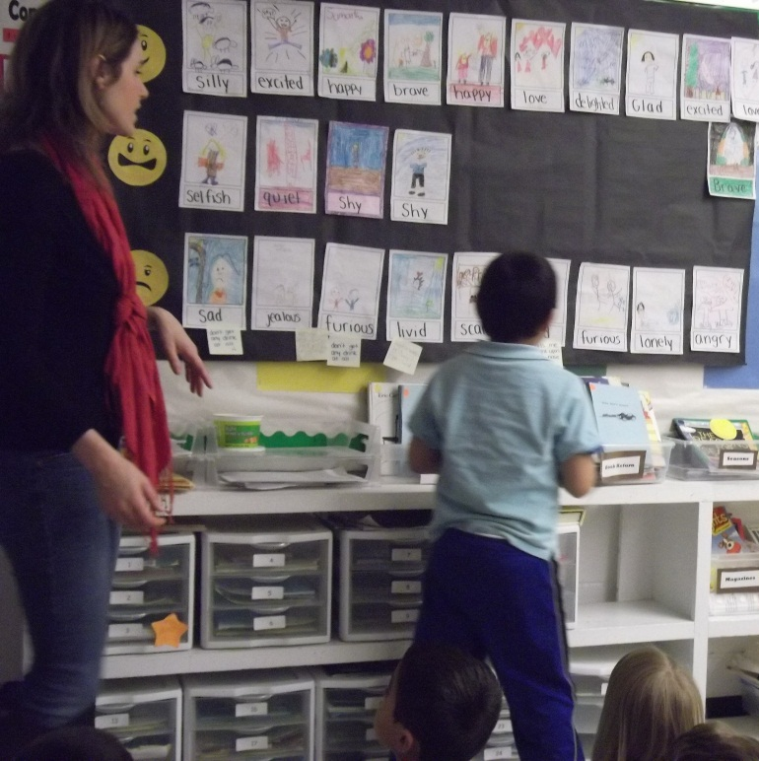
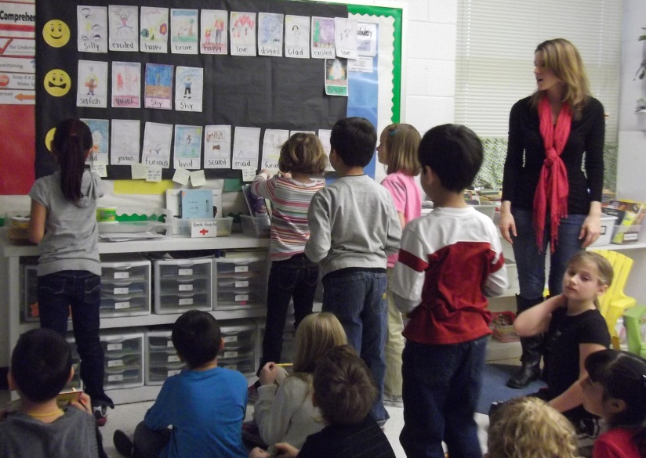
A
Students added the words and phrases they identified from the book to their anchor chart.
(5) Homework and Practice
(9) Generating and Testing Hypotheses

Slide 13
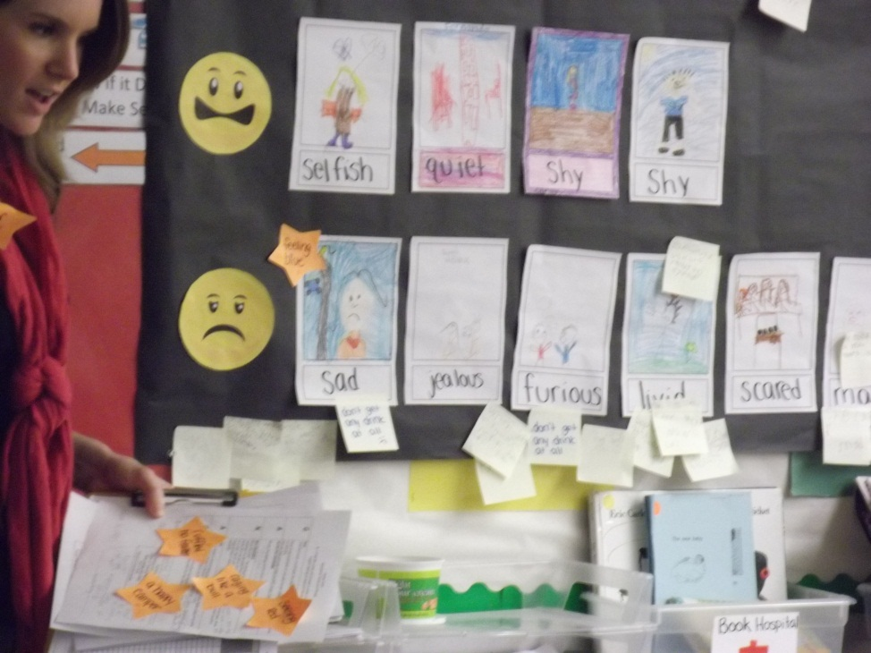
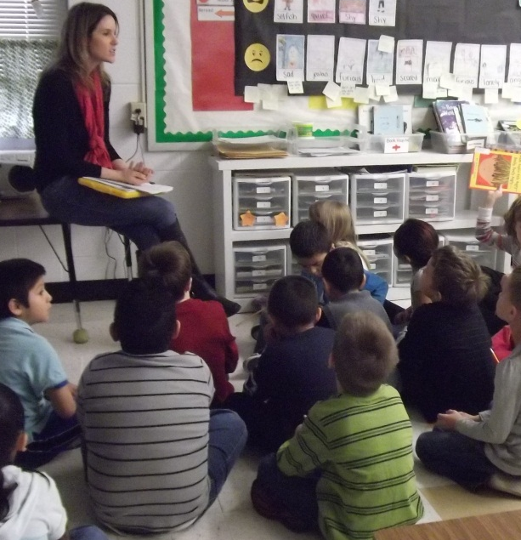
Why did these authors choose different words or phrases to describe how their Character feels?
Why do we need to know this?
How will we use this information?
(3) Summarizing and Note Taking
(9) Generating and Testing Hypotheses

Slide 14
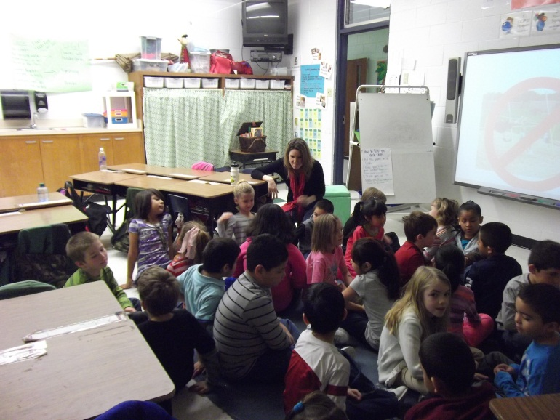
G
Generalize the Goal:
Today we learned that we can describe how someone feels using different words and phrases
Mrs. Smith returned to the pictures from the beginning of the lesson and had students share how the pictures made them feel. She compared their word choices to the choices they made at the beginning of the lesson. Students shared whether or not they understood how their partner felt. ( Were they just a little bit angry or were they furious?)
(8) Setting Objectives and Providing Feedback

Slide 15
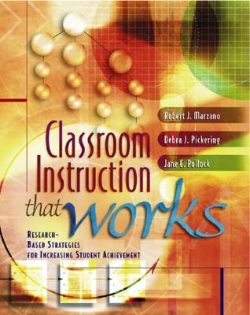
Marzano, R. J., Pickering, D. J., & Pollock, J. E. (2001). Classroom instruction that works: Research-based strategies for increasing student achievement. Alexandria, VA: Association for Supervision and Curriculum Development.
Pollock, J. E. (2007). Improving student learning one teacher at a time. Alexandria, VA: Association for Supervision and Curriculum Development.
Pollock, J. E., & Ford, Sharon M. (2009). Improving student learning one principal at a time. Alexandria, VA: Association for Supervision and Curriculum Development.

