Slide 1
Fourth Grade Domain Specific Words L thru Z
Work in Progress

Slide 2
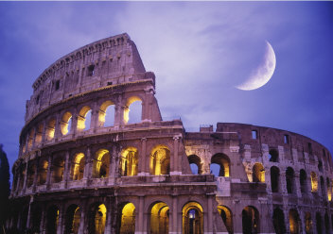
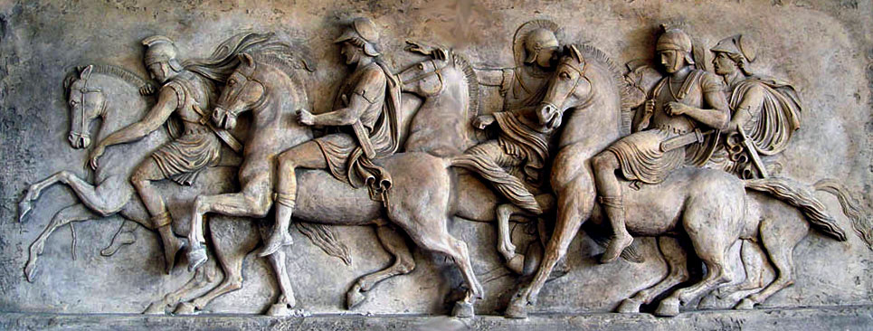
Latin
L.4.4b
L.5.4b
Coming from the language, people, or culture of ancient Rome
4 -5

Slide 3
L.4.5a
L.5.4a, RL.5.4
metaphor
imaginative way of describing by referring one thing to something else which is the same in a particular way
4 -5

Slide 4
L.4.1c
modal auxiliary
used in conjunction with main verbs to express shades of time and mood; also called helping verbs
4

Slide 5
W.4.2a
W.5.2a, RL.5.7
multimedia
Computer programs and
Products which involve sound,
pictures, and film, as well as text
4

Slide 6
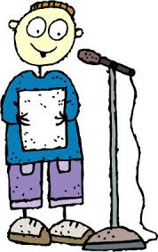
RL.4.7
oral presentation
Reading or presenting to a
class or audience
4

Slide 7
SL.4.2
W.5.8
paraphrase
To say or write what someone else has
said or written in a different way
Original text
“Willy Wonka was famous for his delicious candy. Children and adults loved to eat it.”
Paraphrase
“Willy Wonka was known throughout the world because people enjoyed eating the tasty candy he made.
4

Slide 8
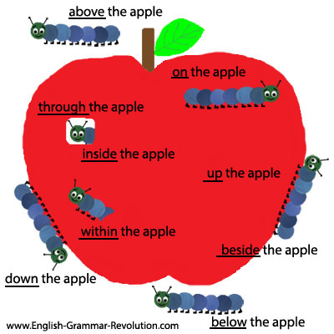
prepositional phrase
L.4.1e
A series of words that
tell more about a noun,
verb, or adjective
Prepositional phrases
are made up of a
preposition and its
object.
4

Slide 9
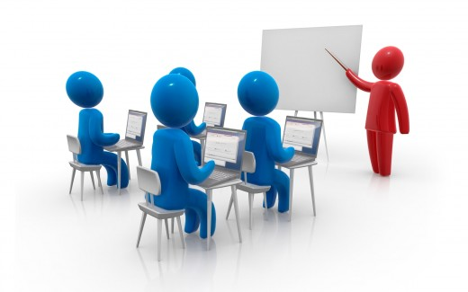
presentations
SL.4.5
SL.5.5
Formal talks, usually done orally
4

Slide 10
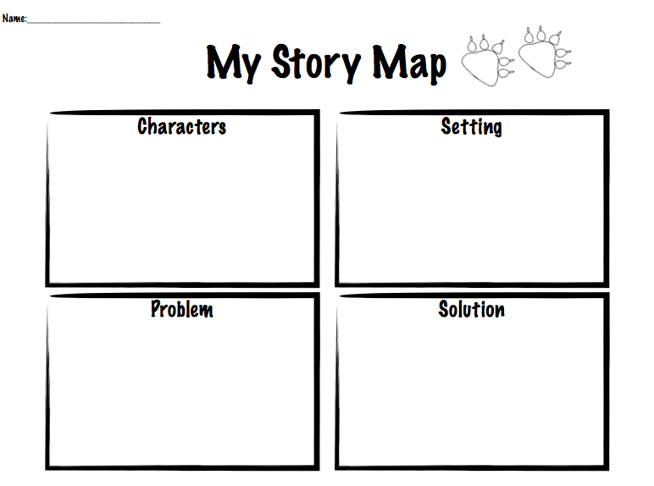
problem/solution
RI.4.5
RI.5.5
A text structure that describes a problem and solution
4-5

Slide 11
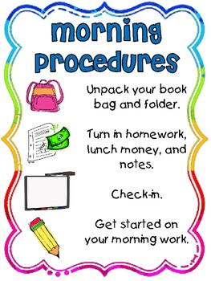
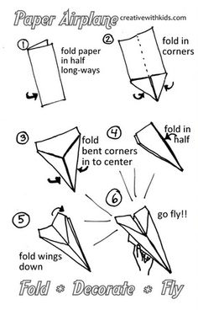
procedure
RI.4.3
A way of doing something;
a series of actions, usually
carried out in a set order, to
accomplish a particular goal
4

Slide 12
progressive verb tense
L.4.1b
Describe ongoing actions in the
present, past or future
4

Slide 13
pronunciation
L.4.4c
L.5.4c
The particular way that a word or phrase sounds when said out loud
4-5

Slide 14
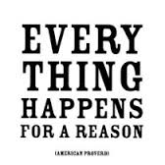
L.4.5b
L.5.5b
proverb
Short sentence that people often quote, because it gives advice or tells you something about life
4-5

Slide 15
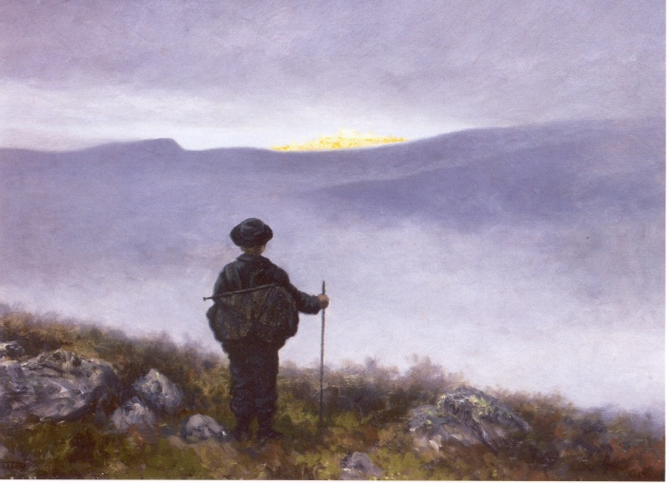
quest
RL.4.9
A long and difficult search for something
4-5

Slide 16
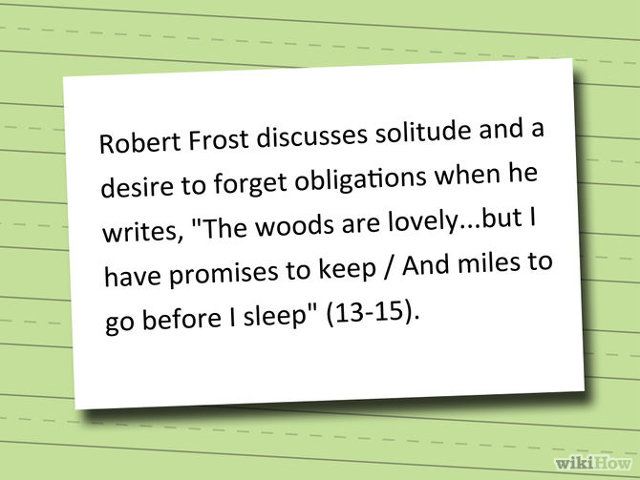
W.4.2b, L.4.2b
W.5.2b
quotation
Sentence or phrase
taken from a book,
poem, speech, or
play, which is
repeated by
someone else
4-5

Slide 17
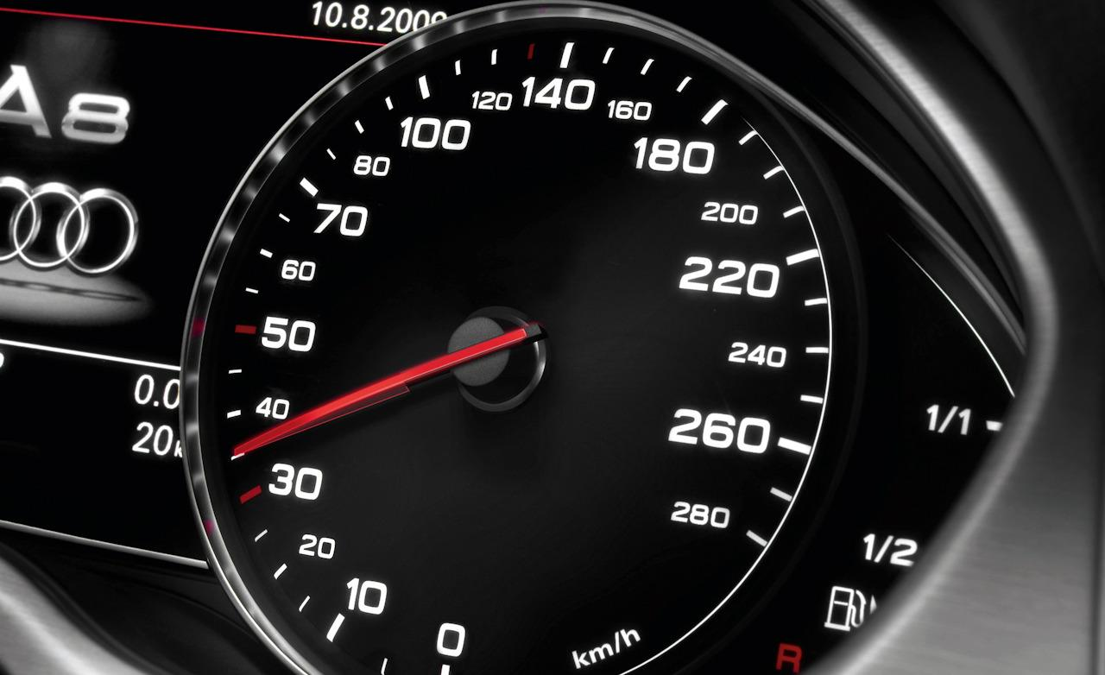
rate
RF.4.4b
RF.5.4b
The speed at which something happens
4-5

Slide 18
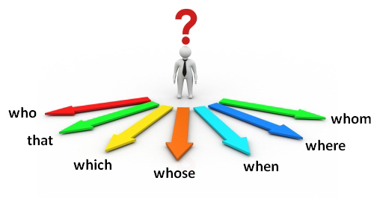
L.4.1a
relative pronoun
connects a clause or phrase to a noun or pronoun
4-5

Slide 19
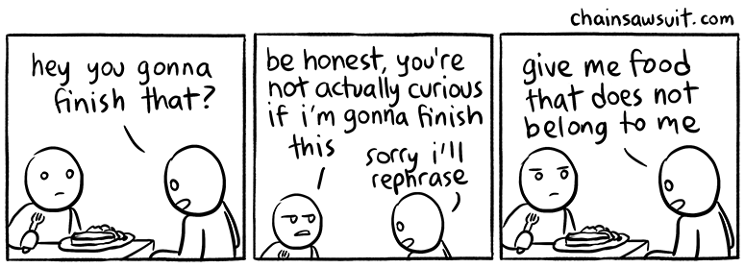
restatement
L.4.4a
To repeat what has been said, usually in a slightly different form
4-5

Slide 20
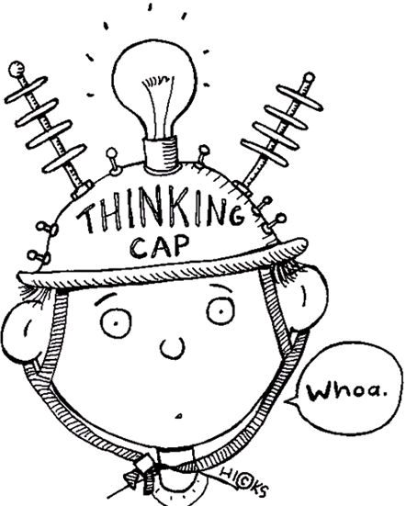
SL.4.1d
SL.5.1d
review
Consider carefully to see that what was presented, either orally or written, was understood
4-5

Slide 21
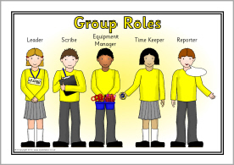
role
SL.4.1b
SL.5.1b
A particular position and function; a job to complete
4-5

Slide 22
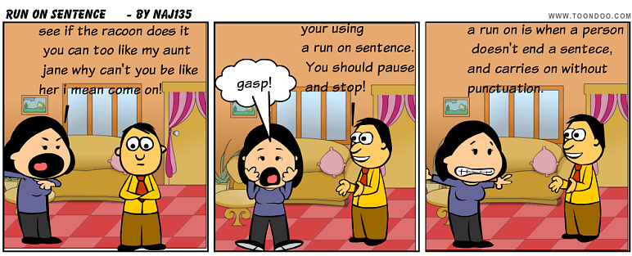
run-on sentence
L.4.1f
When two or more independent clauses (complete sentences) are joined without appropriate punctuation or conjunction
4

Slide 23
secondhand account
RI.4.6
A secondhand account of an event or topic is based on an author’s research, rather than personal experience.
4

Slide 24
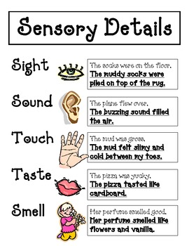
sensory detail
W.4.3d
W.5.3d
Words and/or phrases
that connect the reader
to the writer by drawing
attention to the five
senses-sight, sound,
touch, smell, and taste
4-5

Slide 25
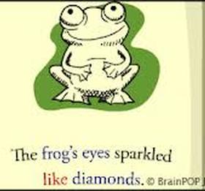
simile
L.4.5a
L.5.5a, RL.5.4
Expression which describes a person or thing as being similar to someone or something else using the words “like” or “as’
4-5

Slide 26
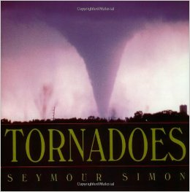
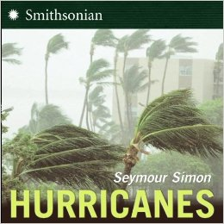
subject
RI.4.9
RI.5.9
The topic of what is said, written, or studied
hurricanes
tornadoes
earthquakes
4-5

Slide 27
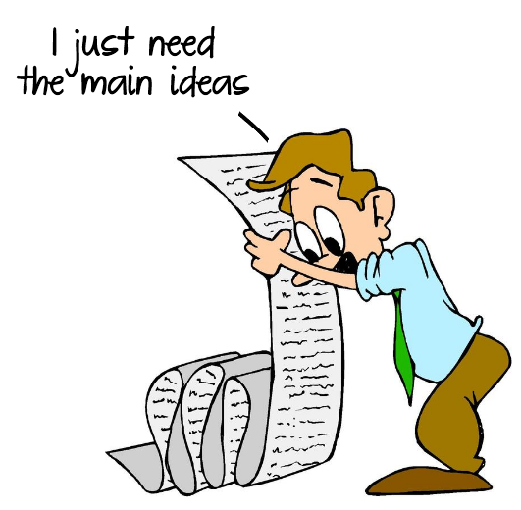
summarize
RL.4.2, RI.4.2
RL.5.2, RI.5.2, W.5.8, SL.5.2, SL.5.3
To tell in your own words what happened in the story
4-5

Slide 28
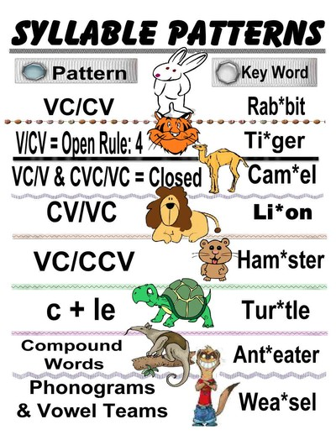
L.3.2f
RF.4.3a
RF.5.3a
syllabication pattern
Rules for dividing words into syllables
3-5

Slide 29
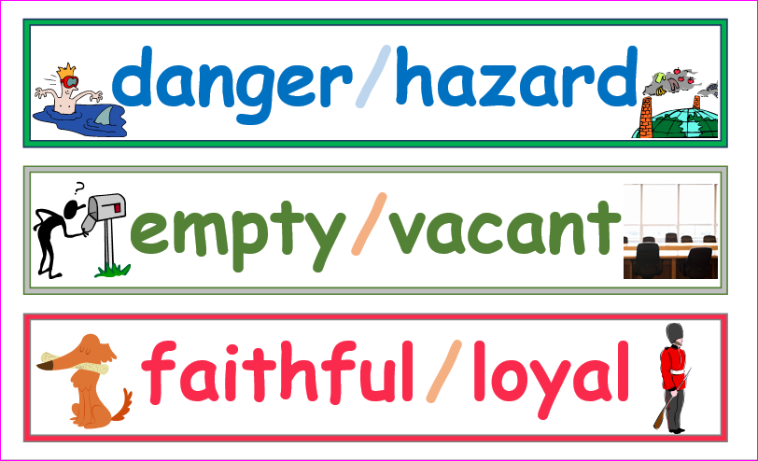
synonym
L.4.5c
L.5.5c
A word or expression which means the same as another word or expression
4-5

Slide 30
third person
RL.4.6
when the story is told from the point of view of someone NOT in the story
4-5

