Slide 1
Fourth Grade Domain Specific Words A thru K
Work in Progress

Slide 2
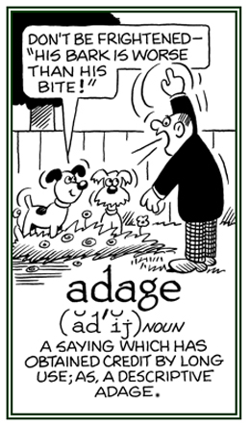
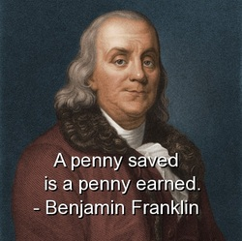
adage
L.4.5b
L.5.5b
an old saying that expresses a general truth about life
4-5

Slide 3
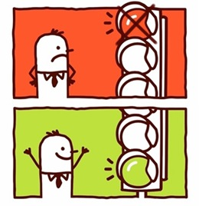
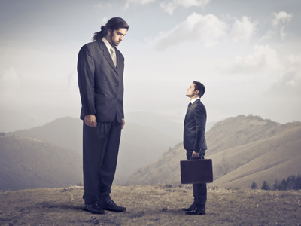
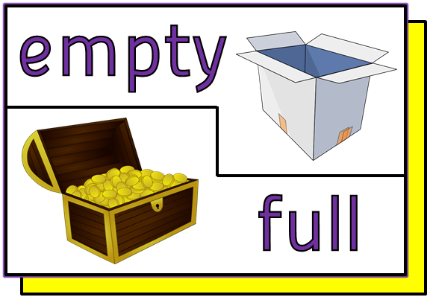
antonym
L.4.5c
L.5.5c
A word that means the opposite
4-5

Slide 4
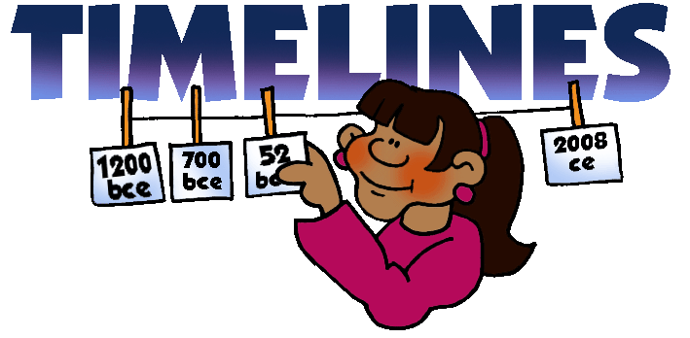
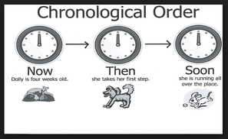
chronology
RI.4.5
RI.5.5
List of past events in the order that they happened
4-5

Slide 5
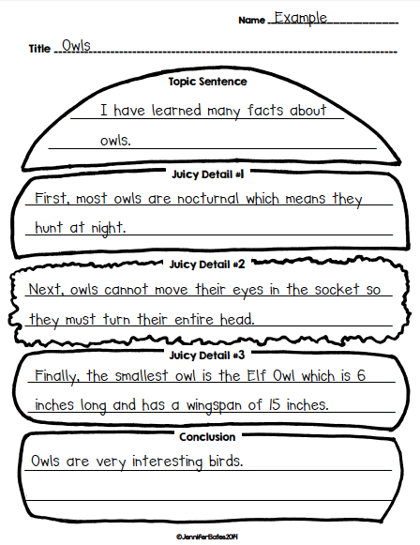
conclusion
W.4.3e
W.5.3e
The last part of a writing or speech
4-5

Slide 6
concrete
W.4.2b, W.4.3d
W.5.2b, W.5.3d
something definite and specific
4-5

Slide 7
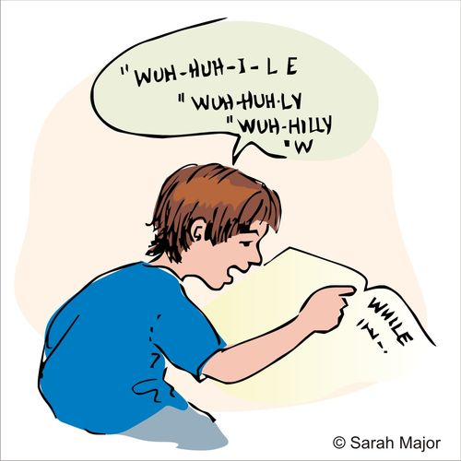
correspondence
RF.4.3a
RF.5.3a
matching printed letters with the sounds they make
4-5

Slide 8
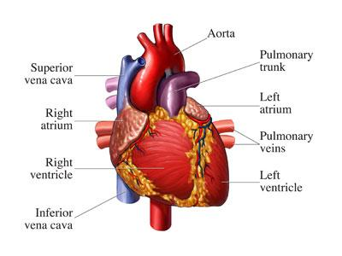
domain specific vocabulary
W.4.2d
W.5.2d
words found and used in particular contents and subjects
4-5

Slide 9
evidence
RI.4.8, SL.4.3
RI.5.8, SL.4.3
proof that causes you to believe something is true
4-5

Slide 10
example
RL.4.1, RI.4.1, W.4.2b, L.4.41
W.5.2b
A situation, object, or person that shows what is being claimed is true
Animals have ways of protecting themselves from predators. Turtles, for example, pull their heads, arms, and legs into their hard shell to avoid serious injury from a hungry animal.
4

Slide 11
first person
RL.4.6
When a character in the story is the narrator
4

Slide 12
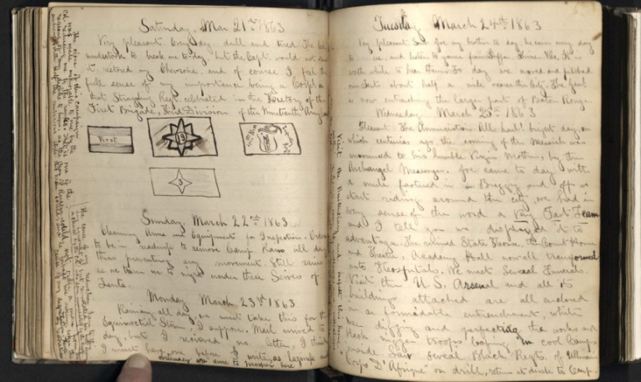
firsthand account
RI.4.6
A retelling based on an author’s personal experience.
Journal from a Civil War soldier
4

Slide 13
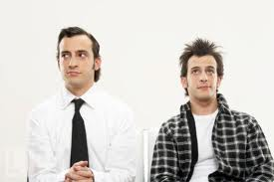
formal English
SL.4.6, L.4.3c
SL.5.6
Used in “serious” texts and situations — for example, in official documents, books, news reports, articles, business letters or official speeches.
Informal
Formal
4 -5

Slide 14
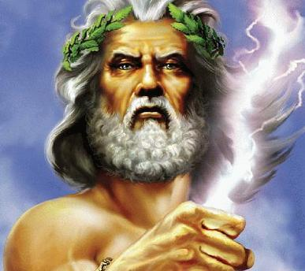
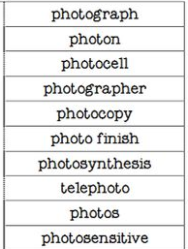
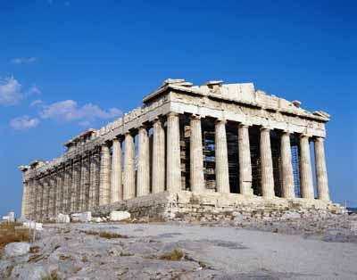
Greek
L.4.4b
L.5.4b
Coming from the language, people, or culture of ancient Greece, or any of the languages that later evolved from it
Words containing Greek roots
4 -5

Slide 15
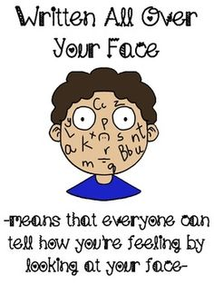
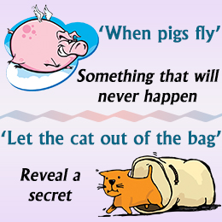
idiom
L.4.4b
L.5.4b
Group of words that have a different meaning when used together from the one they would have if you took the meaning of each word separately
4 -5

Slide 16
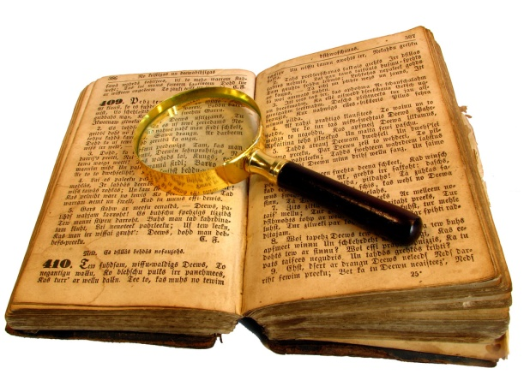
inference
RL.4.1, RI.4.1
RL.5.1, RI.5.1
Making a conclusion about something by using information that you already have about it
I
+
=
Background
knowledge
(what I know)
Text clues
(what I read)
Inference
4 -5

Slide 17
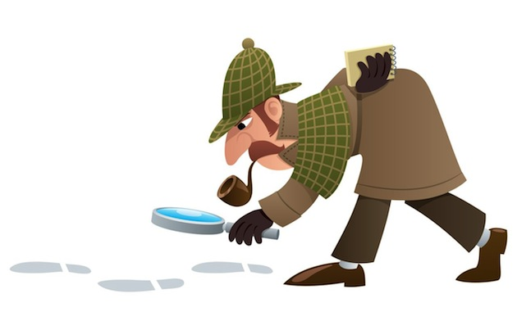
investigation
W.4.7
W.5.7
Investigate means to develop facts to try to find out what happened or what is the truth.
Investigation is the
act of investigating.
4 -5

