Slide 1
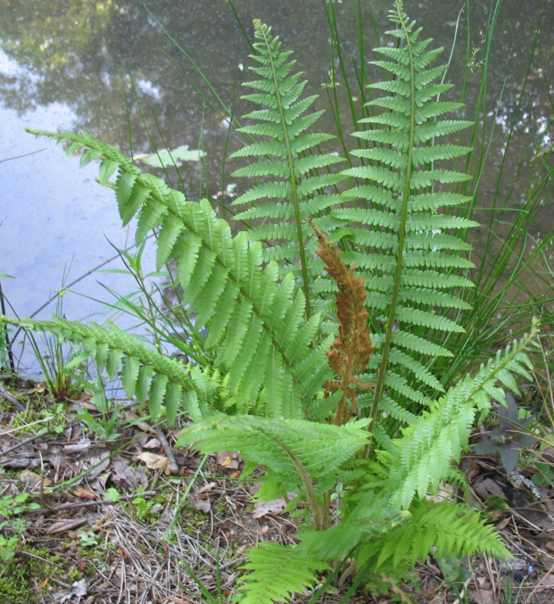
ONSC Project
The goal of this project is to observe and study an organism’s life. This will include the organism’s habitat, behaviors, tracks or evidence animals leave behind, food sources, environmental impacts animals may have, position in the food web, home range, non-native v. native v. naturalized, adaptations, medicinal/human uses, … You will be required to write a research paper, as well as create a poster or PowerPoint and present your organism to the class.

Slide 2
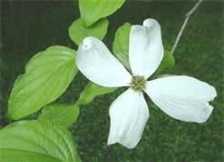
The following is the order in which you will collect information:
Choose Organism
Research and learn about organism (record specific information in Discovery Journals)
Choose Video For Presentation
At ONSC: Make observations, collect data, and utilize teacher naturalists for further research
After ONSC: Create Project (See Rubric)

Slide 3
The following slides are some examples of organisms that live in the Ozark Mountains, specifically on the property of ONSC. You may choose one of these for your final project, or you may choose a different organism to study and get approval from your teacher.

Slide 4
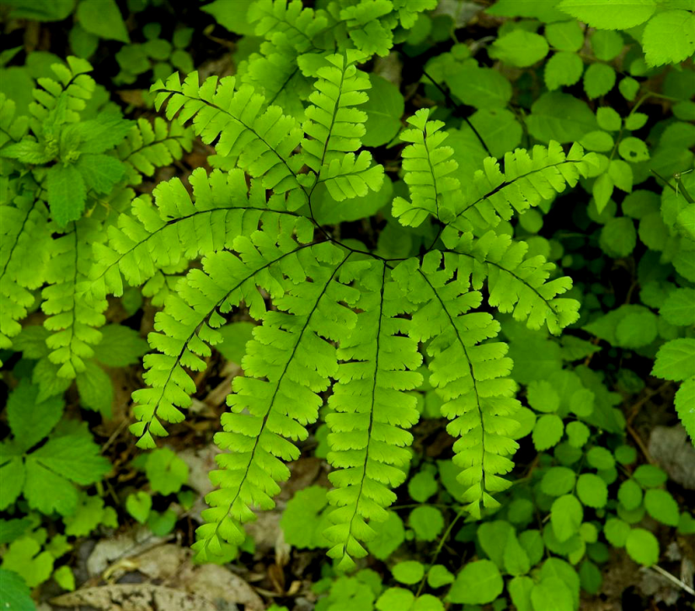
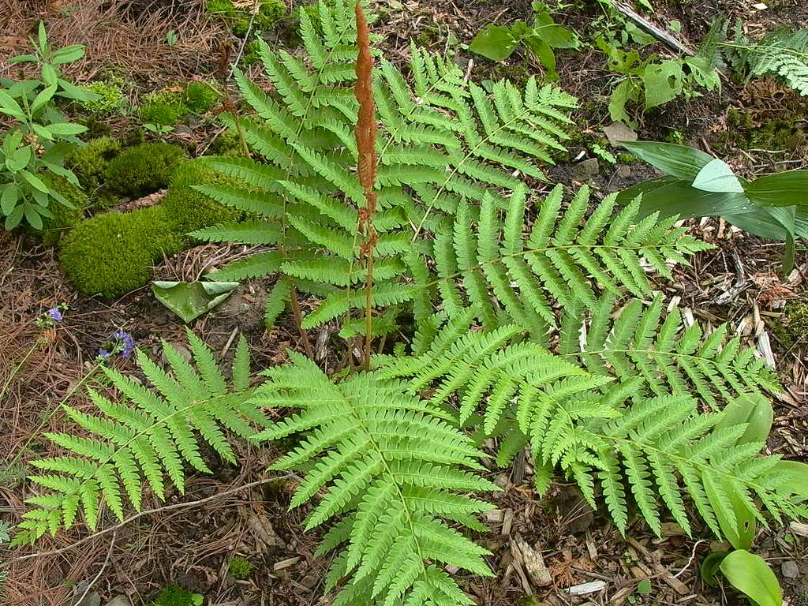
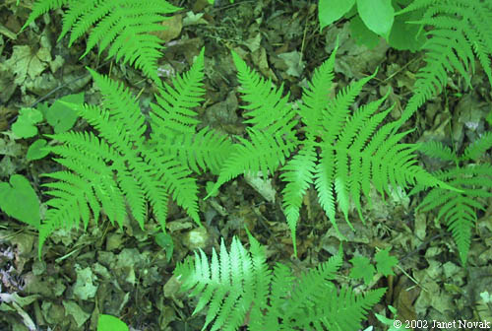
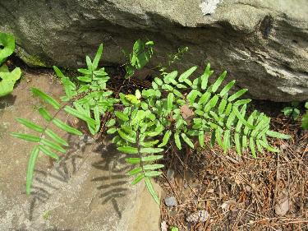
Maidenhair Fern
Christmas Fern
Broad Beech Fern
Purple Cliffbrake Fern

Slide 5
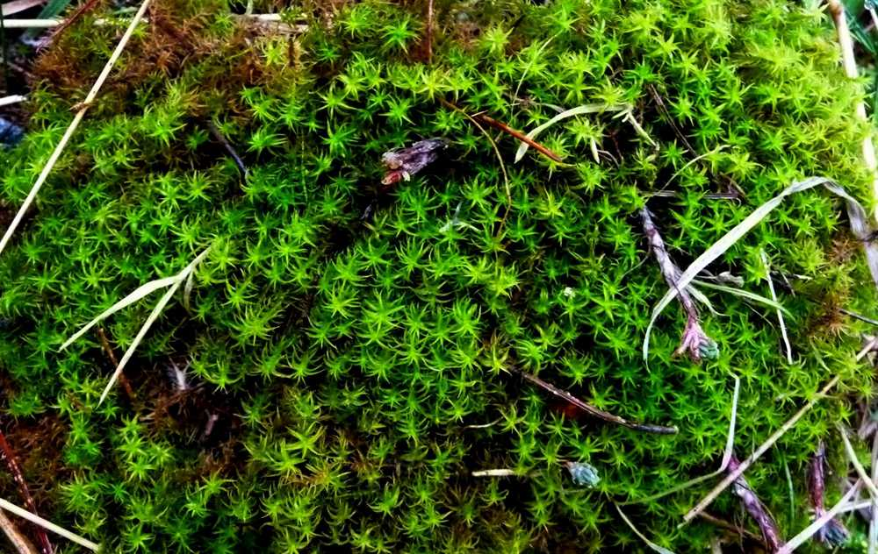
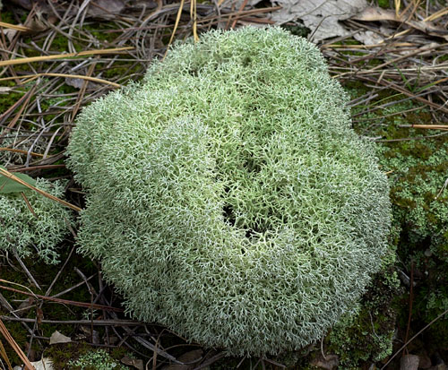
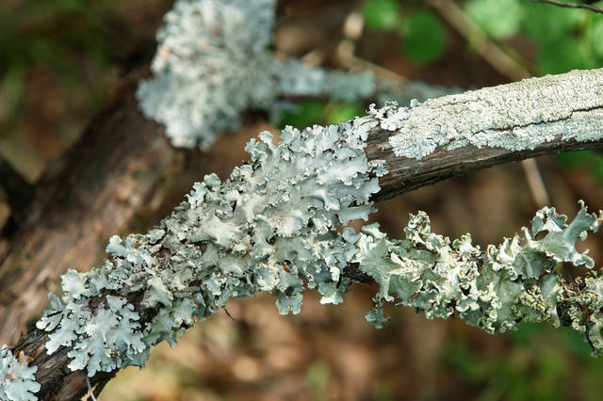
Star Moss
Reindeer Lichen
Foliose Lichen

Slide 6
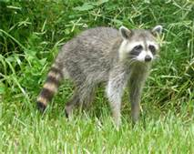
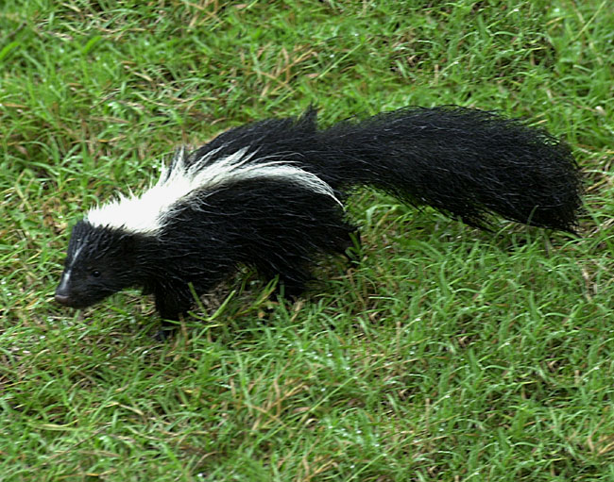
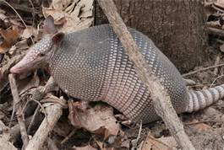
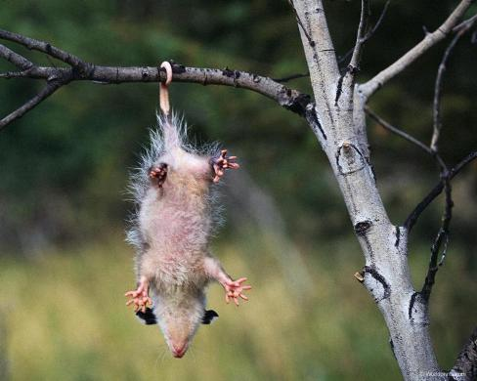
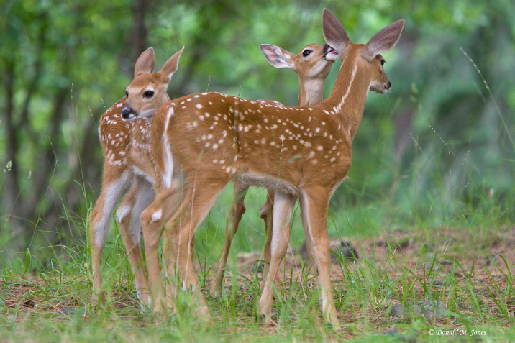
Raccoon
Skunk
Possum
Armadillo
White-tailed deer

Slide 7
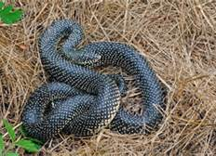
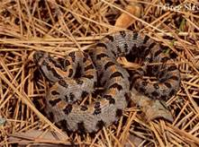
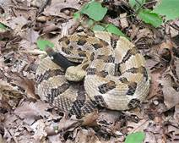
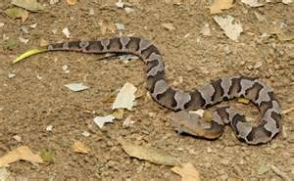
Speckled Kingsnake
Pygmy Rattlesnake
Timber Rattlesnake
Copperhead

Slide 8
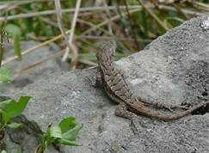
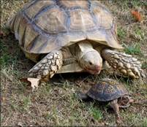
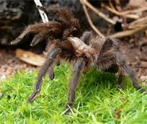
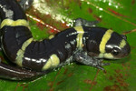
Northern Fence Lizard
Box Turtle
Ringed Salamander
Texas Brown Tarantula

Slide 9
The following is an additional list of organisms that are found in Northwest Arkansas that may be used for your project.
Eastern Chipmunk
Coyote
Woodchuck
Black Bear
Wild Comfrey
Whip-poor-will
Wild Turkeys
Screech Owl
Bard Owl
Pilleated Woodpecker
Indigo Bunting
White-breasted Nuthatch
Bard Owl
Goldfinch
Mourning Dove
Grey-bellied Salamander
Ozark Zig-Zag Salamander
Cave Salamander
Turkey Vulture
Spotted Salamander
Nine-Banded Armadillo
Short-Tailed Shrew
Prickly Pear Cactus
Southern Flying Squirrel
Spring Peeper
Northern Cricket Frog
Dwarf American Toad
Ant Lion
Ozark Chinquapin
Eastern Red Cedar
Flowering Dogwood
Mockernut Hickory
Sassafrass
Daddy-long-legs
Millipedes
Centipedes
Hover Fly

Slide 11
ONSC Organism Research Project Presentation Rubric
CATEGORY | 4 | 3 | 2 | 1
Presentation | Well-rehearsed with smooth delivery that holds audience attention. | Rehearsed with fairly smooth delivery that holds audience attention most of the time. | Delivery not smooth, but able to maintain interest of the audience most of the time. | Delivery not smooth and audience attention often lost.
Video Useage | Relevant with information regarding your organism and can easily be understood by class | Information relevant but not easily understood | Information not relevant but easily understood | Information not relevant and not easily understood
Powerpoint or Poster | Contains picture of organism, video, colorful and well-thought out slides/poster, organized, easily understood, and all information relevant | Contains a picture of organism, video, slides/poster somewhat attractive and organized, easily mostly easy to understand, and information mostly relevant | Contains a picture of organism, video, slides/poster not very attractive and not very organized, not easily understood | Slides/poster not colorful, not organized, not easily understood
Content | Shows a deep understanding of organism and includes 9 of 11 required parts regarding organism (See Content Rubric) | Shows a deep understanding of organism and only includes 7-8 parts of required information | Shows some understanding and only includes 5-6 pieces of required information | Shows little understanding and only includes 3-4 or less pieces of required information
Multimedia Project : ONSC Organism Research Project Teacher Name: Mrs. Pledger Student Name: ________________________________________

