Slide 1
Landforms of the Ocean

Slide 2
What Can You Find Down There?
The ocean floor contains all of the geographic features that can be found on the continents: Mountains, volcanoes, plains, valleys, and canyons.
These underwater landforms are many times taller, deeper, longer, and wider than those on dry land.

Slide 3
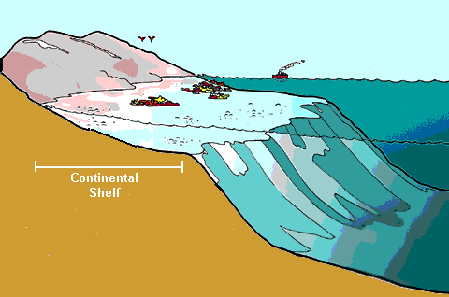
Continental Shelf
The edges of the continents slopes down from the shore into the ocean.
The part of the continent located under the water is known as the continental shelf.
The width of the continental shelf varies around the edges of the continents.
In some places, the continental shelf is fairly shallow and in
other places it
becomes very deep.

Slide 4
Continental Slope
The steep slope where the continental shelf drops to the bottom of the ocean floor is called the continental slope.
The ocean becomes very deep here.

Slide 5
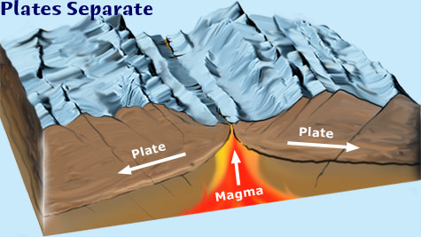
Mid-Ocean Ridge
The largest mountain range on Earth.
It divides the ocean floor into two parts.
Made by volcanoes
Those volcanic mountains that are not formed on the mid-ocean ridge (and do not break the surface of the ocean) are called seamounts. See the next slide to view some!

Slide 6
Seamounts

Slide 7
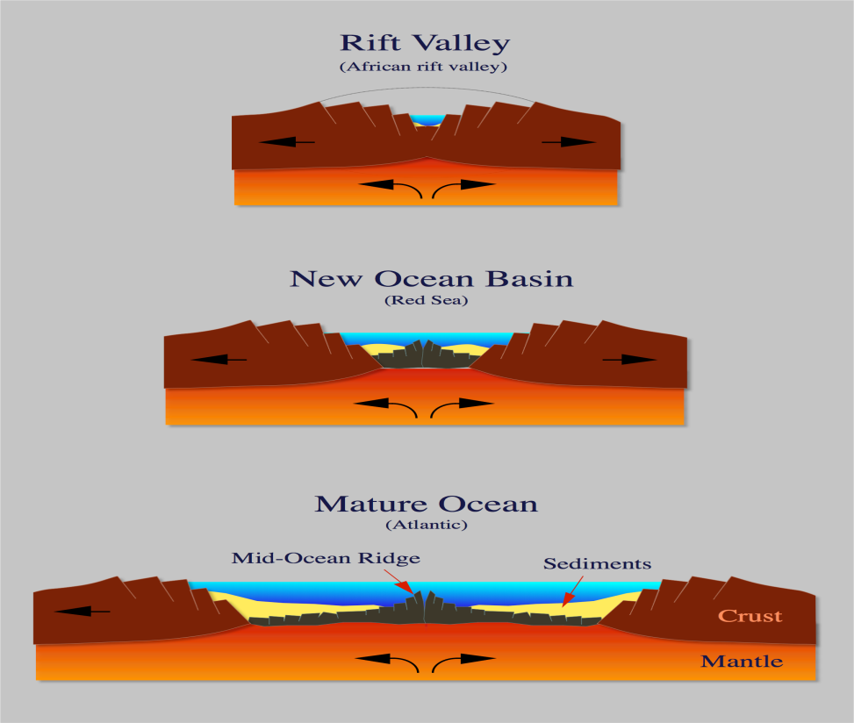
Rift Zone
In the center of the highest part of the mid-ocean ridge is a narrow trench called a rift.
Underwater volcanic activity that adds mountains to either side of the mid-ocean ridge occurs at the rift zone.

Slide 8
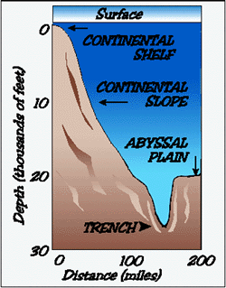
Trench
There are many steep-sided canyons and deep, narrow valleys in the bottom of the ocean.
Ocean trenches are the deepest part of the ocean basin and are deeper than any valley found on land.

Slide 9
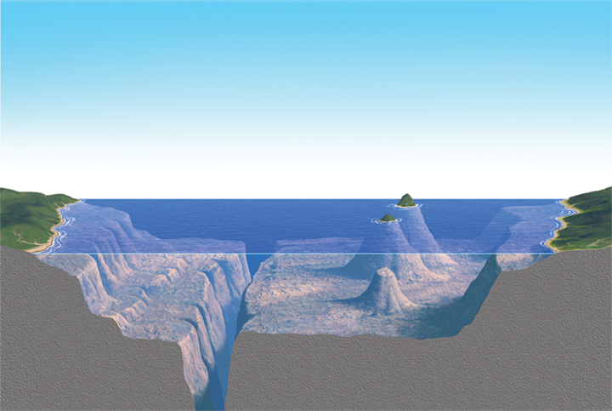
Ocean Basin
Located on either side of the mid-ocean ridge is the ocean basin.
It is made up of low hills and flat plains.

Slide 10
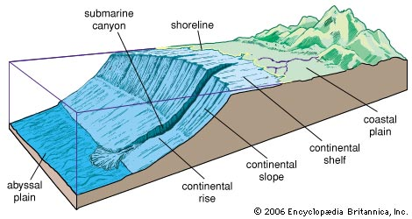
Abyssal Plain
The flat area of the ocean basin is called the abyssal plain.
Seamounts are generally formed on the ocean basin.

Slide 11
How do scientist know the landforms are there?
Maps of the ocean floor are created by collecting and plotting depth measurements.
Depth measurements are taken by sonar.
Sonar are sound waves that are sent from the ocean surface to the ocean floor. The amount of time it takes for the sound to travel down and back is one depth measurement.

Slide 12
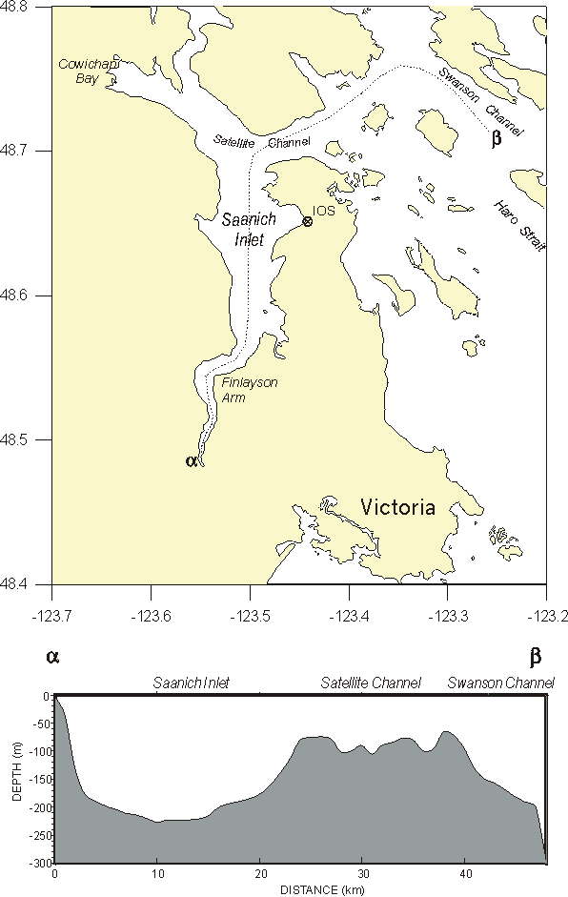
How do scientist know the landforms are there?
Variations in depth are used to infer or explain elevations and depression in the ocean floor.
Depth measurements compiled together make a depth profile.

Slide 13
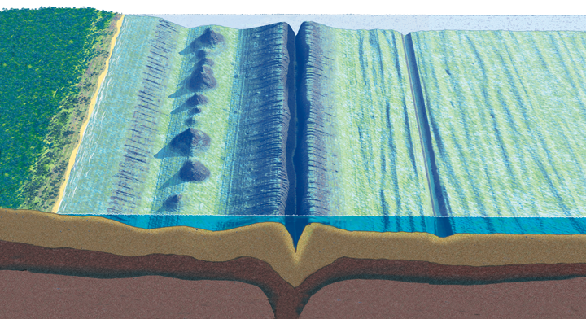
What are the features of the ocean floor?
continent
sea mount
rift valley
continental shelf
trench
mid-ocean ridge
abyssal plain
continental slope
continental rise

Slide 14
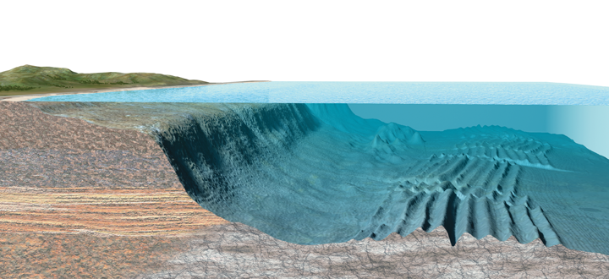
Can you name the landforms of the ocean floor?

