Slide 1
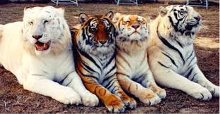
Notes:
Ask: How are the tigers alike and how are they different?
Which of these tigers would survive best in a snowy habitat?
Which of these tigers would survive best in a grassland habitat?
Which of these tigers would survive best in a forest habitat?

Slide 2
