Slide 1
Stars in the Sky
Source: NASA Astronomy Photo of the Day
1-ESS1-1 - Use observations of the sun, moon, and stars to describe patterns that can be predicted. [Clarification Statement: Examples of patterns could include that the sun and moon appear to rise in one part of the sky, move across the sky, and set; and stars, other than our sun, are visible at night but not during the day.]

Slide 2
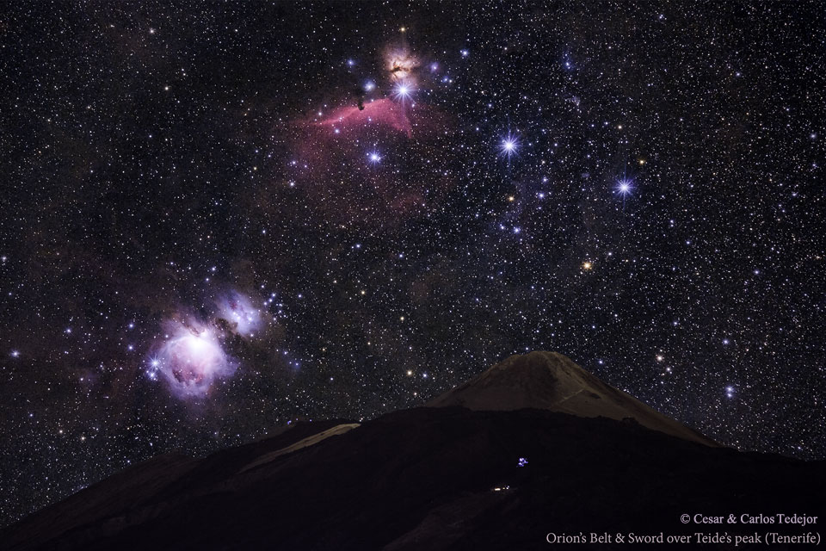

Slide 3
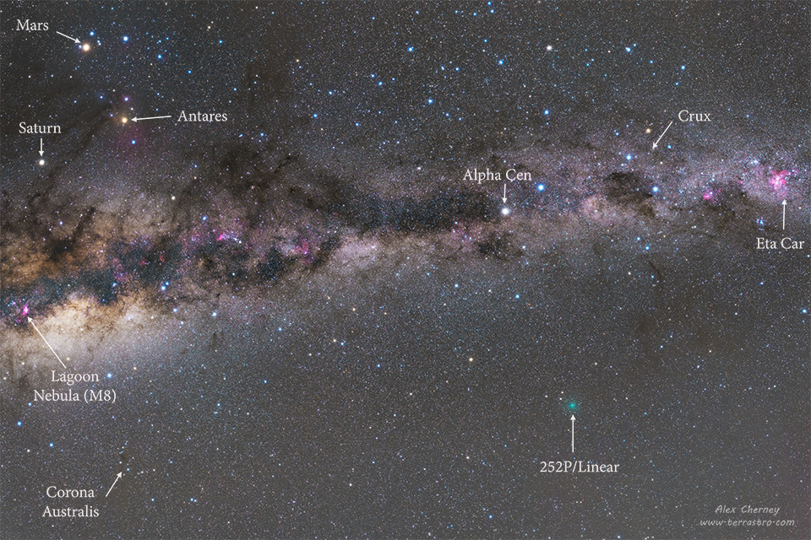

Slide 4
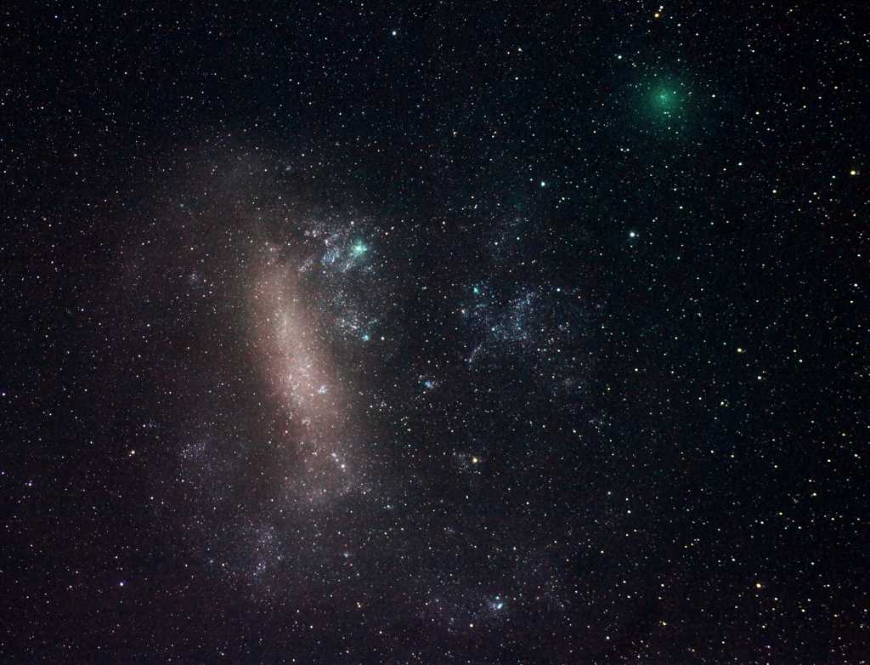

Slide 5
