Slide 1
Comparing Adventures
Ms. Glover’s Kindergarten Class
Mrs. Jones, Literacy Facilitator
Tucker Elementary
12-5-12

Slide 2
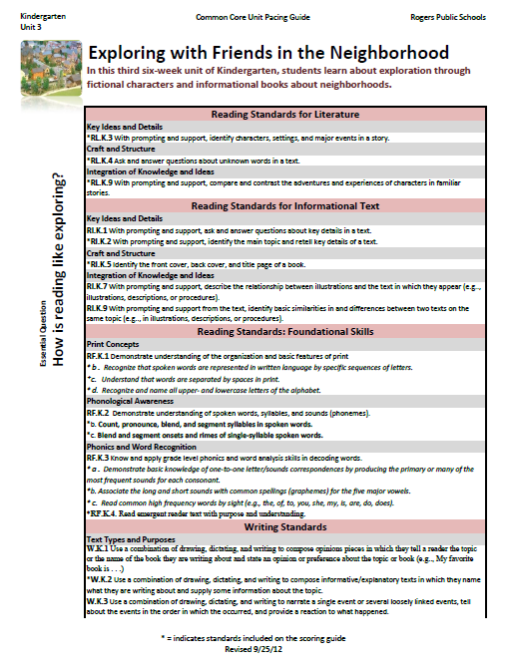
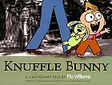
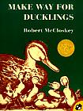
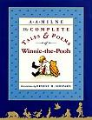
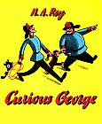
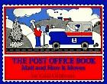
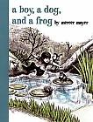
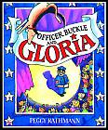
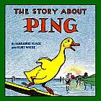
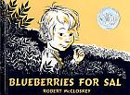
Unit Preparation:
Prior to beginning Unit 3, Ms. Glover and Mrs. Jones did the following:
Identified the standards to be taught- (they looked at the unit 3 pacing guide)
They asked themselves-
“What will my students know and be able to do better at the end of this unit?”
3. They gathered and studied the resources in order to prepare the daily lessons.

Slide 3
Plan Daily Lessons:
Once they had the big picture for the unit, they began planning daily lessons.
The standard for this lesson was:
RL.K.9 With prompting and support, compare and contrast the adventures and experiences of characters in familiar stories.
The resources they selected for the lesson are:
The Red Book (from unit 1)
Train Stop

Slide 4
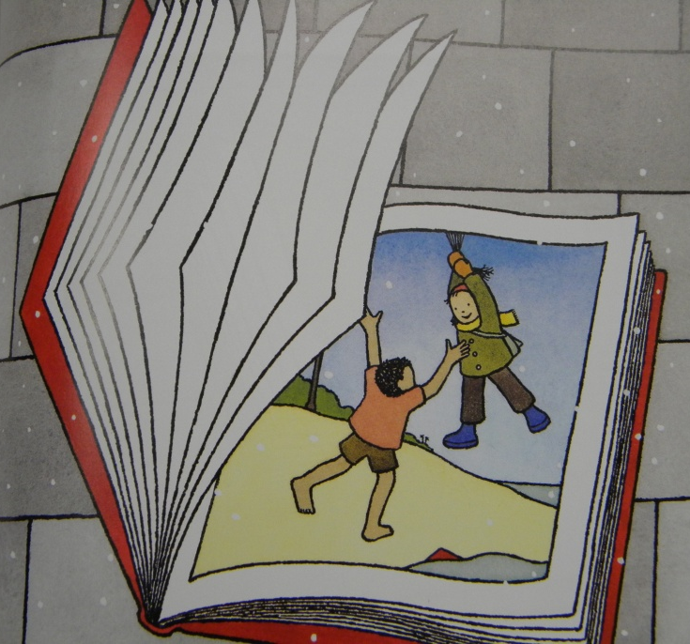
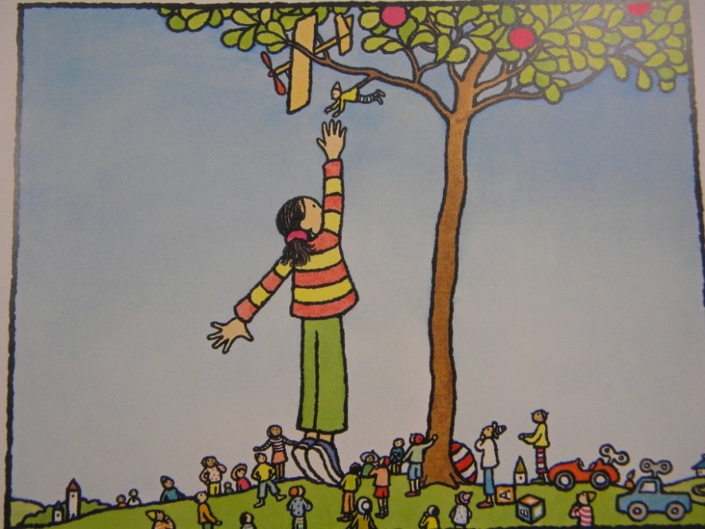
The students were introduced to these books prior to this lesson so the stories were familiar.
The character is the same in both of these wordless picture books.

Slide 5
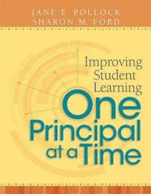
GANAG is a daily lesson structure that allows teachers to plan for student use of research based instructional strategies.
G= goal
A= access prior knowledge
N= new information
A= application
G= generalize the goal

Slide 6
GANAG provides students the opportunity to actively use the nine high-yield strategies:
(2) Identifying Similarities and Differences
(7) Cooperative Learning
(8) Setting Objectives and Providing Feedback
(3) Summarizing and Note Taking
(4) Reinforcing Effort and Providing Recognition
(9) Generating and Testing Hypotheses
(5) Homework and Practice
(10) Cues, Questions and Advance Organizers
(6) Nonlinguistic Representations

Slide 7
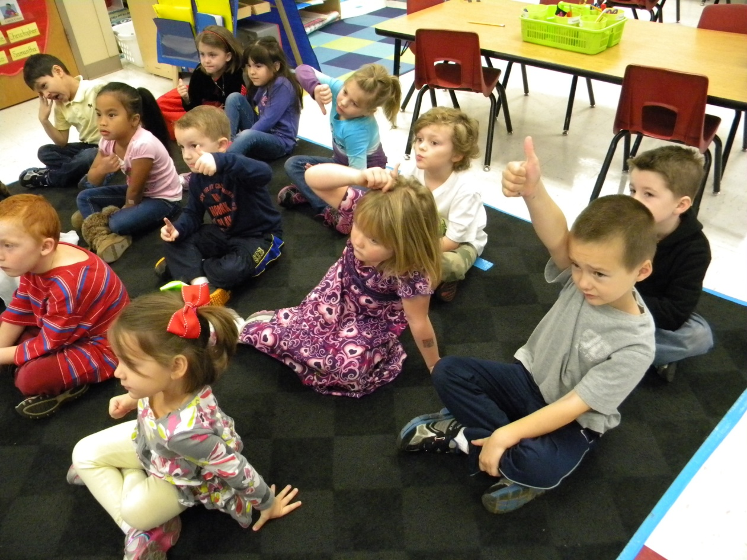
Goal
(8) Setting Objectives and Providing Feedback
I can compare the adventures of characters in familiar stories.
The students scored their understanding before the lesson.

Slide 8
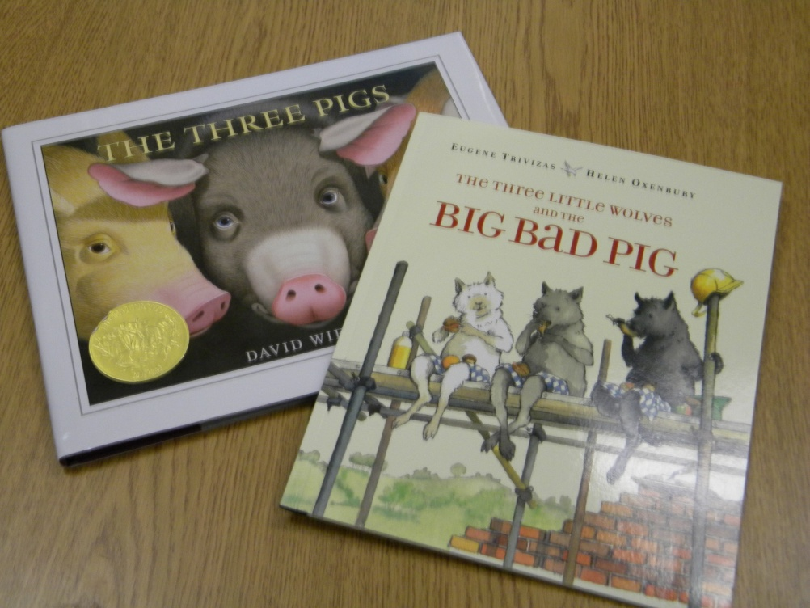
Access Prior Knowledge
The teachers asked the students,
“Do you remember when we compared The Three Pigs and The Three Little Wolves and the Big Bad Pig?”
(10) Cues, Questions and Advance Organizers

Slide 9
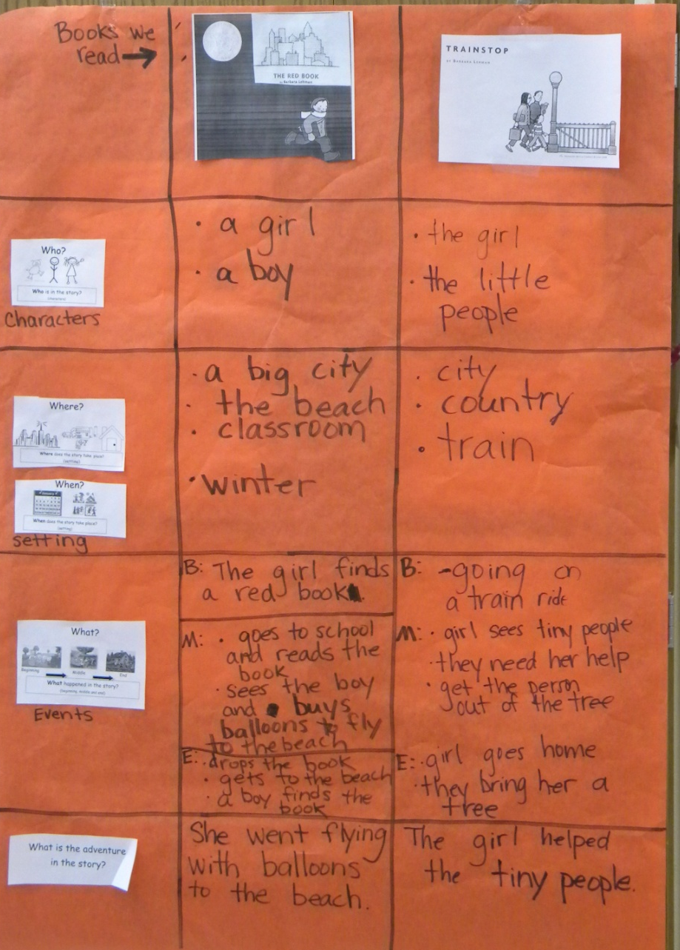
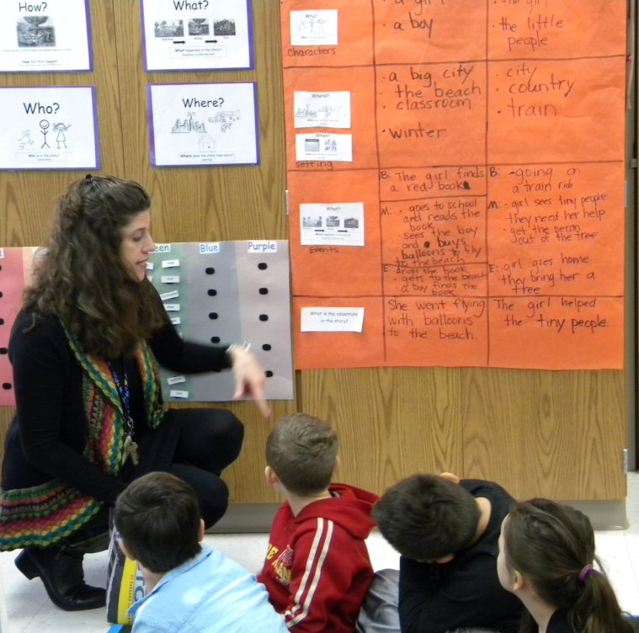
The class looked at the matrix chart they created with both of the stories earlier in the week.
(6) Nonlinguistic Representations

Slide 10
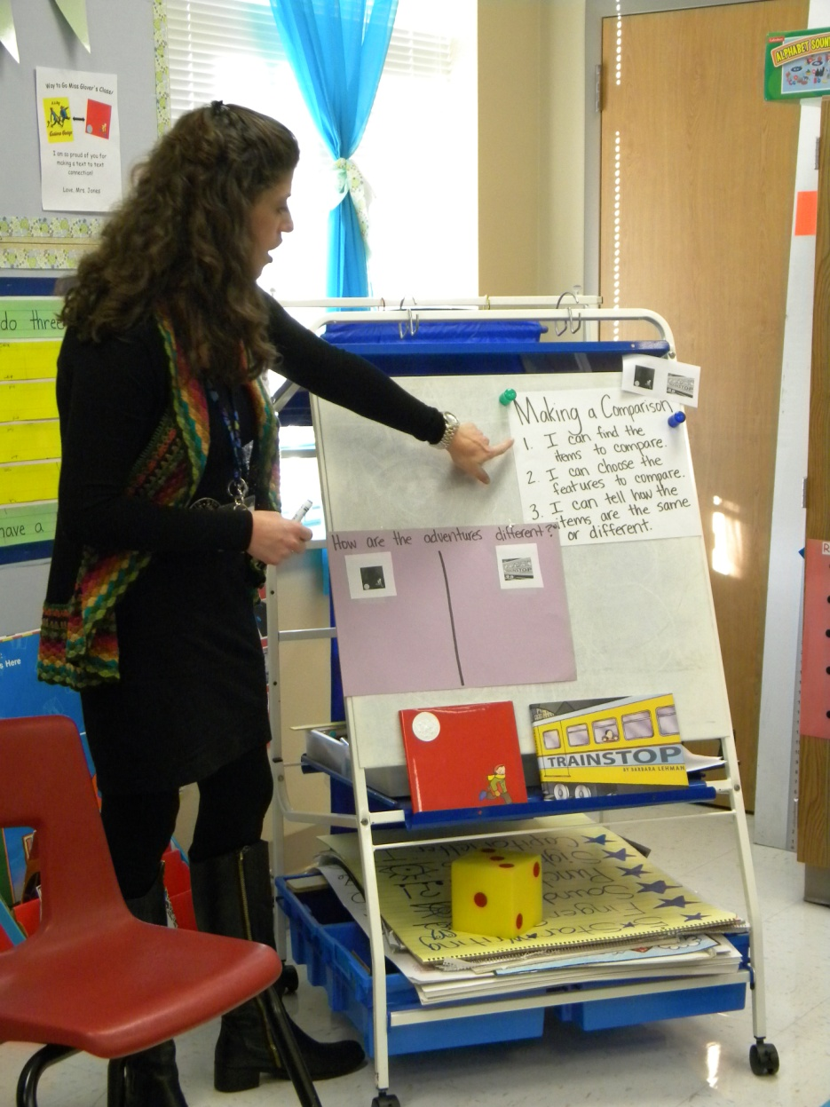
New Information
Mrs. Jones introduced the steps of making a comparison.
Comparing
I can find the items to compare.
I can choose the features to compare.
I can tell how the items are the same or different.

Slide 11
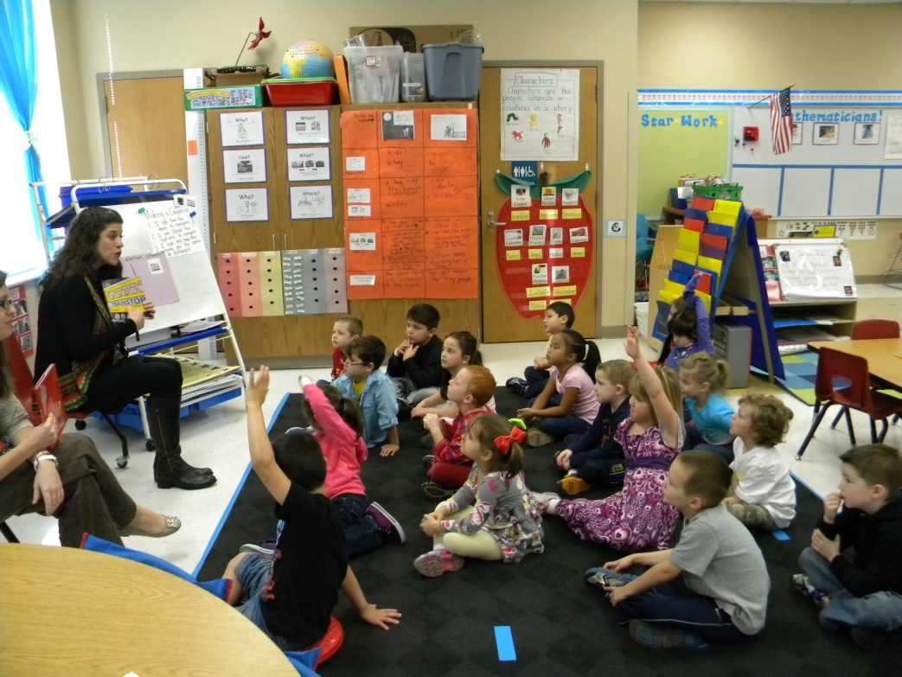
The class identified the items they were going to compare.
Comparing
I can find the items to compare.
I can choose the features to compare.
I can tell how the items are the same or different.

Slide 12
The teachers reminded the students that their goal was to compare the adventures of the character.
Comparing
I can find the items to compare.
I can choose the features to compare.
I can tell how the items are the same or different.
Mrs. Jones drew their attention to the main character and her adventures in each story.

Slide 13
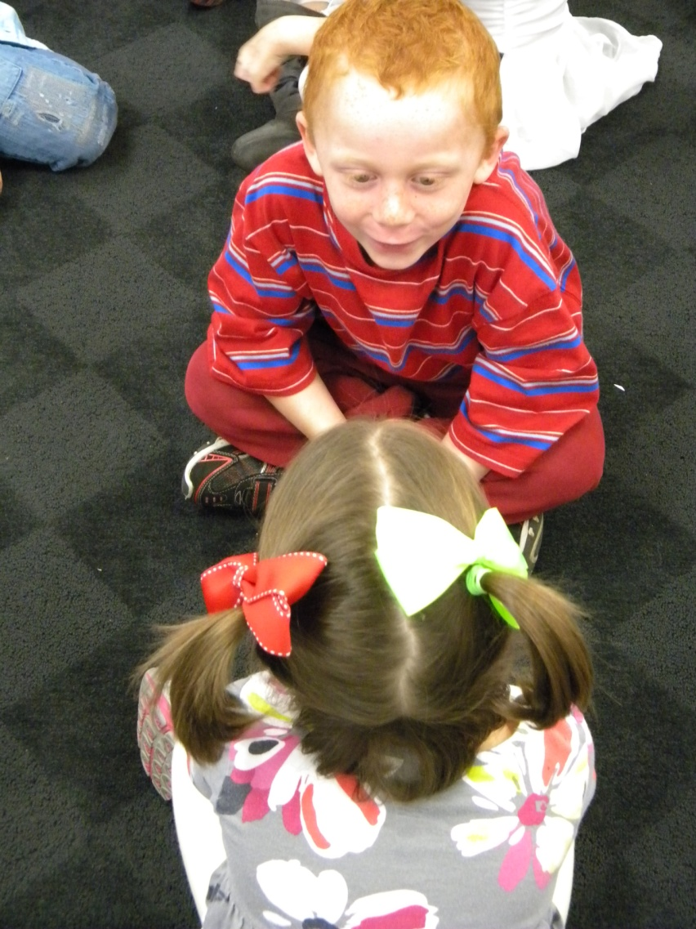
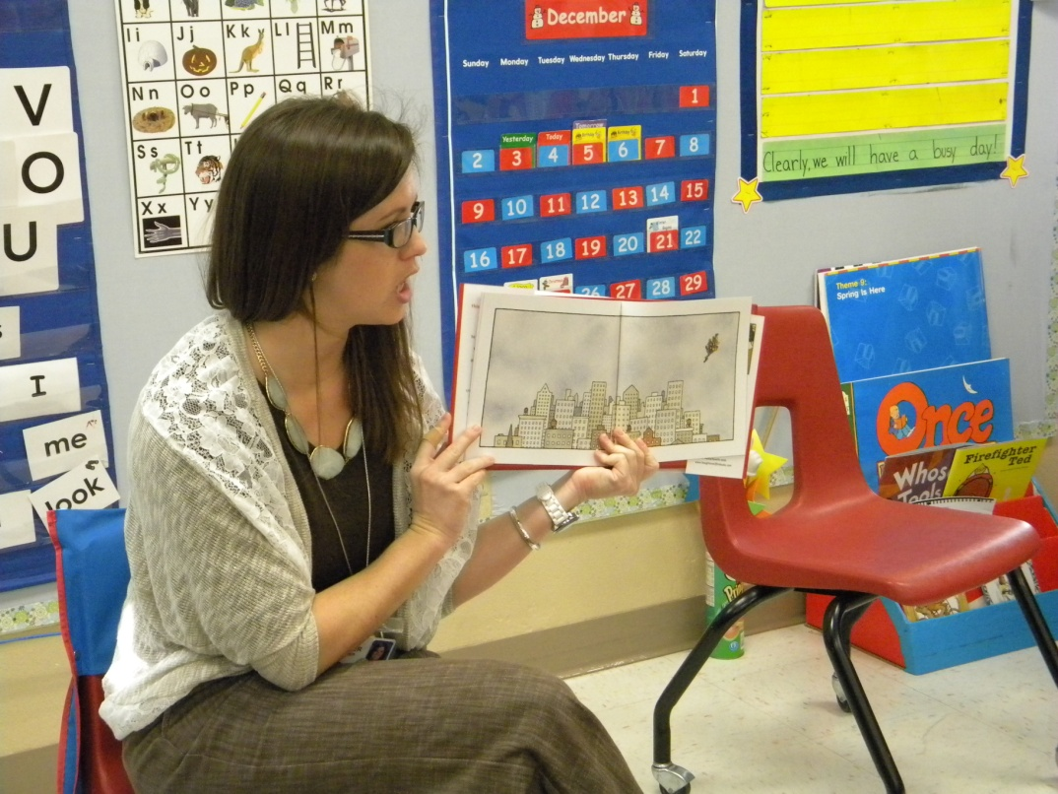
Ms. Glover asked her students to talk with a friend about the girls' adventure in The Red Book.
(7) Cooperative Learning

Slide 14
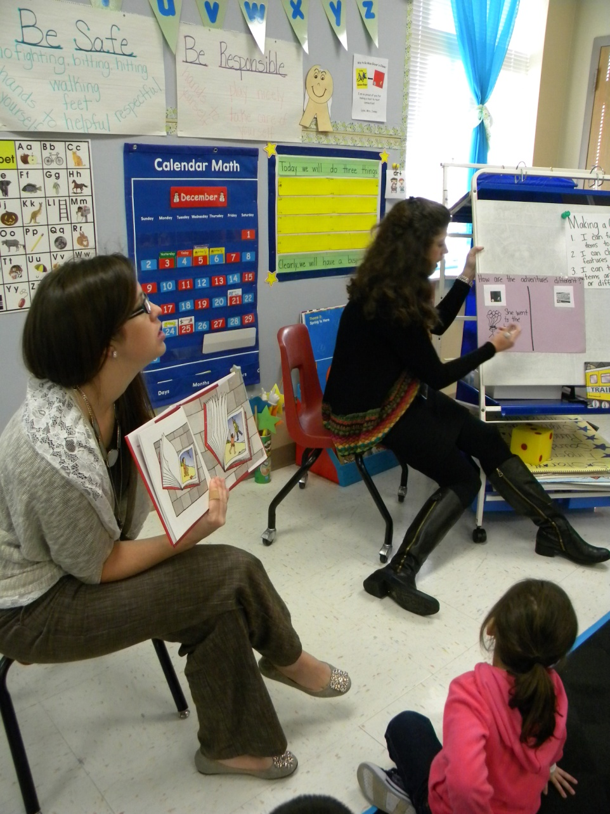
The students helped Mrs. Jones compose a sentence describing the girls adventure.
She went to the beach with balloons.

Slide 15
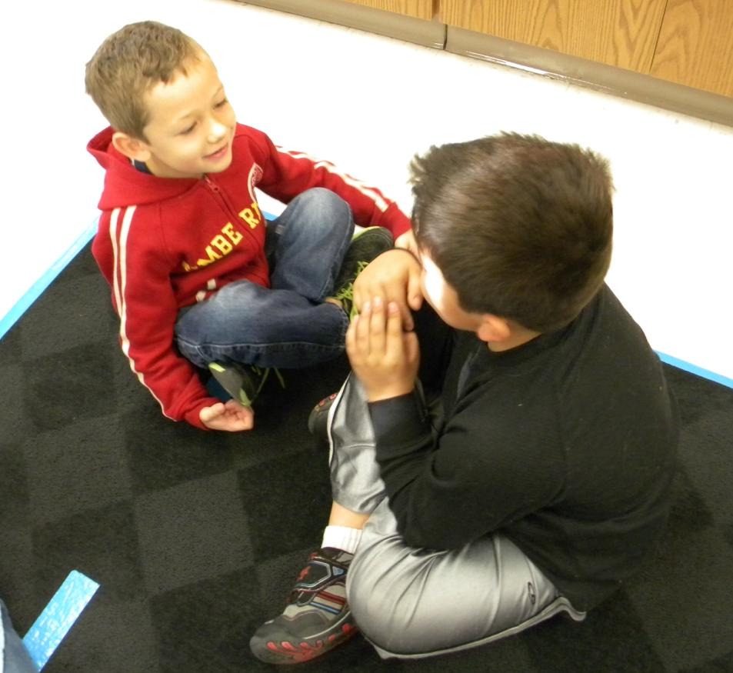
Ms. Glover asked her students to talk with a friend about the girls' adventure in Train Stop.

Slide 16
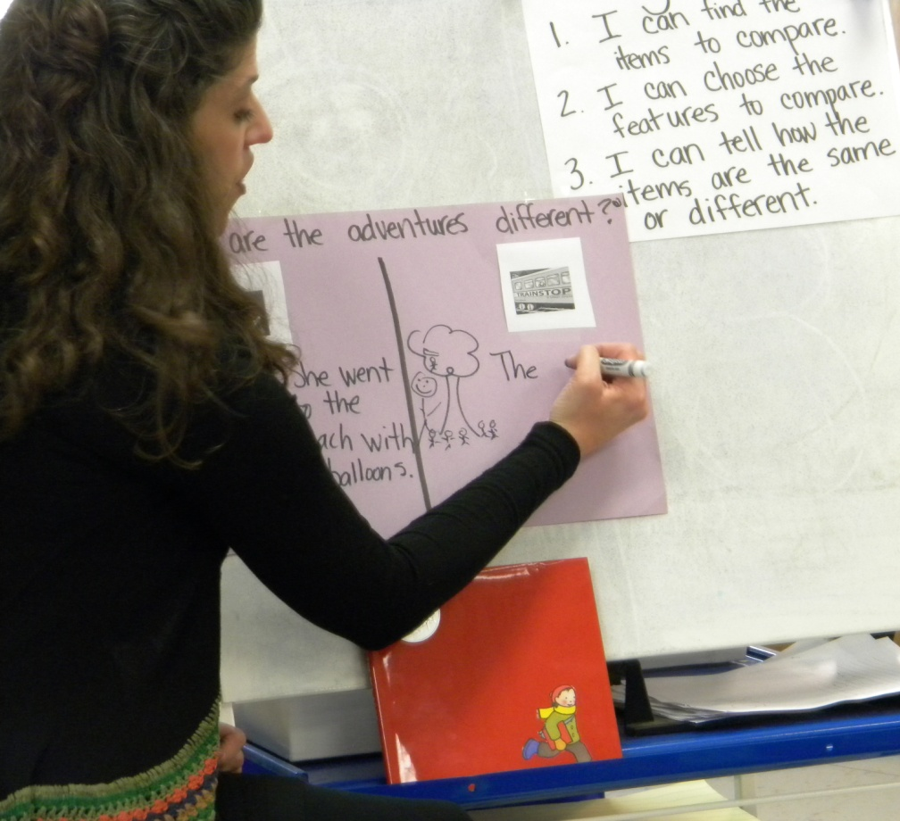
The students helped Mrs. Jones compose a sentence describing the girls adventure.
The girl helped the little people.

Slide 17
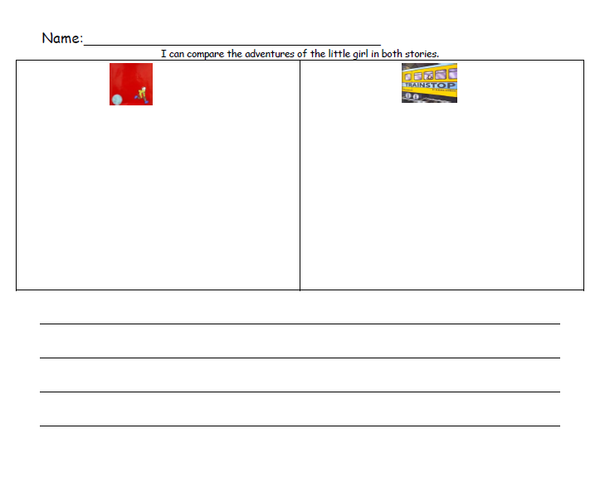
Application
Ms. Glover explained that they wanted the students to draw a picture of the girl’s adventure in each of the stories and then write about how the adventures were different.

Slide 18
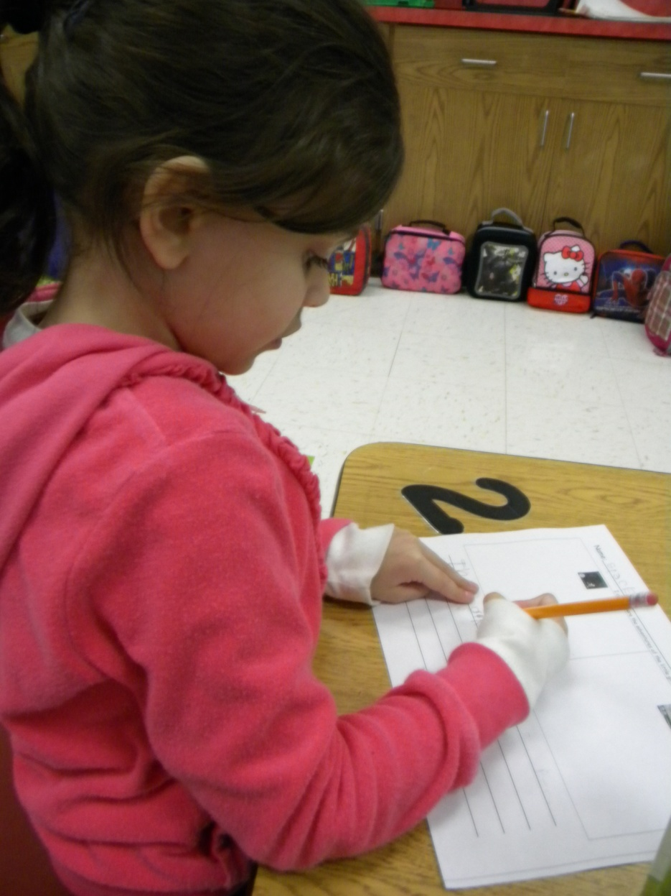
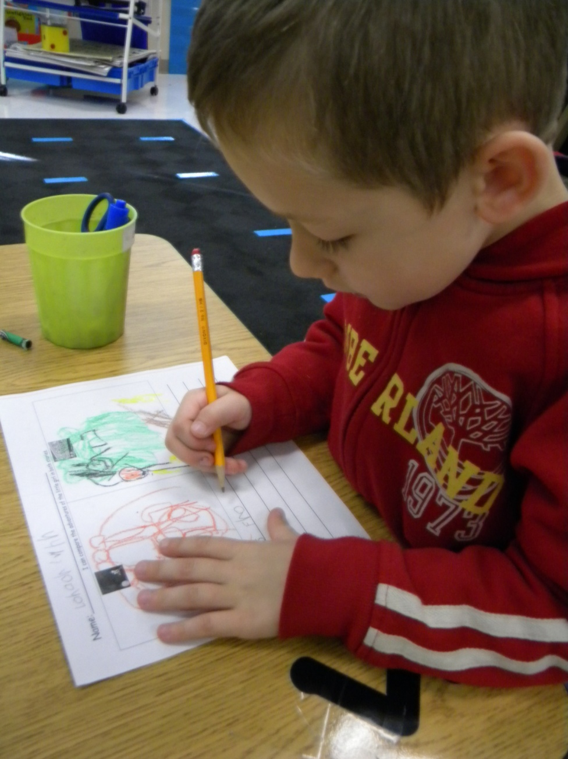
(2) Identifying Similarities and Differences

Slide 19
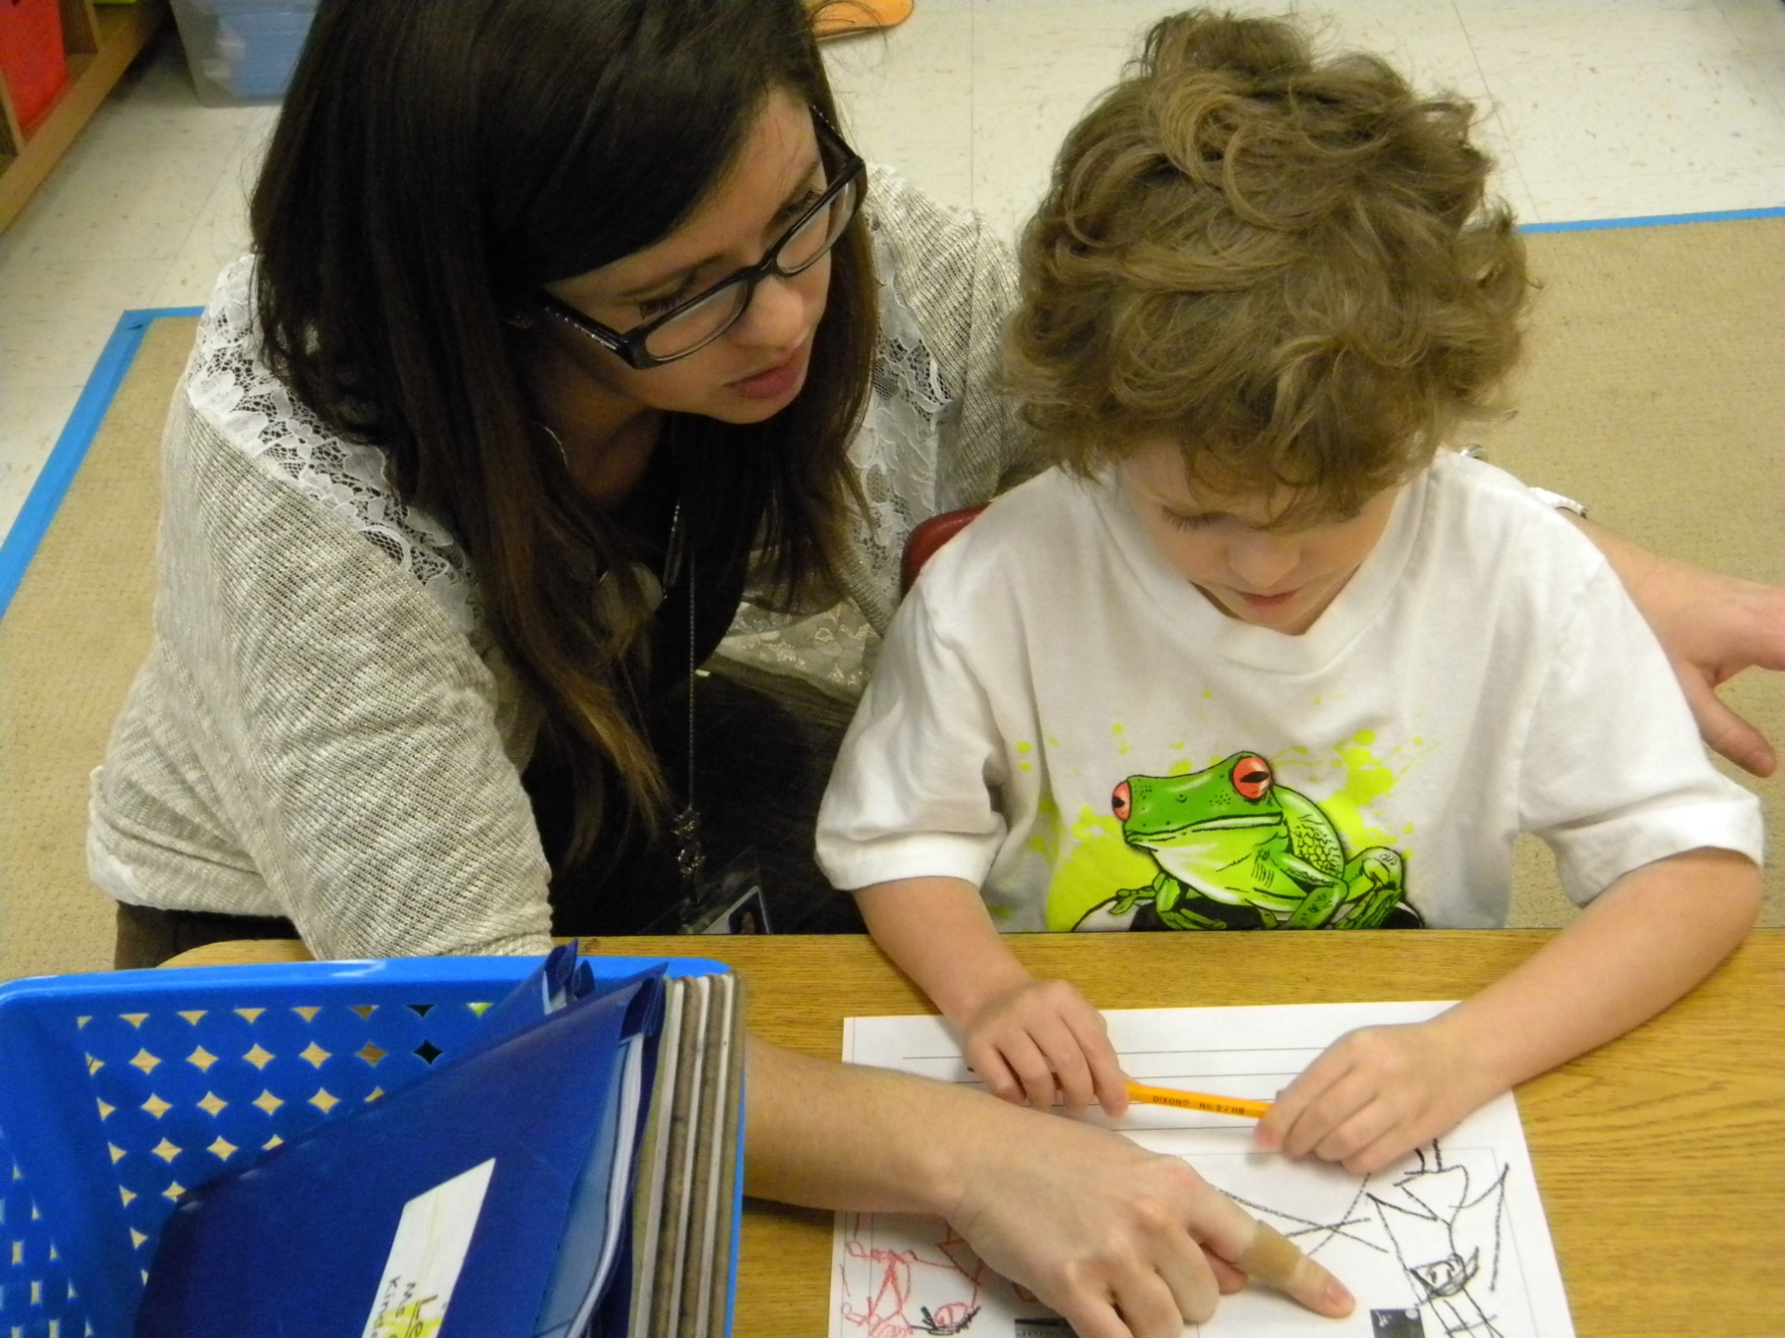

Slide 20
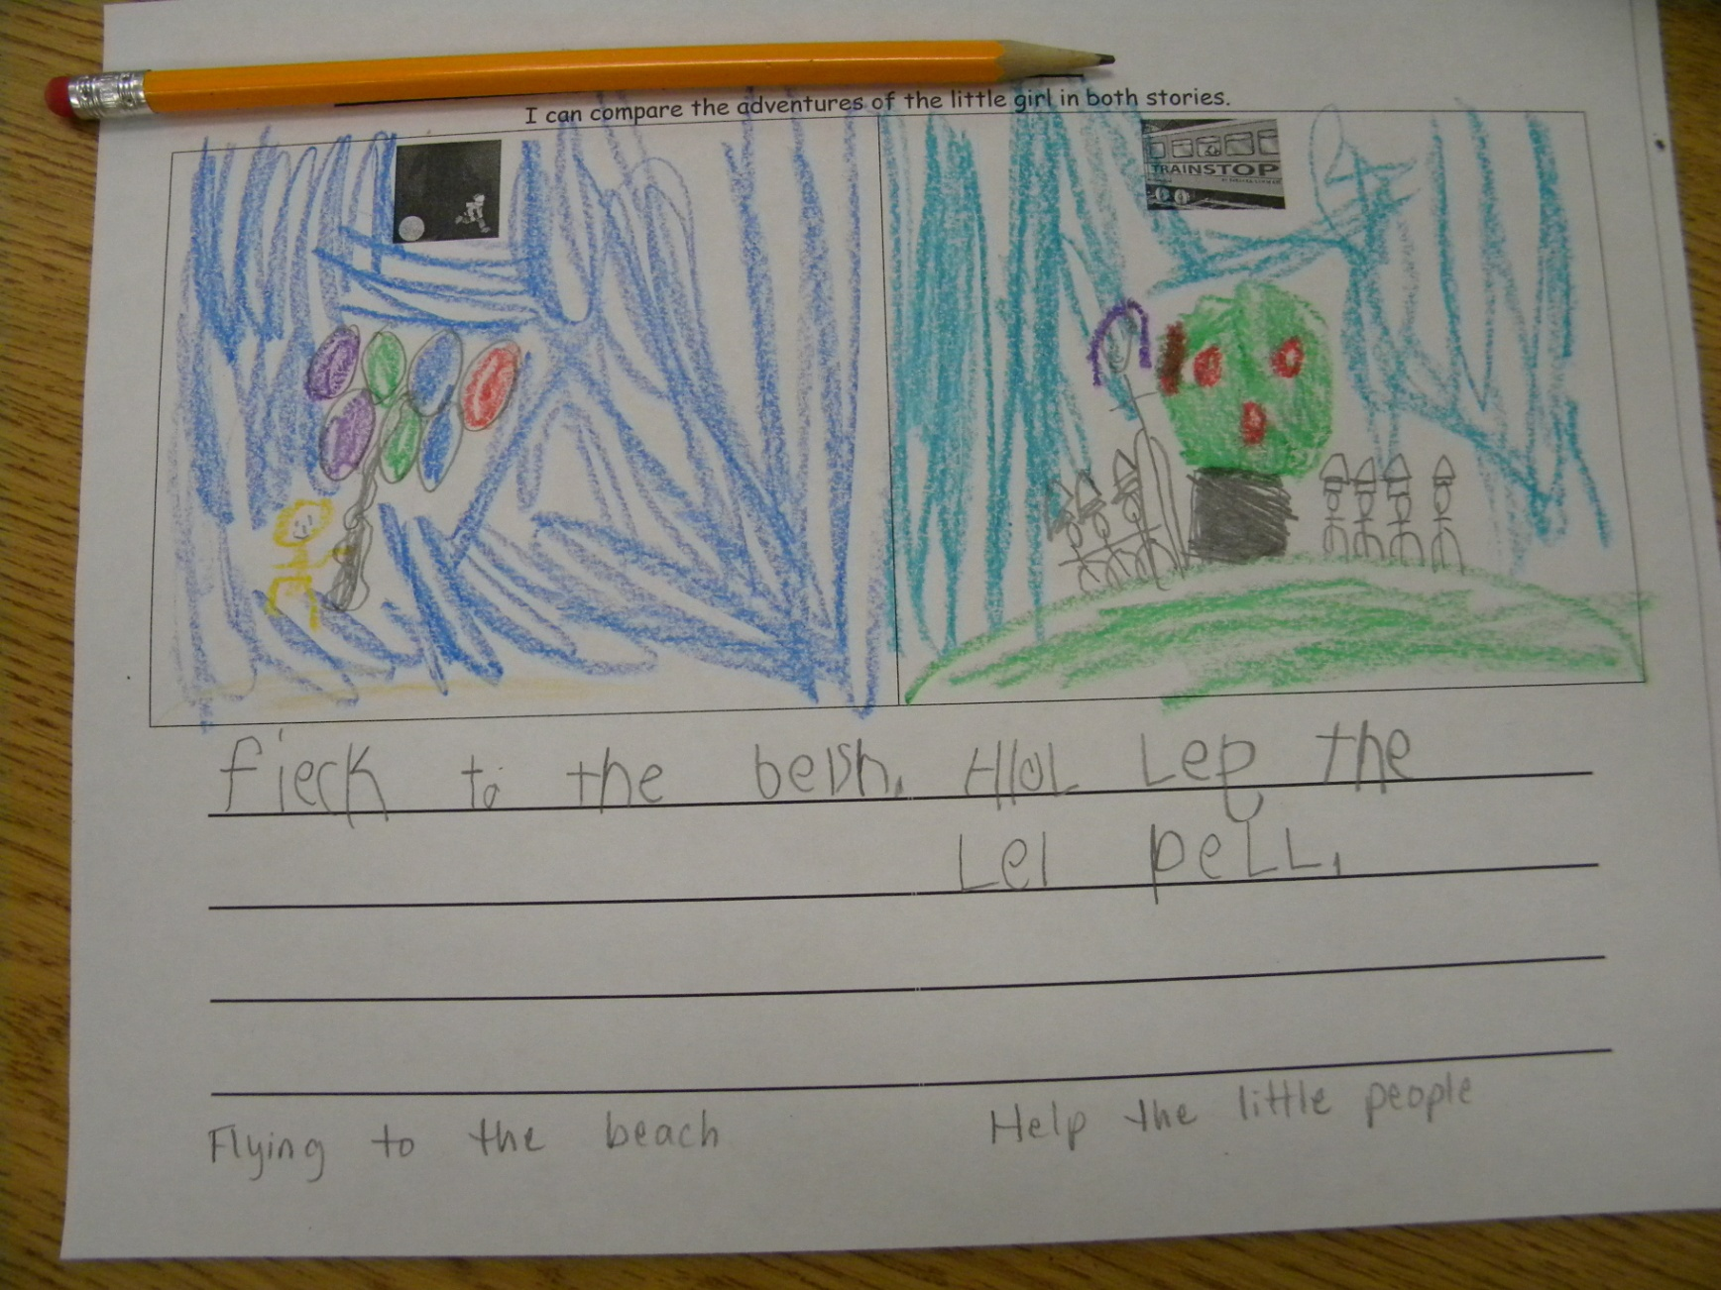

Slide 21
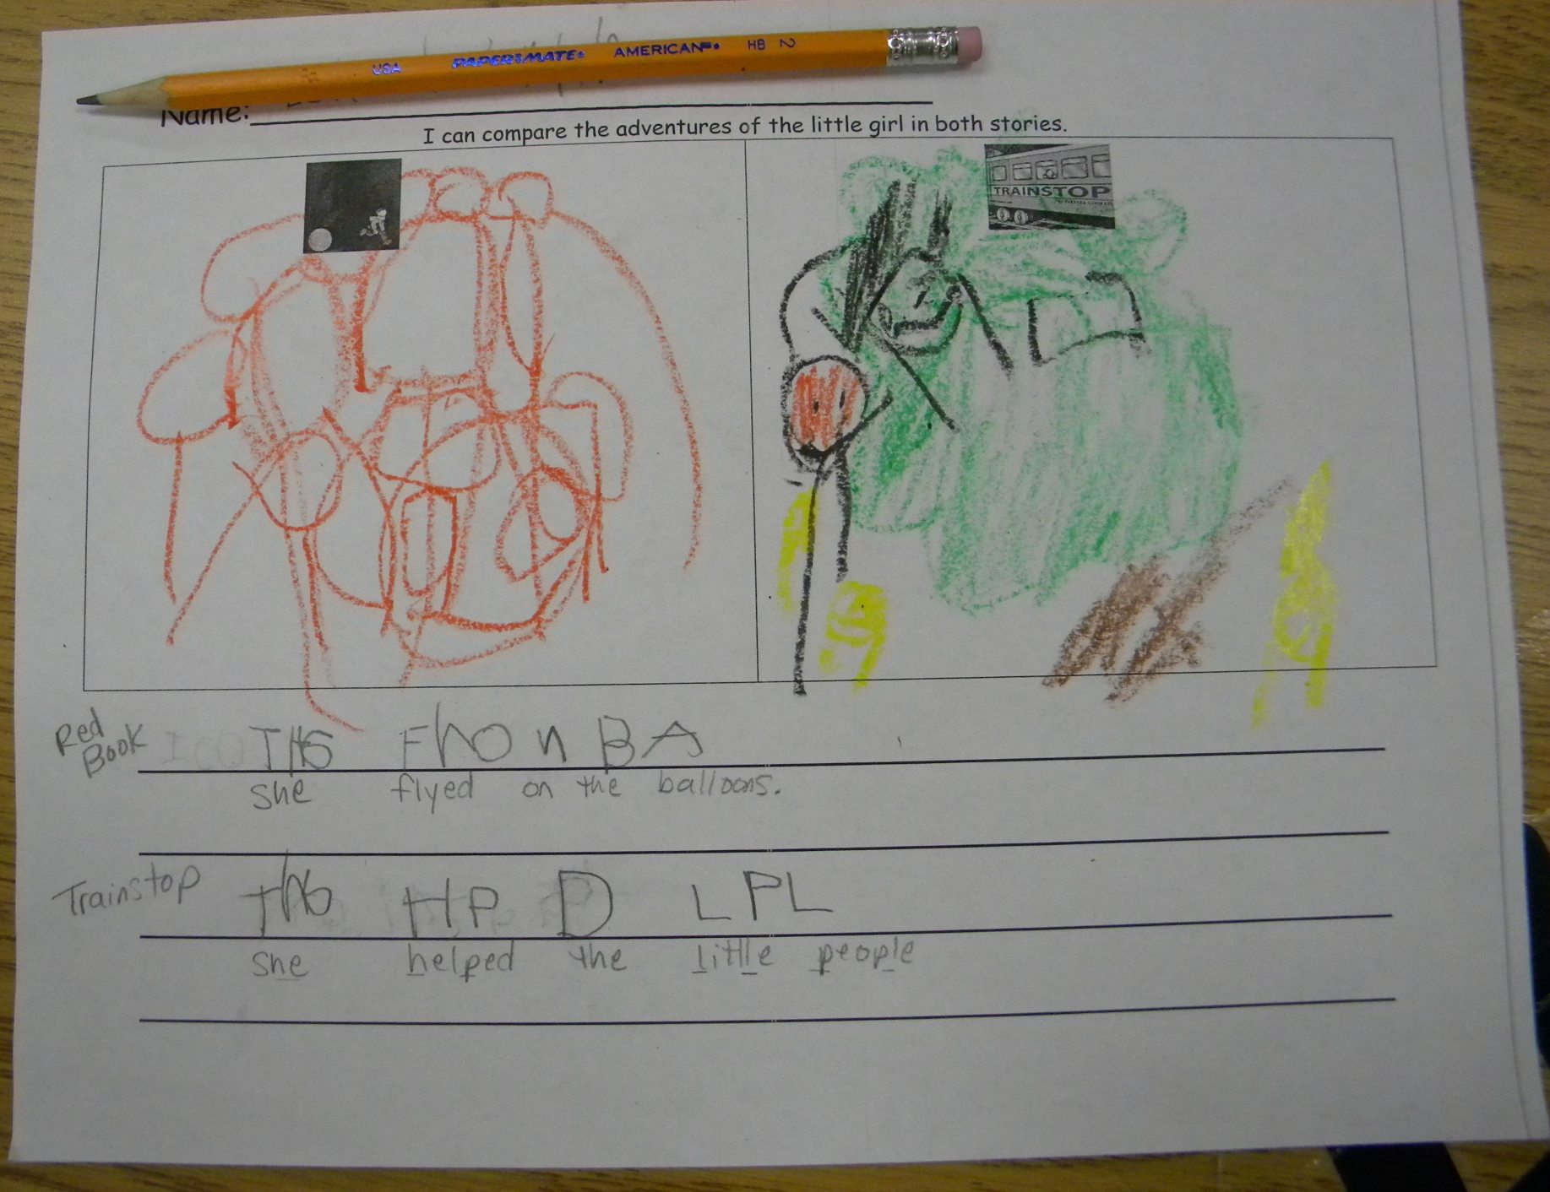

Slide 22
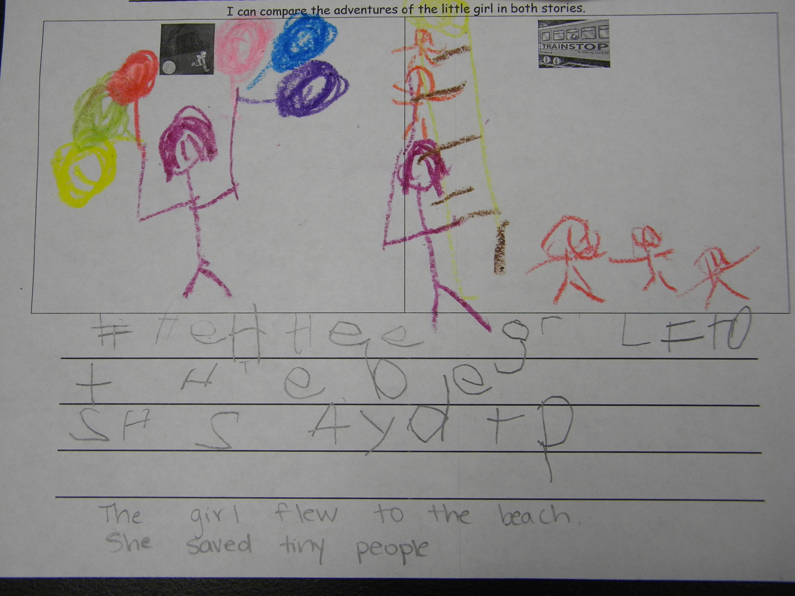

Slide 23
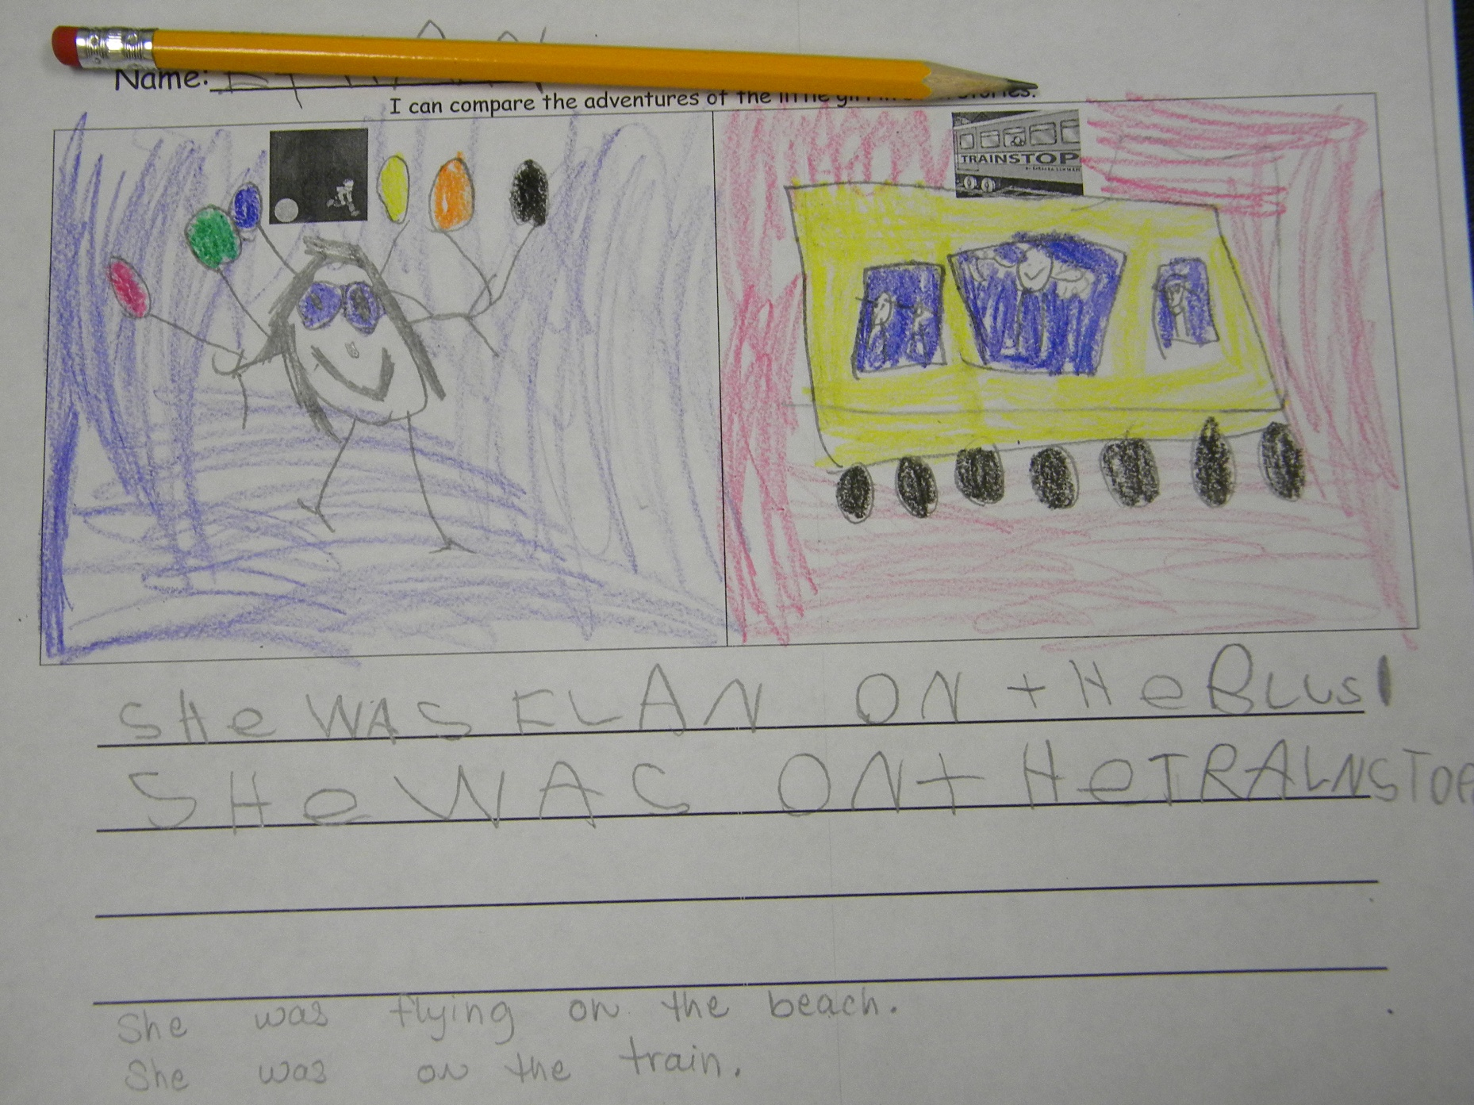

Slide 24
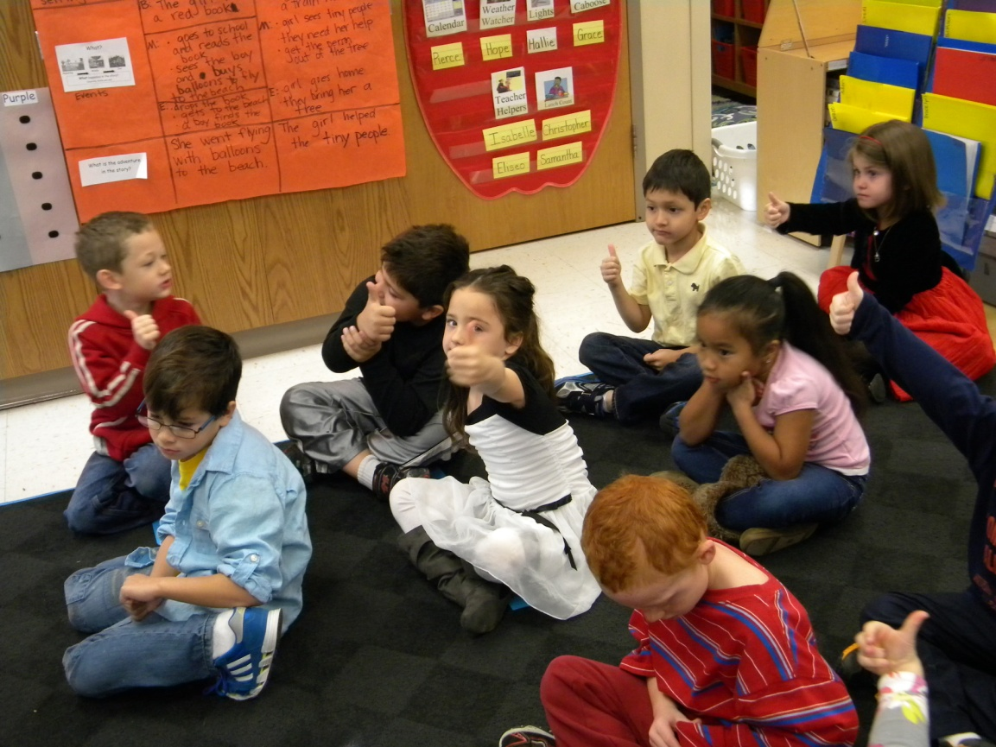
Revisit the Goal
I can compare the adventures of characters in familiar stories.
The students scored their understanding after the lesson.

Slide 25
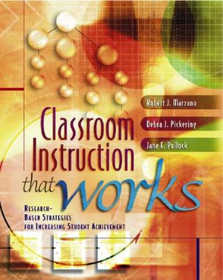
Marzano, R. J., Pickering, D. J., & Pollock, J. E. (2001). Classroom instruction that works: Research-based strategies for increasing student achievement. Alexandria, VA: Association for Supervision and Curriculum Development.
Pollock, J. E. (2007). Improving student learning one teacher at a time. Alexandria, VA: Association for Supervision and Curriculum Development.
Pollock, J. E., & Ford, Sharon M. (2009). Improving student learning one principal at a time. Alexandria, VA: Association for Supervision and Curriculum Development.
Pollock, J. E., Ford, Sharon M., & Black, Margaret M. (2012). Minding the Achievement Gap. Alexandria, VA: Association for Supervision and Curriculum Development.

