Slide 1
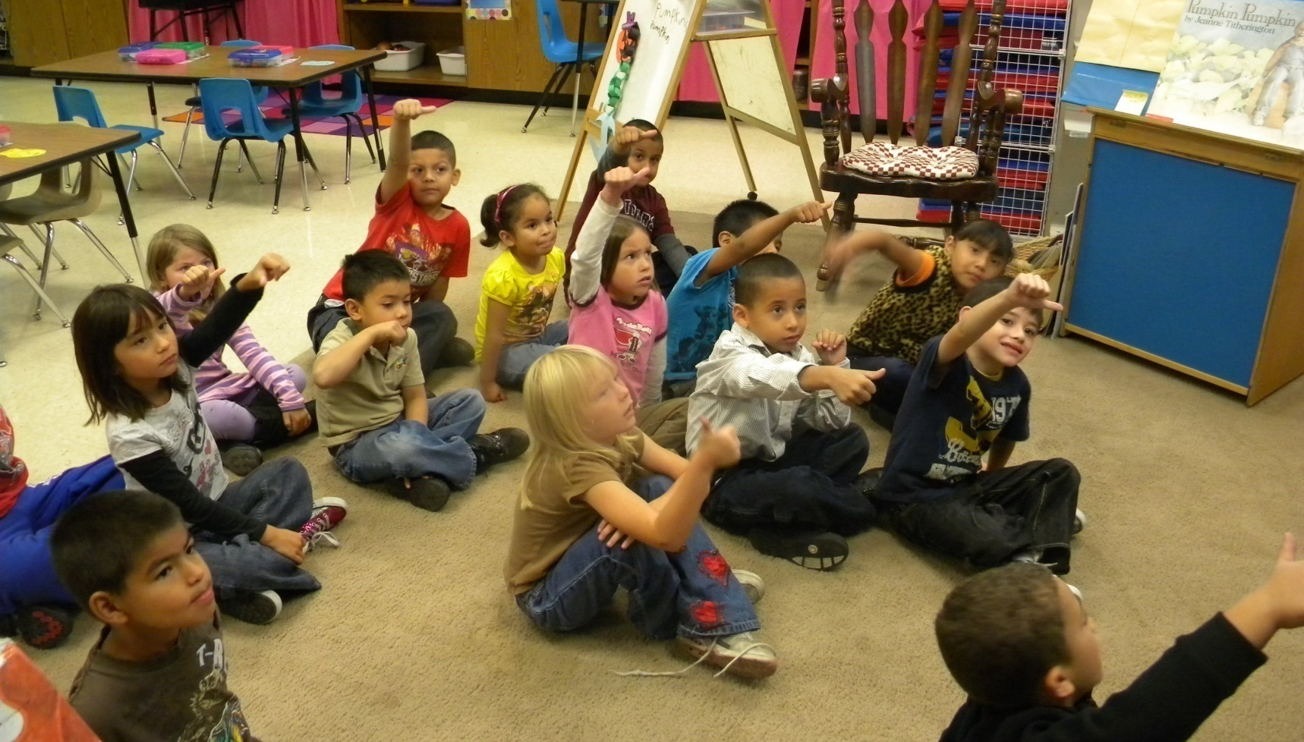
Kindergarteners Scoring to the Objective
3
4
1
2

Slide 2
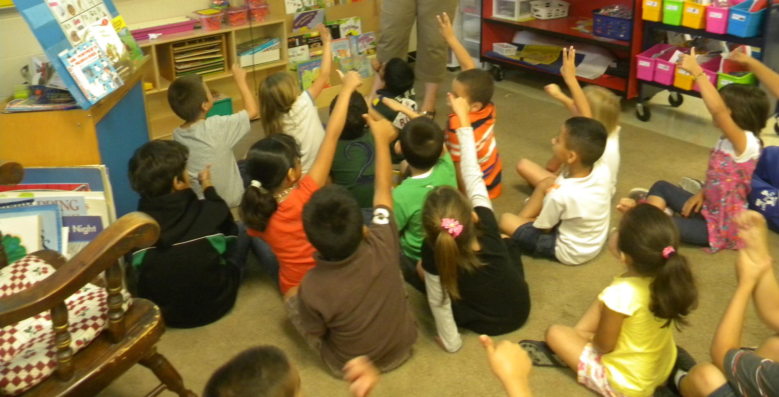
Kindergarteners Scoring to the Objective
Students scored their performance towards the goal
by showing a number (1-4) with their fingers.

Slide 3
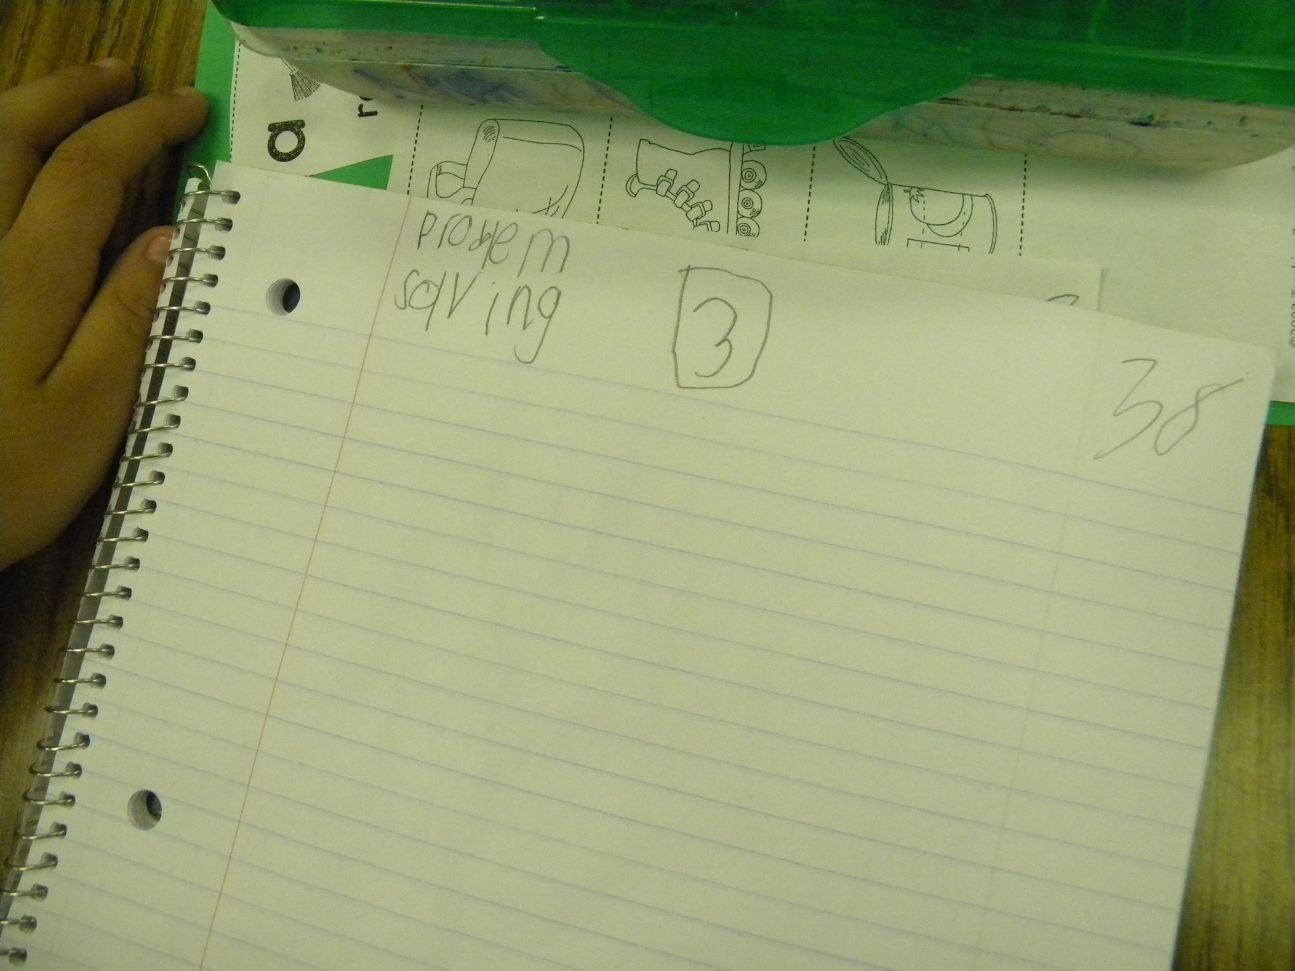
Scoring in a Kindergarten Notebook

