Slide 1
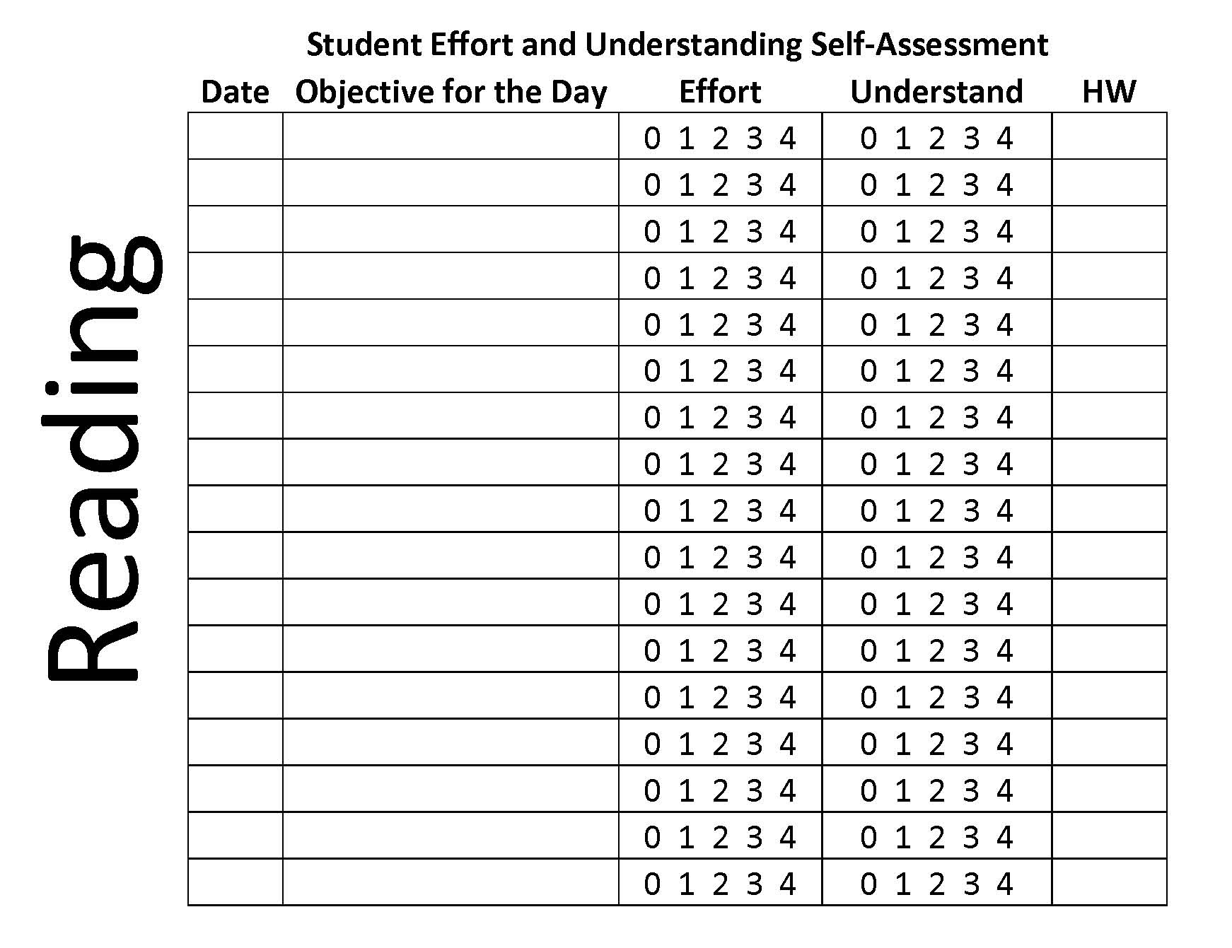
Notes:
Jenny Humble – elementary ed…used the same sheet across all curriculums
Differences?
Audience this would work best for?
Students may use different colors on this throughout the class period….ideas on that?
“instead of calling out students on not participating in pair sharing, I would call out that their effort was lacking because this tied back to a score later in the class”

