Slide 1
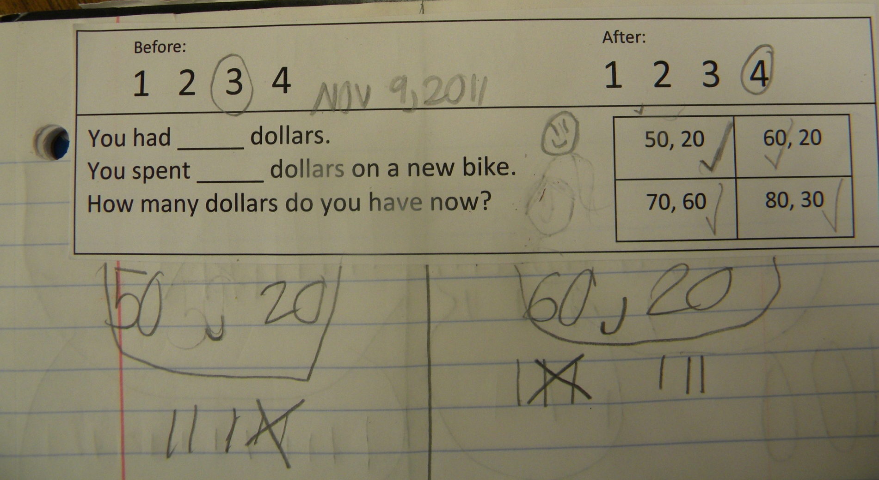
1st Grade CGI Math Notebook Example

