Slide 1
Scoring to the Standards
Ms. Jones’ 2nd Grade
February 2013

Slide 2
If you were reluctant to start scoring…WHY?

Slide 3
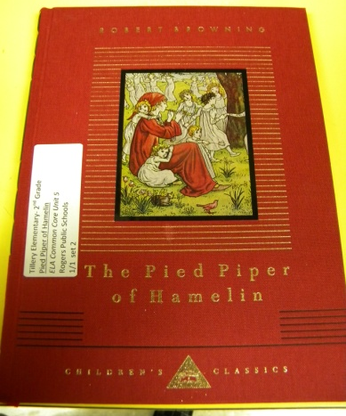
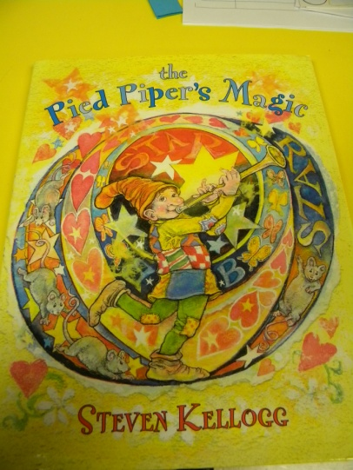
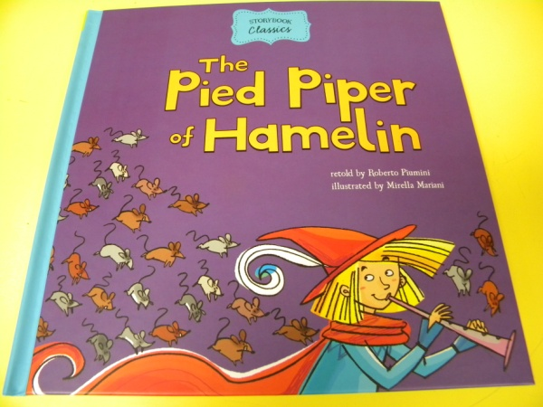
Ms. Jones planned lessons to engage students in performance of RL.2.2 and RL.2.9 using three different versions of The Pied Piper of Hamelin.

Slide 4
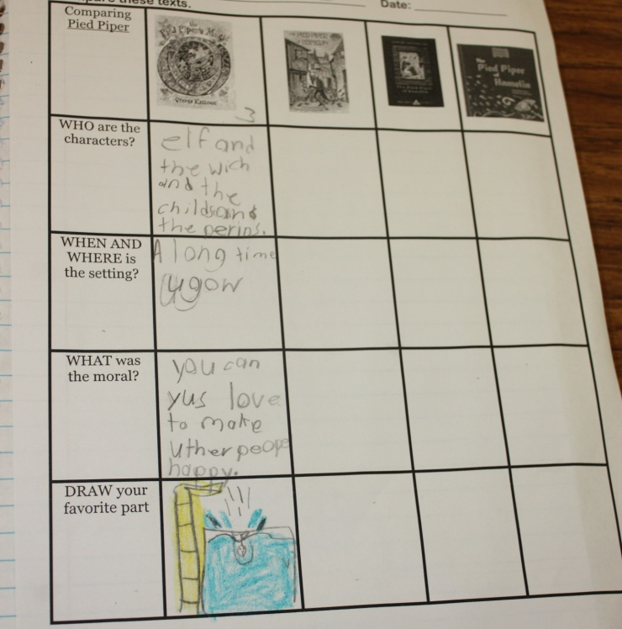
Day 1- RL.2.2
G | I can determine the moral of a story.
A | Review matrix from previous week- find the moral
N | Read- The Pied Piper’s Magic Take notes – characters, setting What is a moral?
A | Determine the moral
G | I can determine the moral of a story

Slide 5
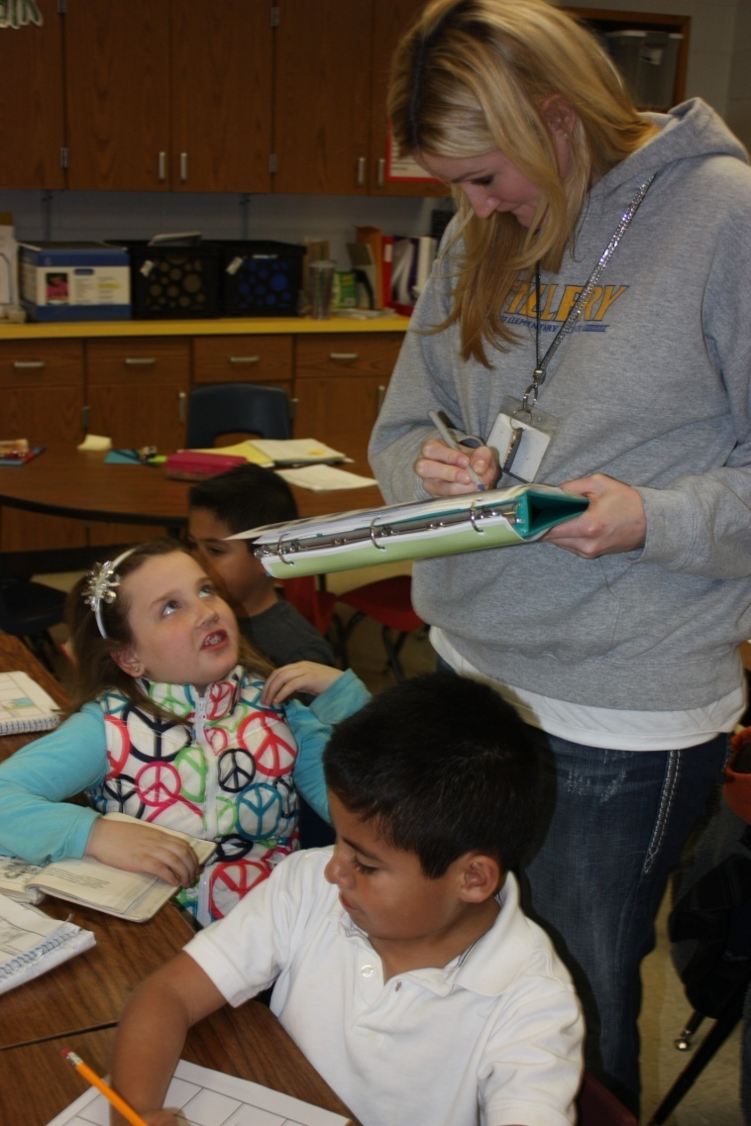
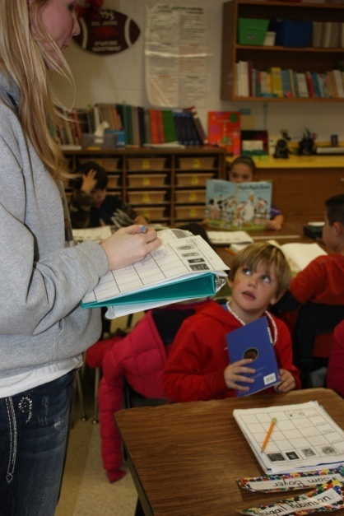
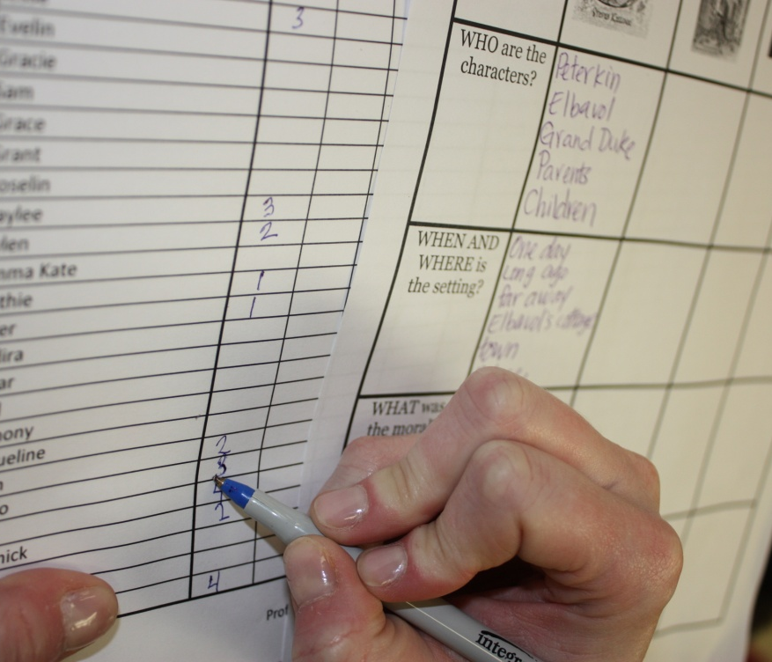
Scoring- Day 1

Slide 6
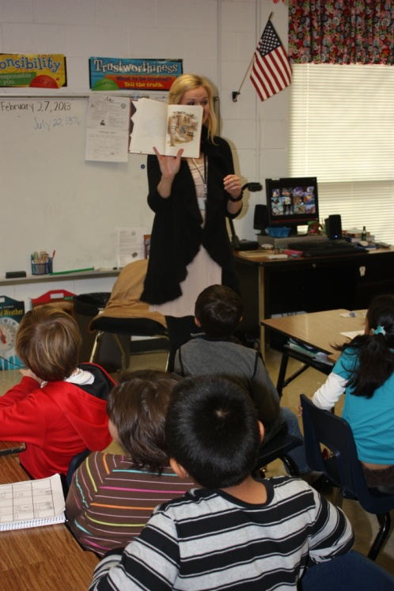
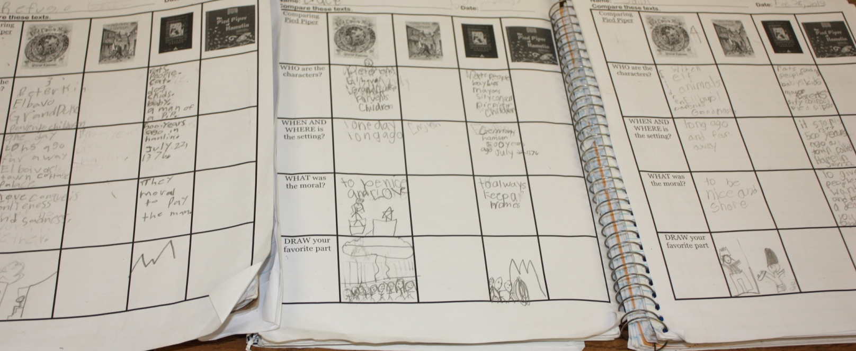
Day 2- RL.2.2
G | I can take notes to help me recount the story.
A | Review matrix from day before
N | Listen to The Pied Piper of Hamelin
A | Take notes- character, setting Determine the moral
G | I can take notes to help me recount the story

Slide 7
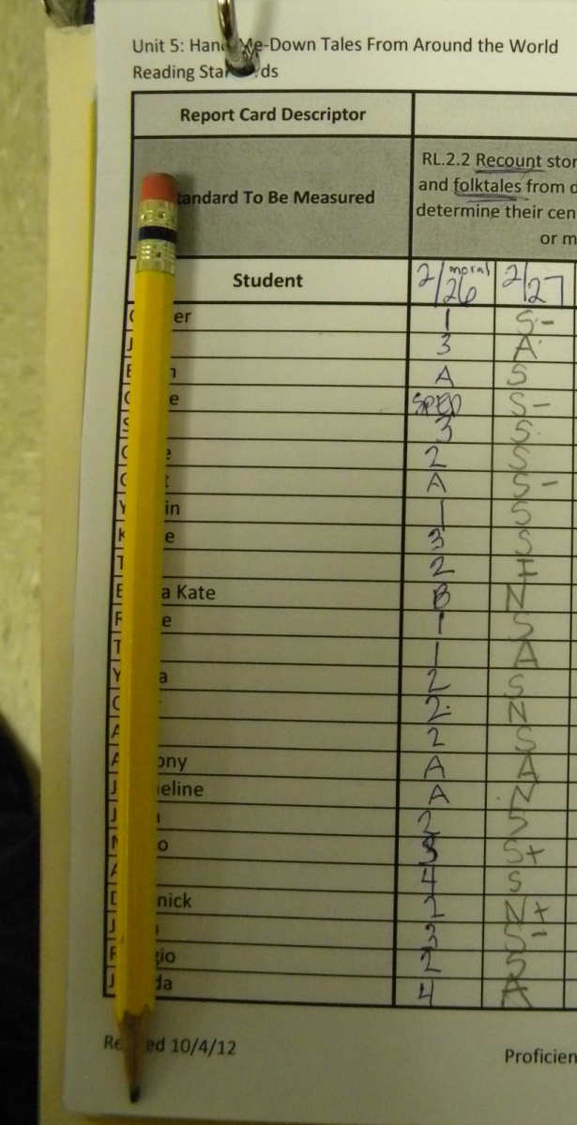
Scoring- Day 2
Ms. Jones focused on the students ability to take notes to recount the story.
She used S and N for recording the student’s performance.

Slide 8
What is most challenging about scoring to the standards?

Slide 9
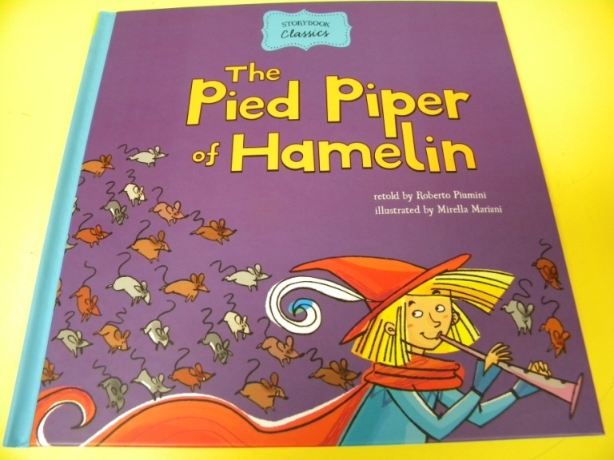
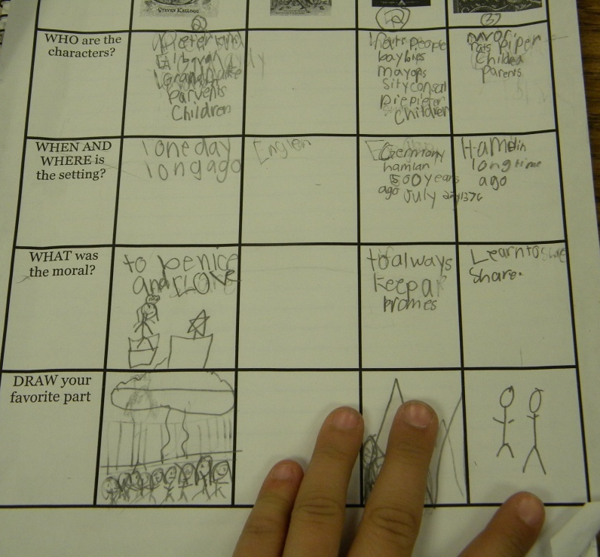
Day 3- RL.2.2
A | How were the first two stories we read the same? Different?
G | I can determine the moral of a story.
N | Read- The Pied Piper of Hamelin Take notes – characters, setting
A | Determine the moral
G | I can determine the moral of a story

Slide 10
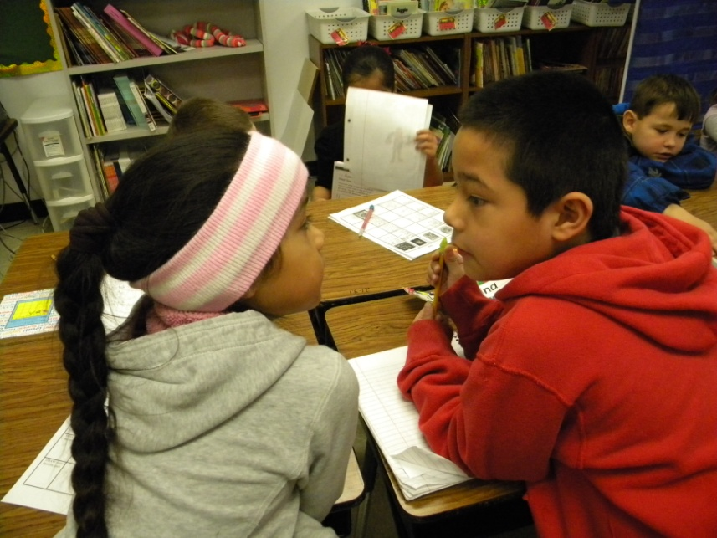
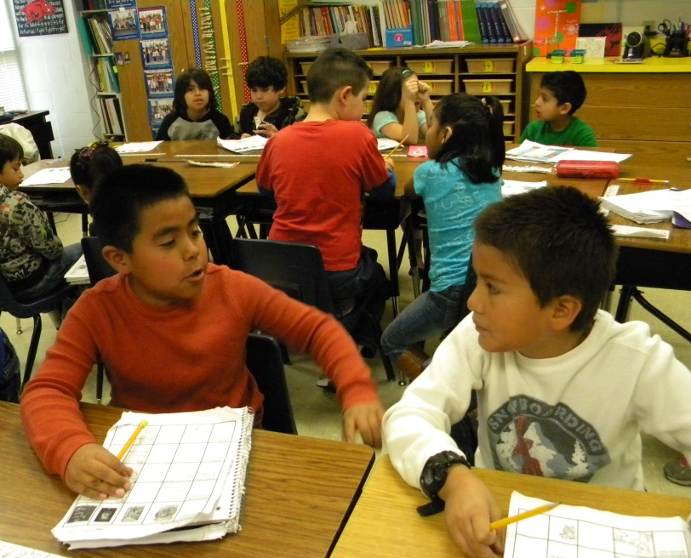
APK- How are the first two stories we read the same? How are they different?
Students turned and talked with a partner.

Slide 11
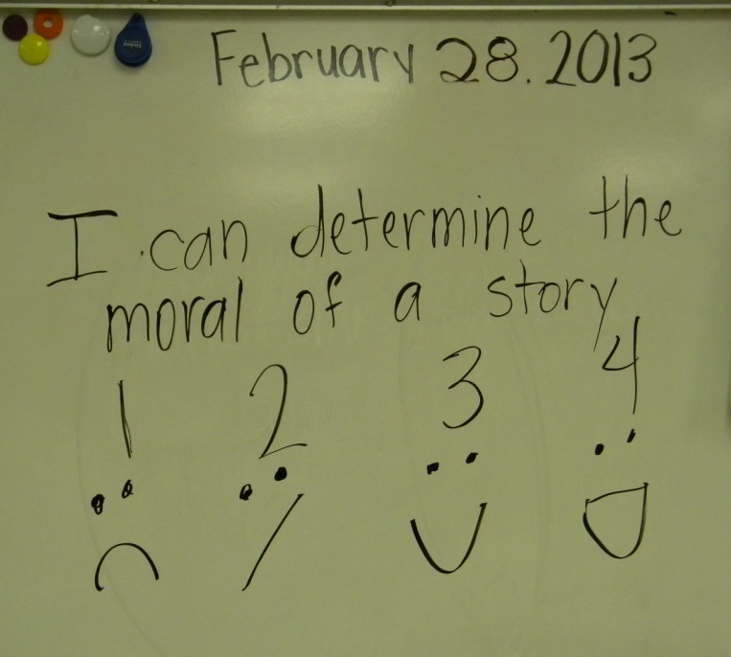
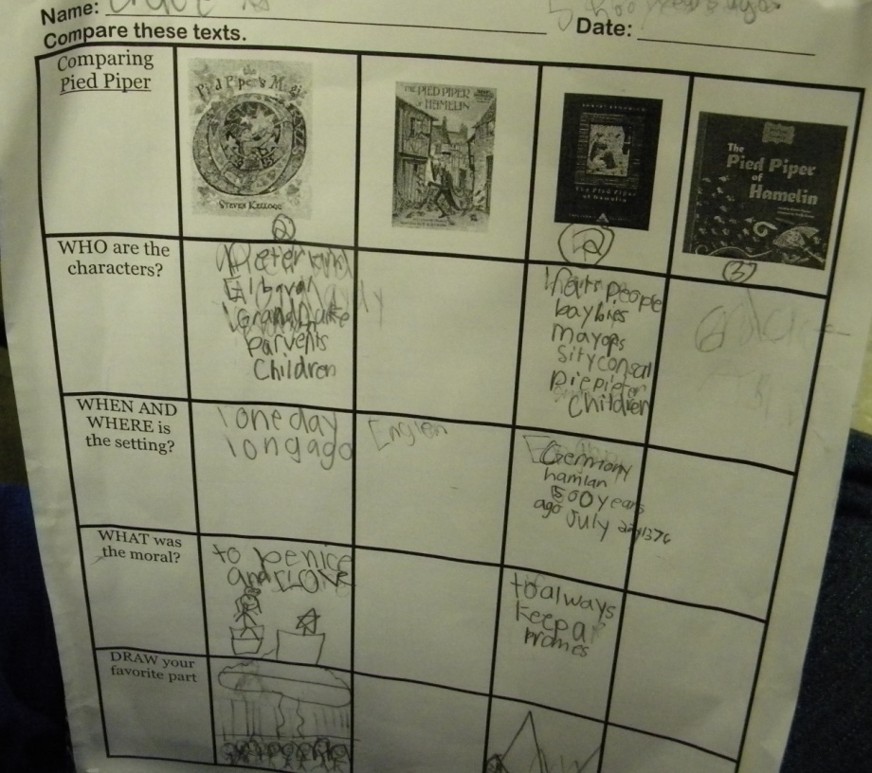
GOAL
Students scored their understanding of the goal.

Slide 12
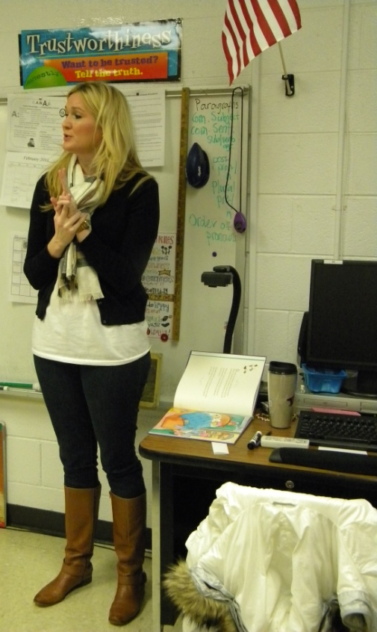
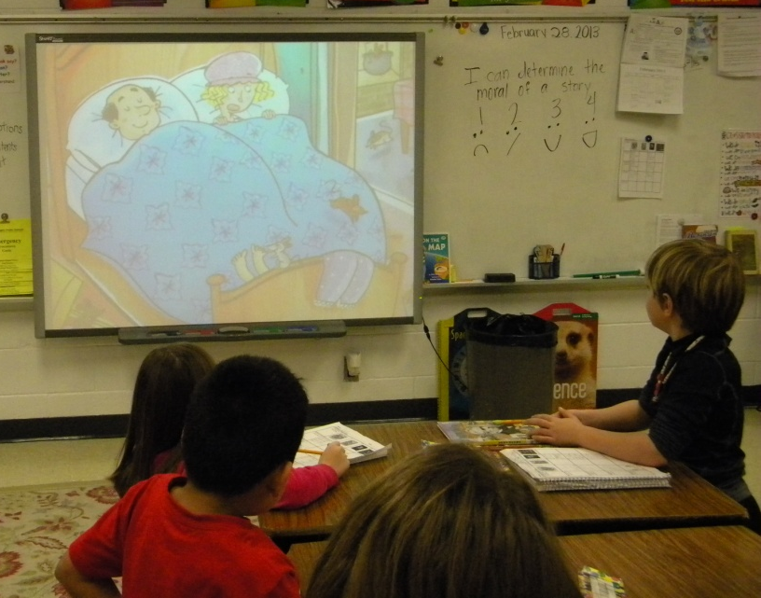
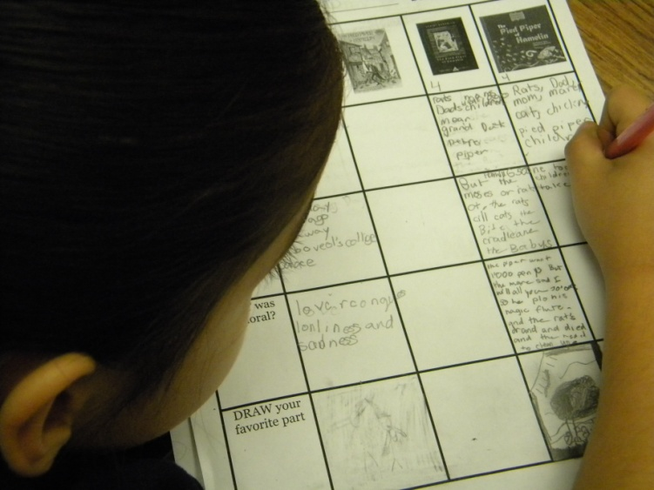
NEW INFORMATION
Ms. Jones read the story to the class, using the document camera to share the text.
The students took notes.

Slide 13
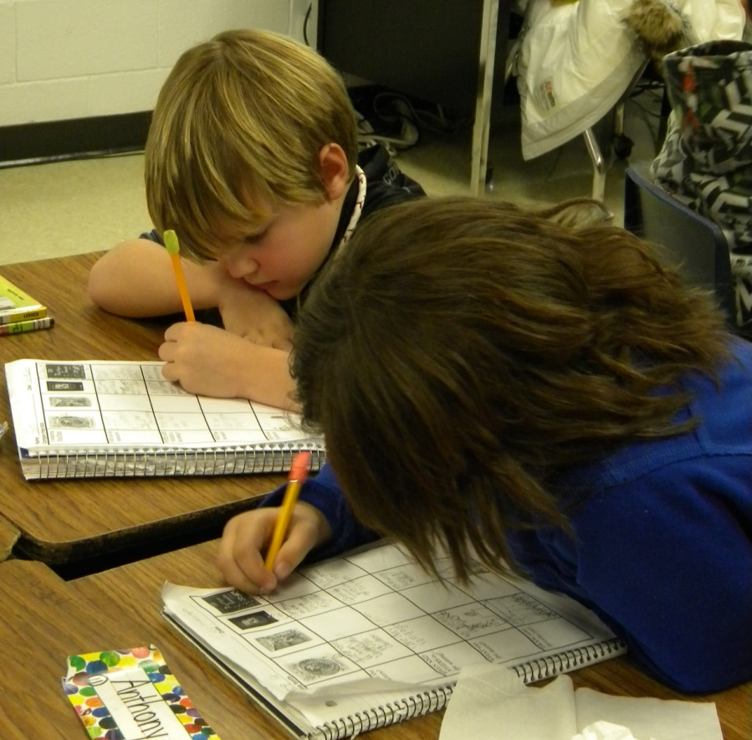
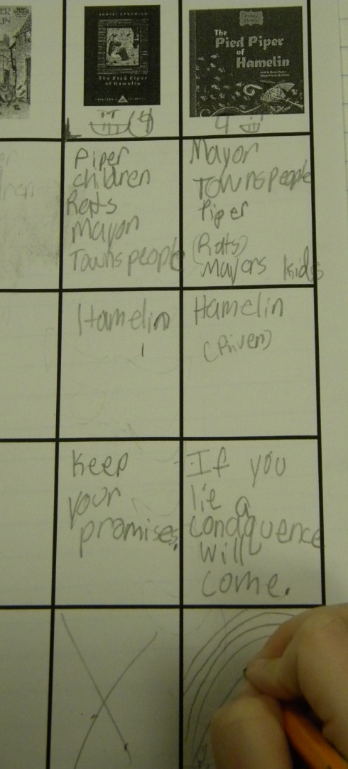
APPLICATION
Students determined the moral and drew a picture of their favorite part of the story.

Slide 14
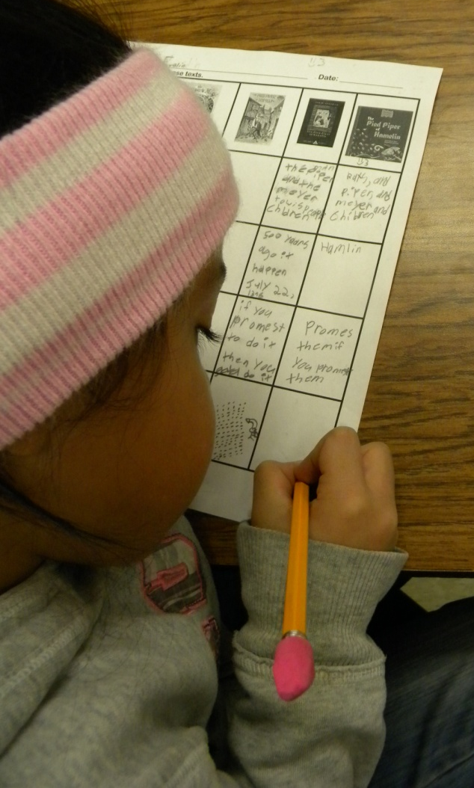
Scoring – Day 3
Ms. Jones reviewed her scoring from the previous days while giving the students time to work.

Slide 15
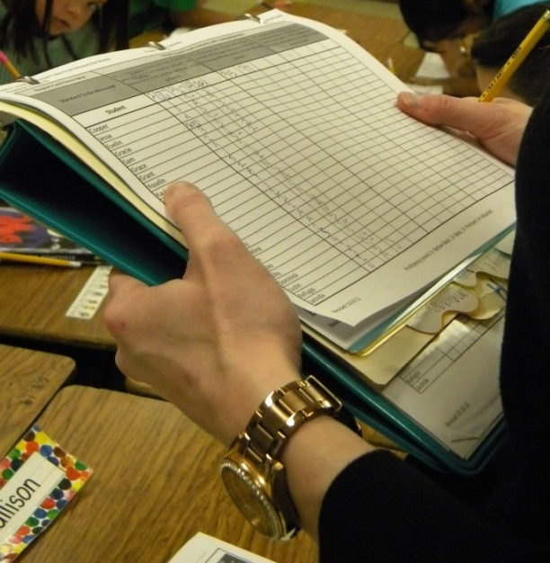

Slide 16
While scoring, Ms. Jones noticed that some students had some confusion about determining the moral.
You need to share instead of not sharing.
When someone does something you should say thank you.
The students left for their activity time.
When they returned, Ms. Jones provided feedback to help clear up any confusions. She let them revise their answers if they changed their mind, but did not change their scores.
The students revisited the goal at the end of the lesson.

Slide 17
How has scoring to the standards impacted your planning, instruction, and feedback?

