Slide 1
Scoring to the Standards
Garfield Elementary
March 2013

Slide 2
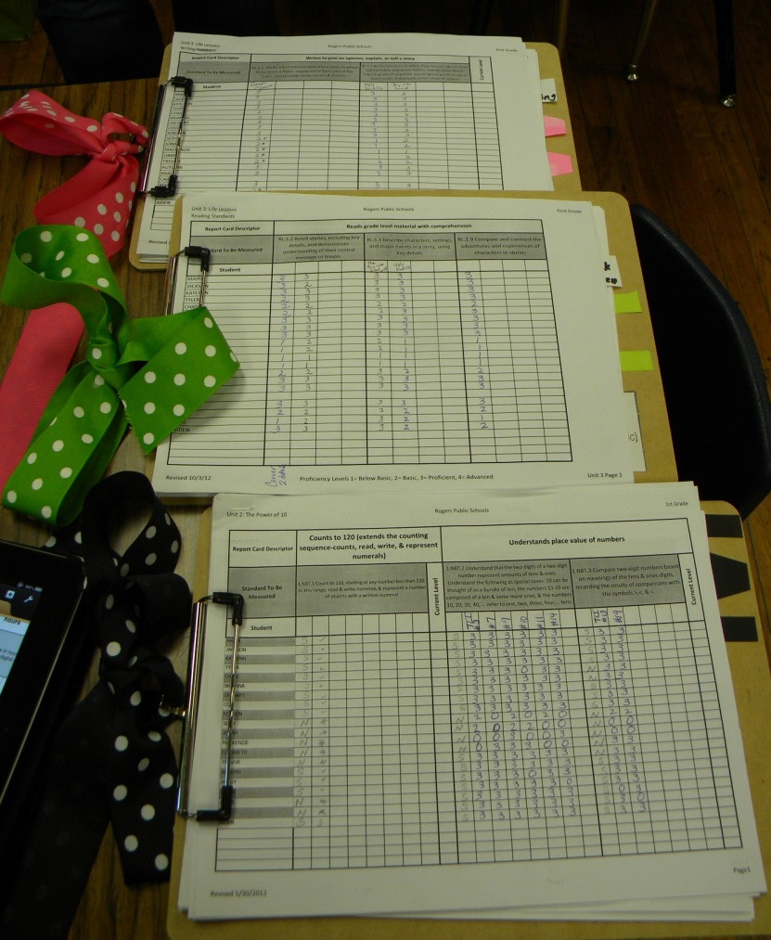
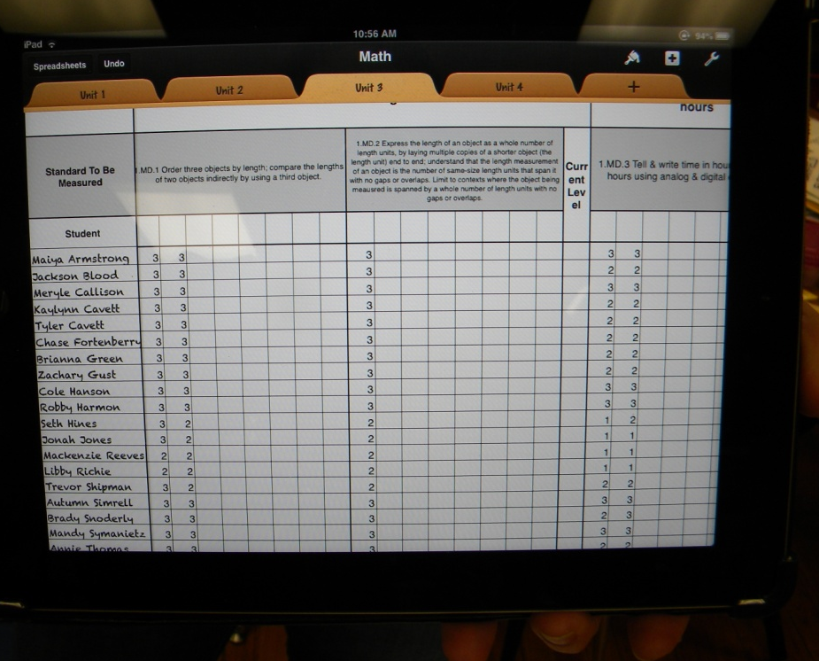
1st Grade
Multiple Clipboards
iPad

Slide 3
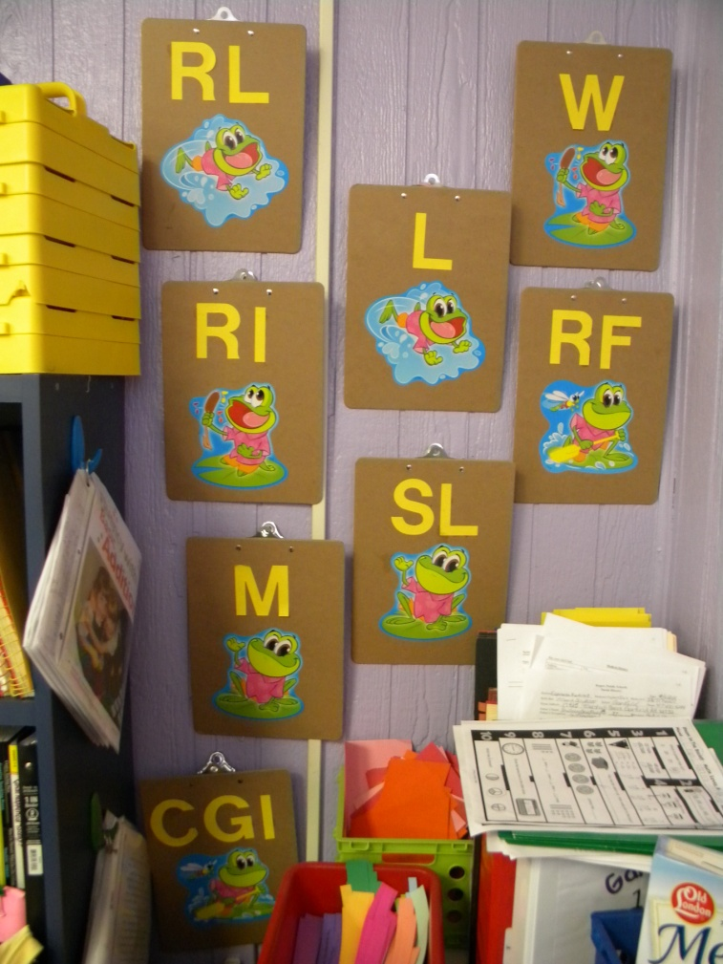
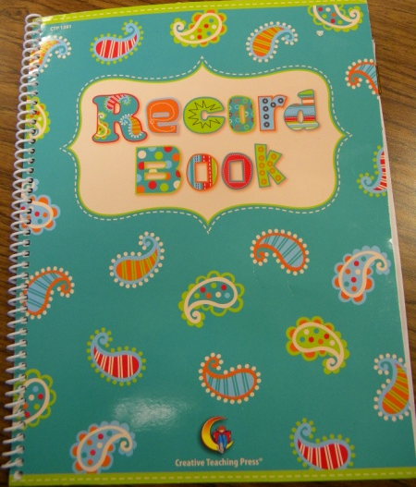
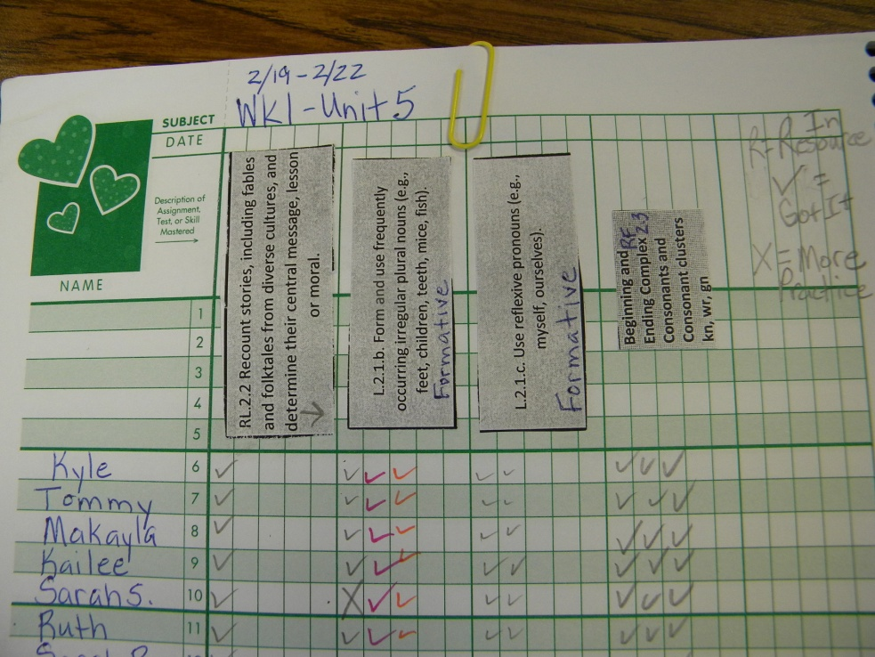
Weekly Grade Book
Multiple Clipboards

Slide 4
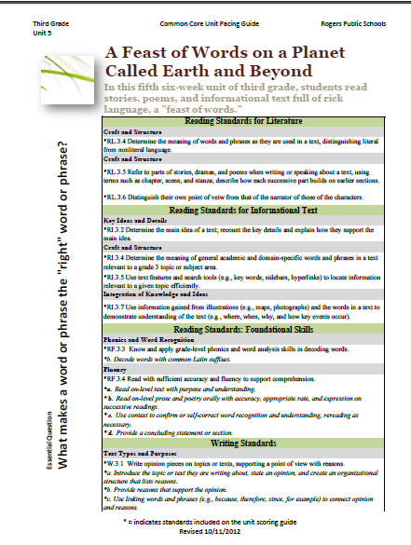
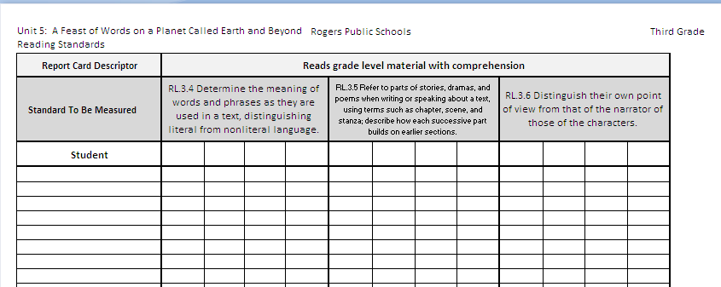
Small Group
Mr. Schacht’s 3rd Grade
RL.3.5 Refer to parts of stories, drama, and poems when writing or speaking about a text, using terms such as chapter, scene, and stanza; describe how each successive part builds on earlier sections

Slide 5
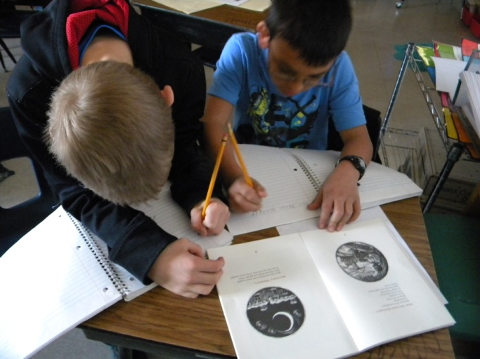
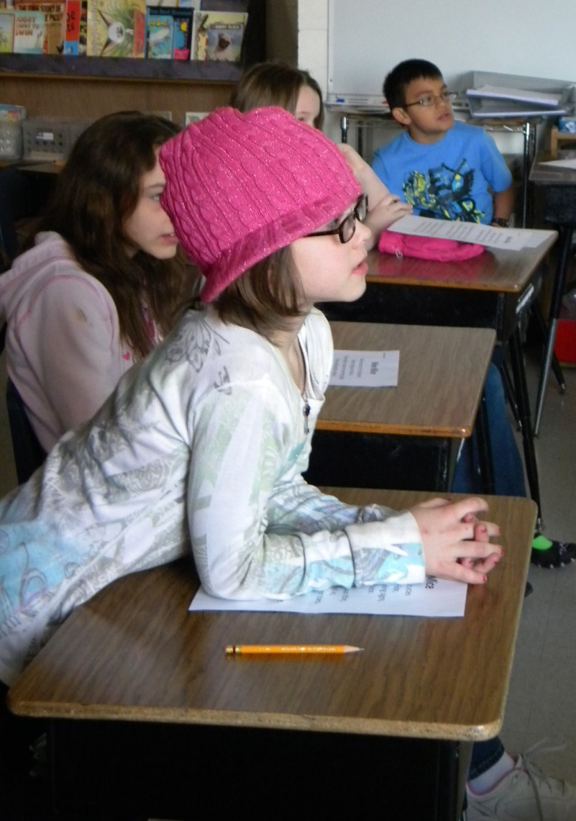
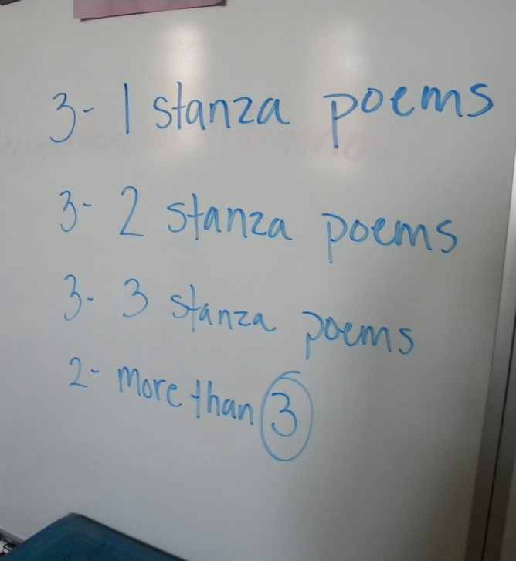
Goal: I can identify stanzas in a poem

Slide 6
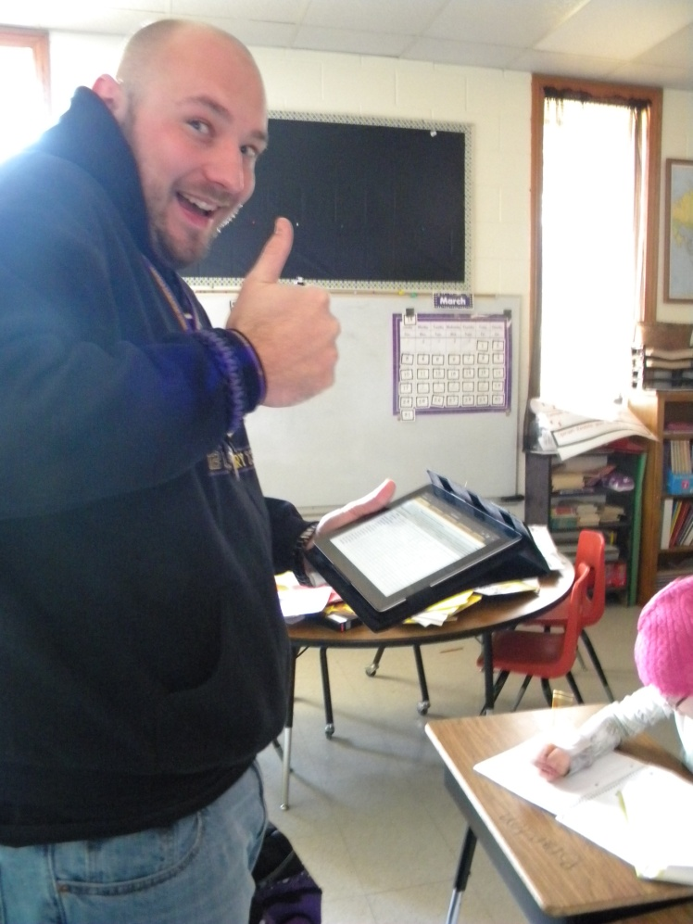
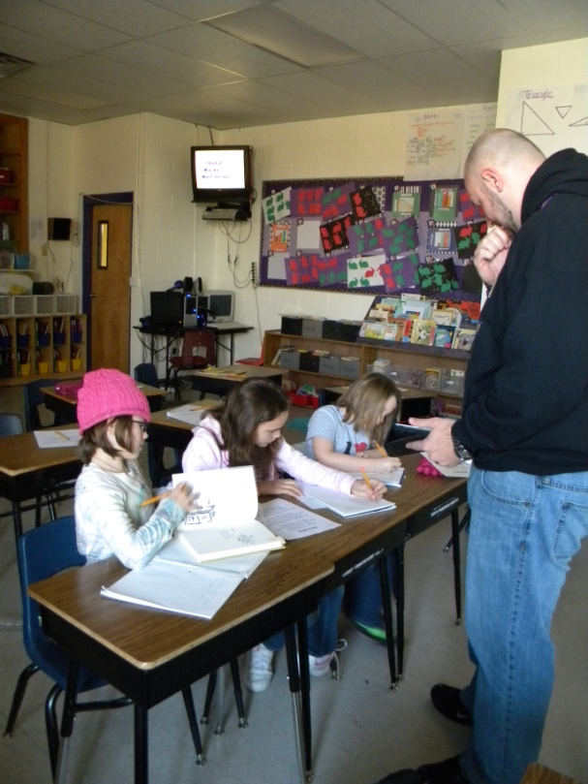
Mr. Schacht explains how he uses his iPad for scoring.

Slide 7
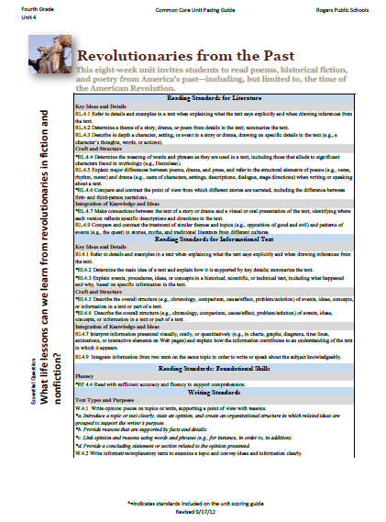
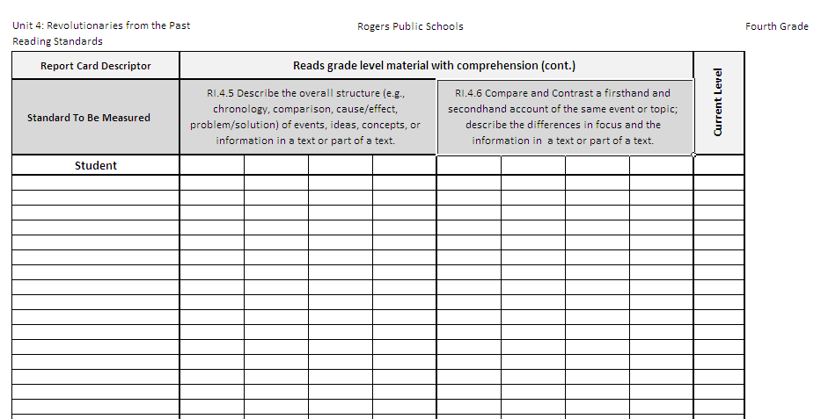
Small Group
Mrs. Minardi’s 4th Grade
RI.4.5 Describe the overall structure (e.g, chronology, comparison, cause/effect, problem solution) of events, ideas, concepts, or information in a text or part of a text.

Slide 8
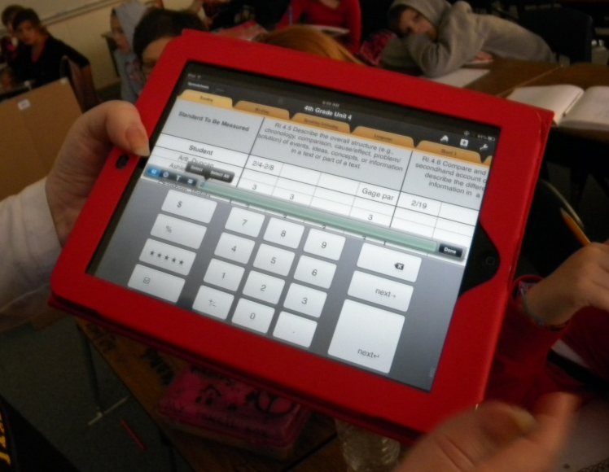
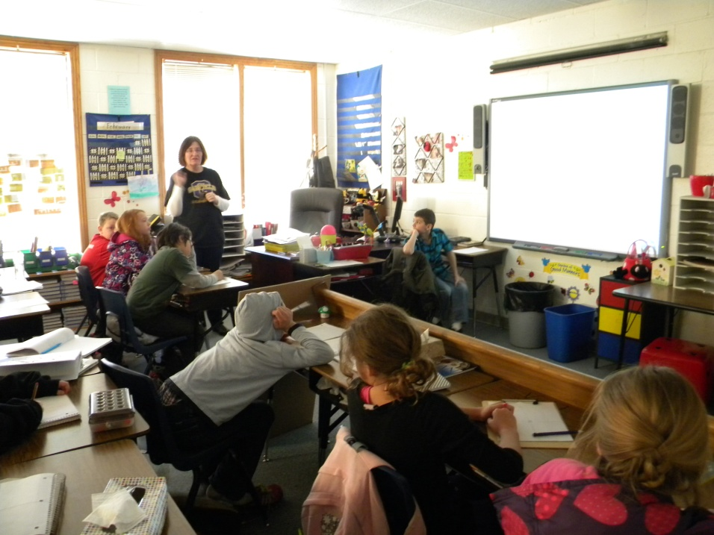
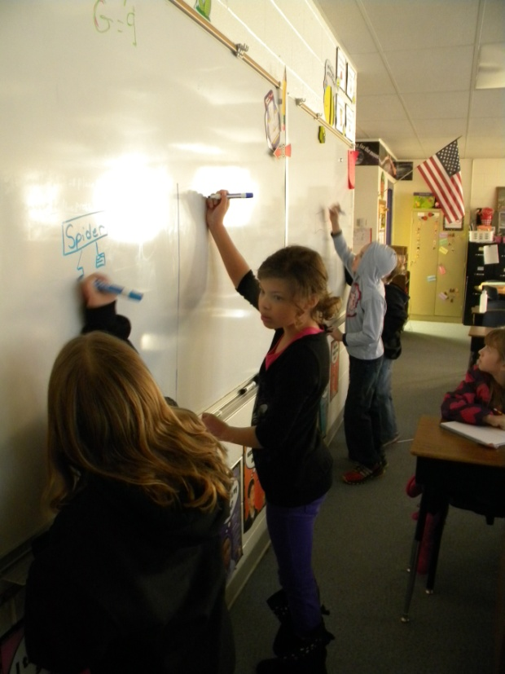
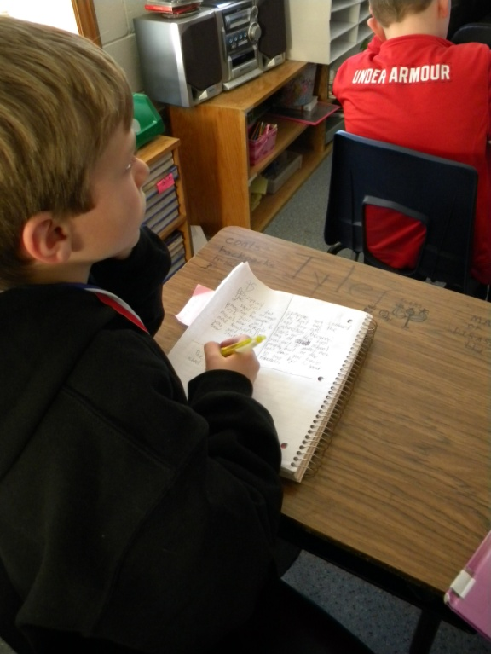
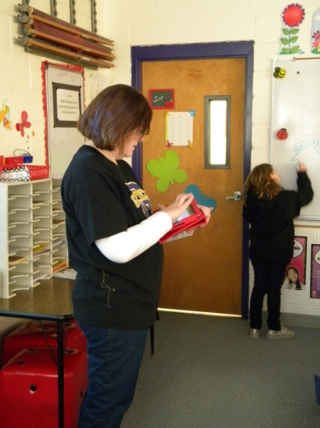

Slide 9
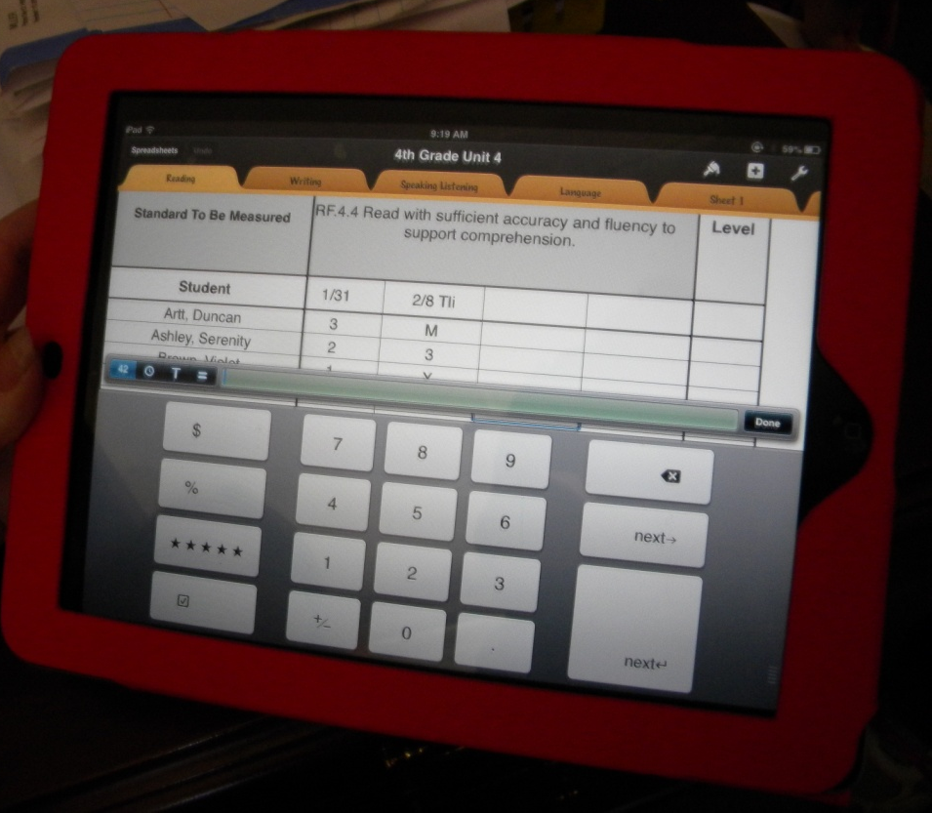
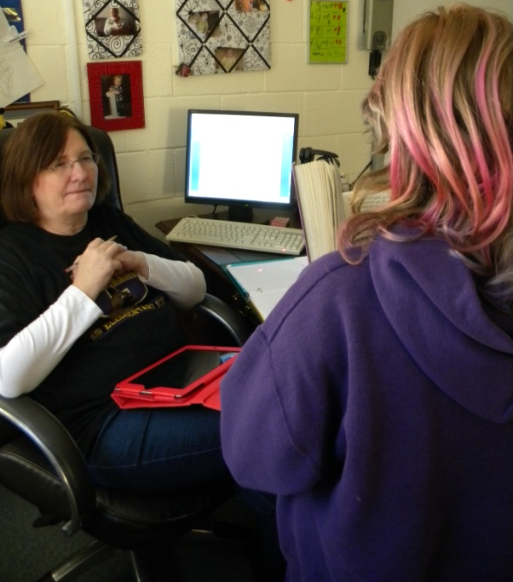
Mrs. Minardi uses technology to help her provide better feedback.
RF.4.4
Read with sufficient accuracy and fluency to support comprehension.

Slide 10
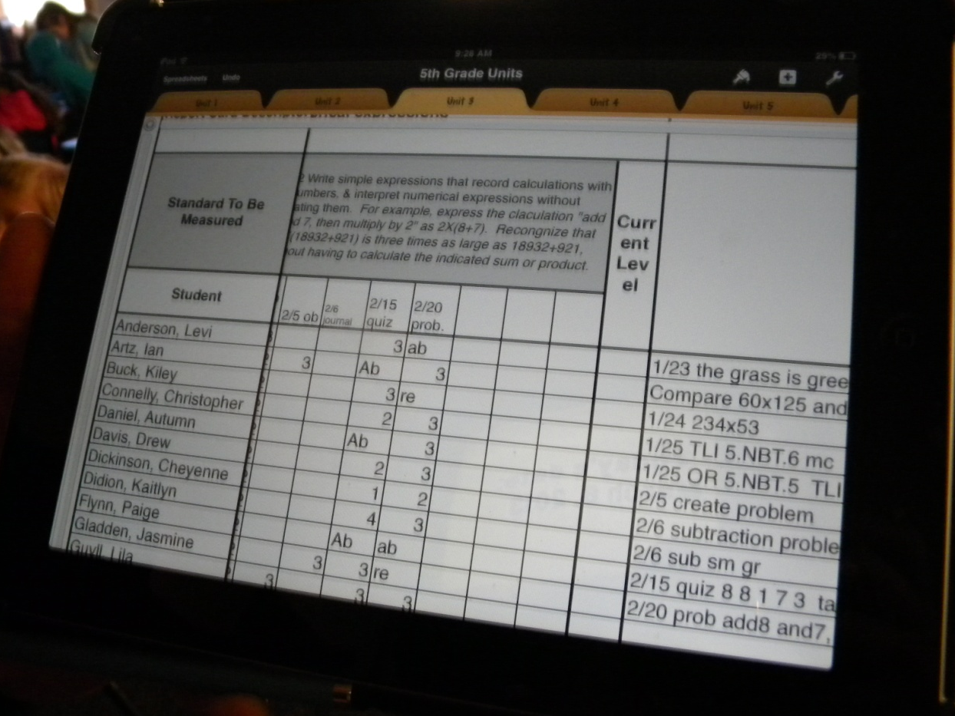
Mr. Dirks added a column to the scoring guide to add information about the task he is scoring.

