Slide 1
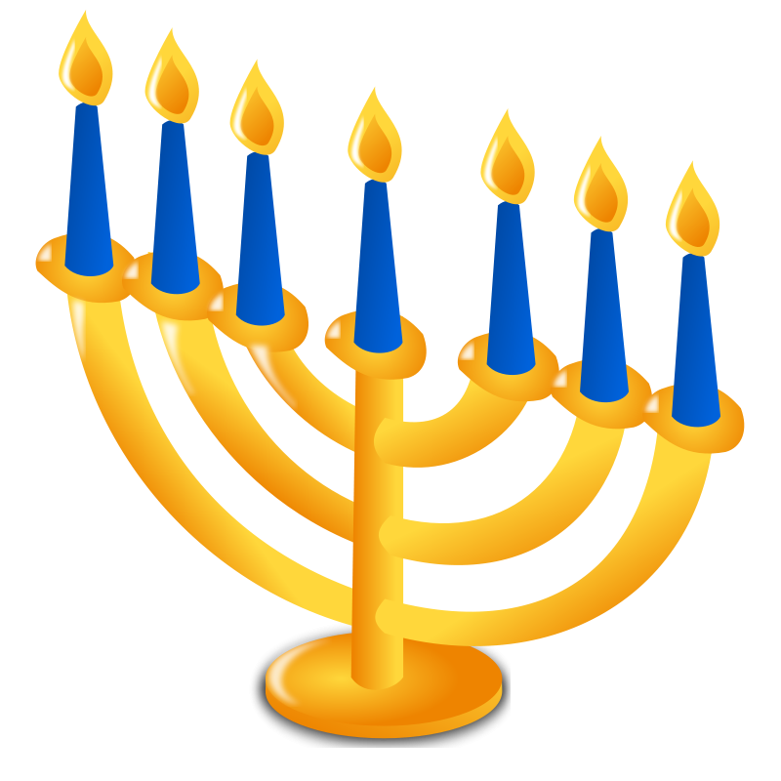
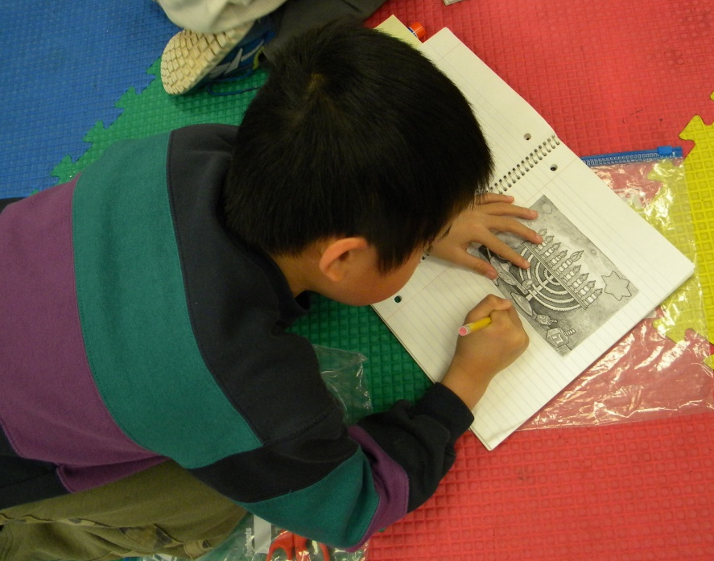
Chanukah
Kindergarten Notebook
Mrs. Williams’ Class
Old Wire Elementary

Slide 2
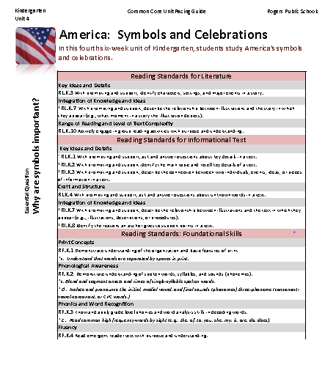
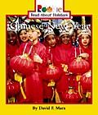
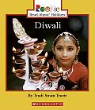
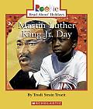
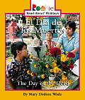
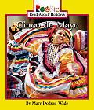
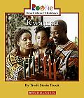
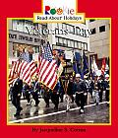
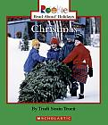
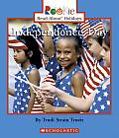
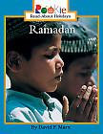
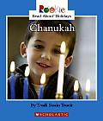
Mrs. Williams began planning her unit by identifying the Common Core State Standards, gathering and studying her resources and thinking about what her students would know and be able to do at the end of the unit.

Slide 3
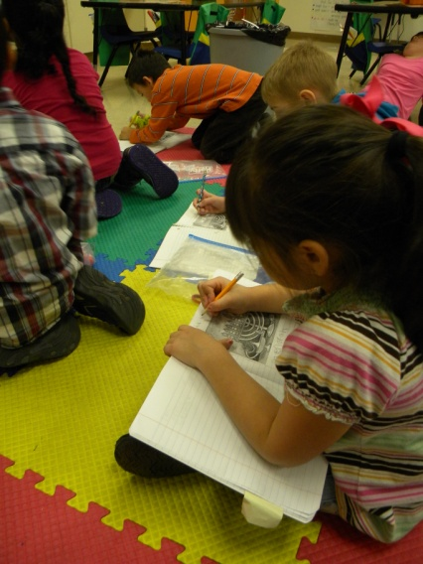
Daily Lesson Planning
Mrs. Williams decided she wanted her students to take notes about the different celebrations in an interactive notebook.
The standard for this lesson is:
RI.K.2 With prompting and support identify the main topic and retell key details of a text.

Slide 4
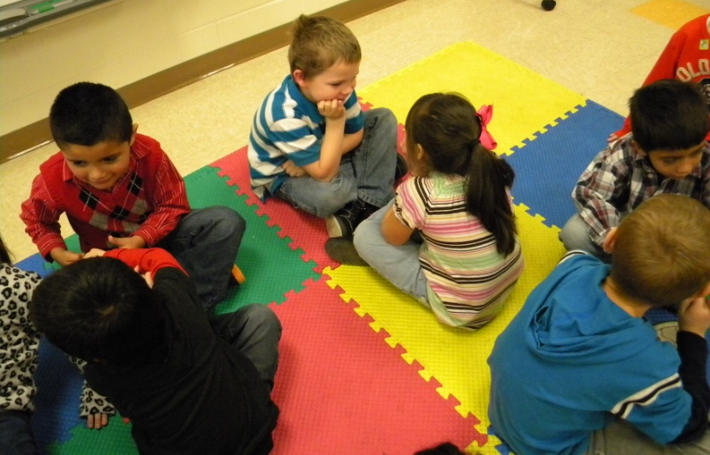
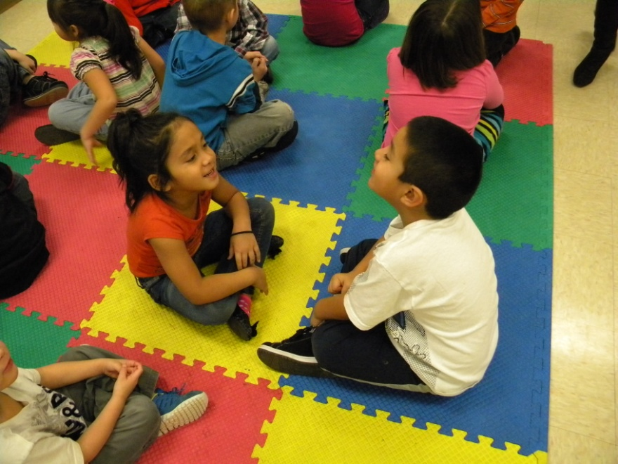
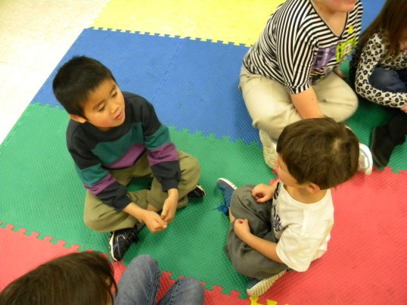
ACCESS PRIOR KNOWLEDGE
Mrs. Williams asked the students to tell their partner something they remembered about the celebration they learned about yesterday-Christmas.

Slide 5
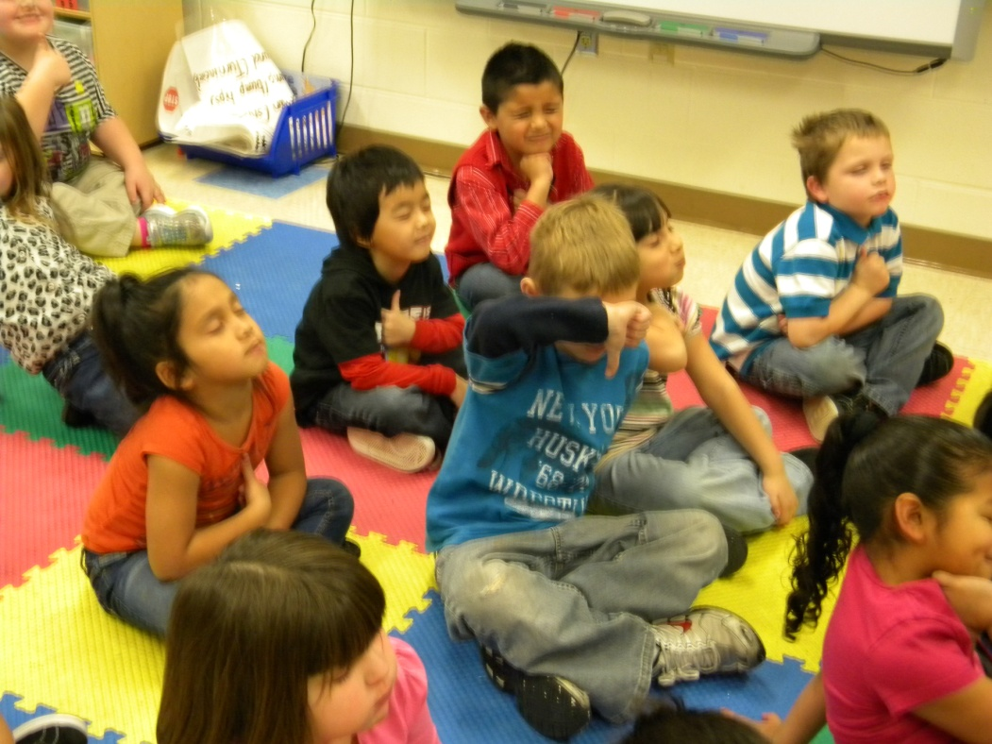
GOAL: I can tell you about Chanukah.
The students scored their understanding of the goal with their eyes closed using their thumbs.

Slide 6
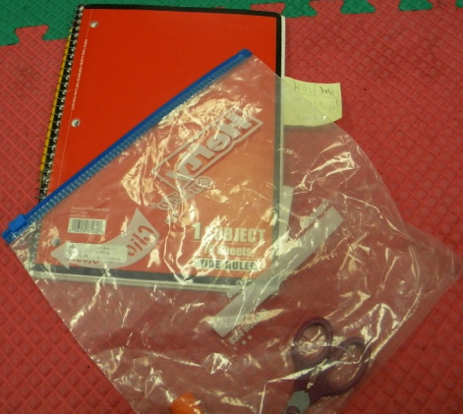
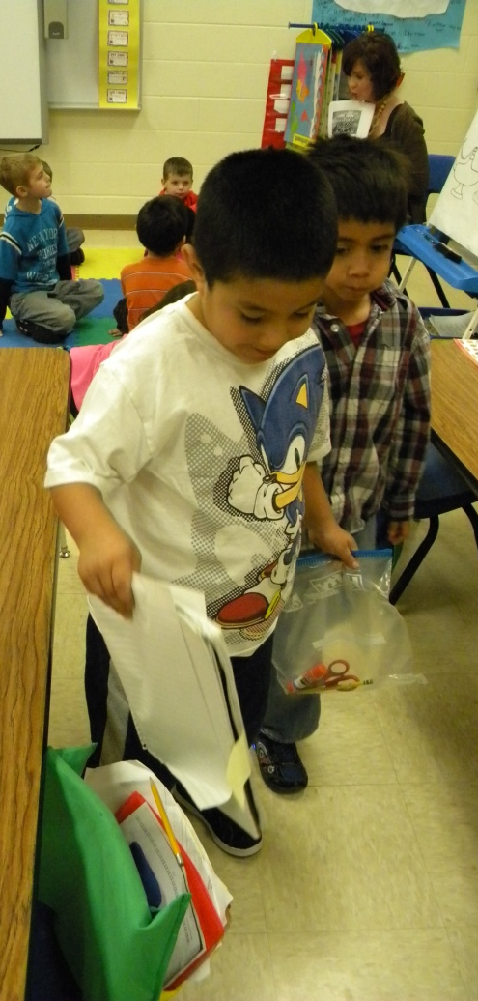
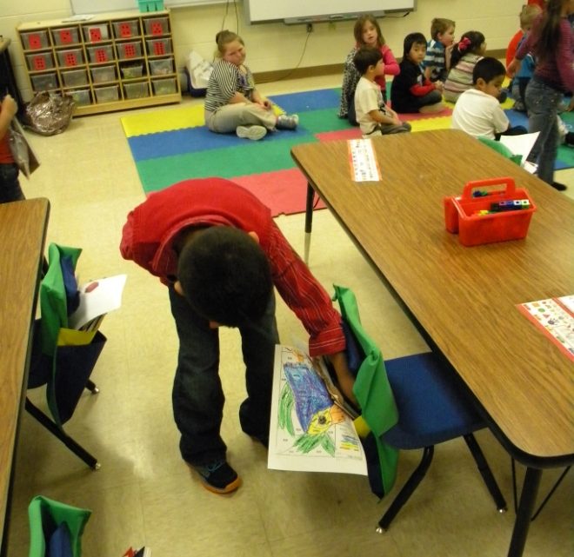
Students gathered their notebooks and supplies.

Slide 7
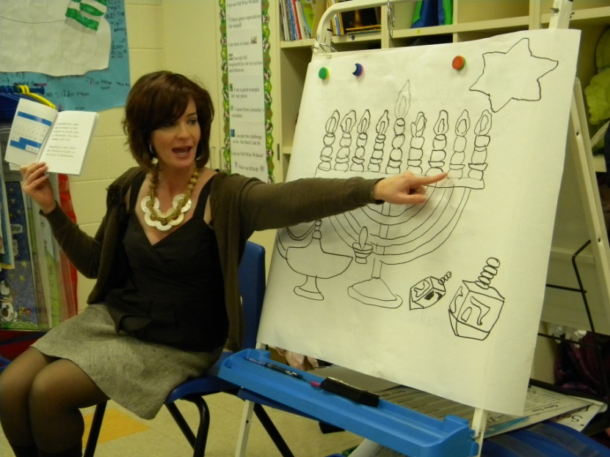
NEW INFORMATION
Mrs. Williams read Chanukah to the students.

Slide 8
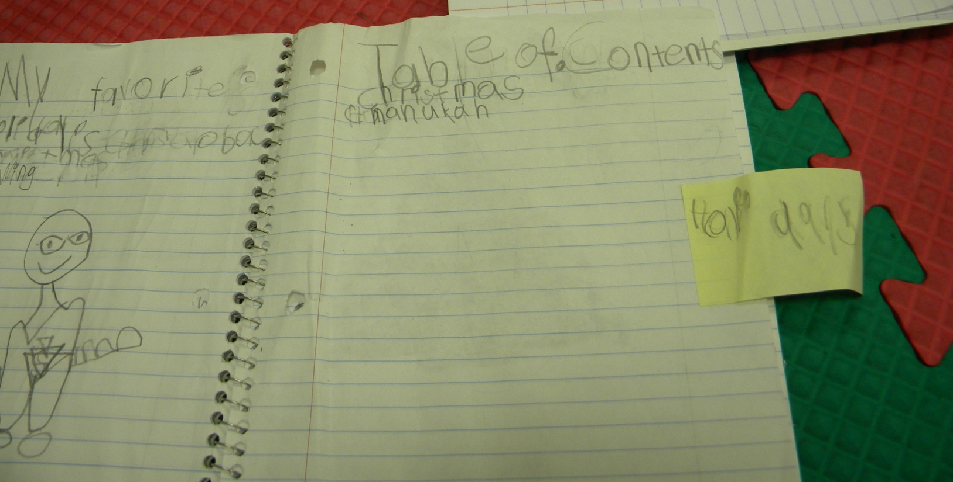
The students added Chanukah to their table of contents.

Slide 9
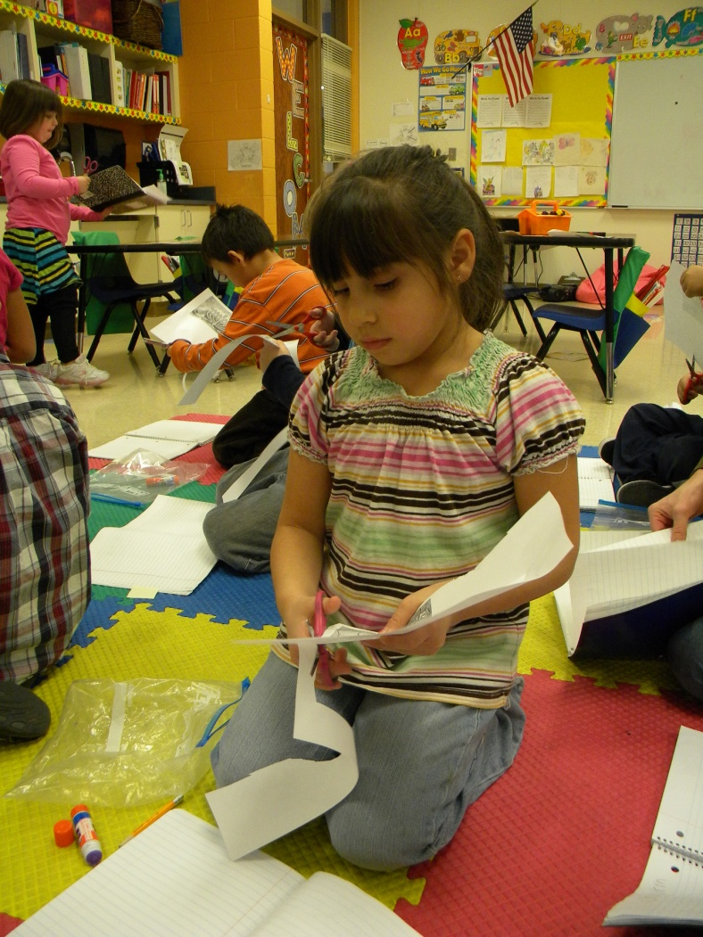
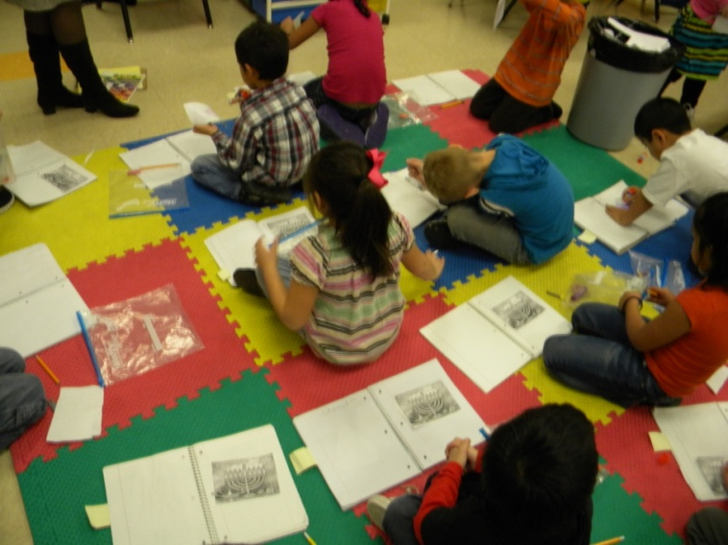
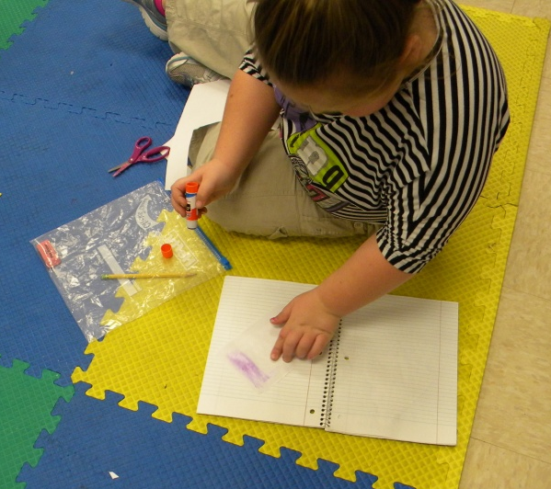
The students glued a Chanukah picture in their notebooks.

Slide 10
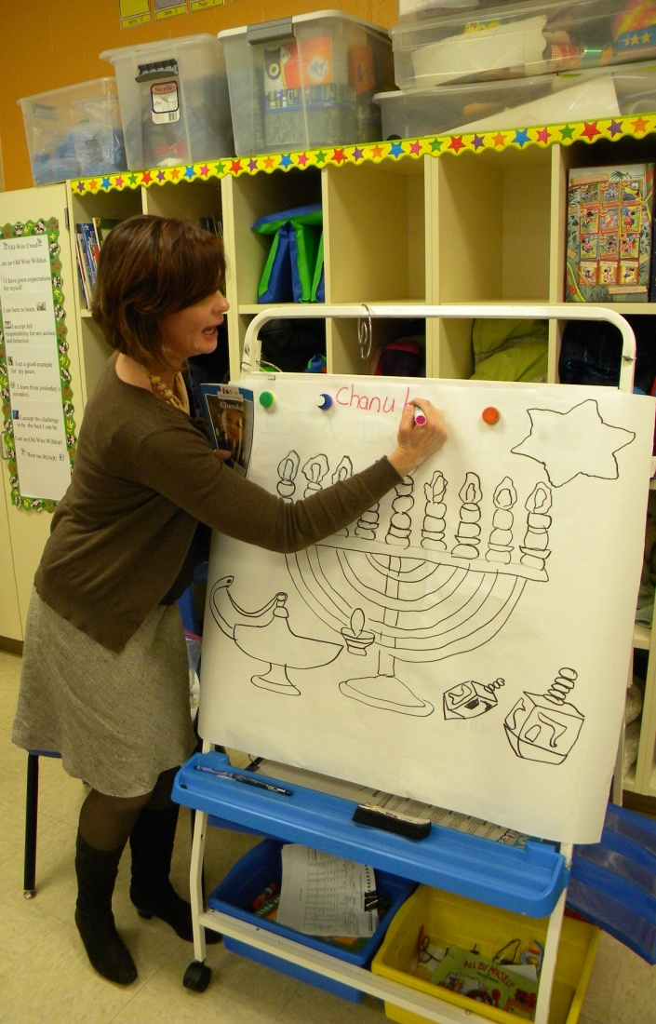
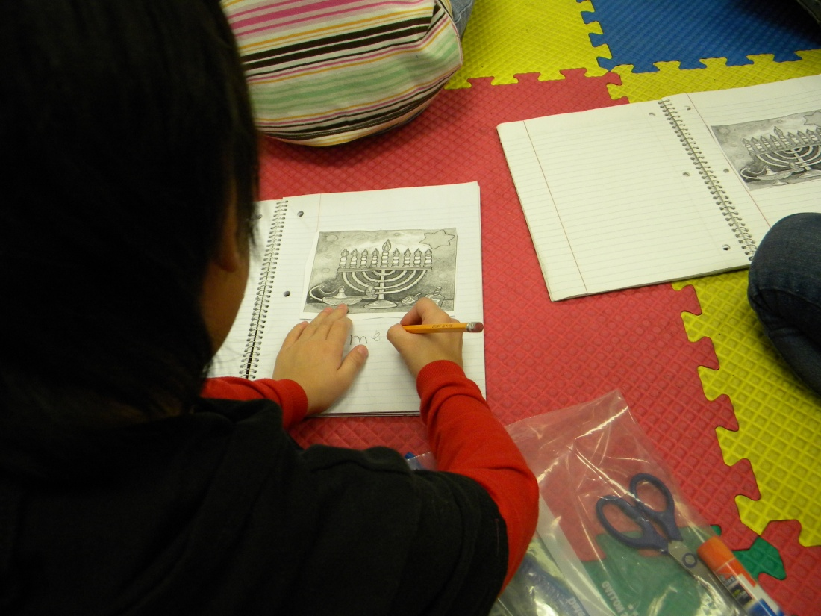
Mrs. Williams modeled note taking while the students took notes in their notebooks.

Slide 11
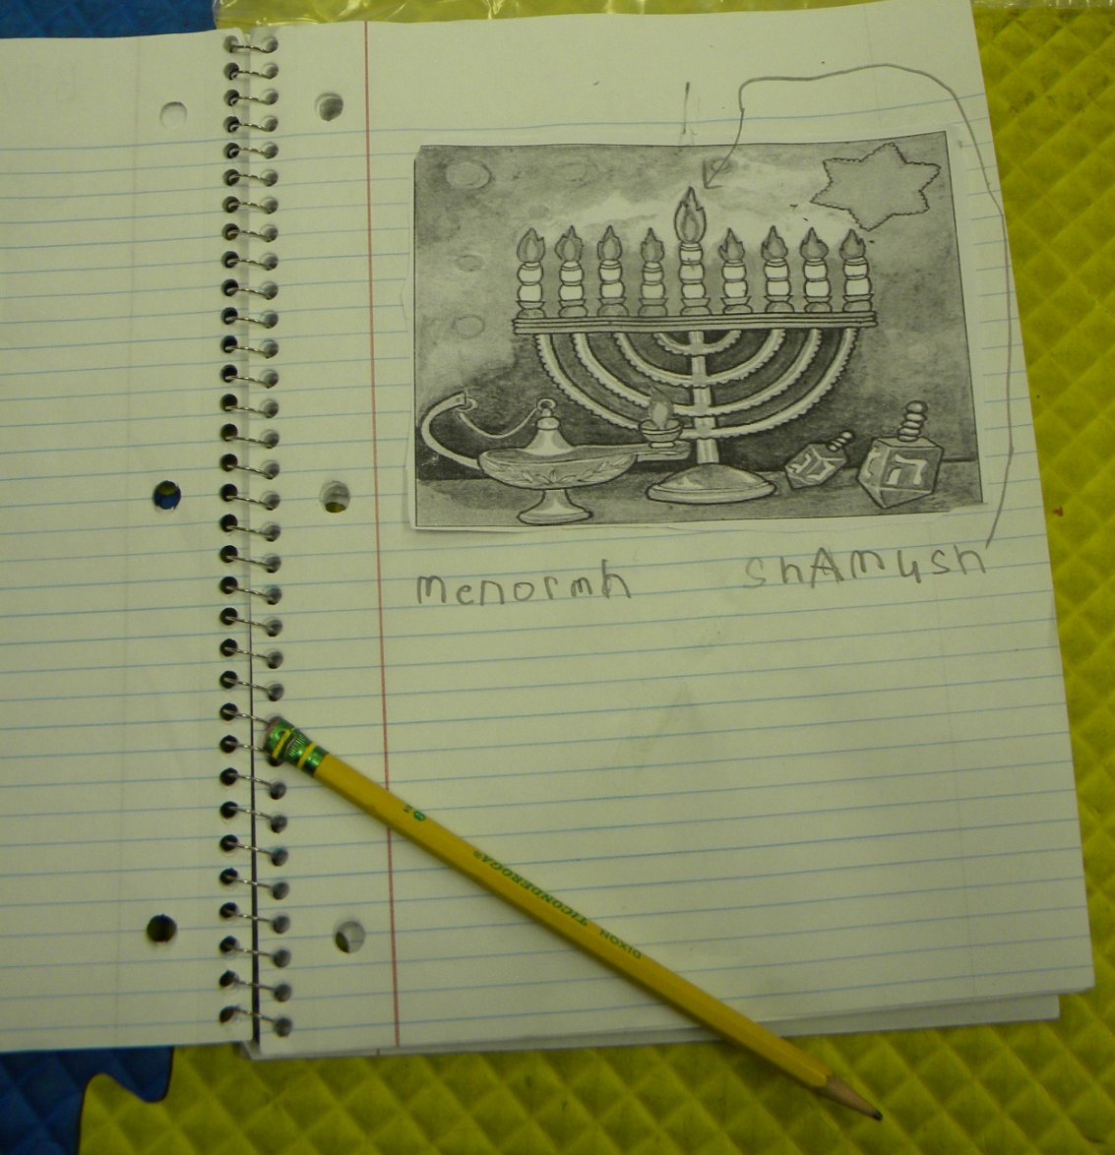

Slide 12
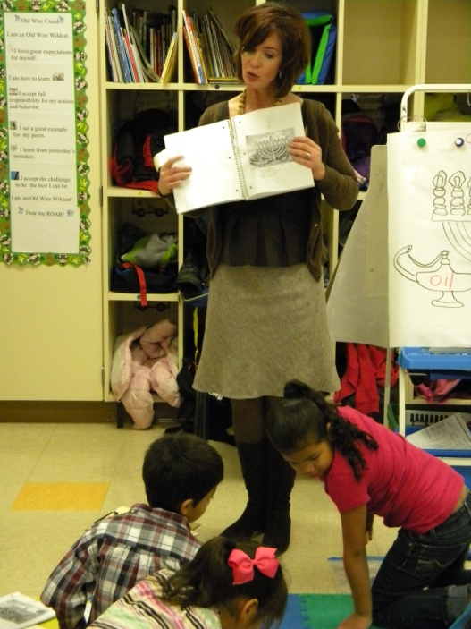
APPLICATION
Mrs. Williams asked the students to turn and talk about what they had learned about Chanukah
She then showed them where they would write about what they had learned.

Slide 13
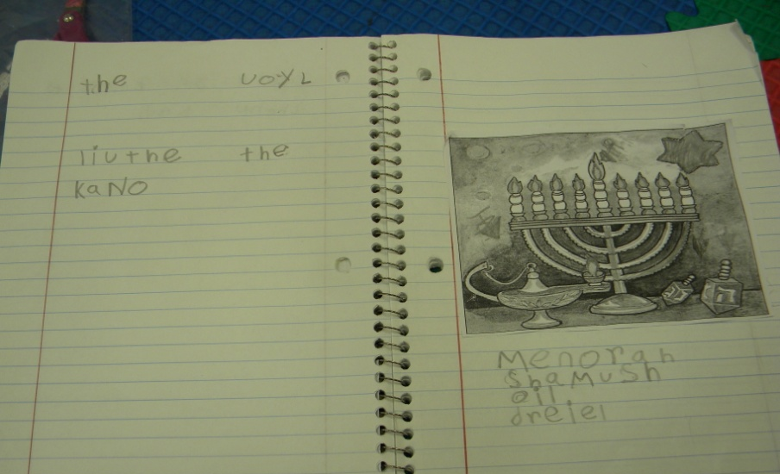
I like the part where they had enough oil.
They have oil.
I like the candle.

Slide 14
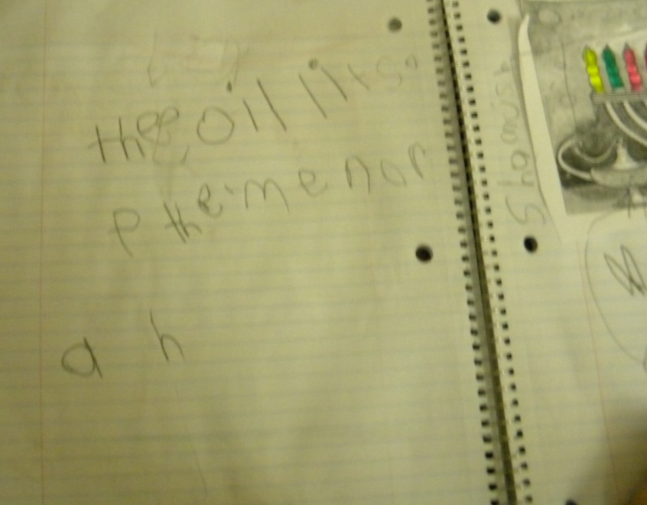
The oil lights the menorah.
I remember the oil can light the candle.
Shamush has fire.

Slide 15
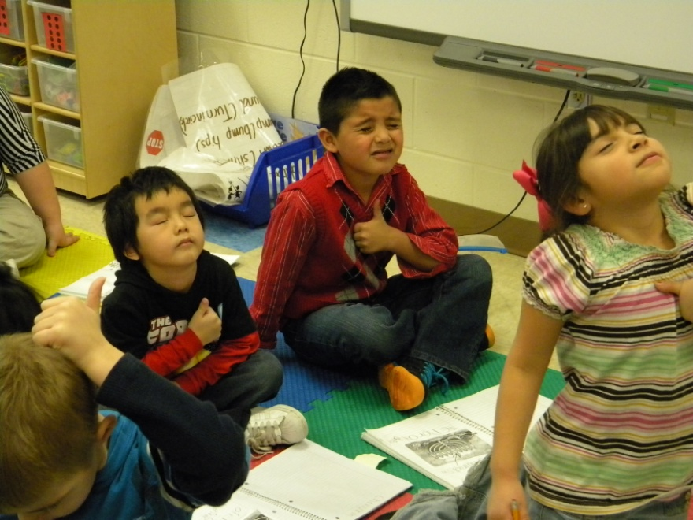
Revisit the GOAL
The student’s repeated the lesson goal and scored their understanding again at the end of the lesson.

