Slide 1
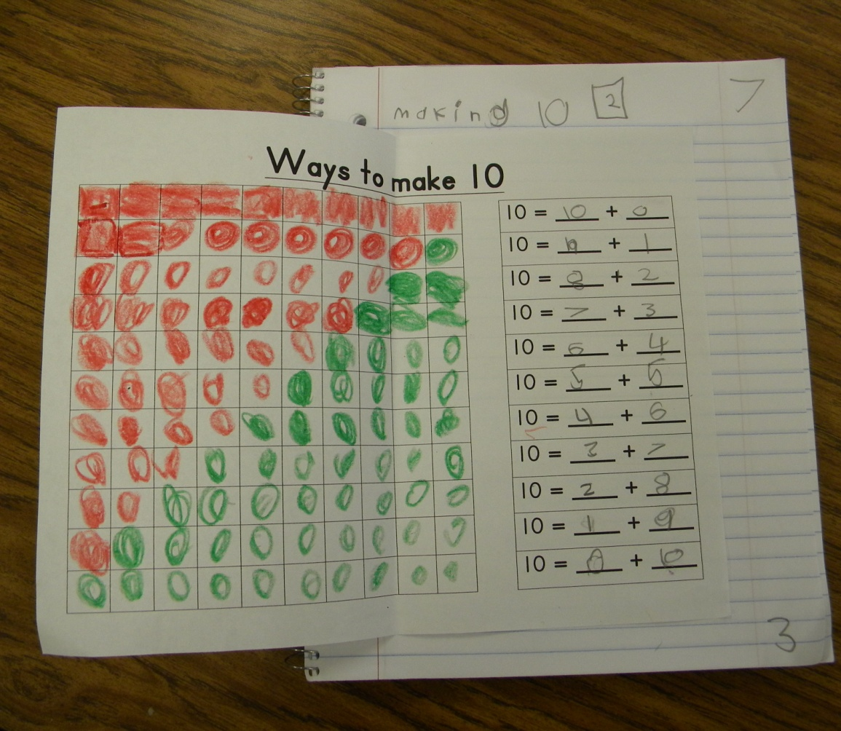
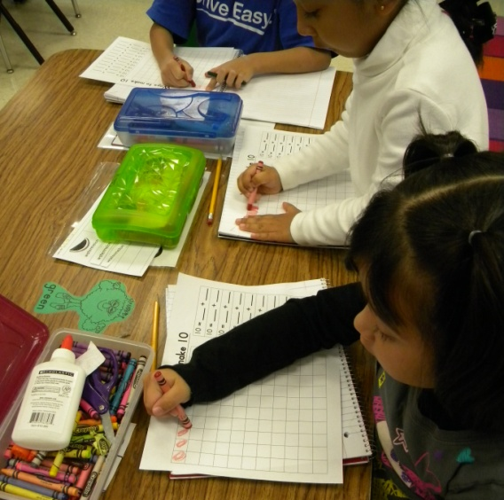
Groups of Ten
Kindergarten Notebooks
Mrs. Kirkland’s Class
Grace Hill Elementary

Slide 2
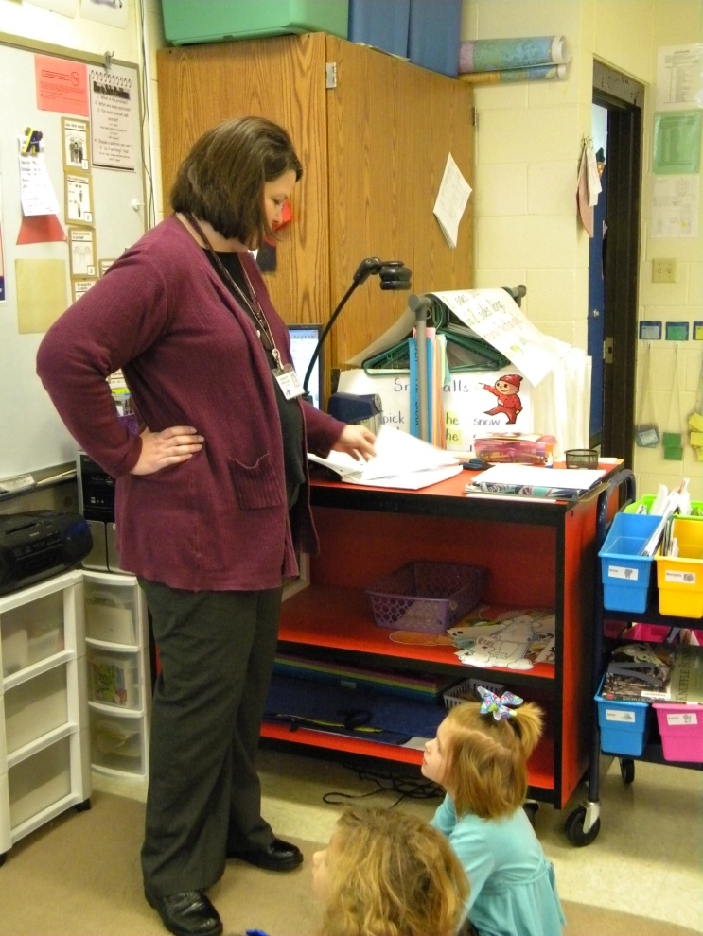
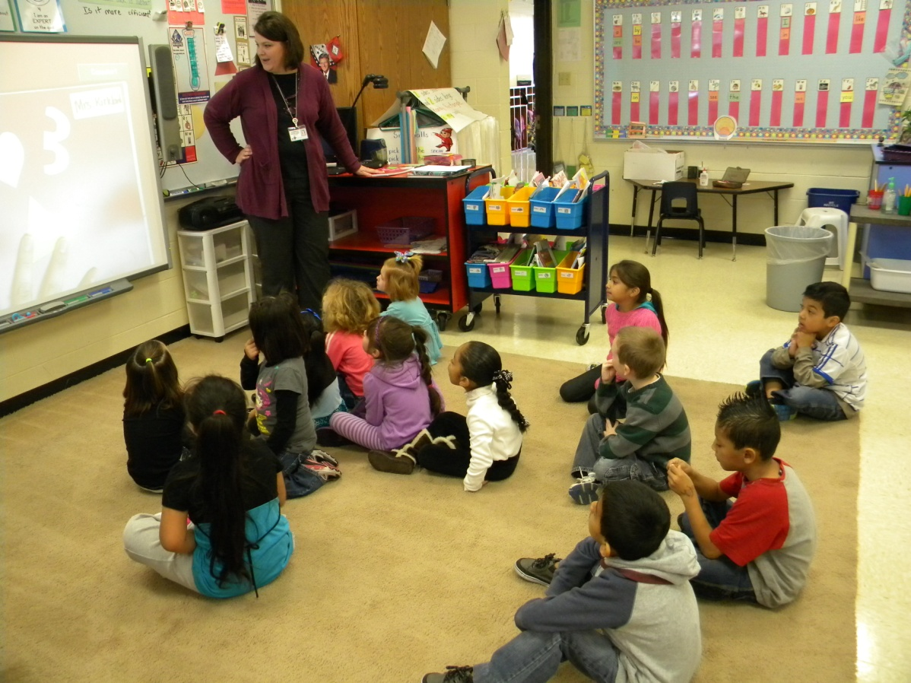
Mrs. Kirkland modeled finding the first clean page.

Slide 3
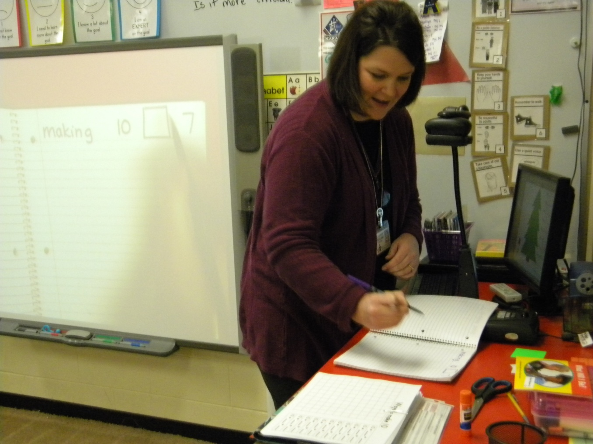
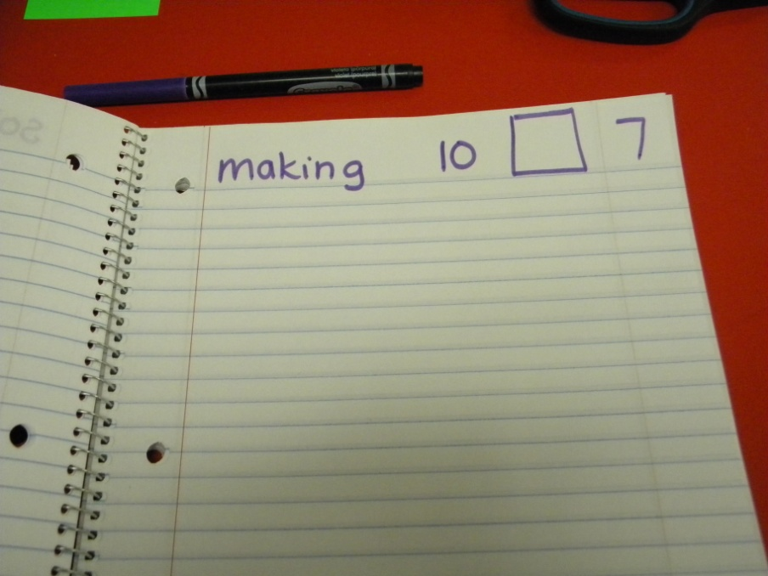
GOAL: I can make groups of ten.
Notes:
Mrs. Kirkland modeled writing the goal in her notebook.

Slide 4
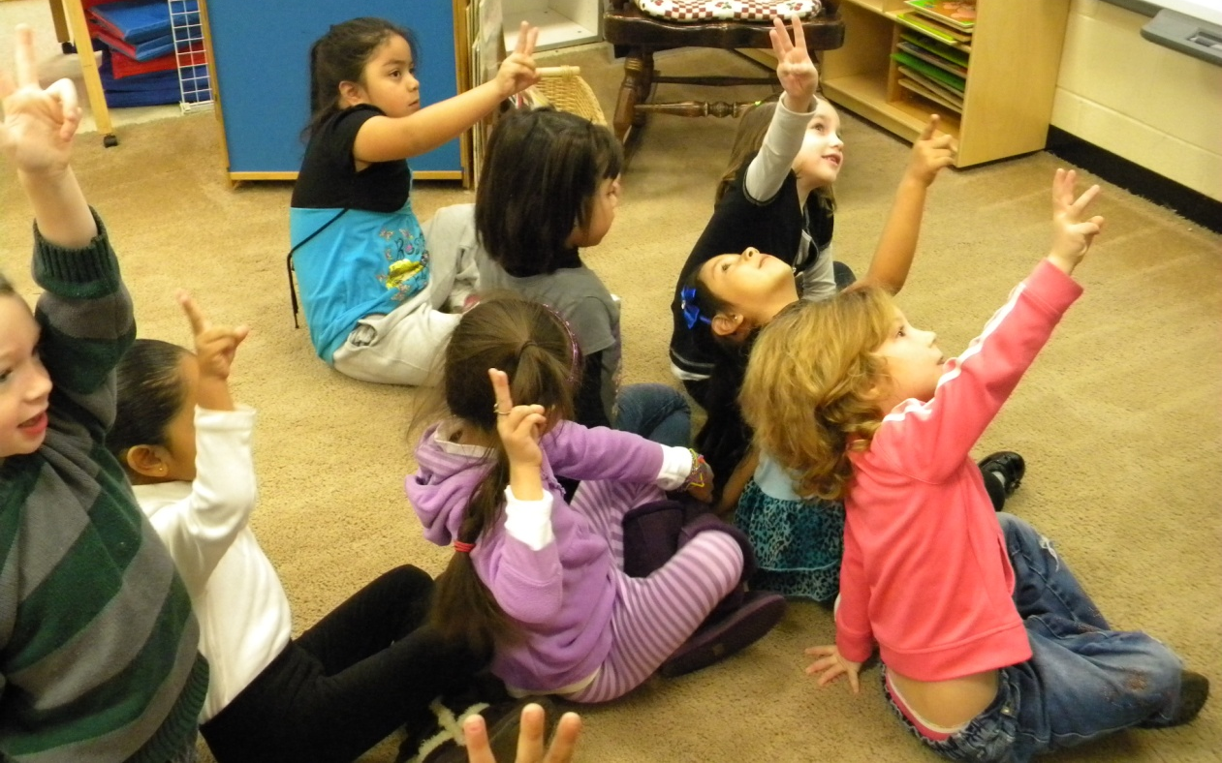
Students scored their understanding of the goal.
Notes:
Mrs. Kirkland asked them to remember their score, because they would be recording it in their notebook.

Slide 5
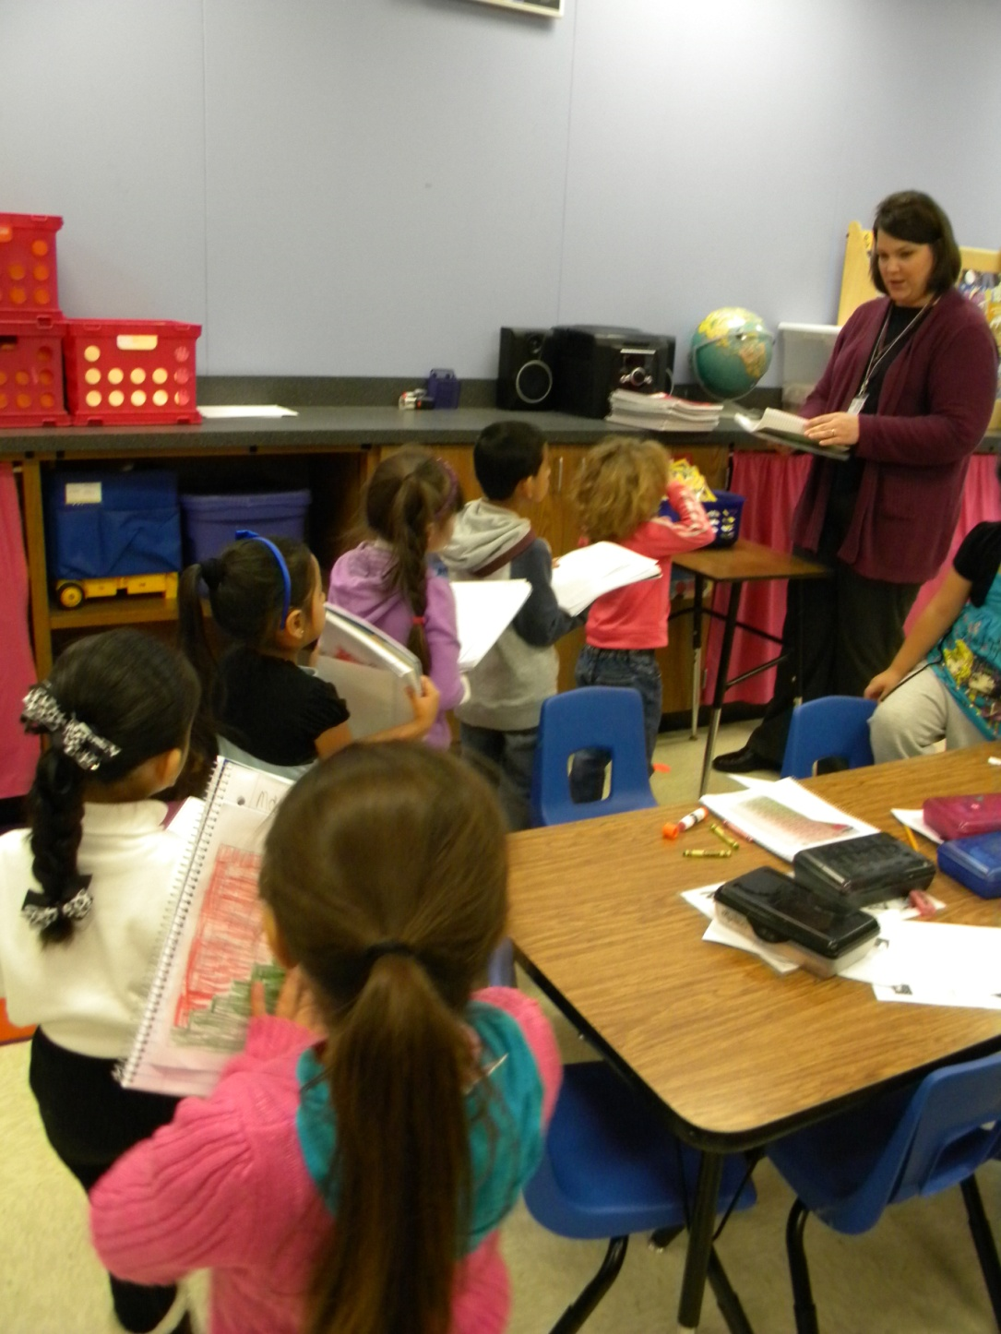
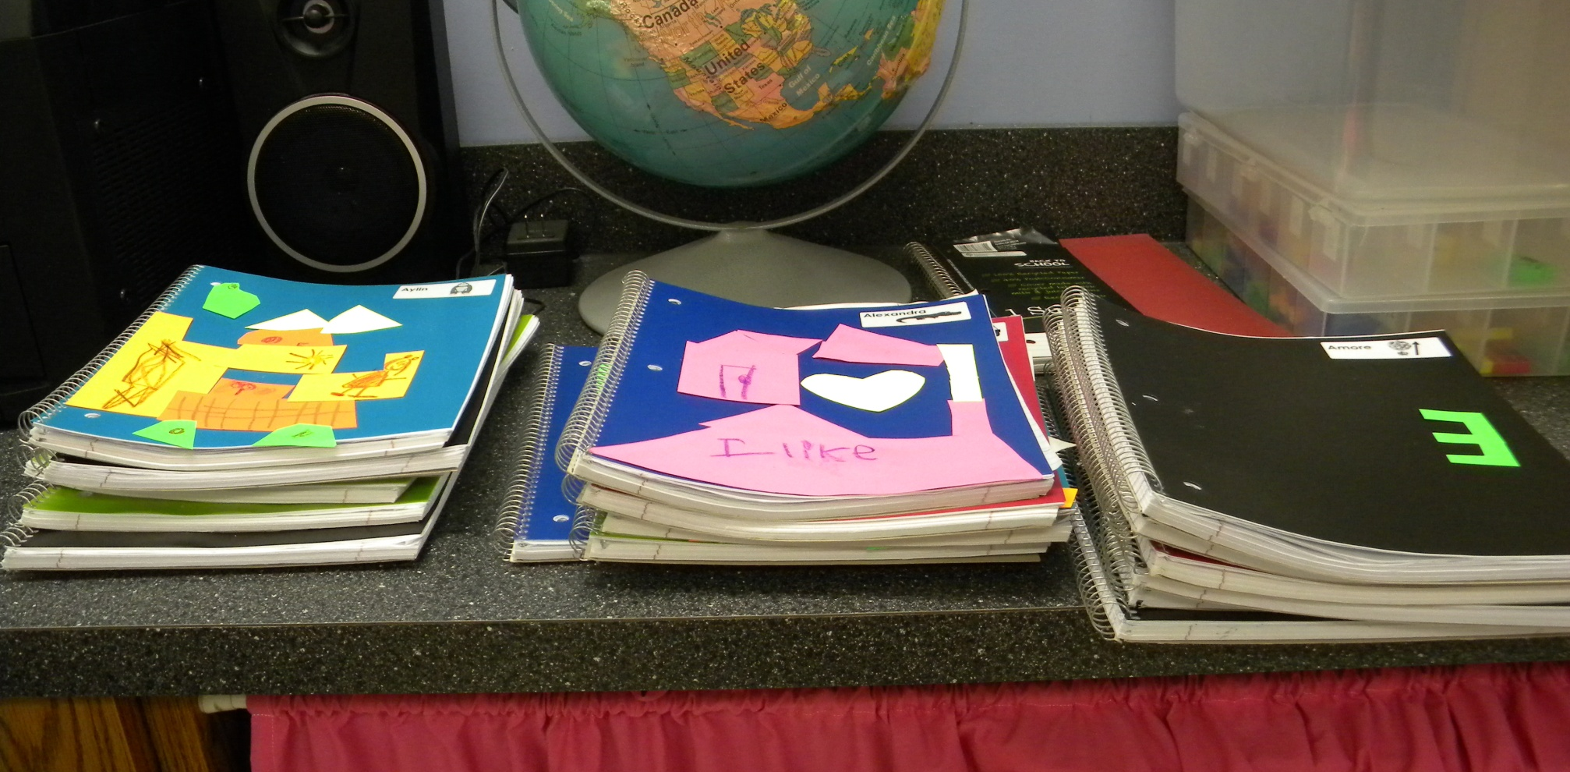
Mrs. Kirkland handed out the notebooks.

Slide 6
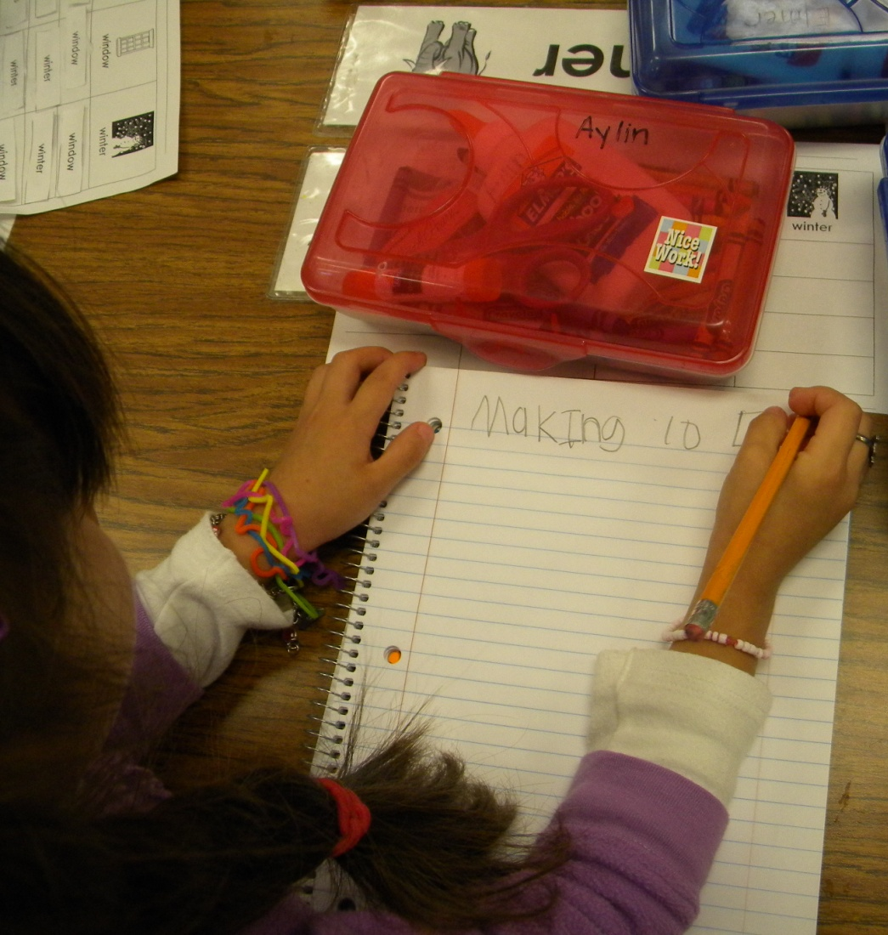
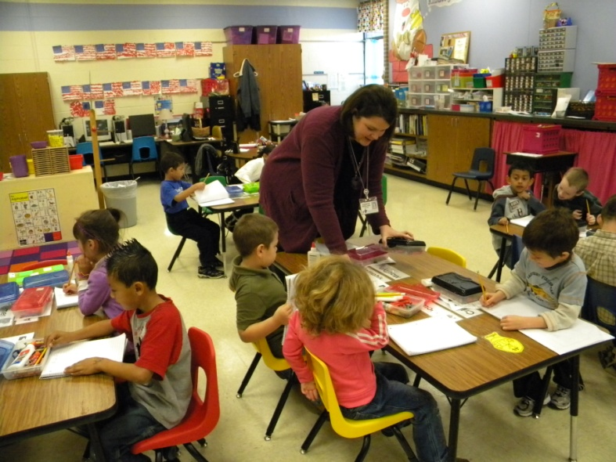
After EXPLICIT modeling, the students knew how and where to write the goal in their notebooks.

Slide 7
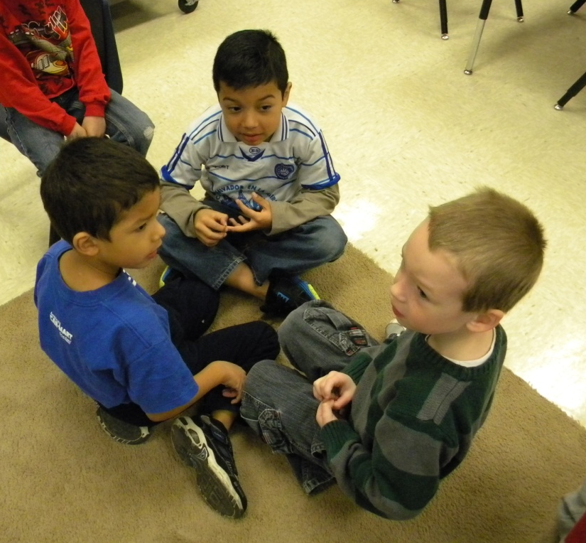
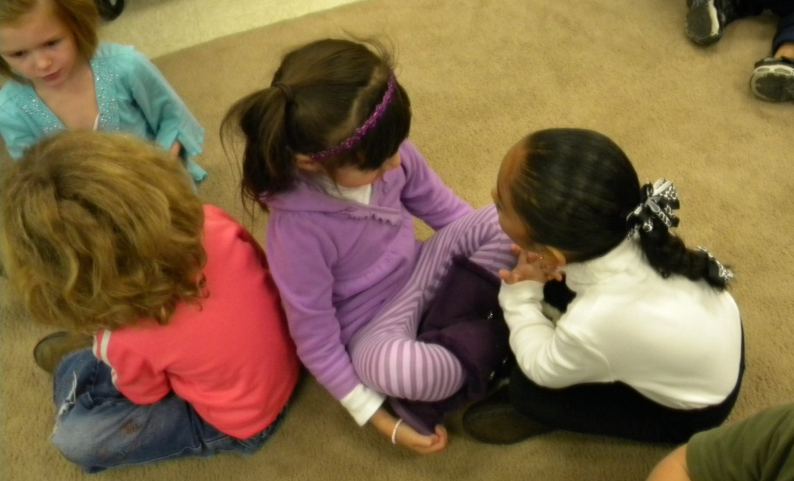
Access Prior Knowledge: “How did you decorate your Christmas tree? What does it look like?”
Students shared with their partners.

Slide 8
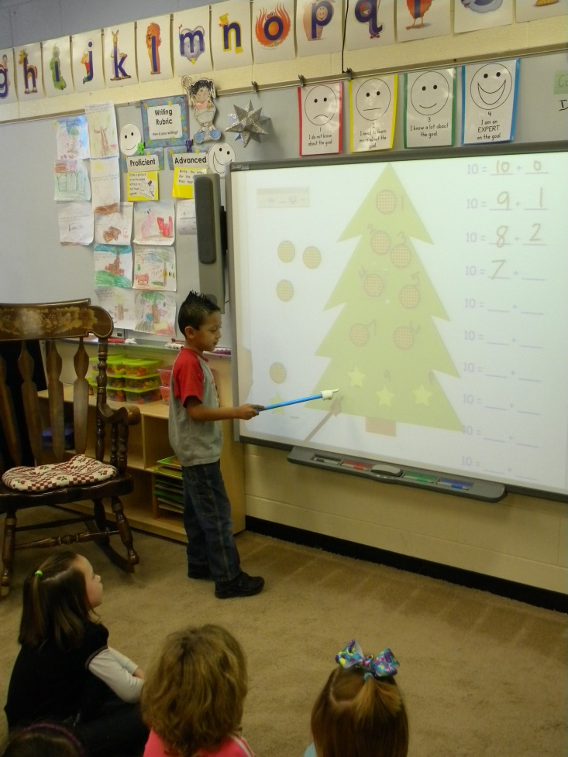
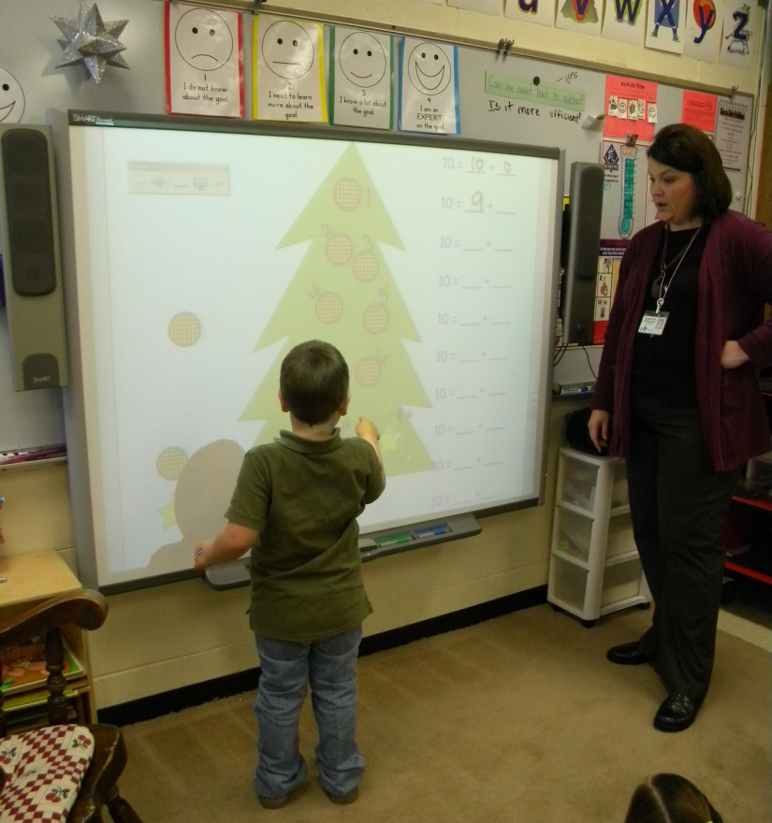
New Information: The students used two types of ornaments to decorate a Christmas tree with exactly 10 ornaments.

Slide 9
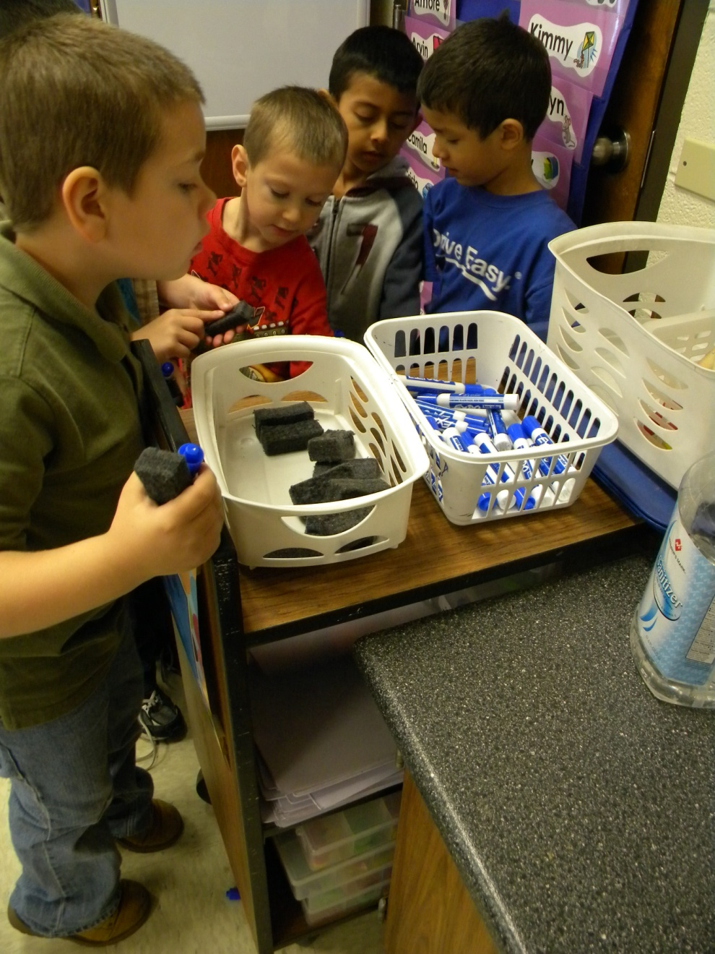
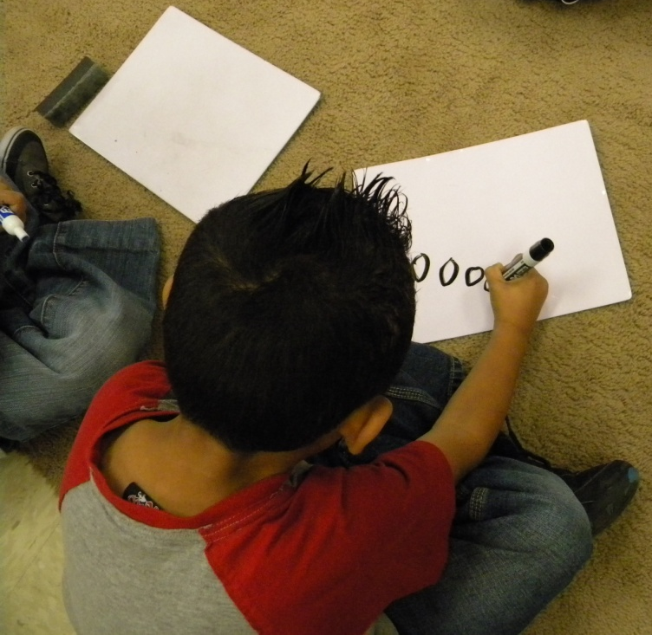
Students collected marker boards and markers to show their work.

Slide 10
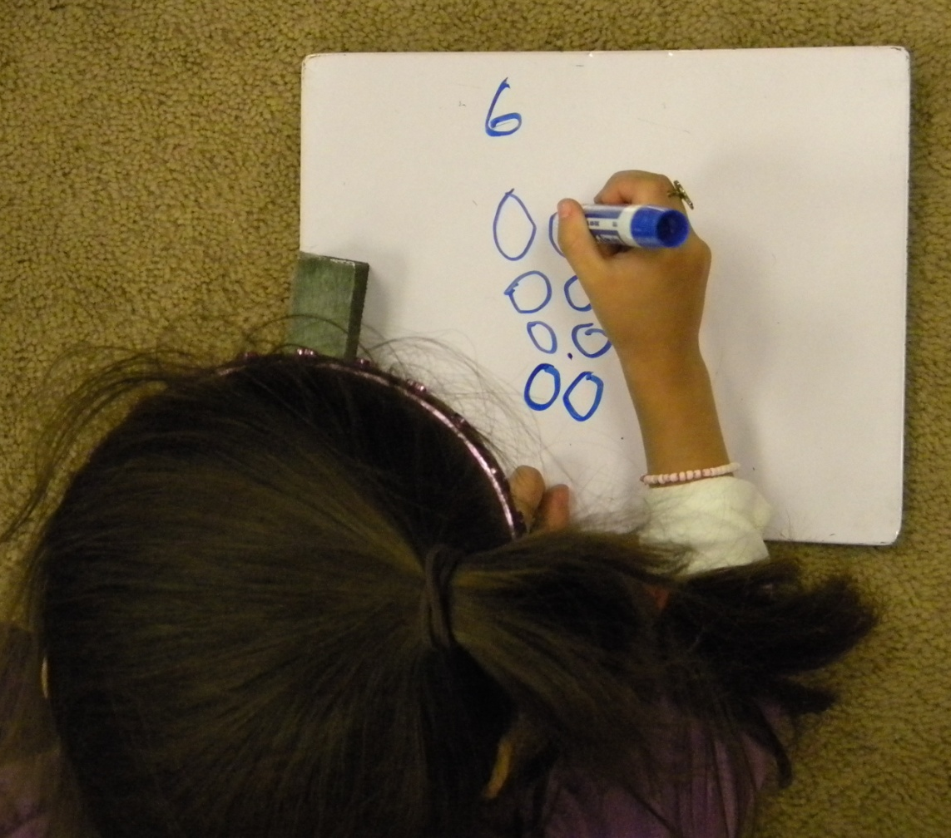
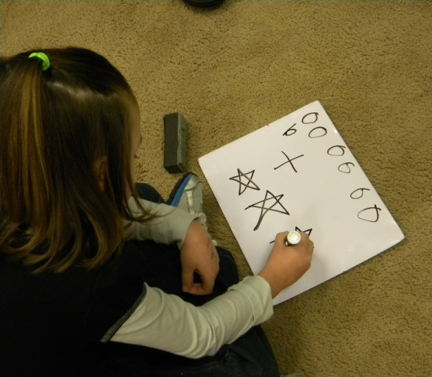
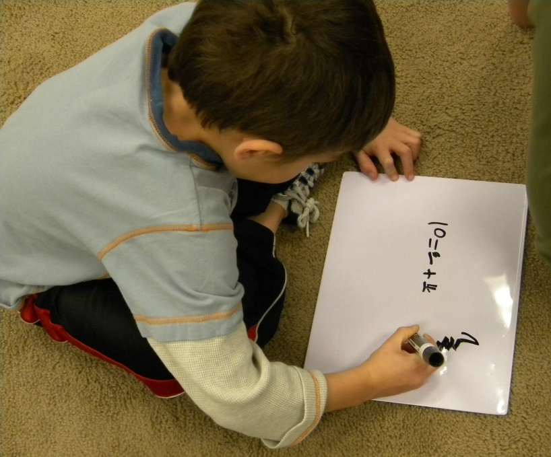

Slide 11
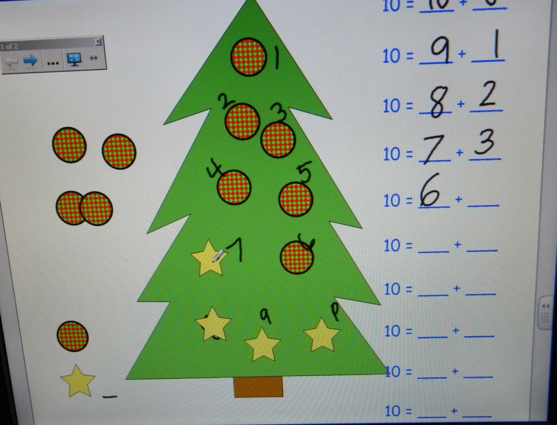

Slide 12
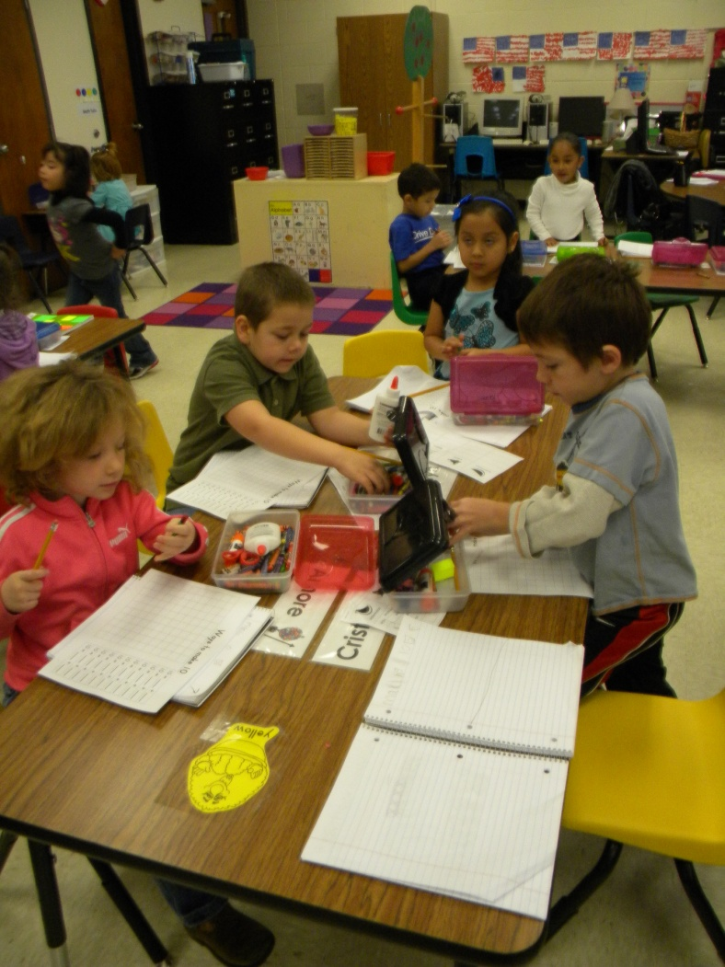
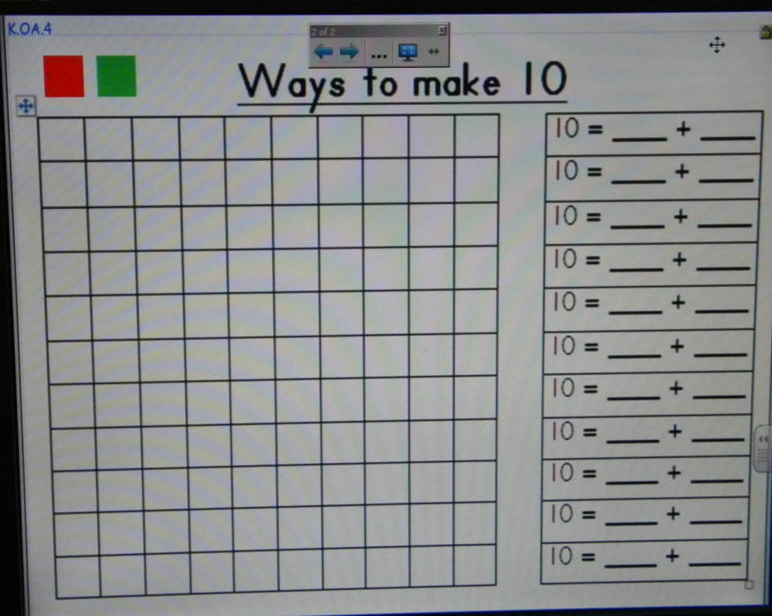
Application: The students used a red and green crayon to record combinations of 10.

Slide 13
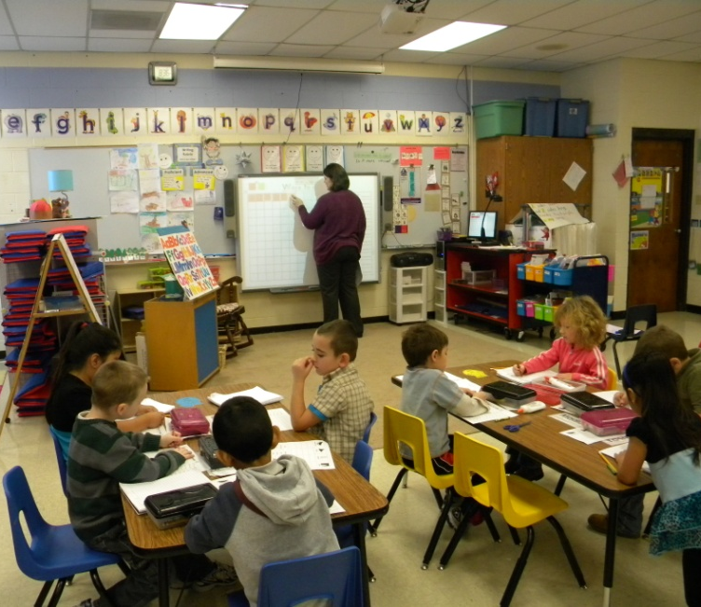
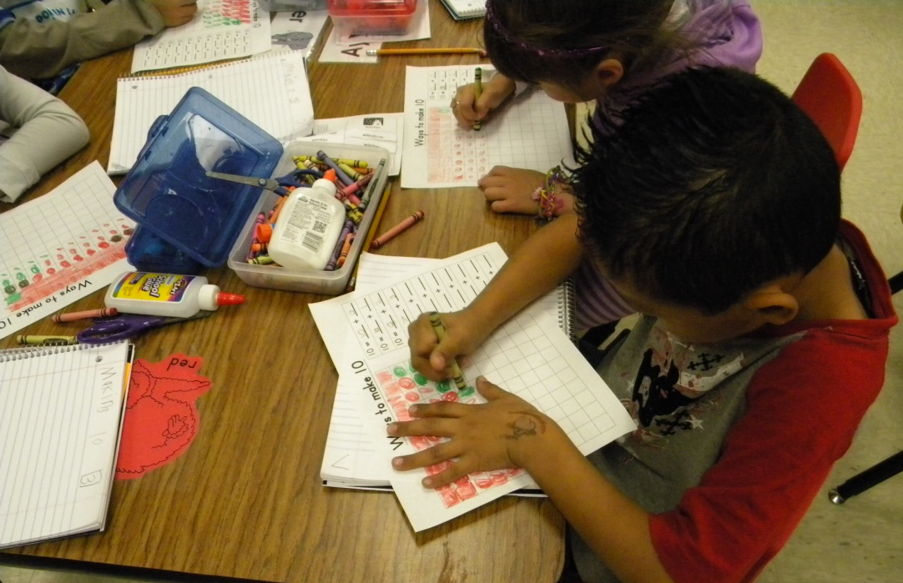

Slide 14
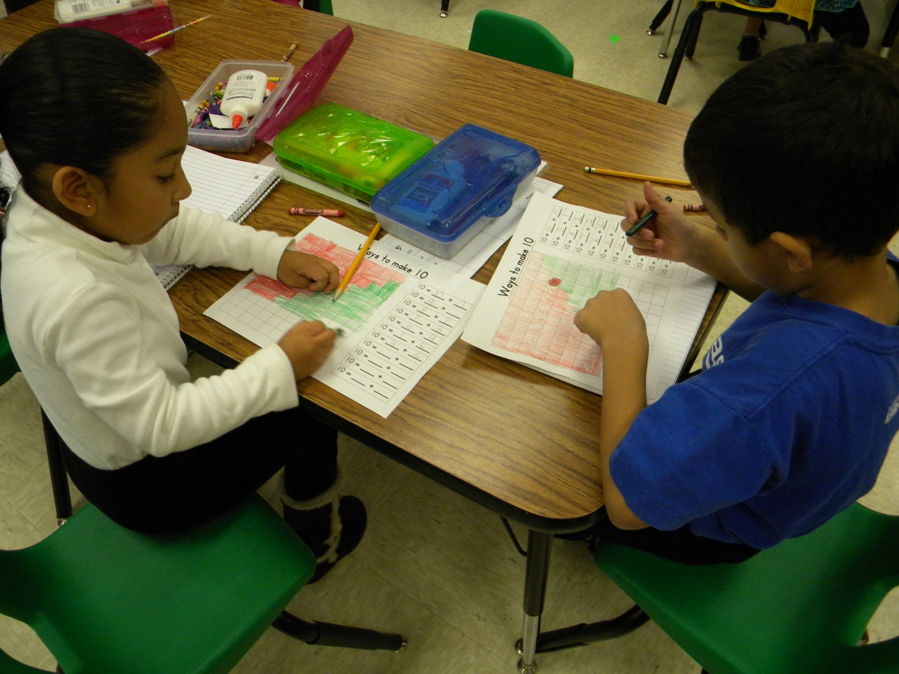

Slide 15
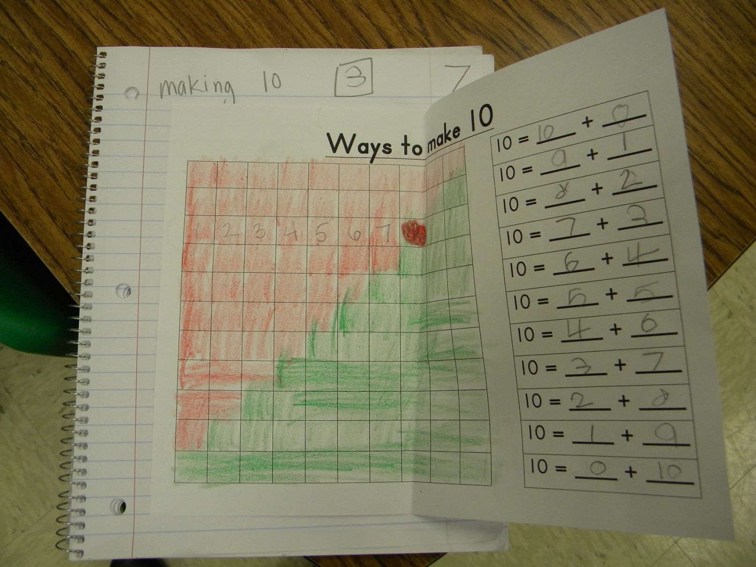

Slide 16
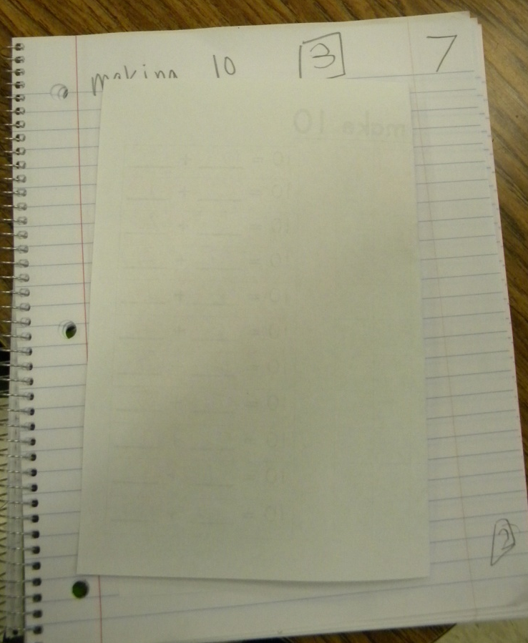
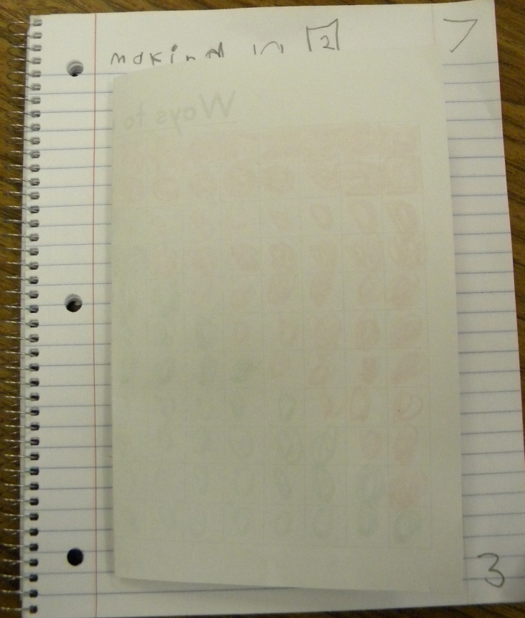
Revisit the Goal: At the end of the lesson, the students reread the goal and scored their understanding again at the bottom of their notebooks.

Slide 17
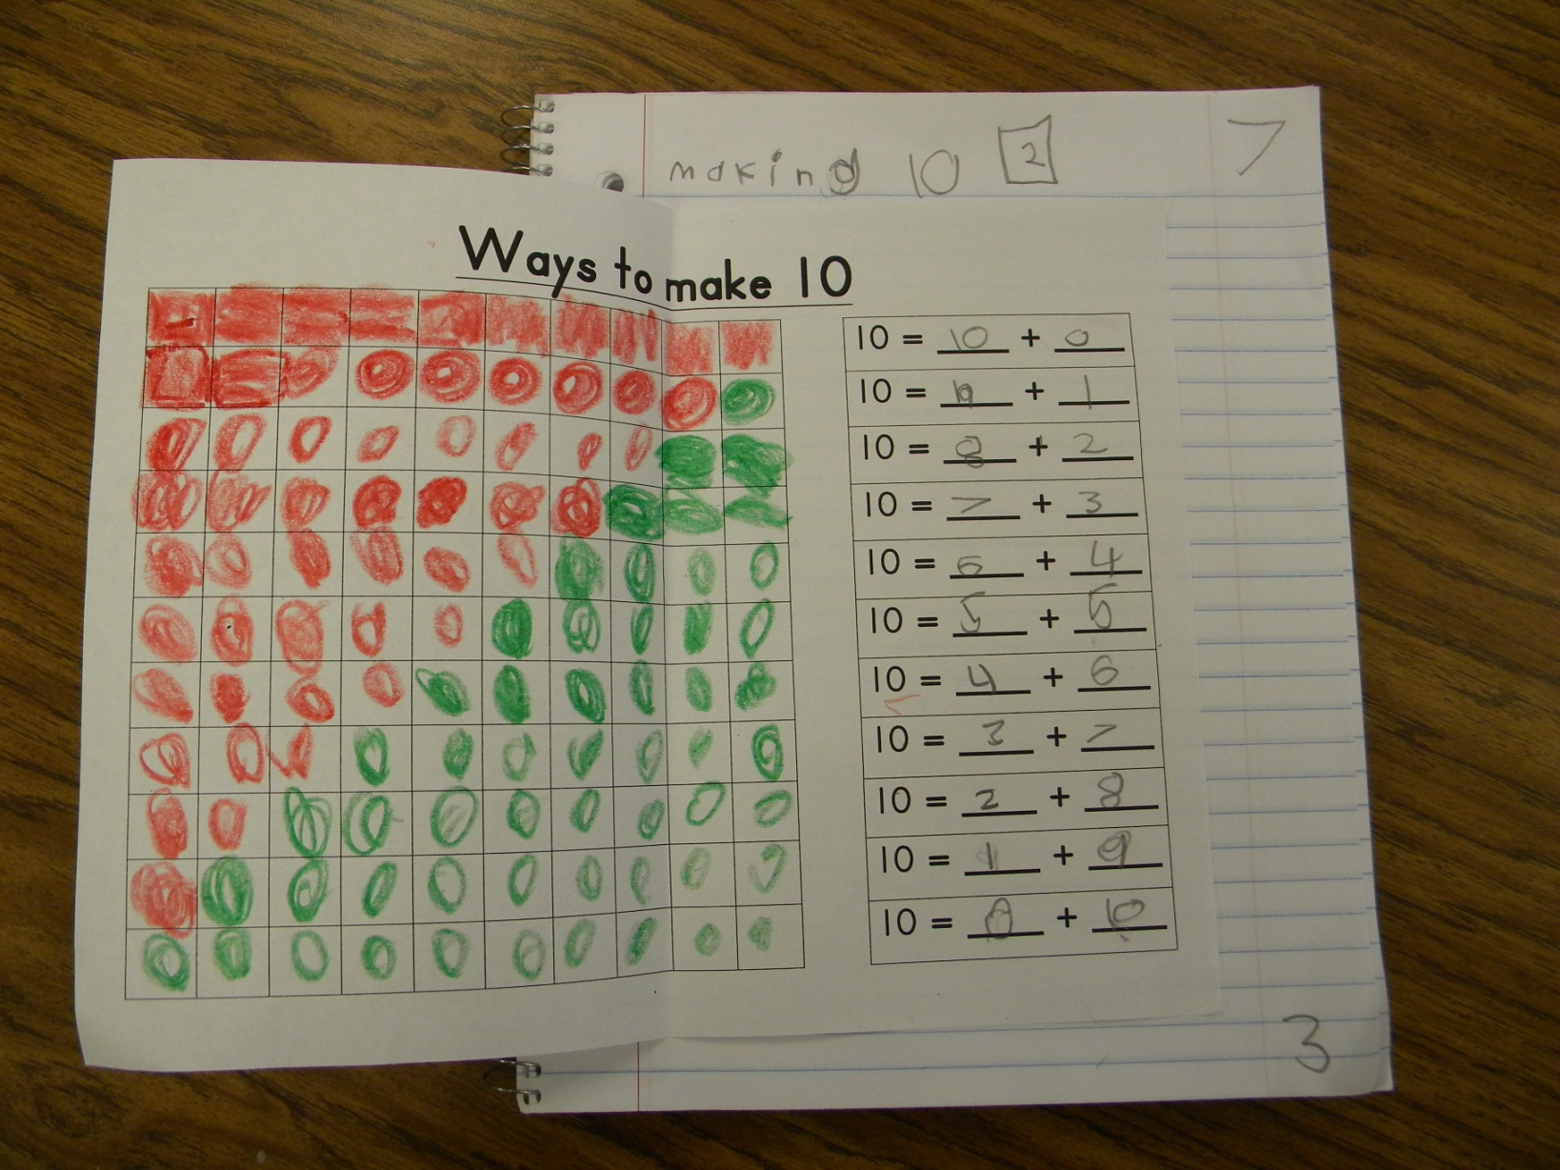

Slide 18
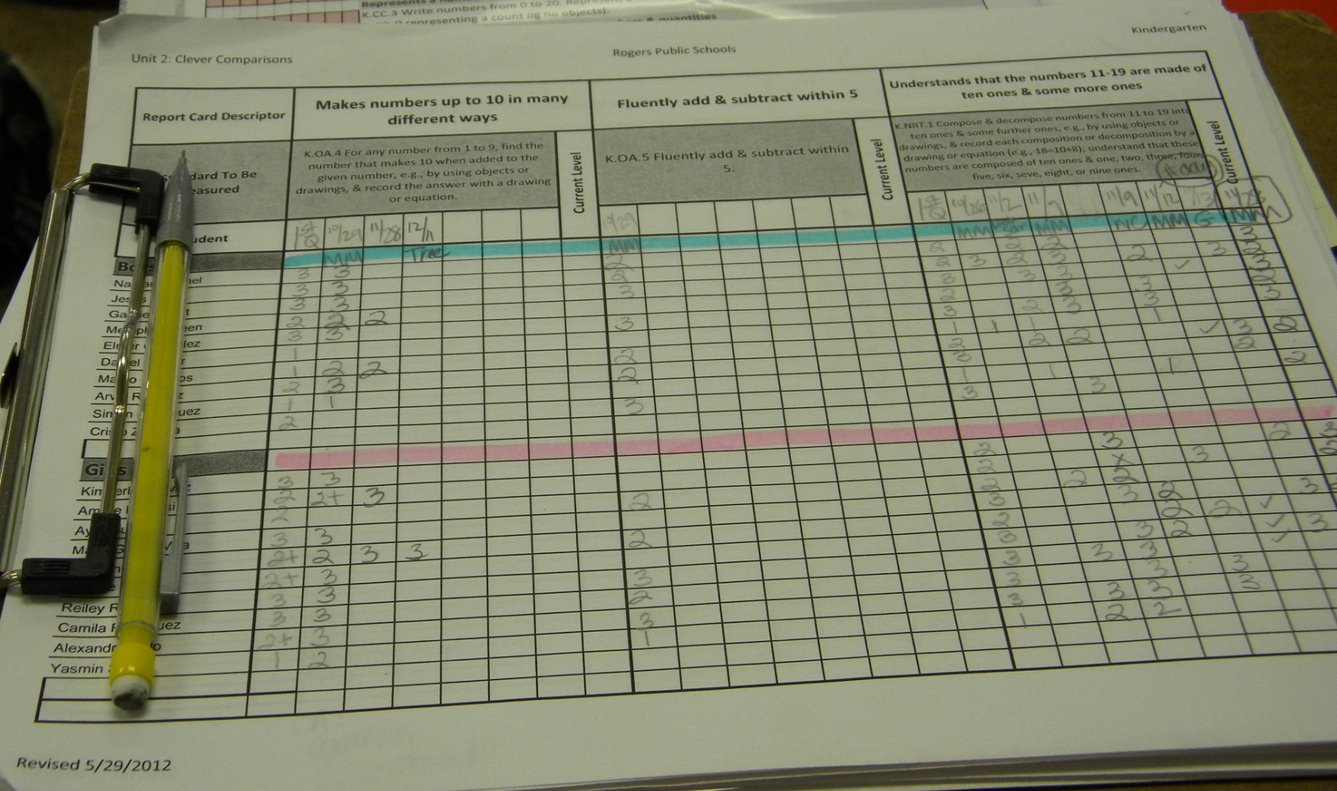
Scoring to the Standard

Slide 19
