Slide 1
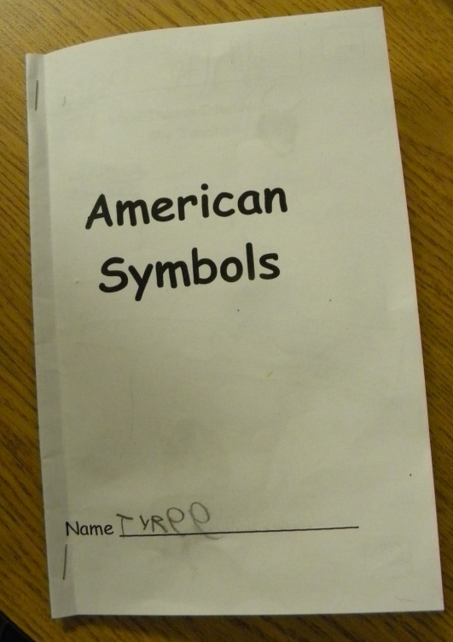
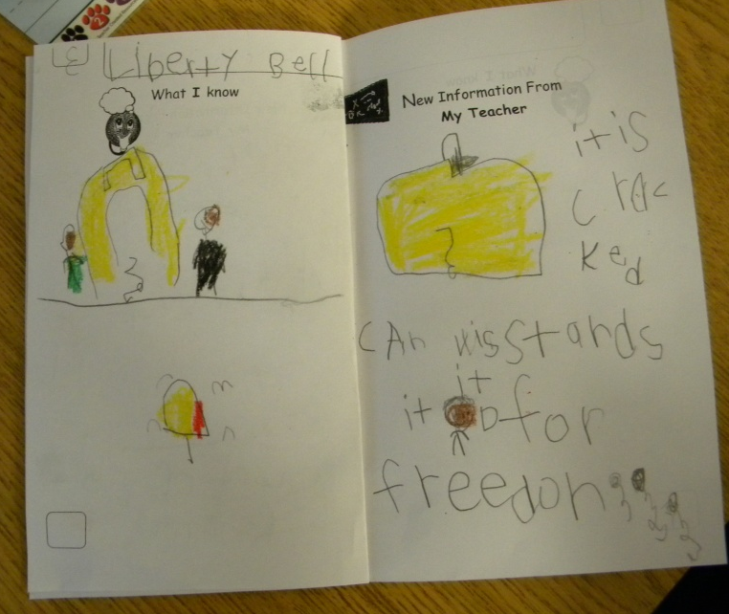
American Symbols
Kindergarten Notebook
Mrs. Benko’s Class
Russell Jones Elementary

Slide 2
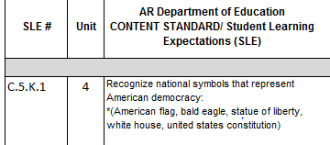
Mrs. Benko began planning her unit by identifying the social studies student learning expectations, gathering and studying her resources and thinking about what her students would know and be able to do at the end of the unit.
She then began planning daily lessons.

Slide 3
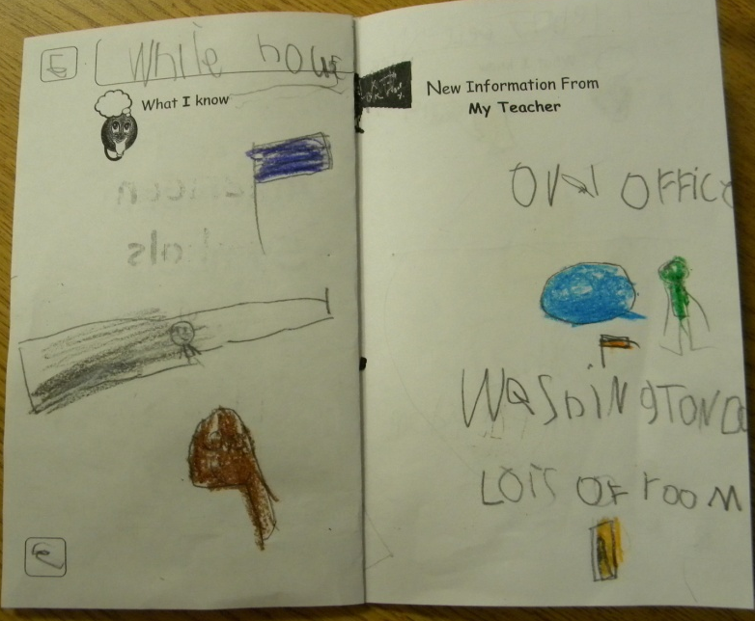
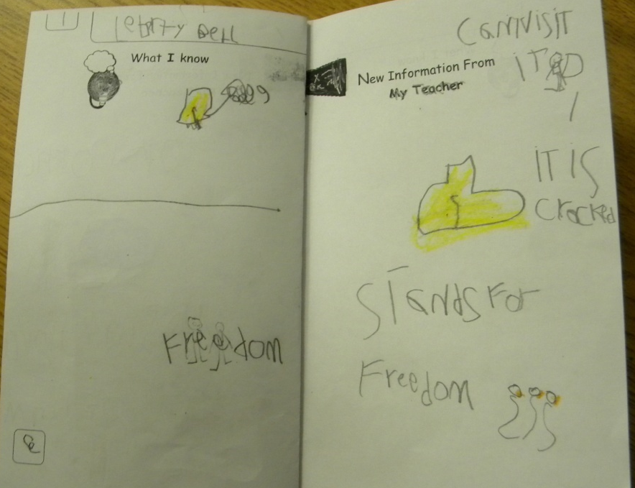
She decided that she would like her students to take notes about each of the symbols in an interactive notebook.
DAY 2
DAY 1

Slide 4
The Bald Eagle
Day 3

Slide 5
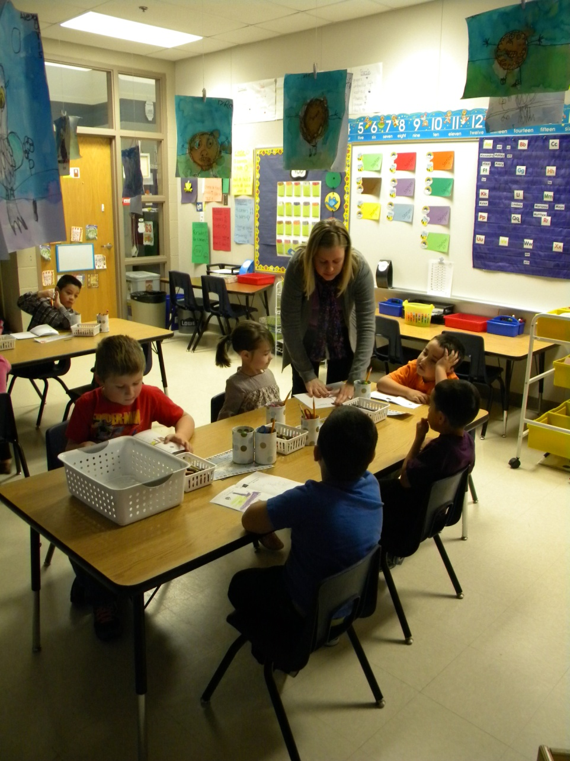
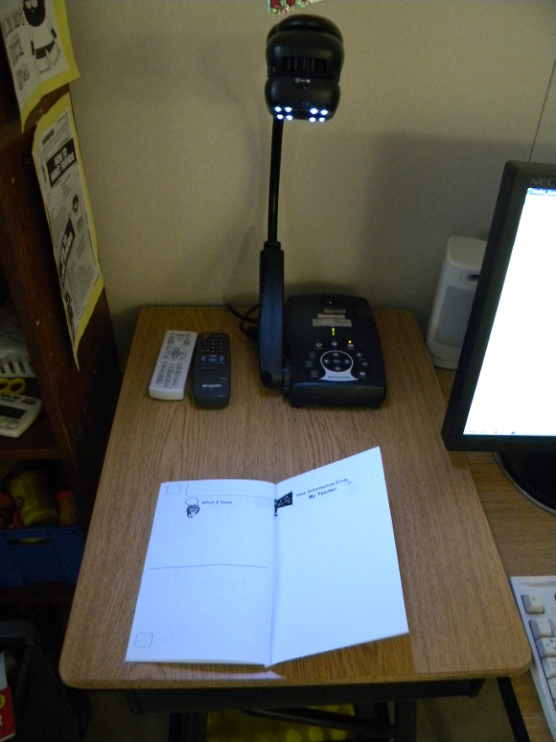
Mrs. Benko handed out the notebooks to her students, opening them to the correct page.
She used her document camera to model drawing a line dividing the left page in half.

Slide 6
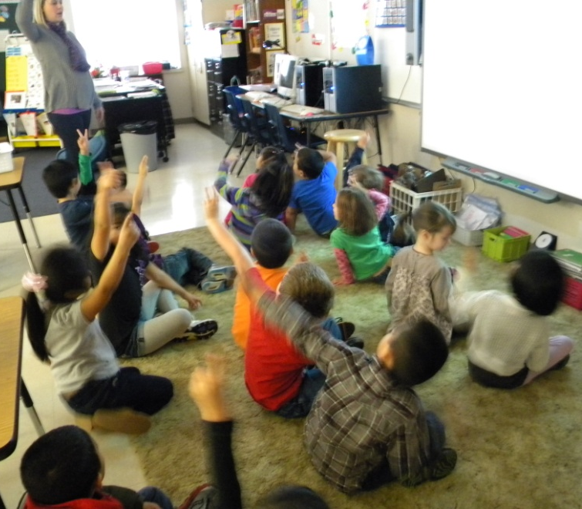
Goal: We can name the Bald Eagle as an American Symbol
Student’s scored their understanding of the goal.

Slide 7
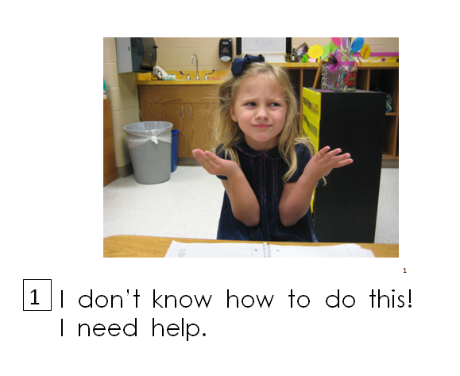
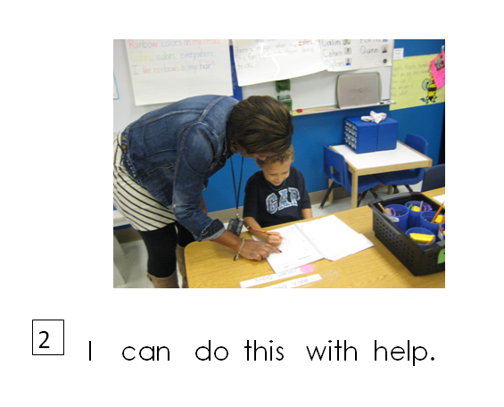
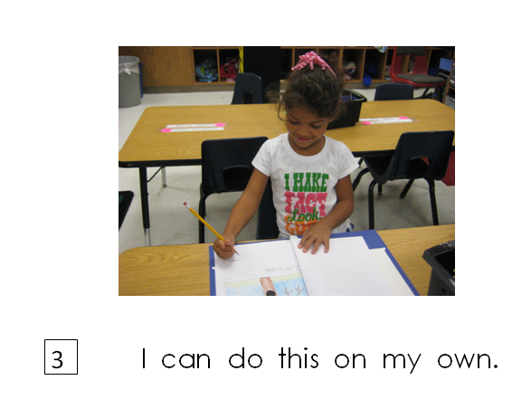
Scoring Rubric

Slide 8
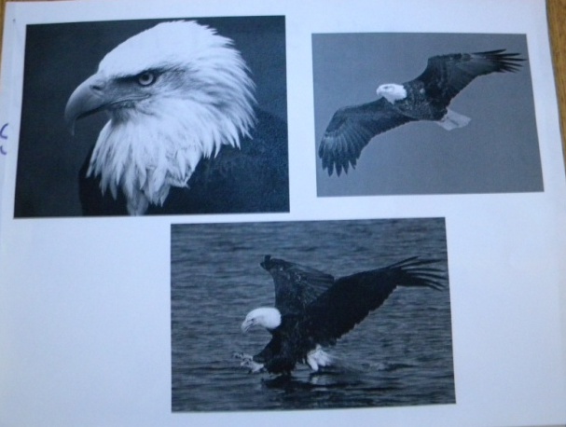
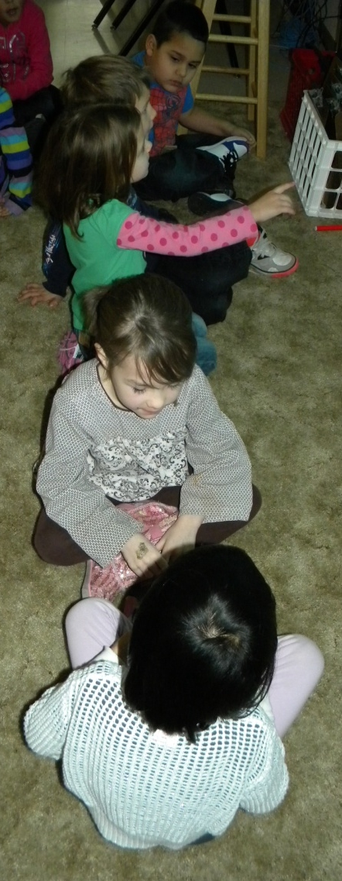
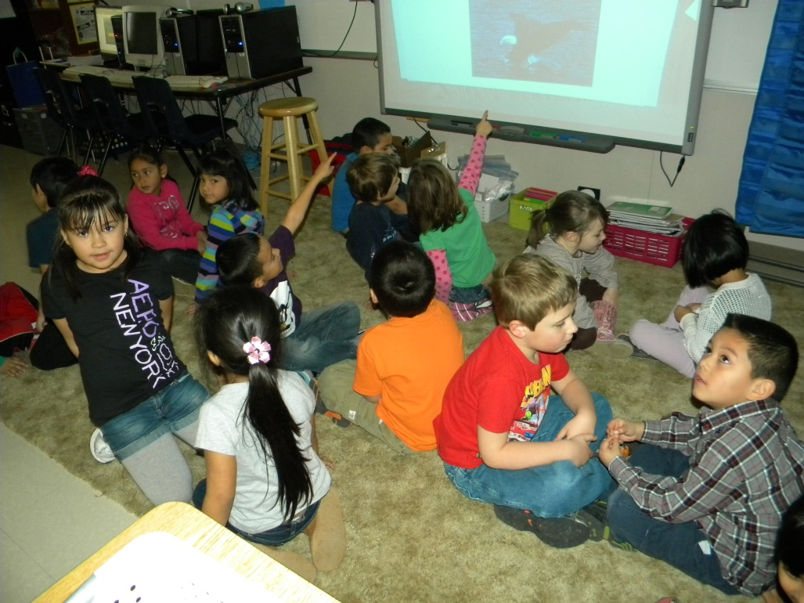
Access Prior Knowledge
Mrs. Benko displayed some images of a bald eagle. The students turned and talked about what they knew about bald eagles.

Slide 9
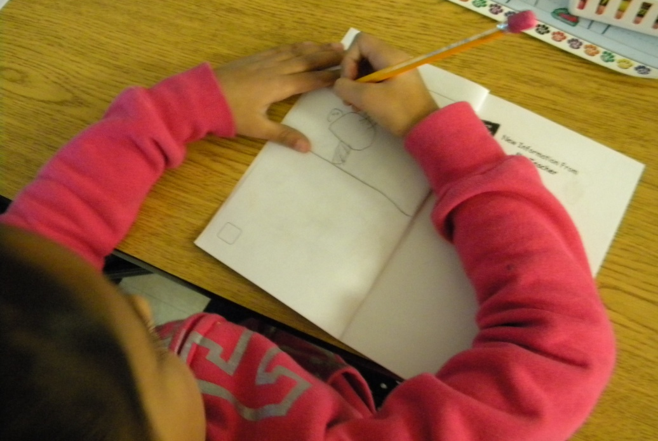
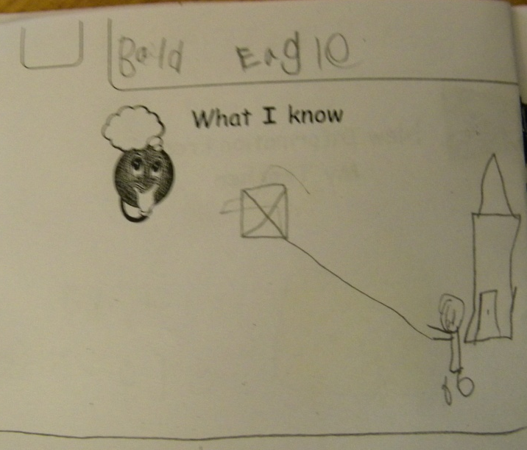
The students drew a picture to show what they knew about bald eagles.
I saw one at the zoo.
They are American.
They fly like my kite.

Slide 10
The students recorded their goal score in the box at the top of the page.

Slide 11
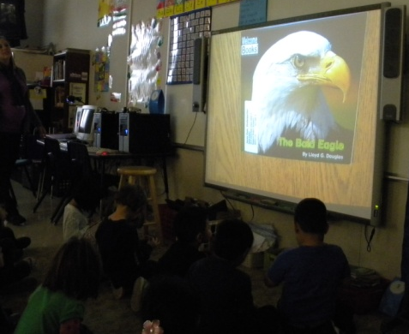
New Information
Mrs. Benko read The Bald Eagle to the students and then they watched a YouTube video.

Slide 12
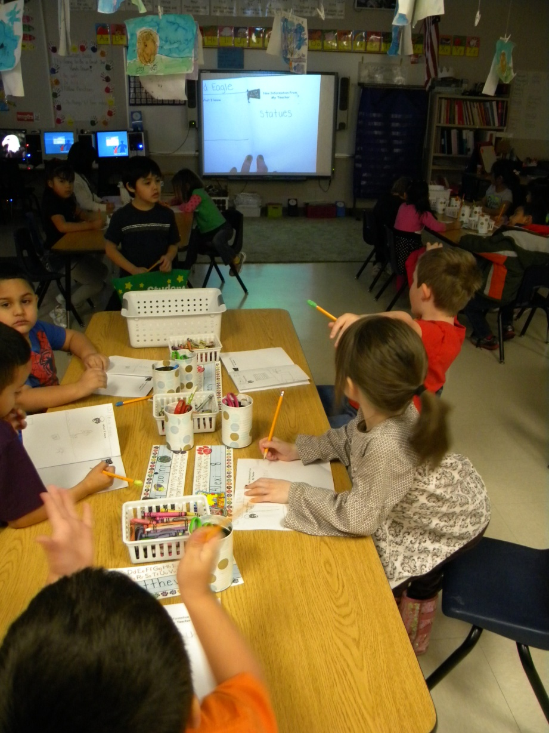
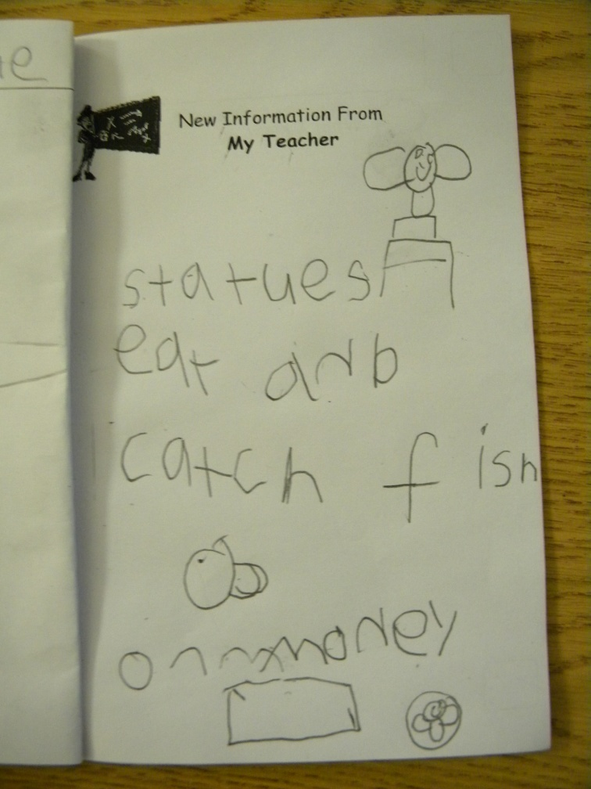
Mrs. Benko asked the students to think about what they had learned about bald eagles. They took notes together.

Slide 13
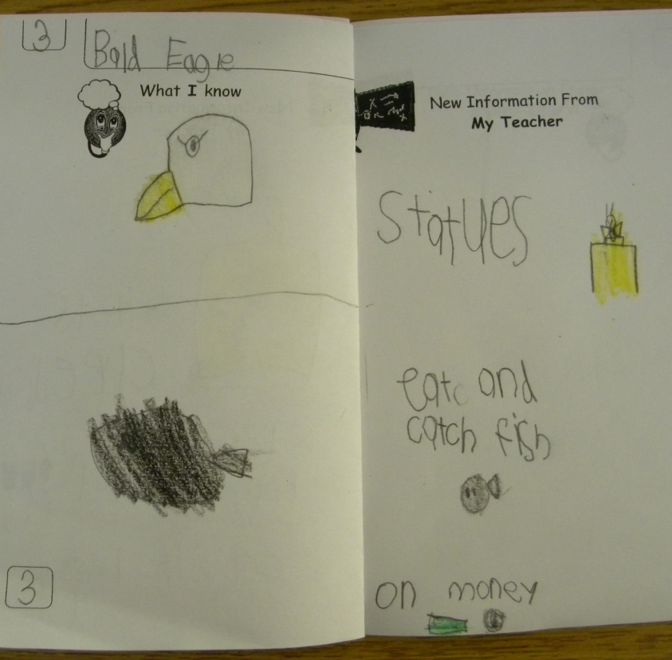
Application
They are on statues.
Bald Eagles
eat fish.
The Students drew a picture of something they learned about the bald Eagle.
Bald Eagles are on money.

Slide 14
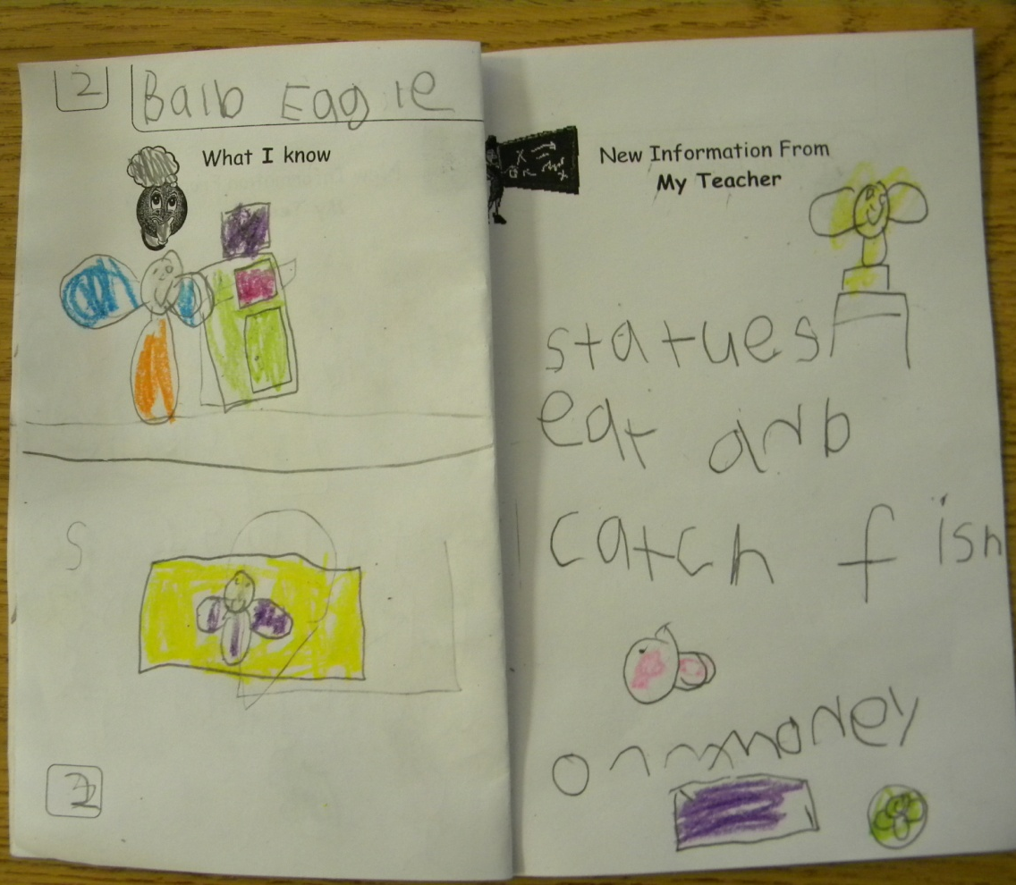
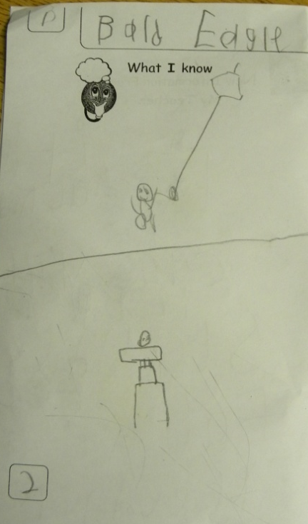
Revisit the Goal
The class revisited the goal and the students scored their understanding of the goal again at the bottom of their paper.

Slide 15
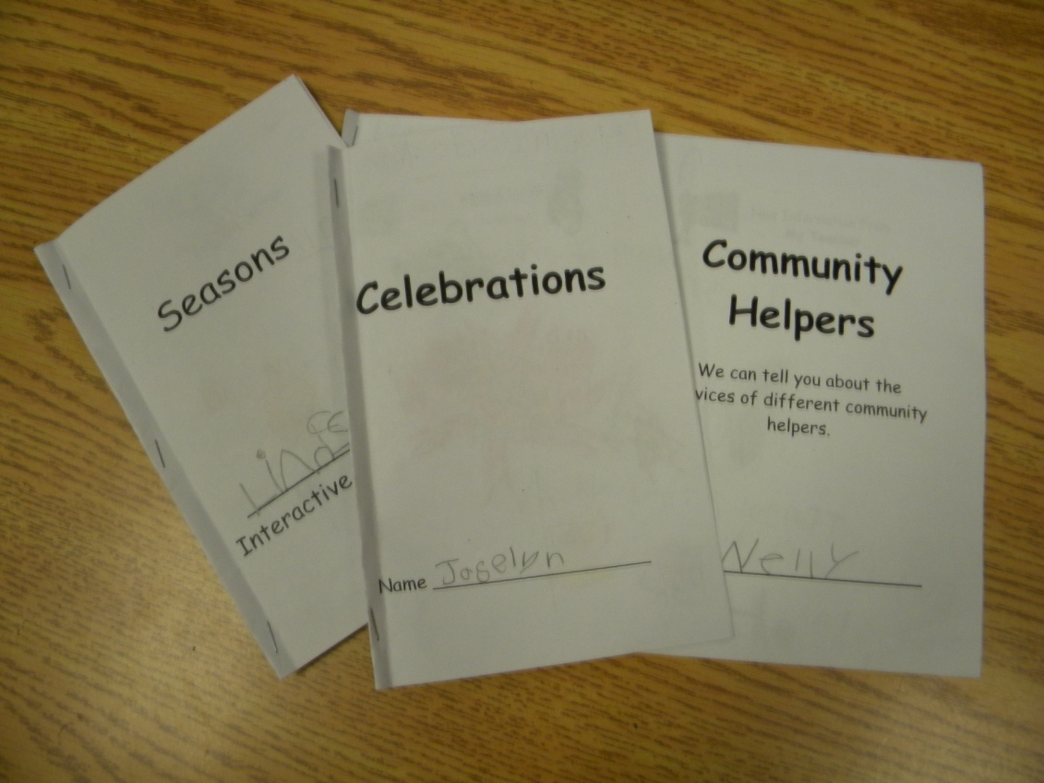
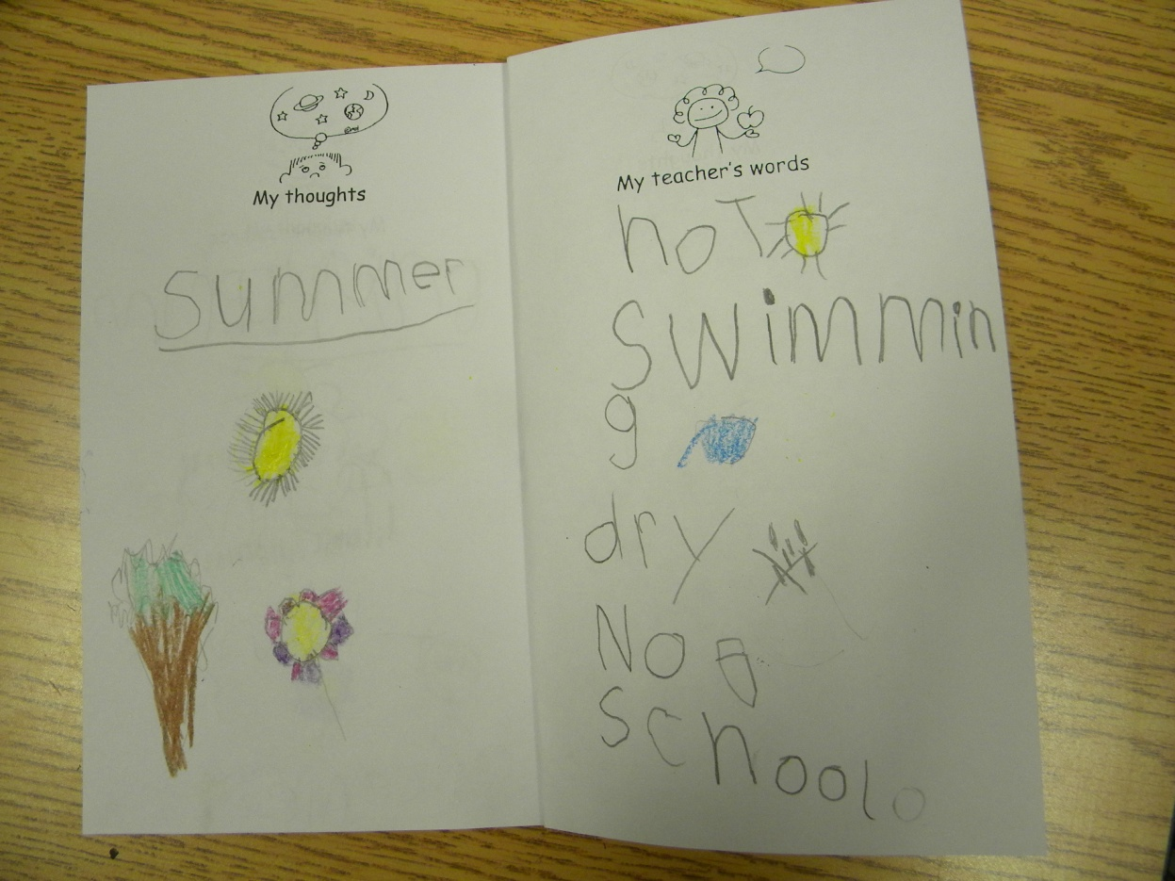
Notebook Evolution
In the first notebooks, students took notes about new information on the right page and used the left page for their application.

Slide 16
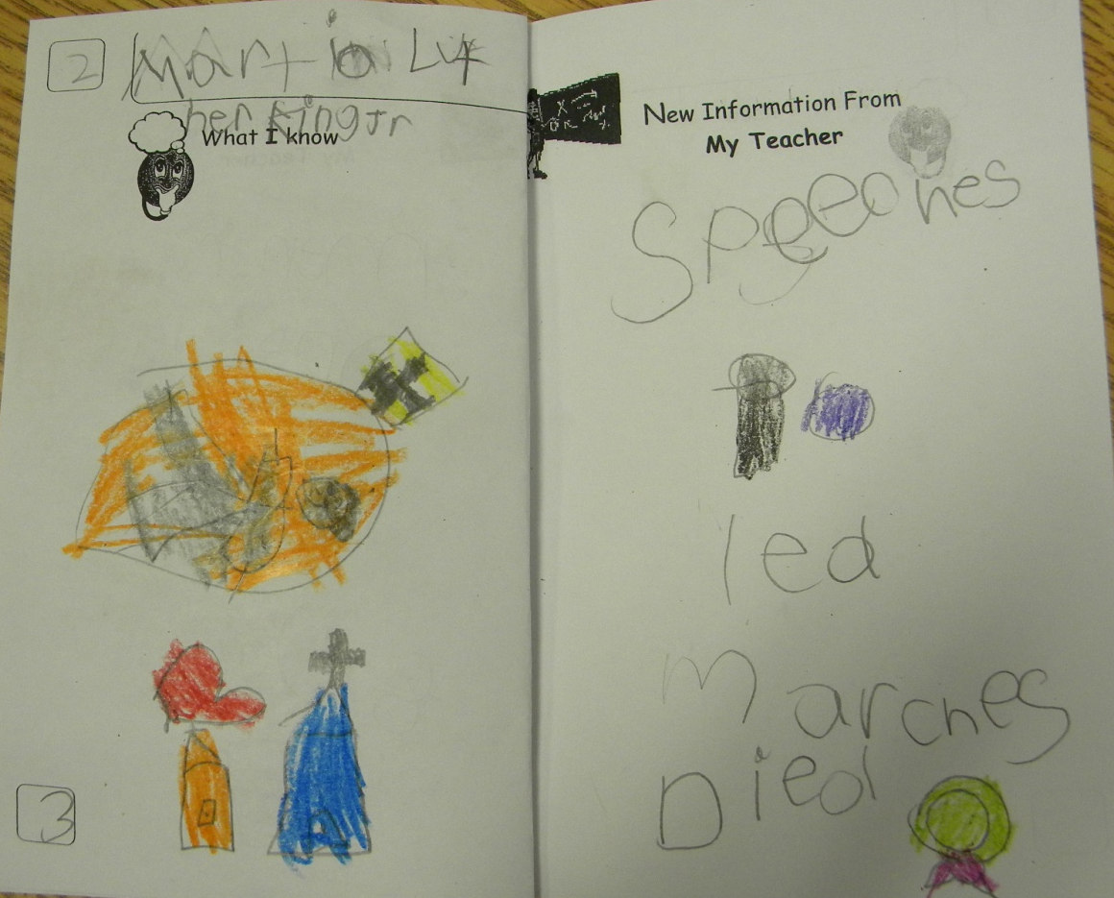
In the next notebooks, boxes were added to record goal scores.

Slide 17
APK
New Information
Goal
Application

