Slide 1
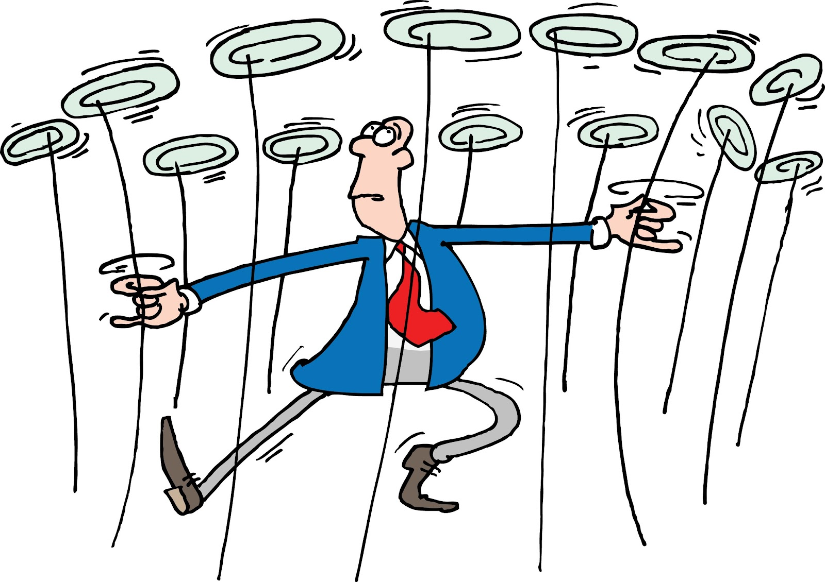
Notes:
Take a minute to jot down all of the curriculum plates that you are spinning

Slide 2
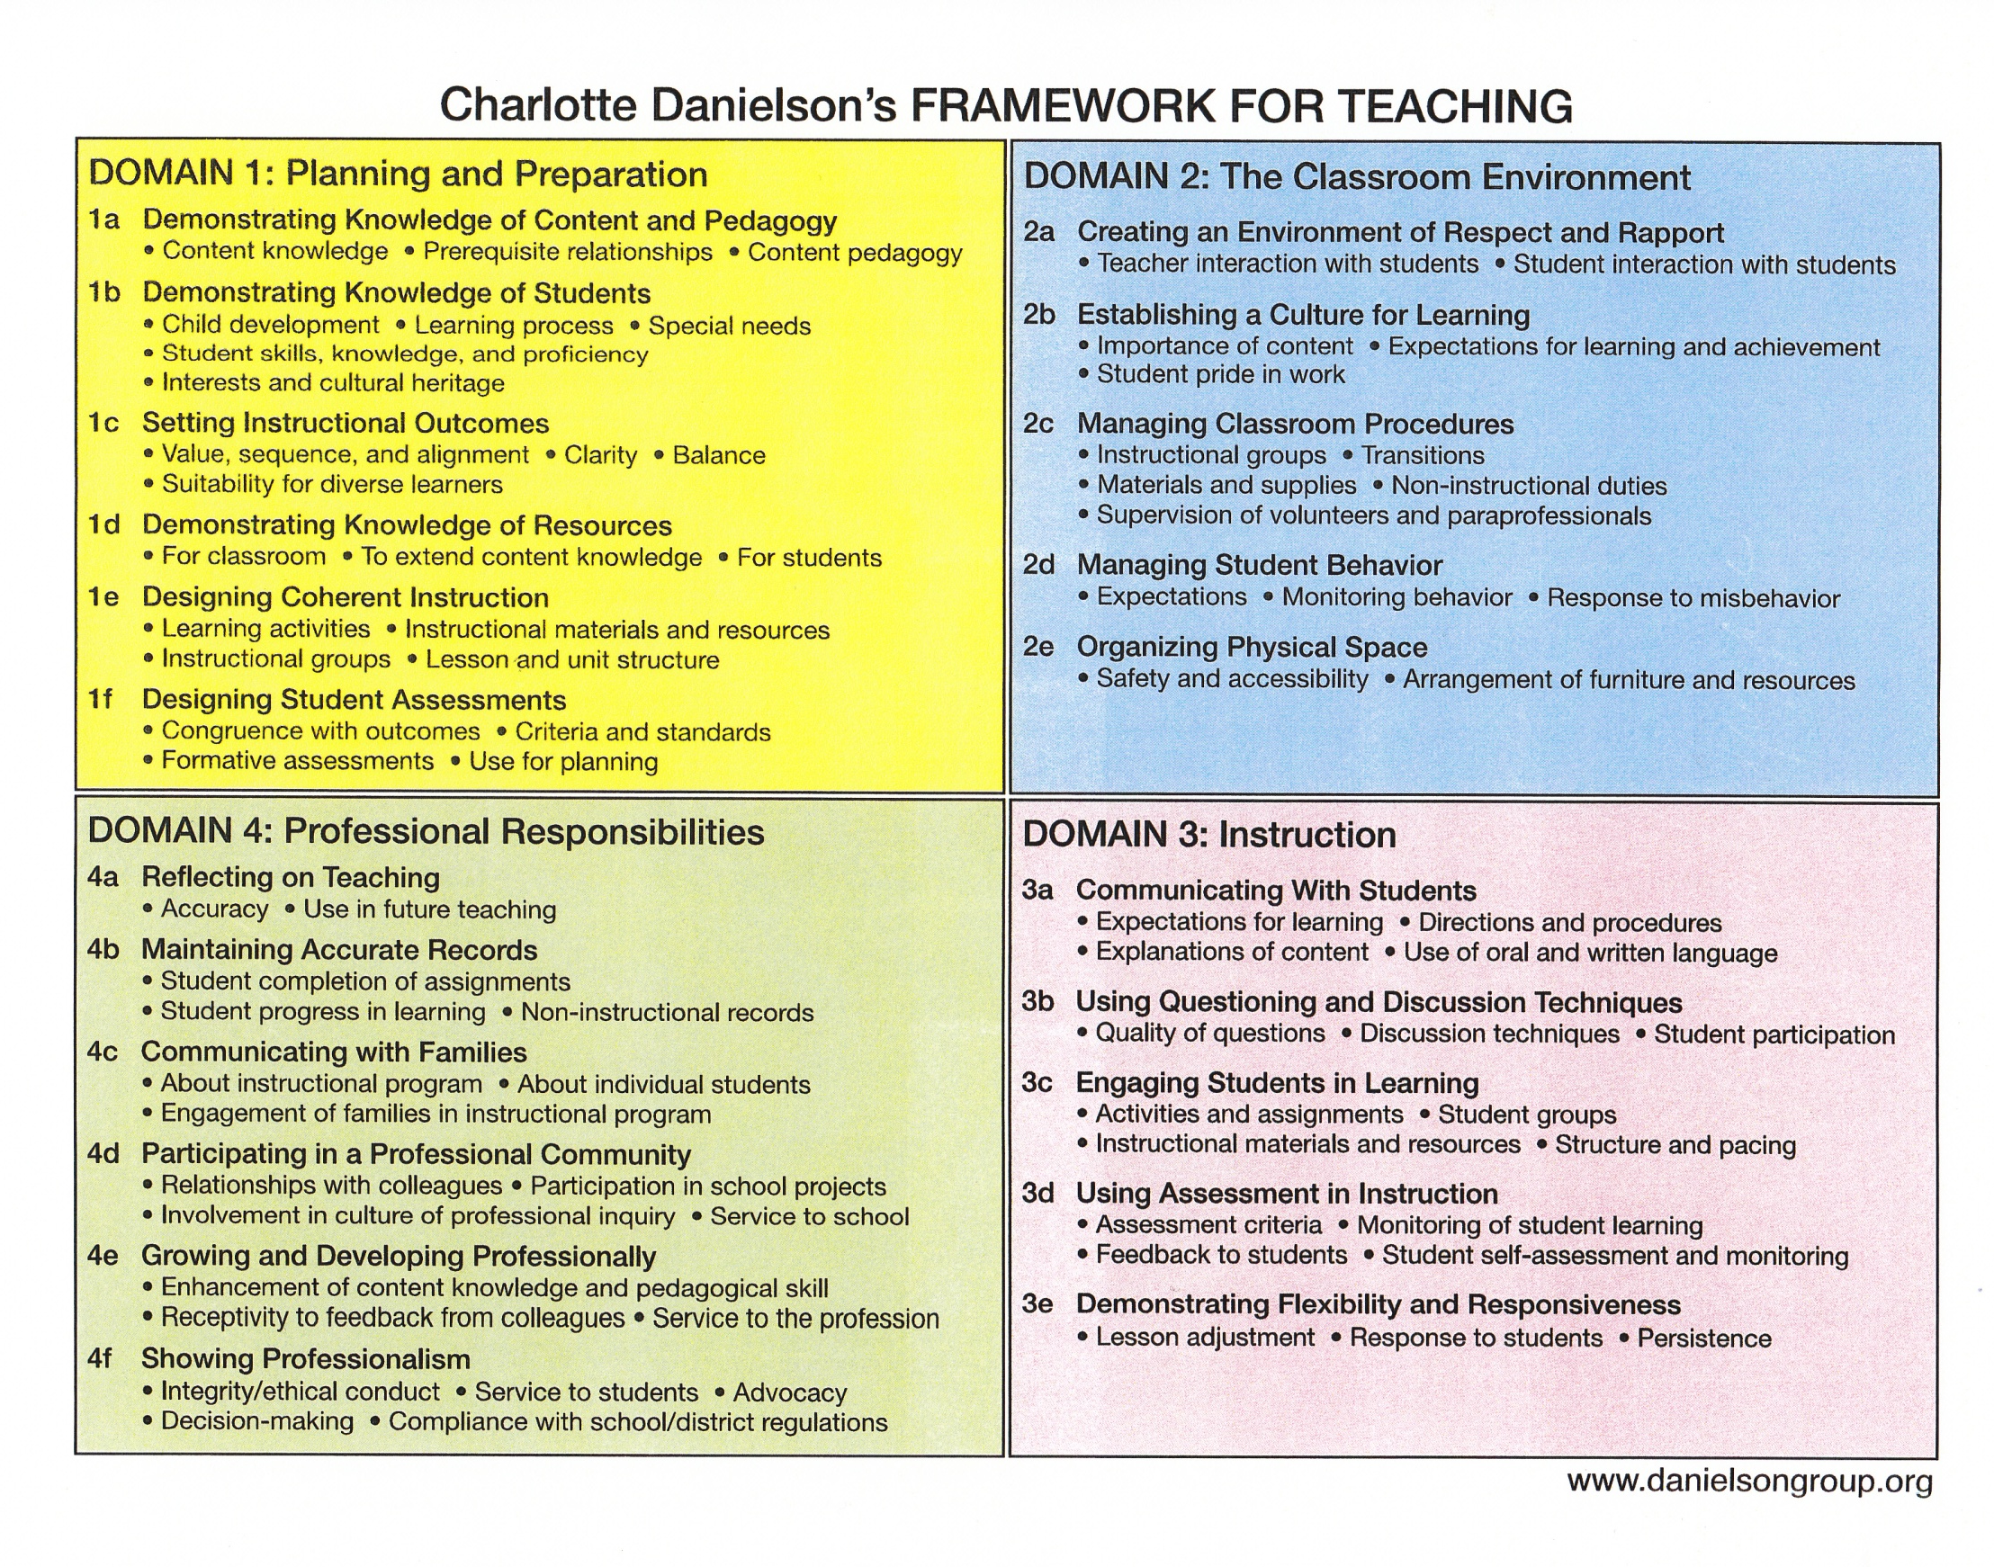
What it Looks Like
Teacher
Evaluation Instrument
The Big Four
GANAG
High Yield Strategies
How We Get There

Slide 3
Daily Instruction
G - set a goal chapters 8/4
A – access prior knowledge chapters 6/7/10
N – new information (d or p) chapters 3/5/11
A – apply thinking/practice chapters 2/9/10 and 5
G – generalize, goal review, grade chapters 8/4
Homework/Assessment
Notes:
GANAG provides opportunities for students to use all nine strategies.

Slide 4
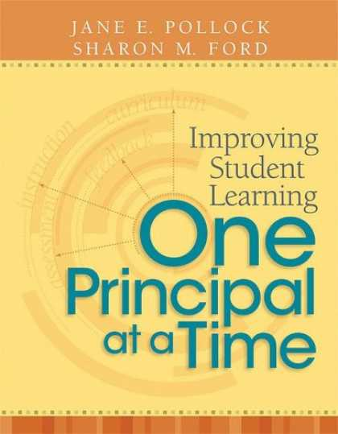
GANAG
The First G

Slide 5
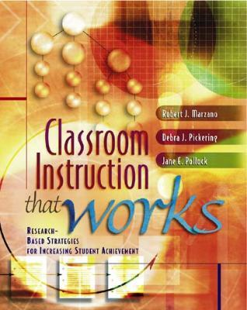
Gs= Opportunities for 2 Strategies
Notes:
2-2-2
By asking the students to interact with the goal, they are setting their objective and providing you feedback.
If you choose to have them score their effort, you will hit #4 Reinforcing effort and providing recognition.

Slide 6
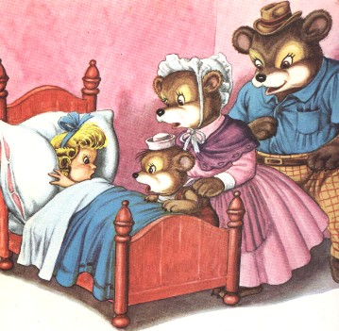
Begin with the standard
State the learning objectives in simple language and in terms of the learning rather than the activity.
Goldilocks Rule
Not too Broad
Not too Specific
“Just Right!”
Notes:
OTAT pg. 30

Slide 7
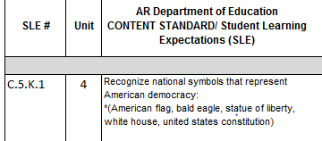
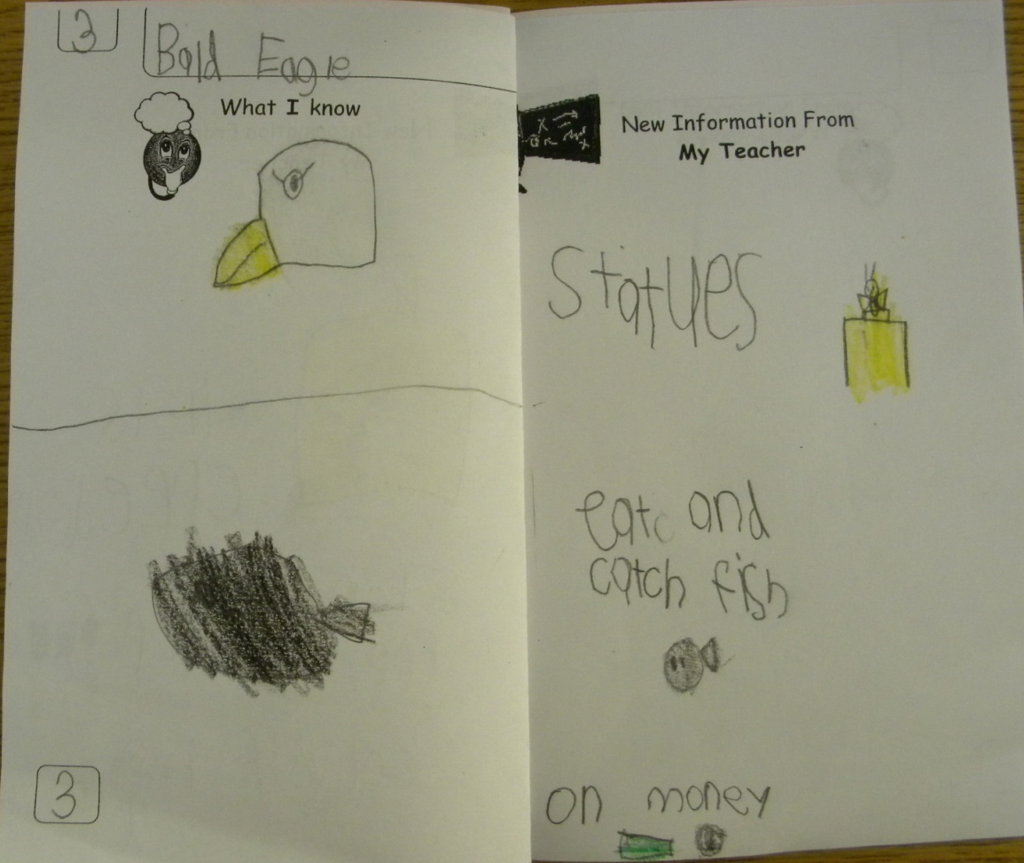
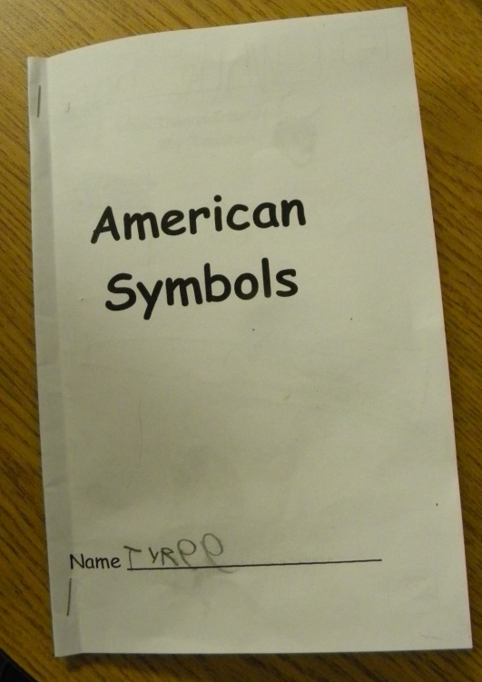
Mini-Unit Goal
I know about national symbols.
Specific Lesson Goal
I know about bald eagles.

Slide 8
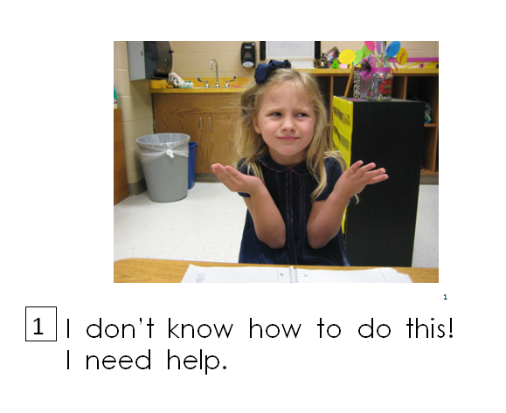
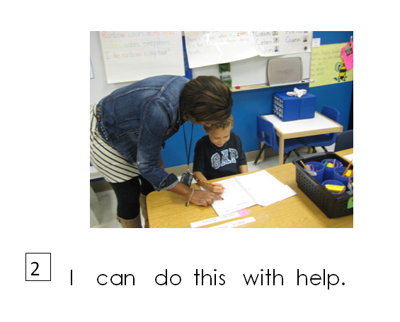
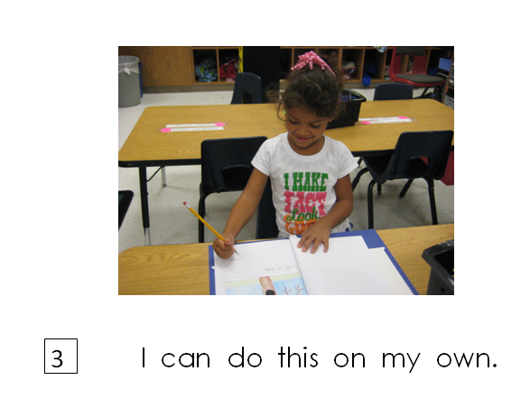
Scoring Rubric

Slide 9
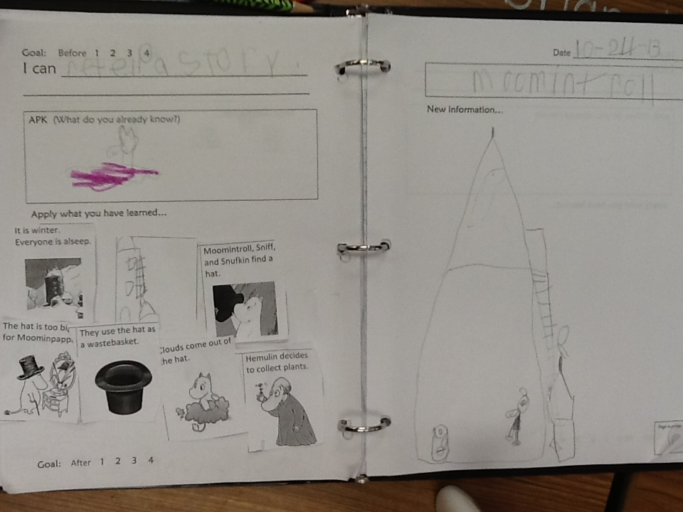
RL.1.2. Retell stories, including key details, and demonstrate understanding of their central message or lesson.

Slide 10
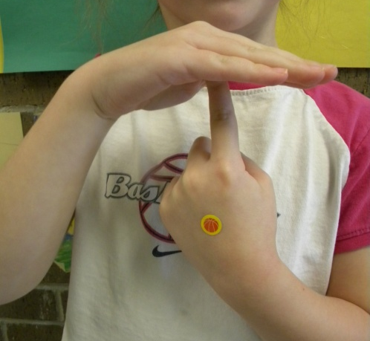
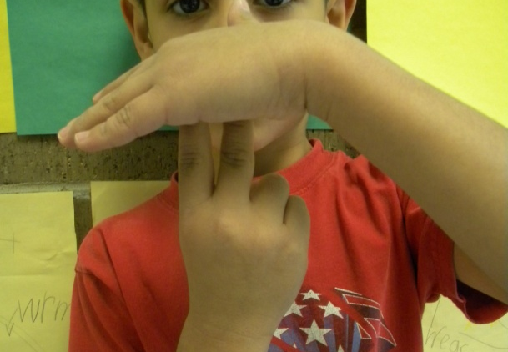
Secret Show Scoring Rubric
1 = I don’t understand
2 = I can do this with some help
3 = I can do this by myself
4 = This is so easy, I can teach someone else how to do it!

Slide 11
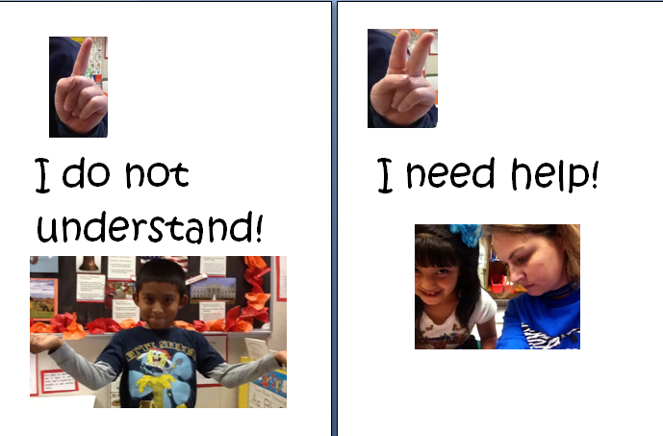
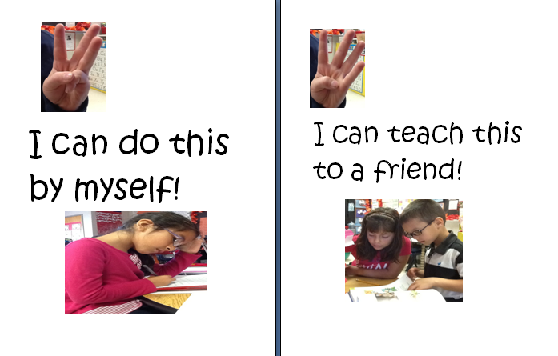
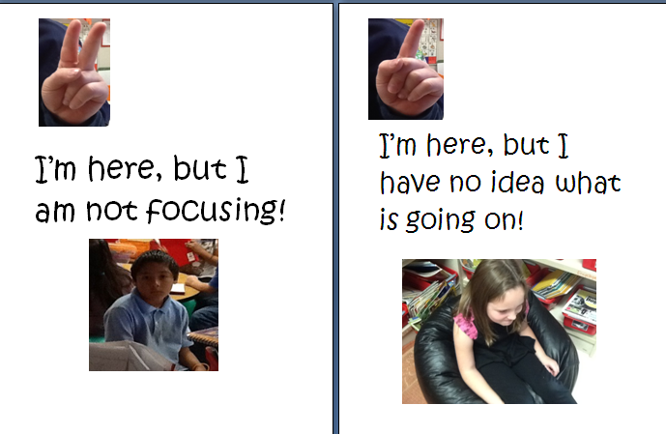
Scoring- Objectives and Effort

Slide 12
GANAG
Accessing Student Prior Knowledge

Slide 13
Three Minutes
Notes:
It takes about 3 minutes to Access Student Prior Knowledge

Slide 14
APK= Opportunities for 3 Strategies

Slide 15
3 simple steps
Use an image, story, object or even notes from the day before.
2. Ask students to respond to a cue or question. If possible, have students write down their response (a word, phrase, numbered list, sketch or pictograph).
3. Pair share to help students fire each other’s neurons- allowing for every student to participate.
Notes:
Does the image help me access prior knowledge?
Does the cooperative learning insure that every child gets to participate in the learning?

Slide 16
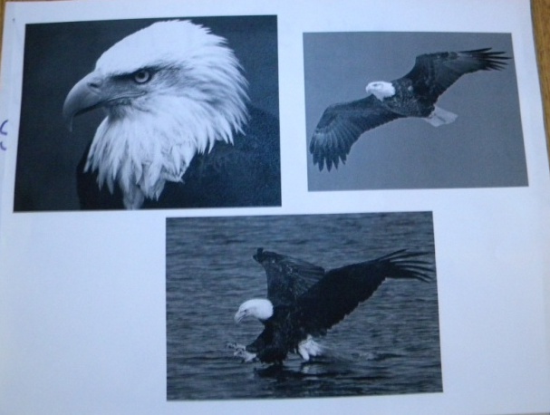
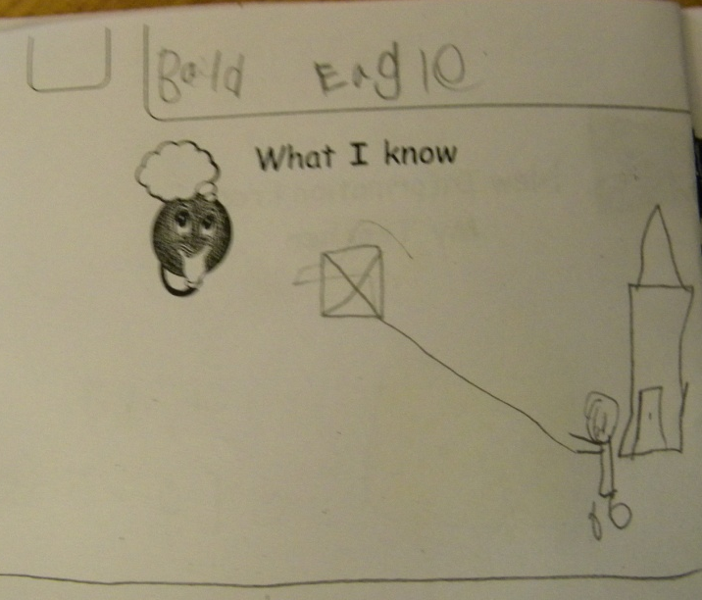
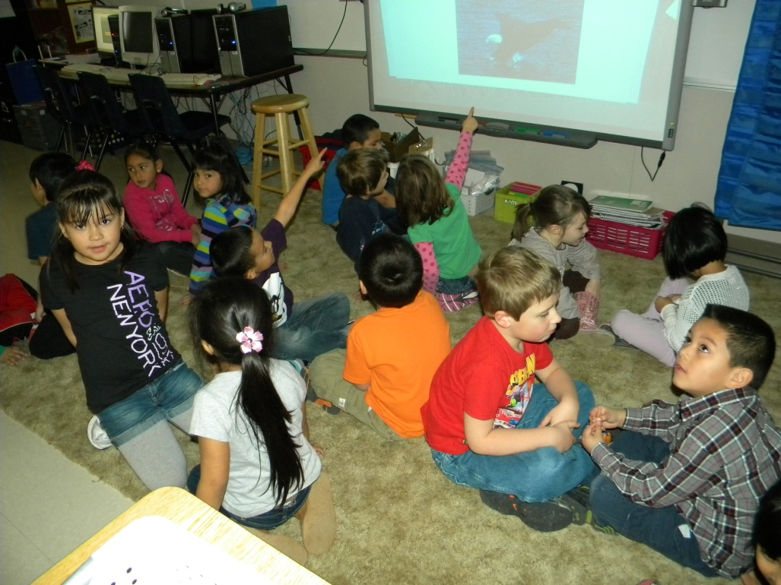
View Images
Question- What do you know about this animal?
Pair Share & Record in Notebook
They fly like my kite.
They are American.

Slide 17
View Book Cover
Question- What happened in our story yesterday?
Record in Notebook then Pair Share

Slide 18
GANAG
New Information

Slide 19
N= Opportunities for 2 Strategies
Chapter 11
Teaching Specific Types of Knowledge

Slide 20
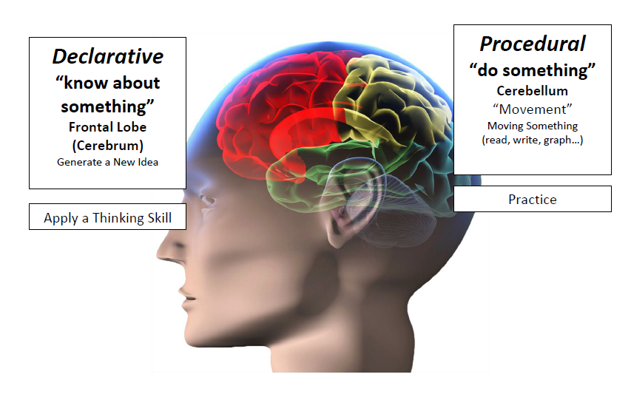
We process different types of knowledge in different parts of our brain…
Notes:
-Students have to know A LOT about something before they can use thinking skills
-Approximately 80% of what elementary students learn in procedural knowledge.

Slide 21
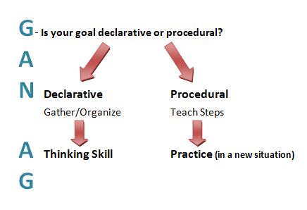

Slide 22
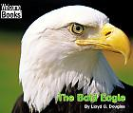
Declarative Goal- “Understanding”
New Information- Read & take notes (gather & organize)
I know about bald eagles.

Slide 23
Procedural Goal- Retelling
New Information-
Review sequencing ideas in a story (steps)
Listen to a new chapter & take notes

Slide 24
GANAG
Application

Slide 25
A= Opportunities for 4 Strategies
DECLARATIVE
PROCEDURAL
DECLARATIVE
DECLARATIVE

Slide 26
They are on statues.
Bald Eagles
eat fish.
“What have you learned about bald eagles?
Bald Eagles are on money.

Slide 27
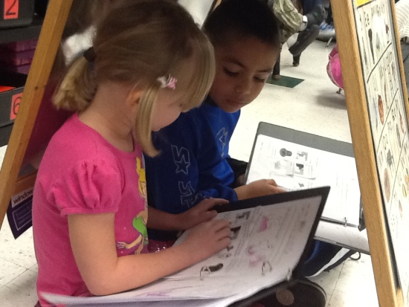
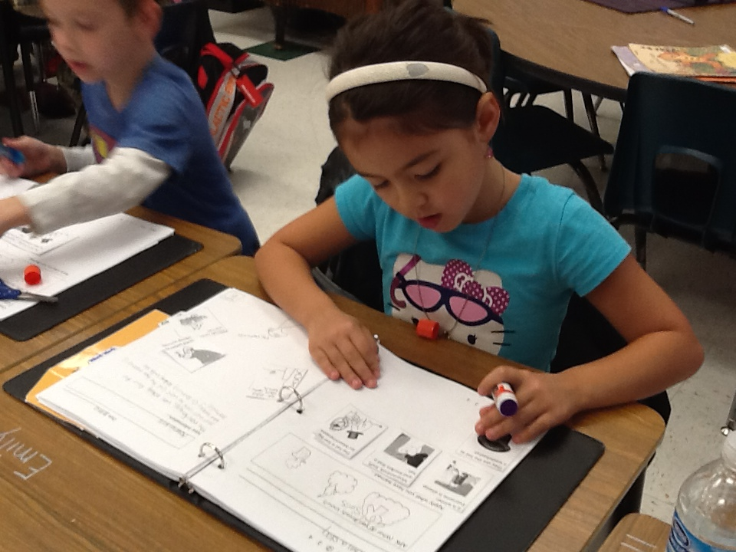
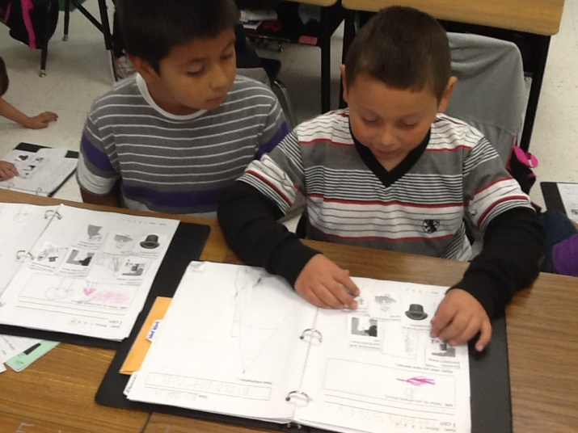
Practice Sequencing Events & Retelling

Slide 28
GANAG
The Final G

Slide 29
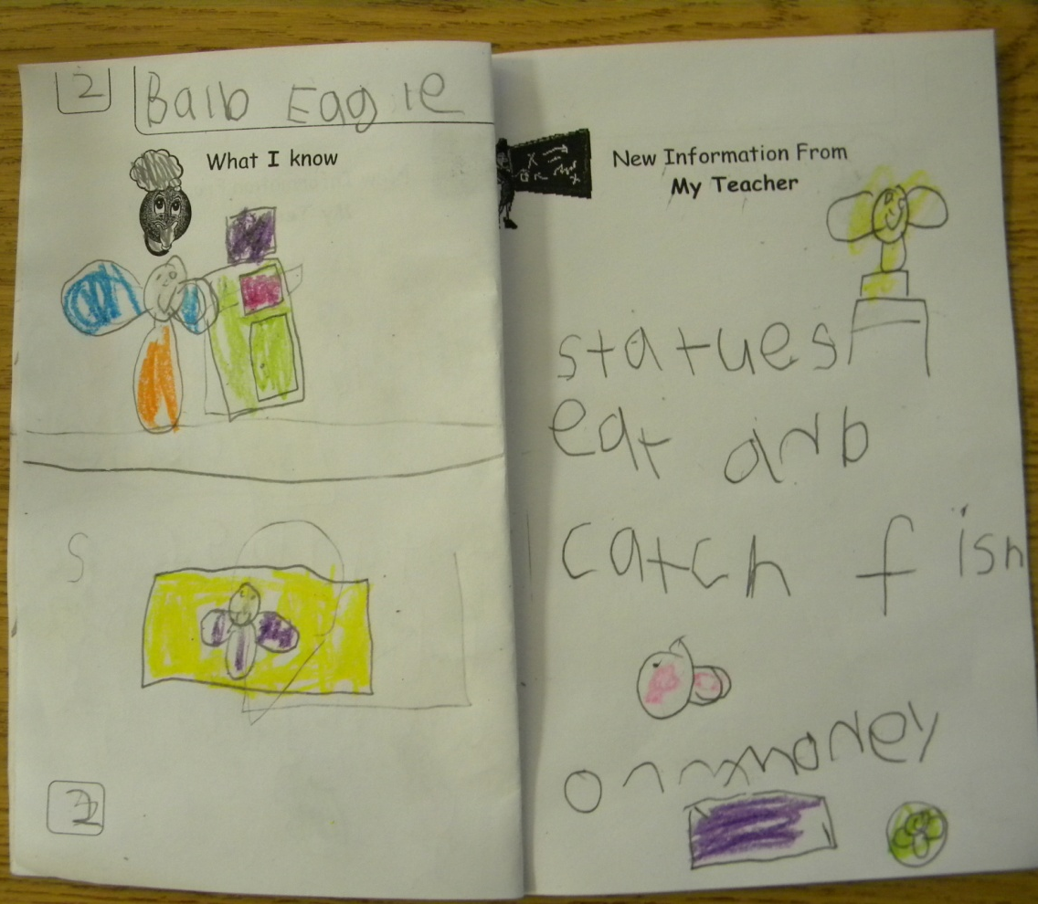
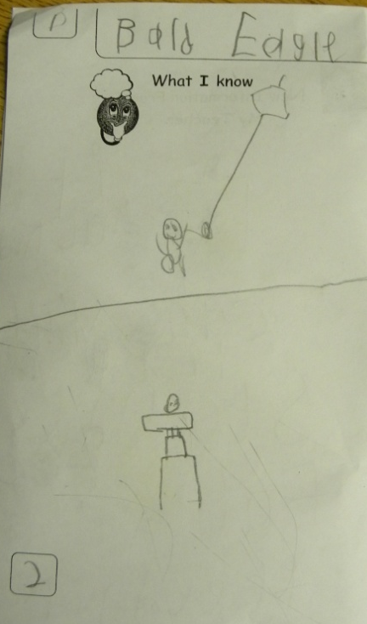
Revisit the Goal
The class revisited the goal and the students scored their understanding of the goal again at the bottom of their paper.

