Slide 1
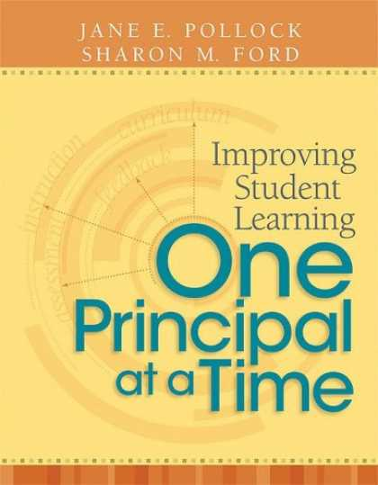
GANAG
Goal Setting
Monday, January 14, 2013

Slide 2
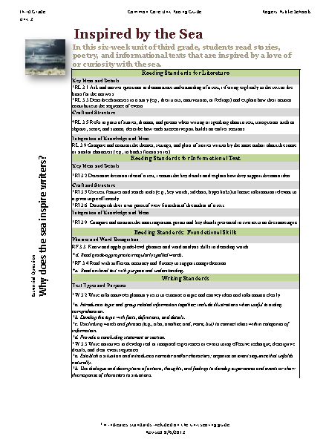
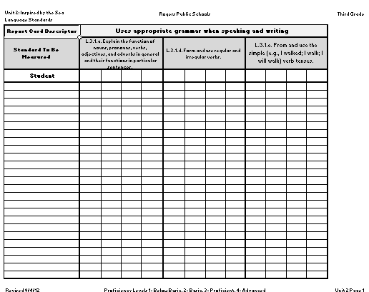
Gs of GANAG
Goal- Set a learning goal based on the standards.
Access Student Prior Knowledge
New information (declarative/procedural)
Application
Goal- Revisit the goal. Score to the standards.
Notes:
One way we can ensure that we are focusing on students learning is to have students interact with the goal at the beginning and the end of the lesson, and then make sure we are scoring student’s progress towards that goal during and/or after the lesson.

Slide 3
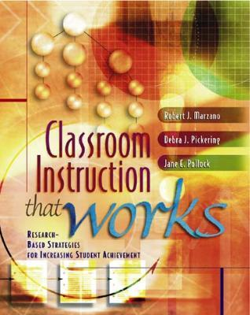
Gs= Opportunities for 2 Strategies
Notes:
2-2-2
By asking the students to interact with the goal, they are setting their objective and providing you feedback.
If you choose to have them score their effort, you will hit #4 Reinforcing effort and providing recognition.

Slide 4
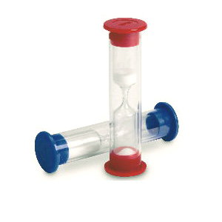
Two Minutes
Notes:
Once you have established routines, it takes about two minutes to have students interact with the goal.

Slide 5
2 simple steps
Make sure students:
1. See & Hear the Goal
2. Interact with the Goal
Read it
Say it
Write it
Score it
Notes:
Turn and Talk
“What is your favorite way to have students interact with the goal?”

Slide 6
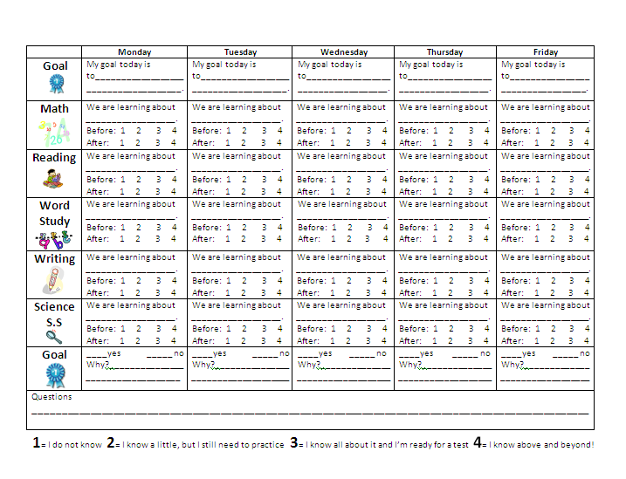
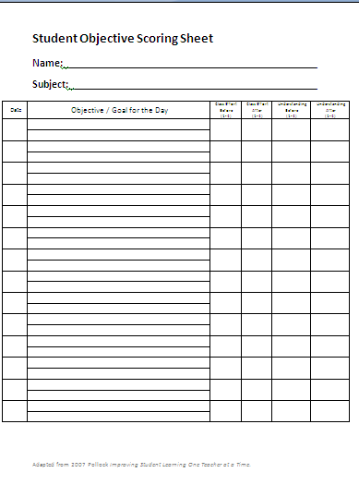
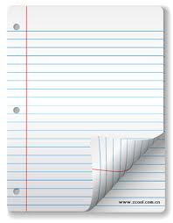
Goal Scoring Tools
Notes:
These tools do not have to be complicated. They can be as simple as hand signals or a blank piece of paper.

Slide 7
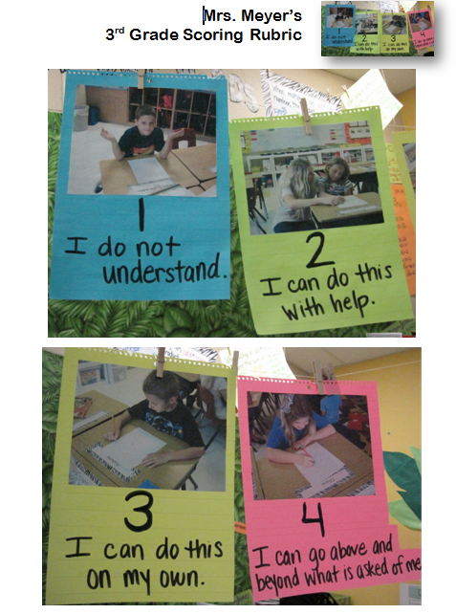
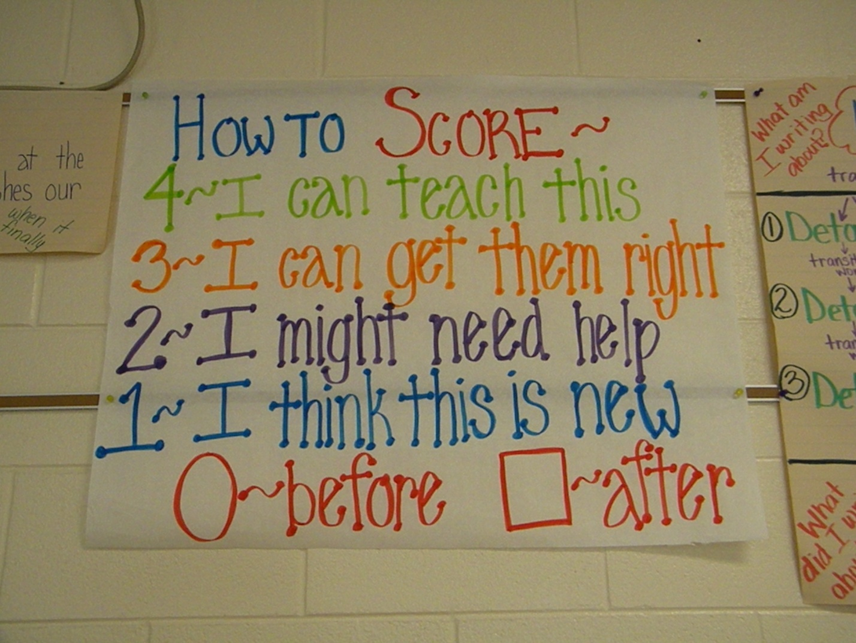
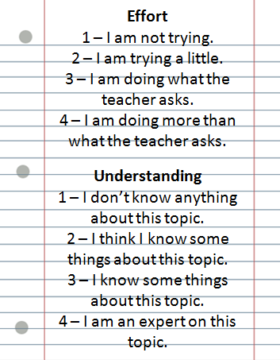
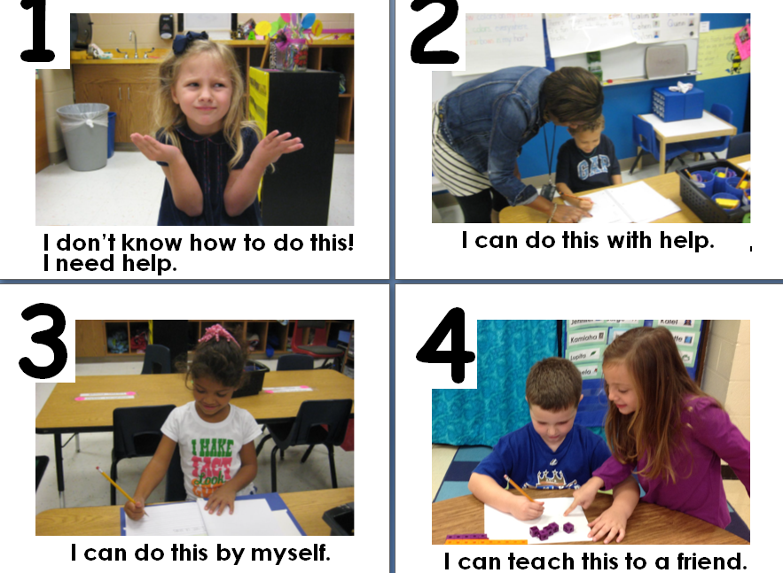
Scoring Rubrics
Notes:
Here are some scoring rubrics our teachers have created.
3rd Grade- Jessica Sallis GH (top left)
3rd Grade- Kim Myer ET (top right
K- Aticha Jamison (ET) and Sue Jordan (GH) (bottom left)
5th- Jenny Humbel (GH)

Slide 8
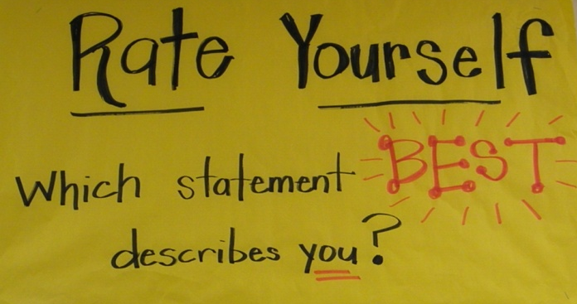
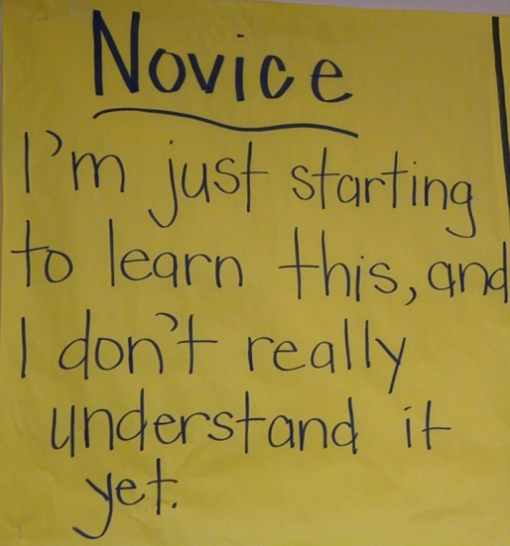
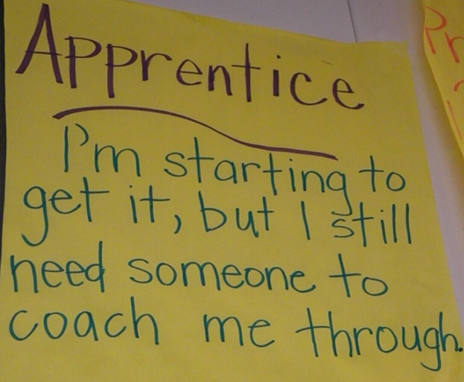
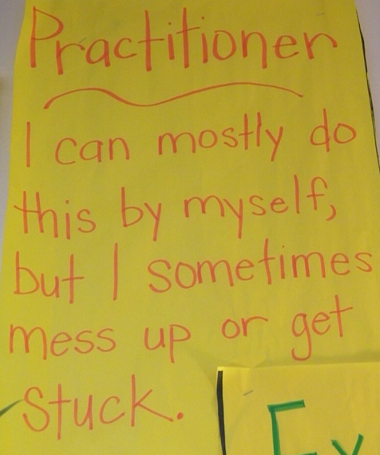
1
2
3
4
Notes:
The 4th grade team at Lowell began using these descriptors to help their students understand it was O.K. to be a 1,2 or 3.

Slide 9
GANAG
The First G

Slide 10
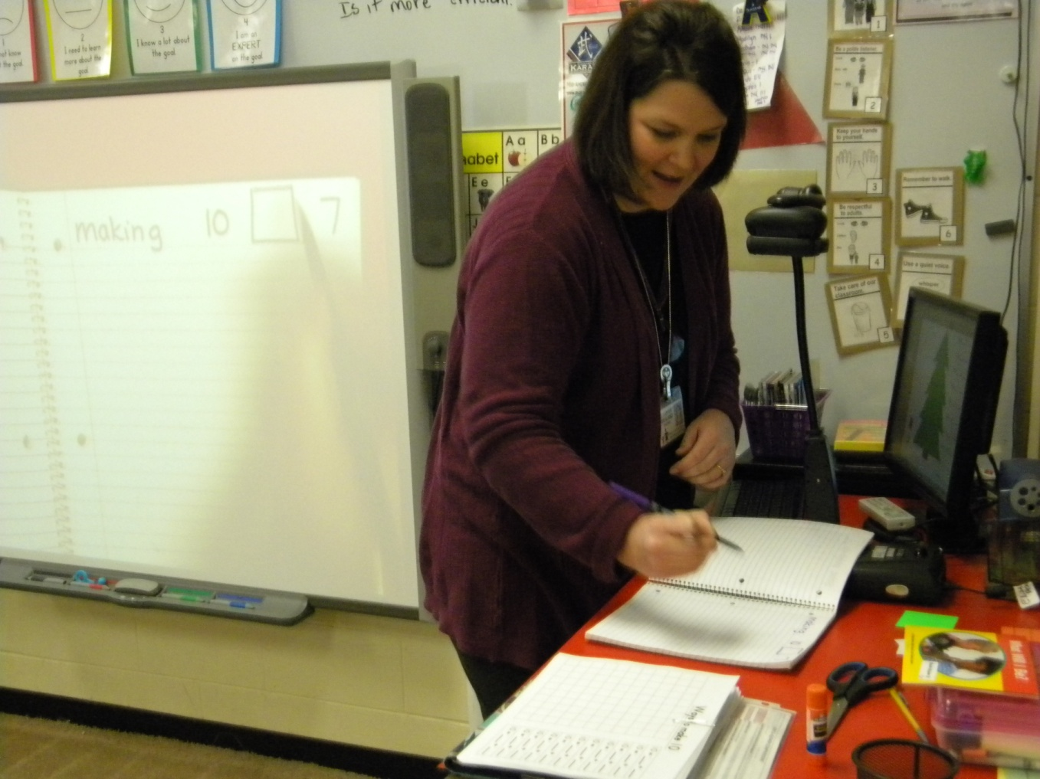
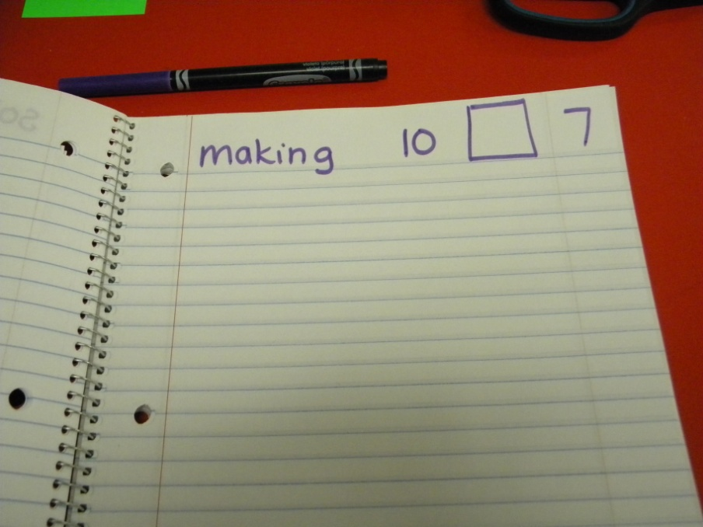
Goal: I can make groups of ten.
KINDERGARTEN
Notes:
Mrs. Kirkland (GH) reads the goal to her students (HEAR) and then models writing it in her notebook (SEE).

Slide 11
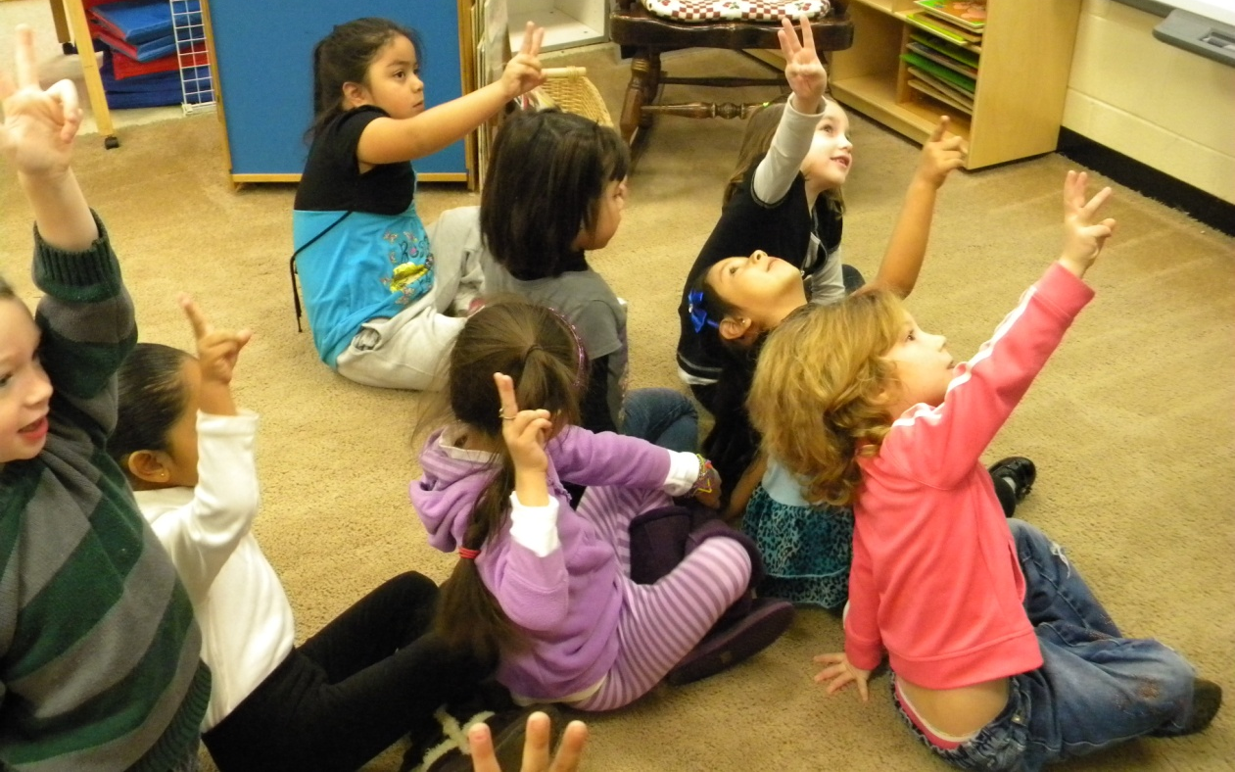
Students scored their understanding of the goal.
(8) Setting Objectives and Providing Feedback
Notes:
Students interacted with the goal by scoring their understanding.

Slide 12
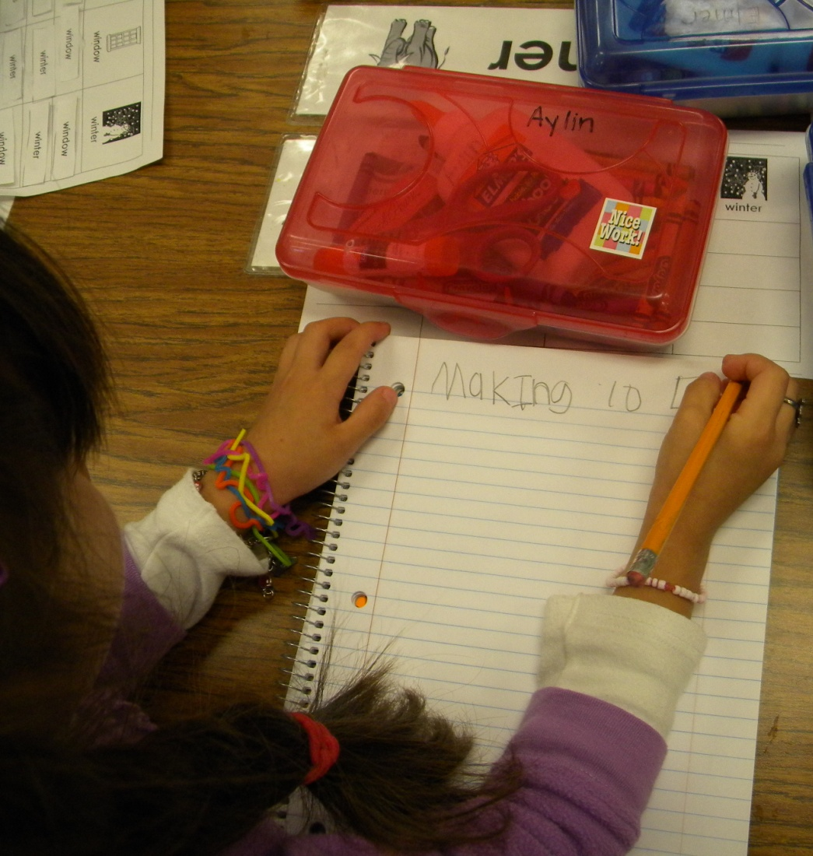
Students wrote their goal and recorded the score they shared with Mrs. Kirkland earlier.
Notes:
Increased interaction with the goal.

Slide 13
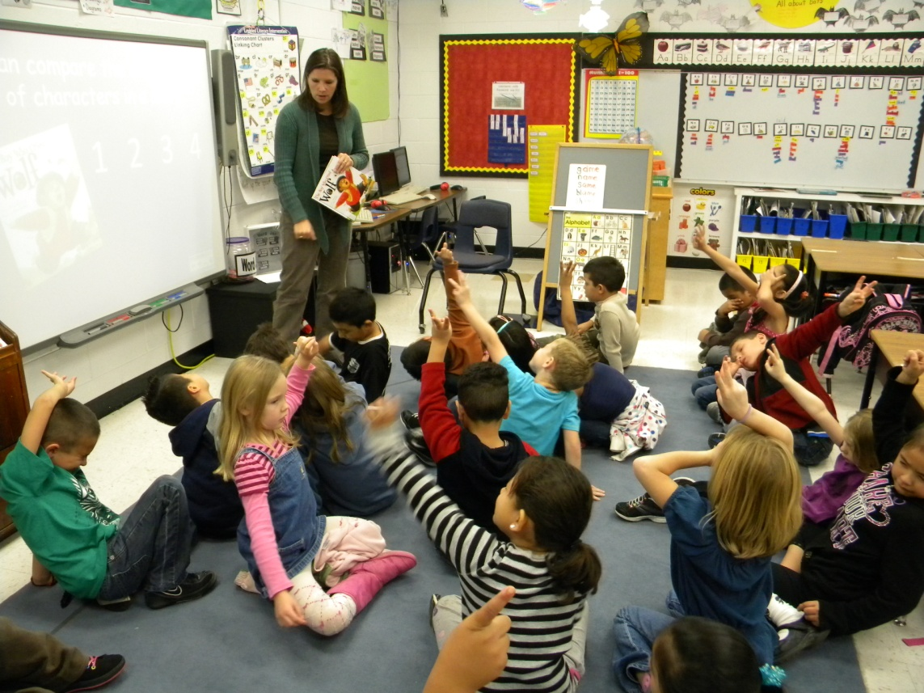
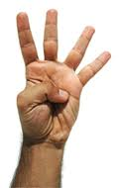
1st GRADE
(8) Setting Objectives and Providing Feedback
GOAL:
I can compare the experiences of characters.
The students scored their understanding before the lesson by holding up the number of fingers of their score.
Notes:
Mrs. Felts (ES) displayed the goal on her SMARTboard and read it to her students (SEE and HEAR). She asked students to score their understanding (INTERACT).

Slide 14
The class recorded their understanding of the goal score at the top of their comparison matrix.
Notes:
Increased interaction.

Slide 15
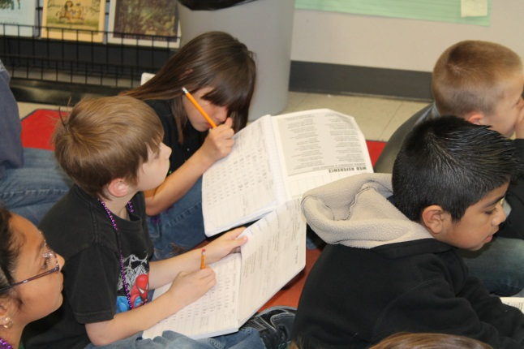
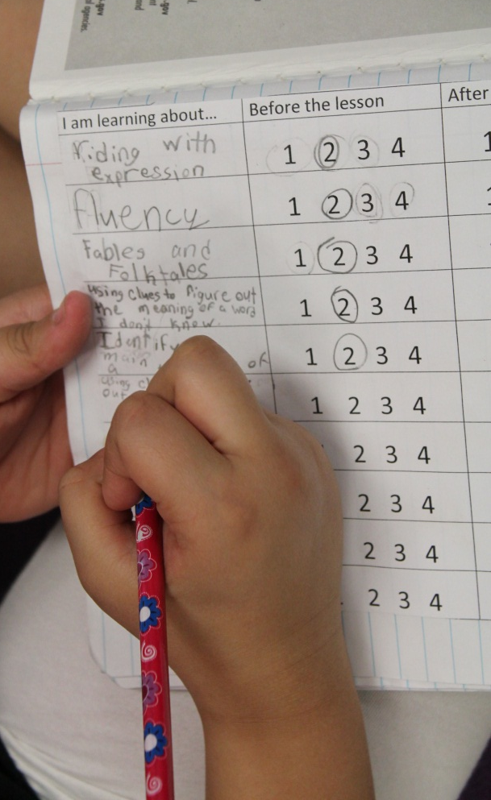
GOAL: I can use the author’s clues to determine the meaning of a word.
2nd GRADE
Students write the goal for the lesson in their notebook and score themselves.
(8) Setting Objectives and Providing Feedback
Notes:
Mrs. Eides (JM) wrote the goal on the board as students wrote it in their interactive notebook.

Slide 16
Goal
3rd GRADE
I can use the internet to research.
Students were asked to score themselves.
They used the Student Scoring Sheets in their Interactive Notebooks.
(8) Setting Objectives and Providing Feedback

Slide 17
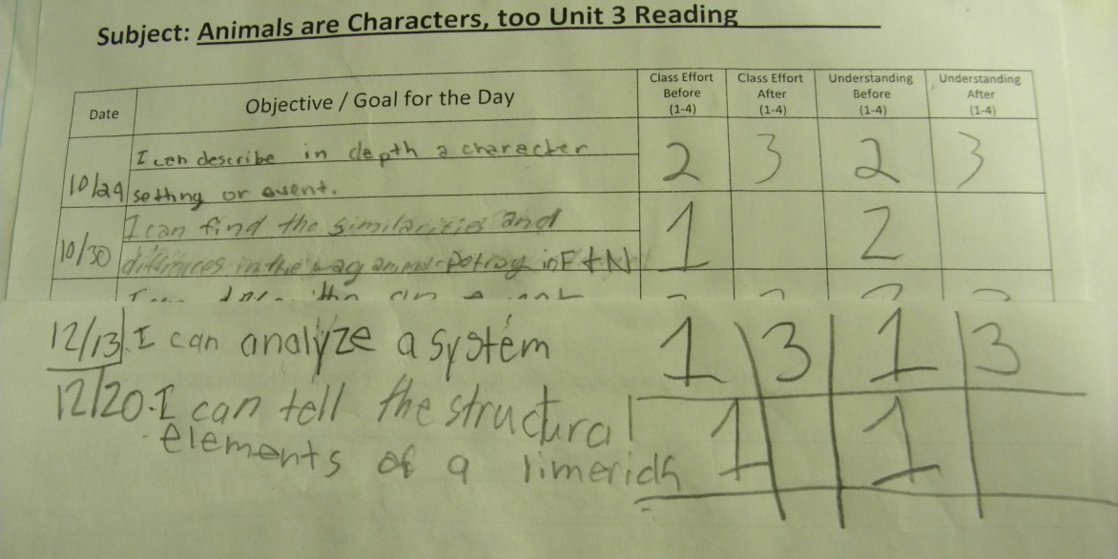
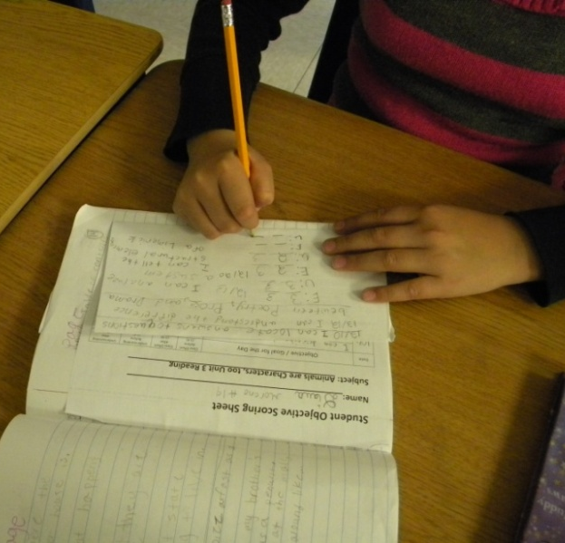
Goal I can tell the structural elements of a limerick.
4th GRADE
Students wrote the goal in their notebooks and scored both their understanding and effort.
(4) Reinforcing Effort and Providing Recognition
(8) Setting Objectives and Providing Feedback
Notes:
Mrs. Grayson’s class (OW). The students had filled up their score sheet for the unit, so they were folding their paper and continuing on the back.

Slide 18
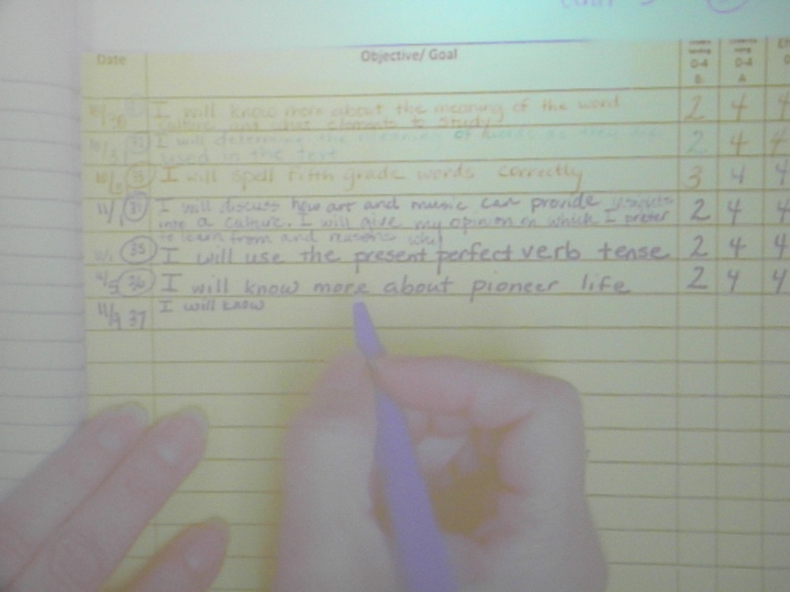
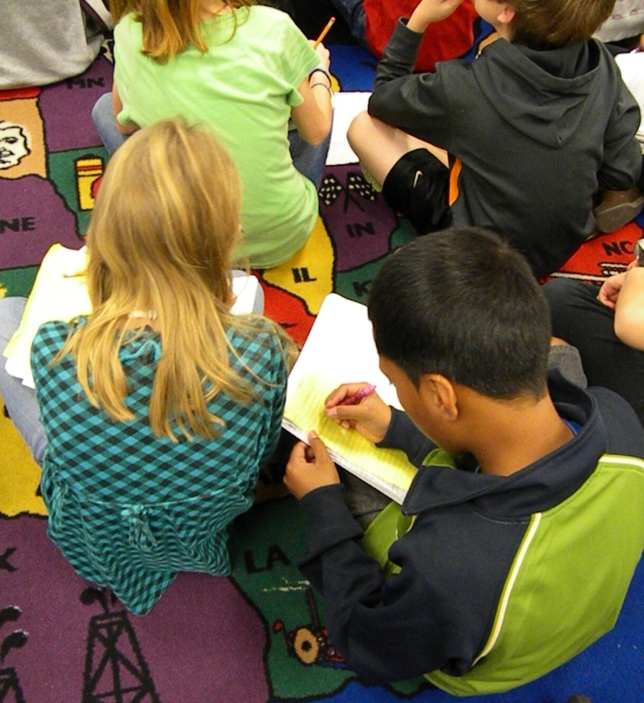
GOAL
5th GRADE
I will know about pioneer life- compare and contrast schools
Students recorded the goal in their notebooks.
Notes:
Mrs. Harp (LW) runs her objective score sheets on a different color for each unit. This unit was yellow.

Slide 19
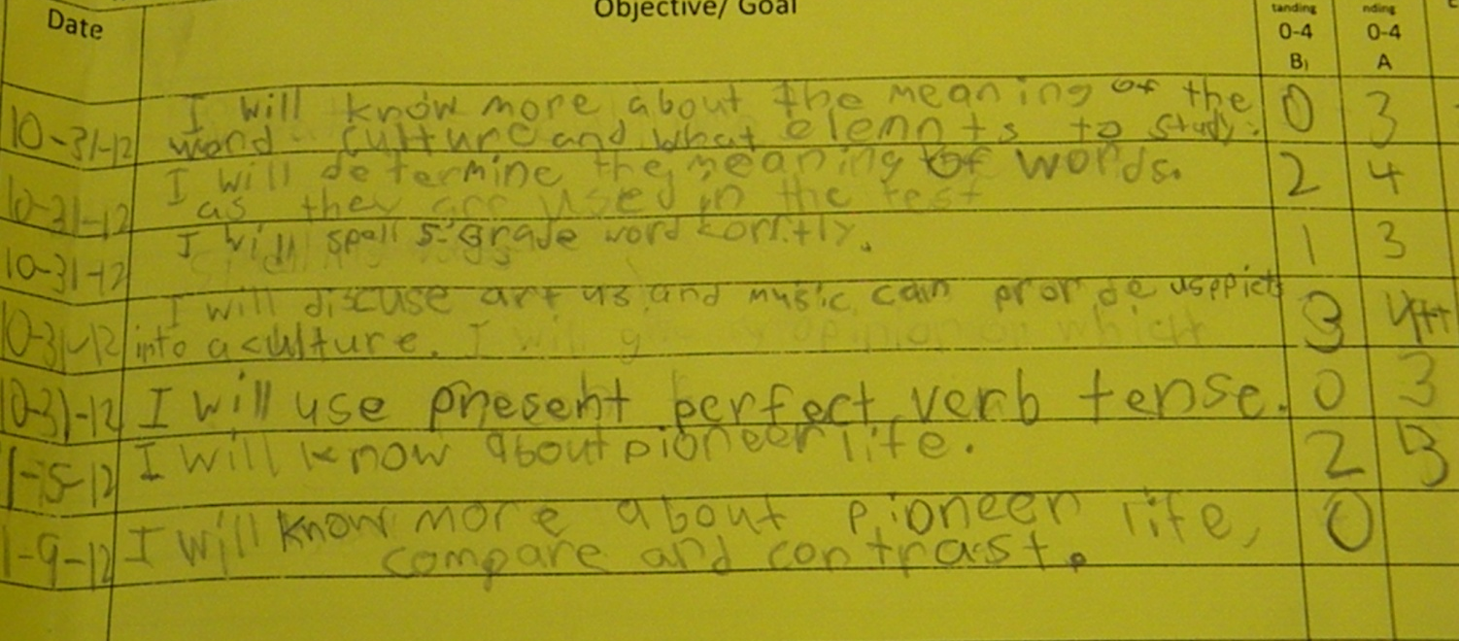
Students scored their knowledge of the goal before the lesson.
(8) Setting Objectives and Providing Feedback

Slide 20
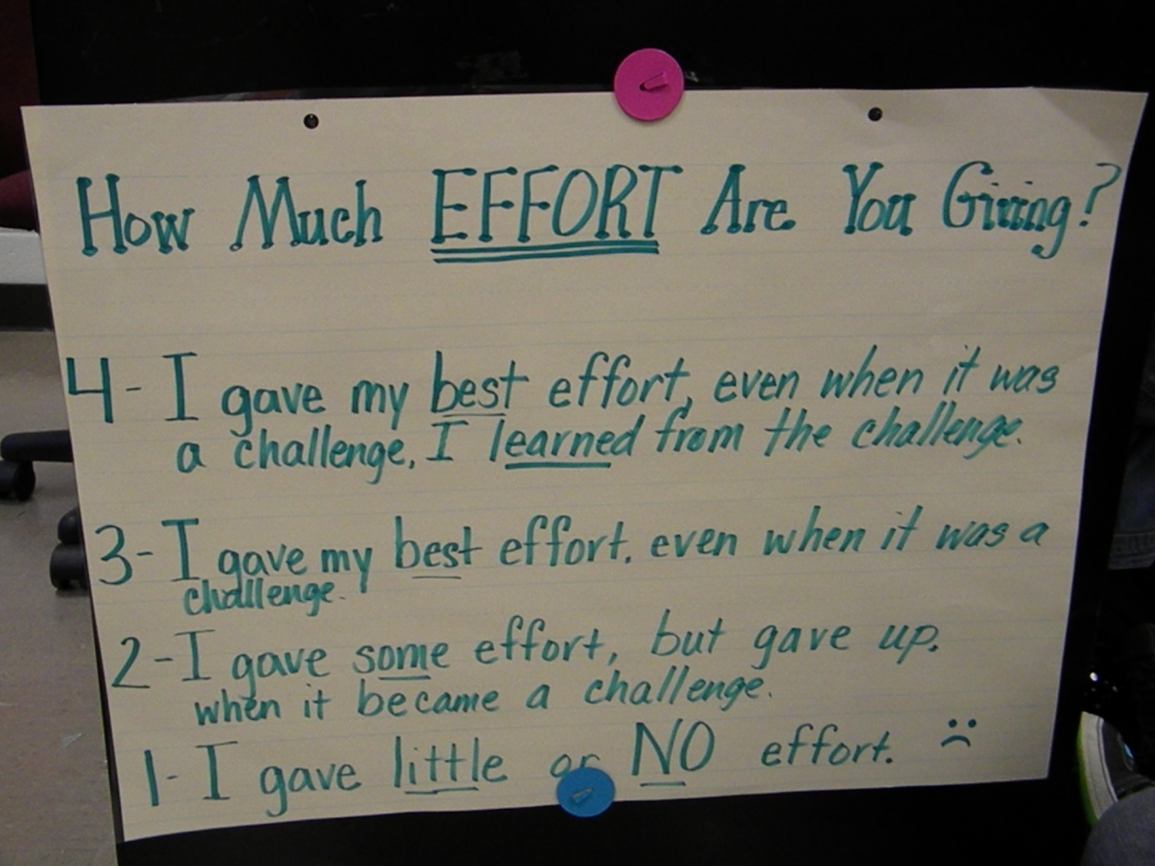
They used an effort rubric to score the effort they would put into the lesson.
(4) Reinforcing Effort and Providing Recognition

Slide 21
GANAG
The Last G

Slide 22
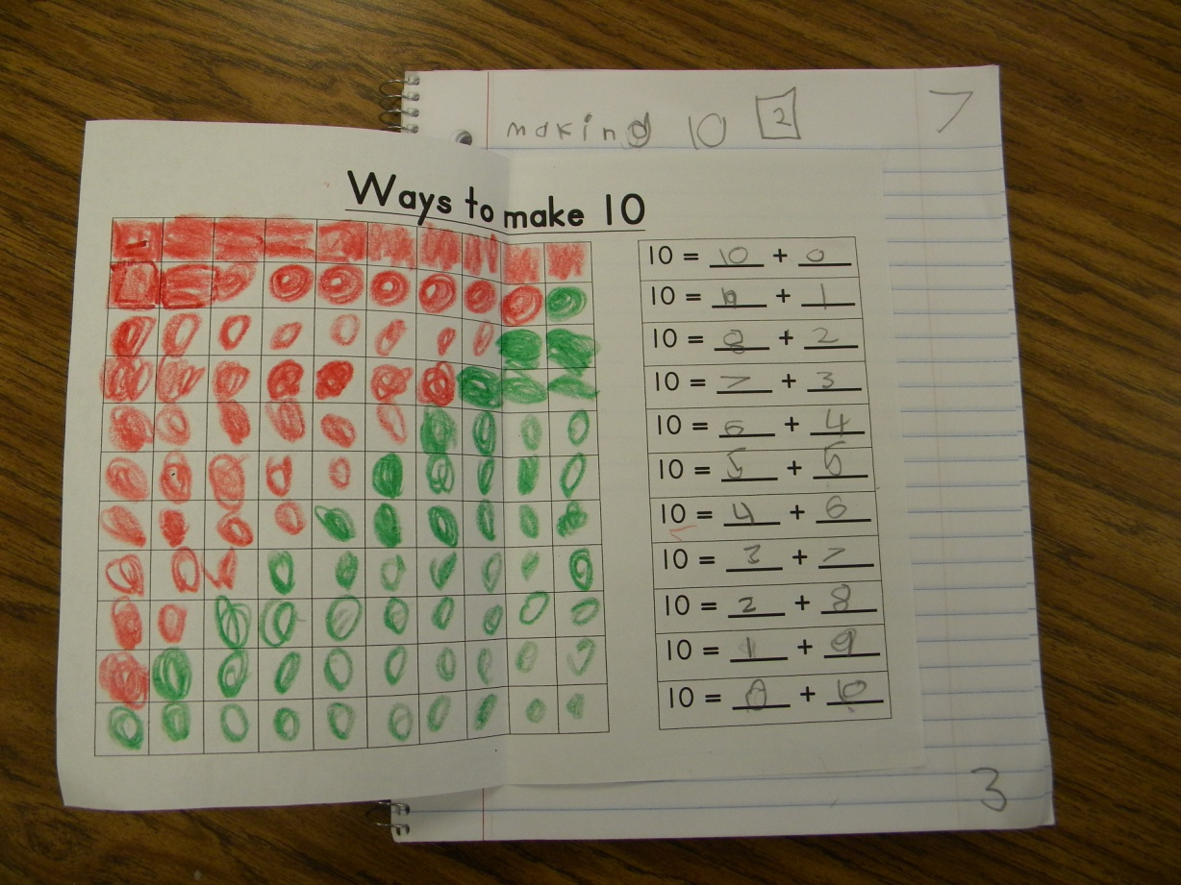
Goal: I can make groups of ten.
KINDERGARTEN
The students revisited the goal at the end of the lesson and scored their understanding at the bottom of the page.
Notes:
The score at the beginning of the lesson is in the box at the top of the page. Mrs. Kirkland (GH) has the kids draw a box for the score at the top to keep them from getting mixed up with the page number.

Slide 23
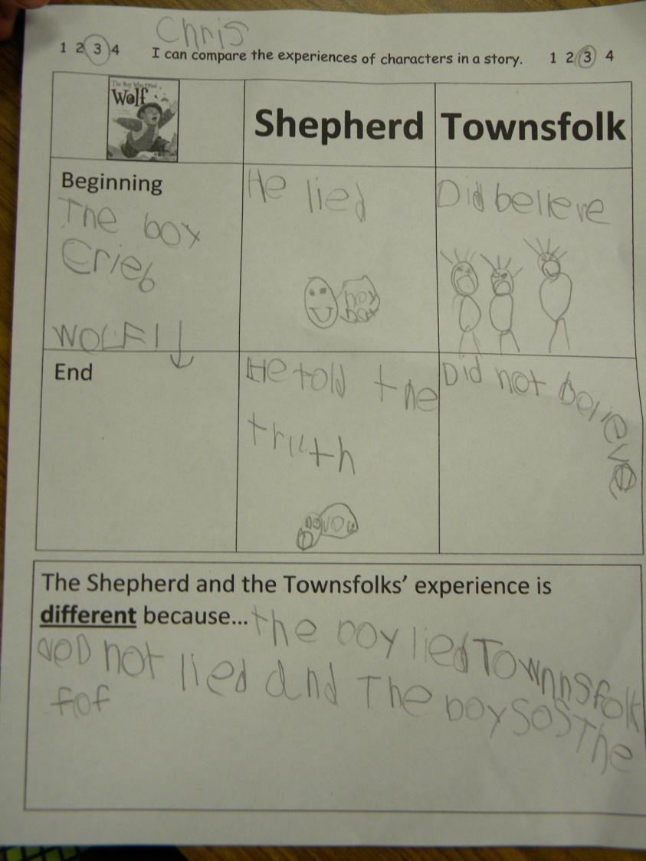
Revisit the Goal
1st GRADE
I can compare the experiences of characters.
The students scored their understanding after the lesson.
Notes:
Mrs. Felts (ES)

Slide 24
G= Generalize the Goal
2nd GRADE
At the end of the lesson students revisit the goal on the goal sheet in the front of their notebook. They score themselves again to see how much they have learned.
This student scored herself a “2” before the lesson. After the lesson, she said she was still a “2.” She said, “I’m starting to get it, but I need more practice.”
Notes:
Mrs. Eides (JM)

Slide 25
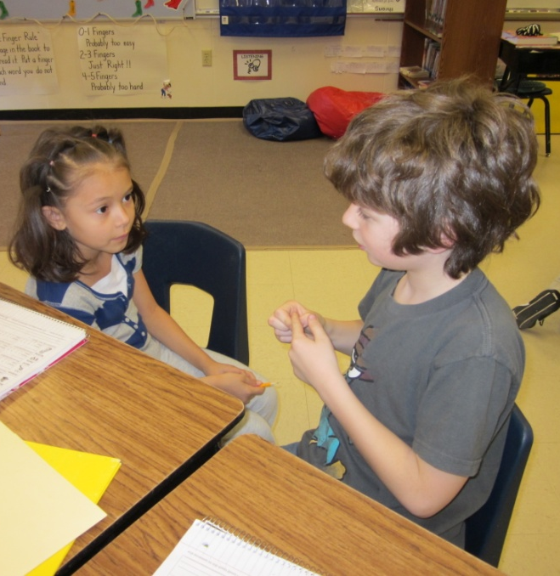
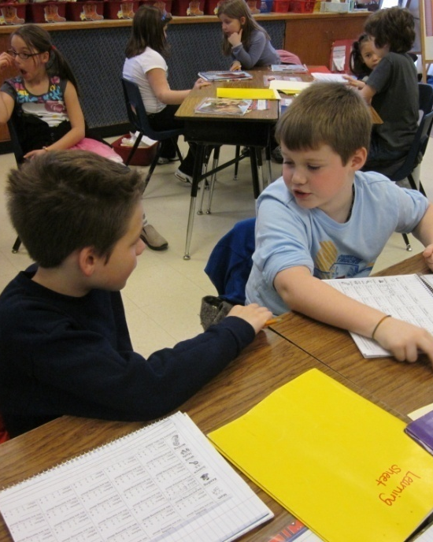
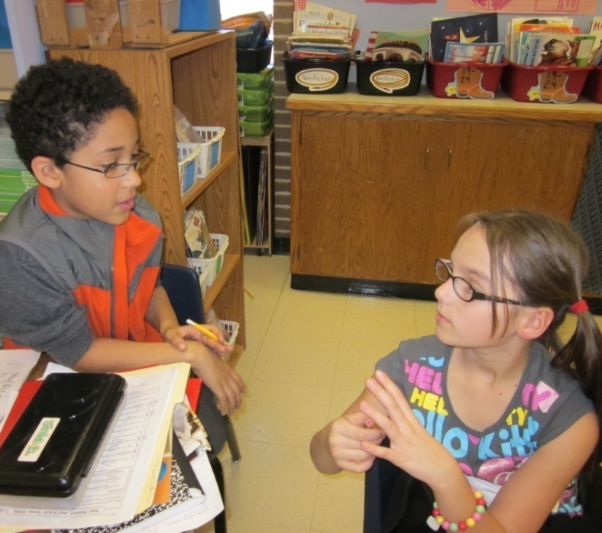
G= Generalize the Goal
3rd GRADE
Students turned and talked to revisit the goal, then
rescored themselves in their Interactive Notebooks.
Notes:
Mrs. Kilch (GH)

Slide 26
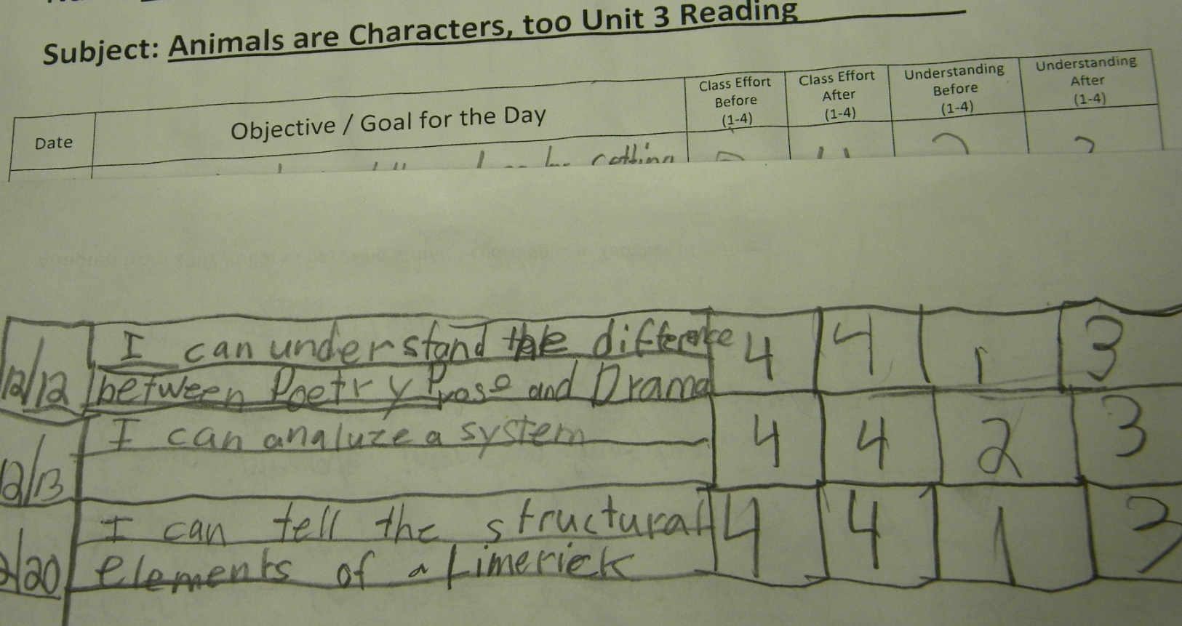
Revisit the Goal
4th GRADE
The students revisited the goal and scored their understanding and effort at the end of the lesson.
Notes:
Mrs. Grayson (OW)

Slide 27
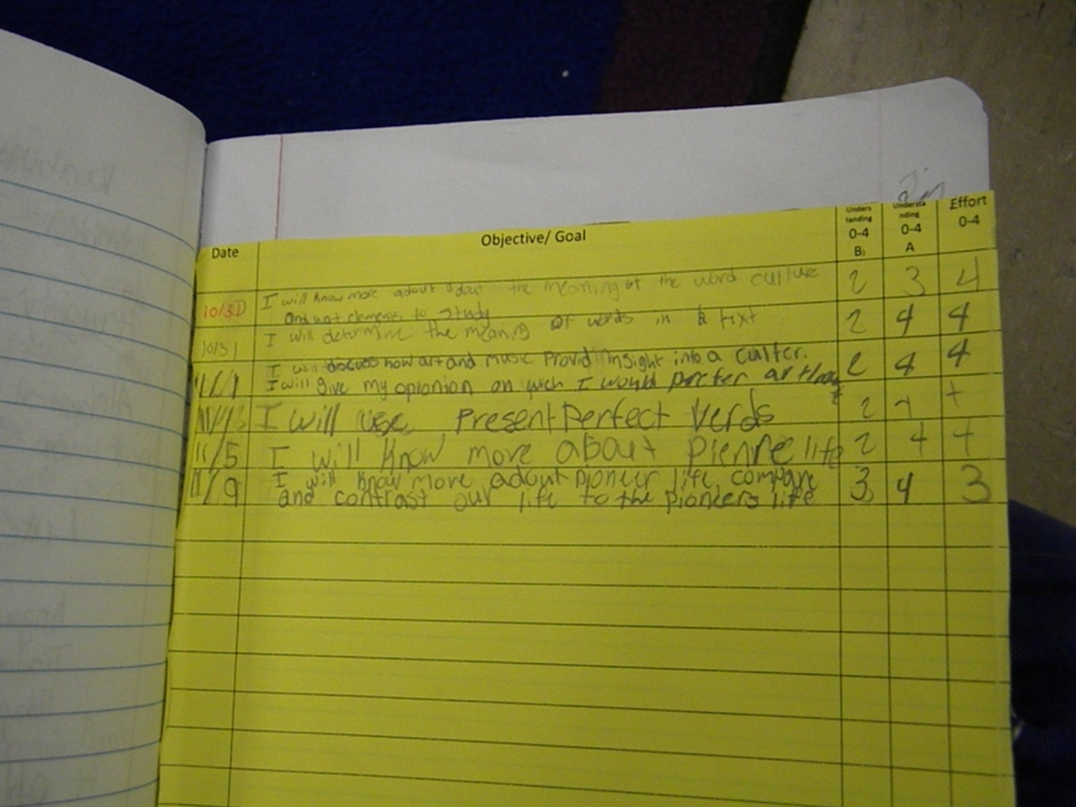
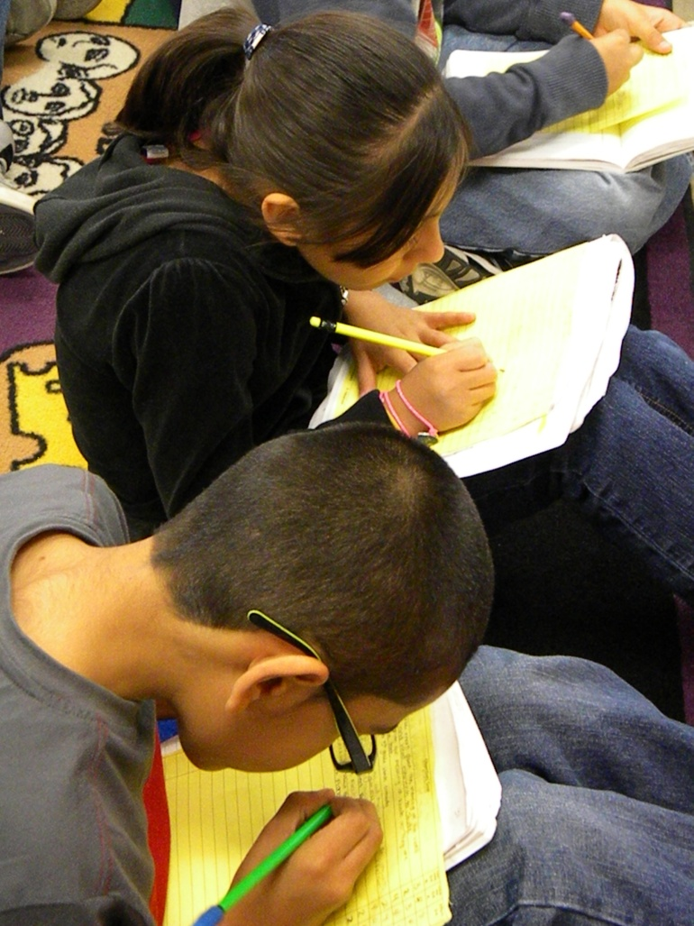
Revisiting the Goal
5th GRADE
Students scored their knowledge of the goal at the end of the lesson.
Notes:
Mrs. Harp (LW)

