Slide 1
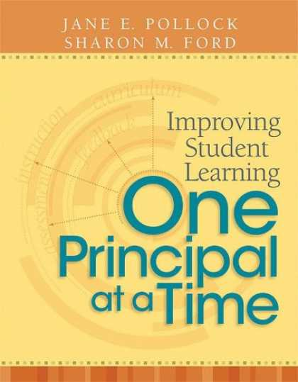
GANAG
The Last G

Slide 2
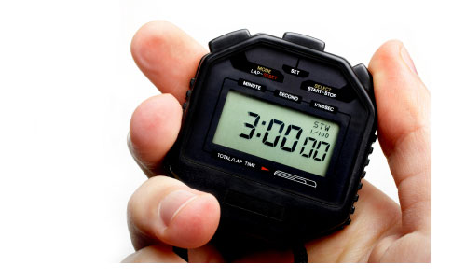
Three Minutes
Notes:
It takes about 3 minutes to Access Student Prior Knowledge

Slide 3
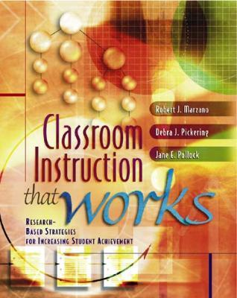
APK= Opportunities for 3 Strategies

Slide 4
3 simple steps
Use an image, story, object or even notes from the day before.
Ask students to respond to a cue or question. If possible, have students write down their response (a word, phrase, numbered list, sketch or pictograph).
Pair share to help students fire each other’s neurons- allowing for every student to participate.
Notes:
Does the image help me access prior knowledge?
Does the cooperative learning insure that every child gets to participate in the learning?

Slide 5
Scale of 1 to 10
1- Teacher asks a question, takes 1-2 responses and moves on to new information
5- Teacher asks all students to take out their notebooks, look through notes from the day before, circle 1-2 key words or phrases that are not clear, and write a question to share with the class
10- Teacher uses a non-linguistic representation, asks students to think-pair-share, and write or draw a response in their notebooks

Slide 6
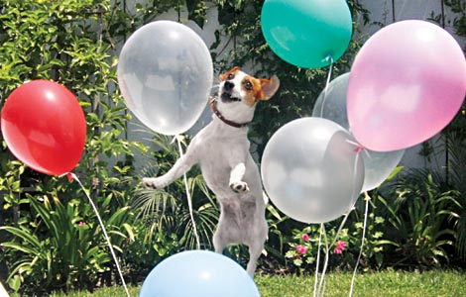
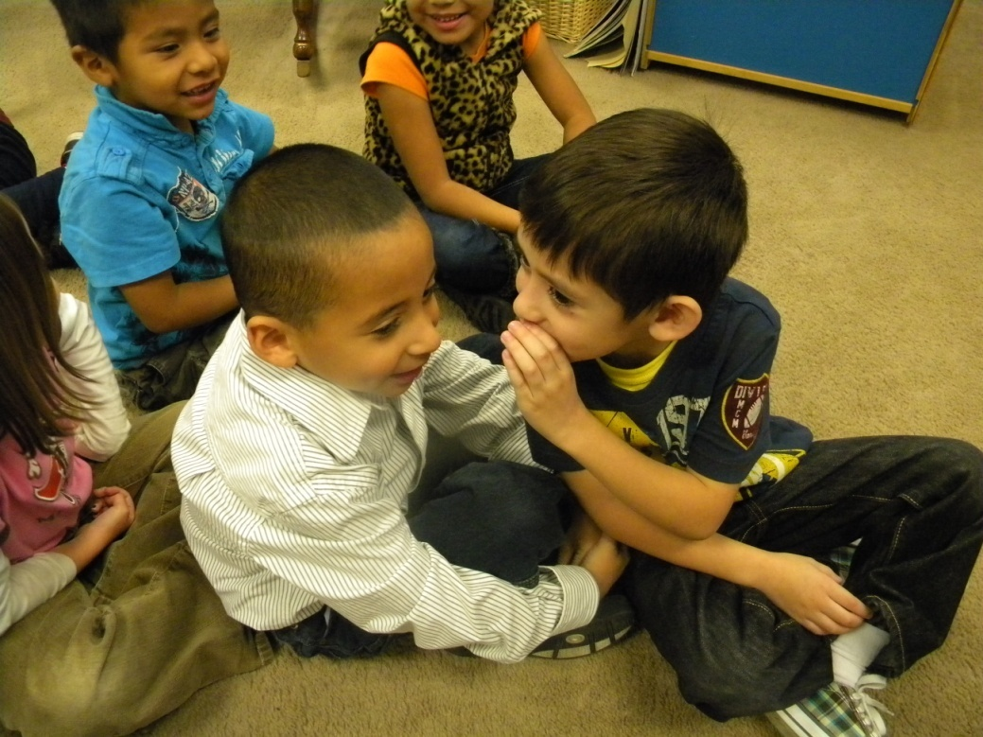
Kindergarten Reading
Student Goal- I can ask questions to help me understand
(The students would be using photographs for text.)
APK- “Talk to your friend about this picture.”

Slide 7
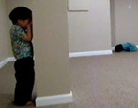
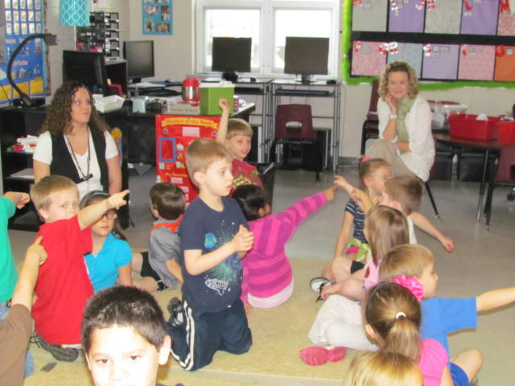
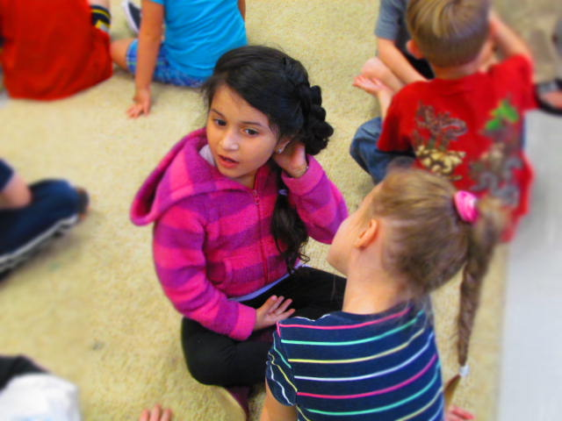
Kindergarten Math
Student Goal- I can find hidden tens in numbers
APK- watch a video
(two children play hide and seek in an empty room)
Turn and Talk-
“What was silly about his video?”
“Imagine you were going to play hide and seek in this room. Where would you hide?”

Slide 8
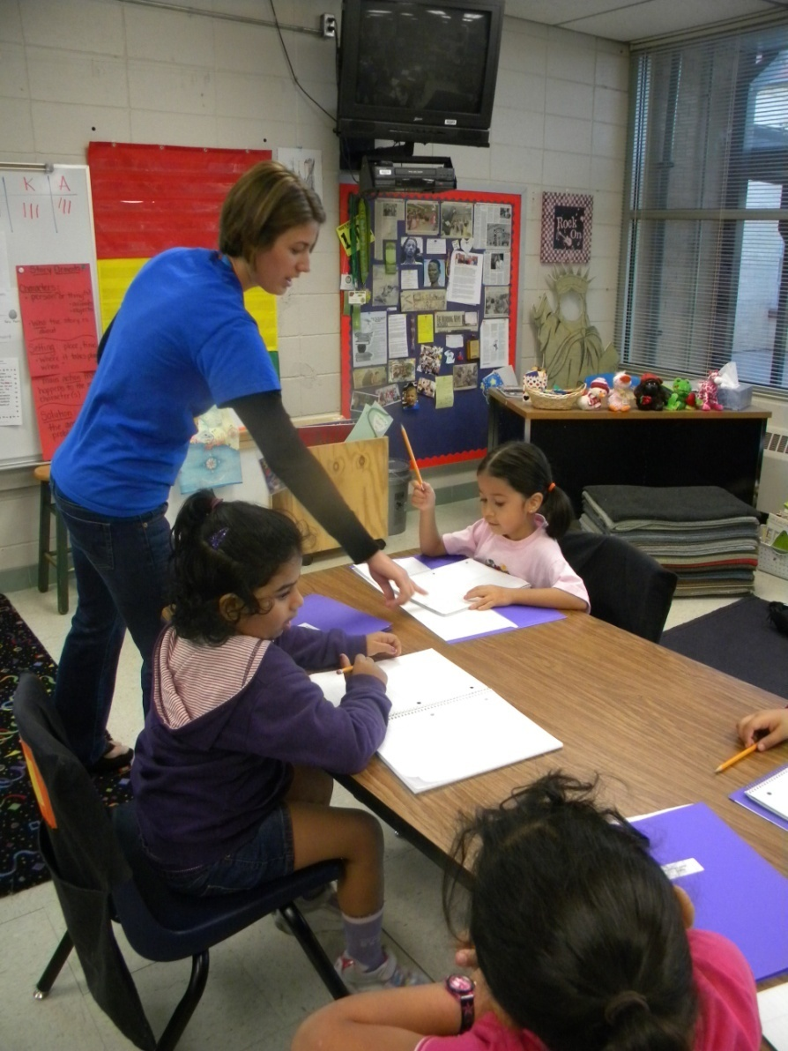
1st grade English Language Development
Student Goal- I can describe pictures using simple sentences and pronouns
APK- review pronoun chart
(from a previous lesson)

Slide 9
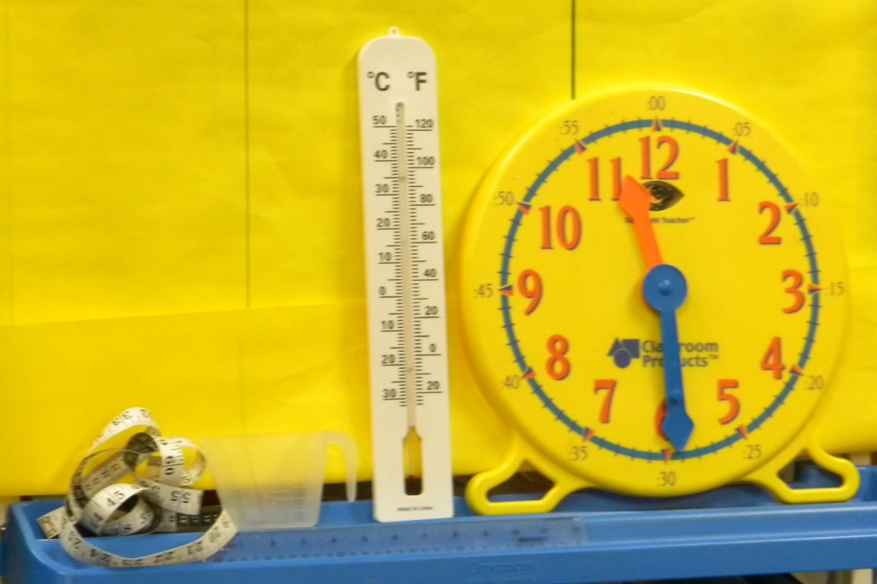
1st grade Math
Student Goal- I can select appropriate measurement tools
APK- Pair Share
“What do you notice that is the same and different about these objects?”
Tape measure
Measuring cup
Thermometer
Clock

Slide 10
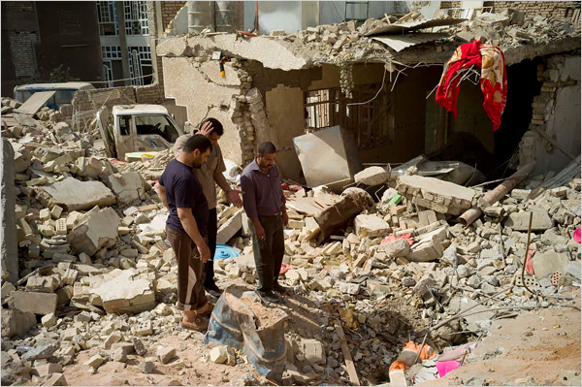
2nd grade Reading
Student Goal- I can describe how characters in a story respond to major events and challenges.
(The text for the lesson is Silent Music)
APK- Watch a video to glimpse life in Baghdad.
“How would you feel if you walked outside and saw this?
What would you see? What would you hear?”
Turn and Talk

Slide 11
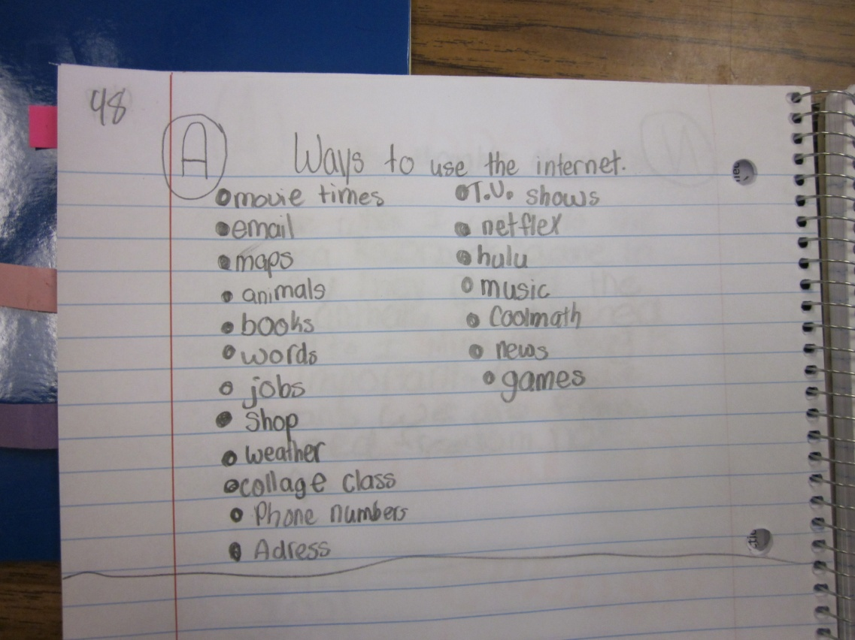
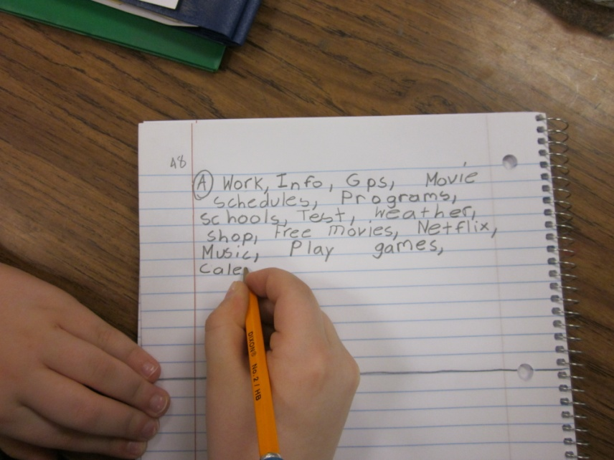
3rd grade Reading/Social Studies
Student Goal- I can use the internet to research
APK- Pair Share and then make a list of the types of information a person could get from the internet
Notes:
Non-linguistic representation
Cooperative learning

Slide 12
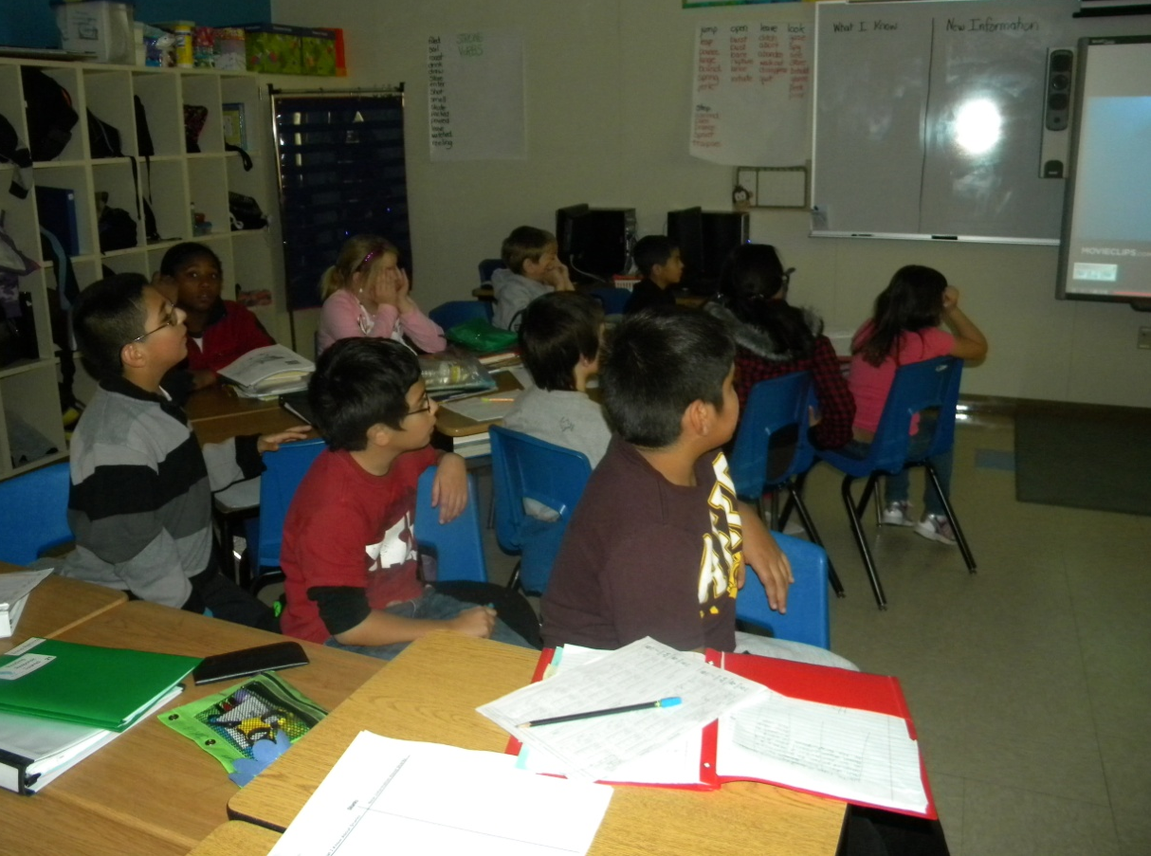
4th grade Reading
Student Goal- I can use old information to help me learn new information.
(The students will read an informational article about sharks in the lesson)
APK- Watch the theatrical trailer for the movie “Jaws”
Pair Share- “What do you know about sharks?”
Notes:
Non-linguistic representation
Cooperative learning

Slide 13
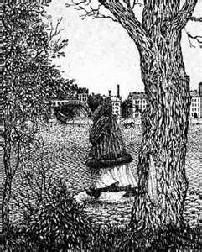
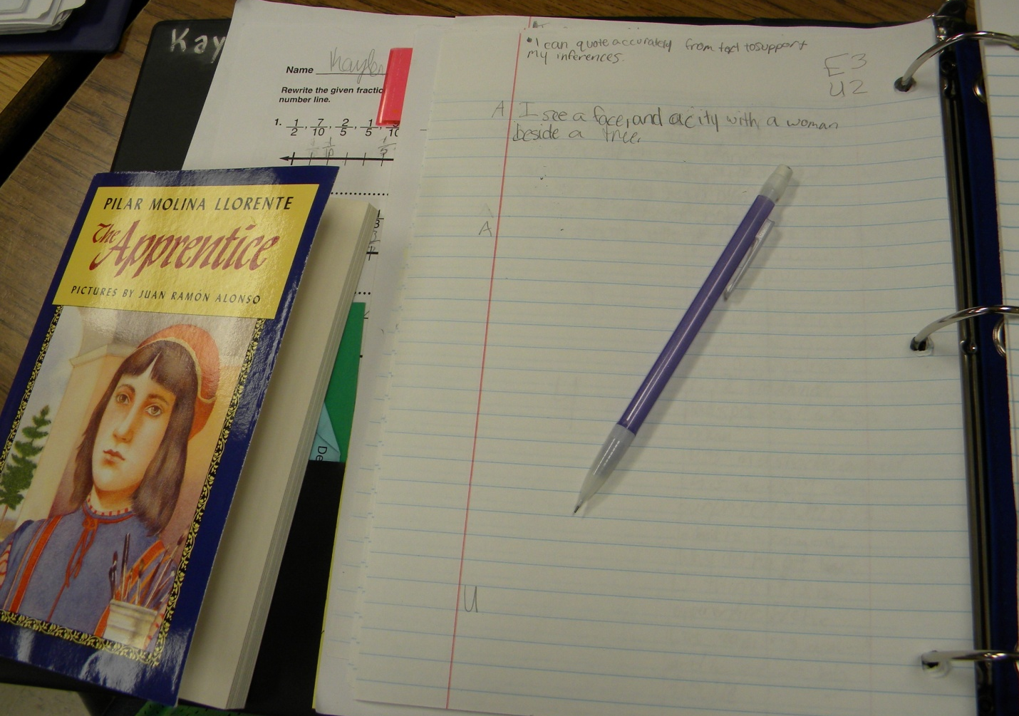
5th grade Reading
Student Goal- I can quote accurately from a text to support my inferences.
APK- Look at the picture.
“What do you see?”
“In your notebook write two things you see in the picture.”
The class created an analogy together.
Optical illusion is to picture as inferences are to reading.

Slide 14
GANAG
New Information

Slide 15
N= Opportunities for 2 Strategies
Chapter 11
Teaching Specific Types of Knowledge

Slide 16
GANAG
Application

Slide 17
A= Opportunities for 4 Strategies
DECLARATIVE
PROCEDURAL
DECLARATIVE
DECLARATIVE

