Slide 1
Making Sense of Problems and Persevering in Solving Them. Cheryl Scott, Math Facilitator, Old Wire Elementary ad title
Rebecca Rodriguez’s
3rd Grade Classroom
Old Wire Elementary

Slide 2
G: Goal
Students will make sense of problems and persevere in solving them.
Students used a scoring
guide to rate their
comfort in persevering
in solving math story
problems on their own.
Setting Objectives and Providing Feedback

Slide 3
A: Activate Prior Knowledge
Students were given a
scenario about a man
with a financial
problem. He didn’t
have enough money to
pay his bills.
Nonlinguistic Representation

Slide 4
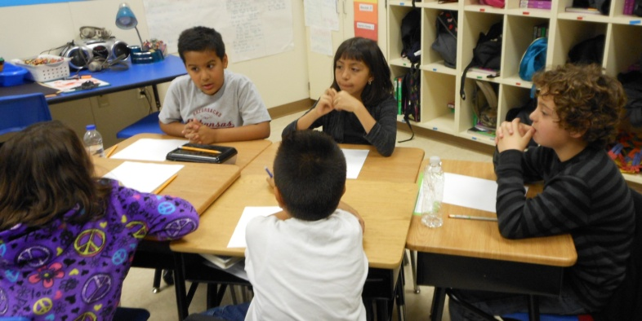
A: Application
Mathematical Practice 1: Solve problems and persevere in solving them.
Students worked in cooperative groups to create a solution to the financial problem the man encountered. The groups shared their plans with the entire classroom.
Cooperative Learning
Generating and Testing Hypothesis

Slide 5
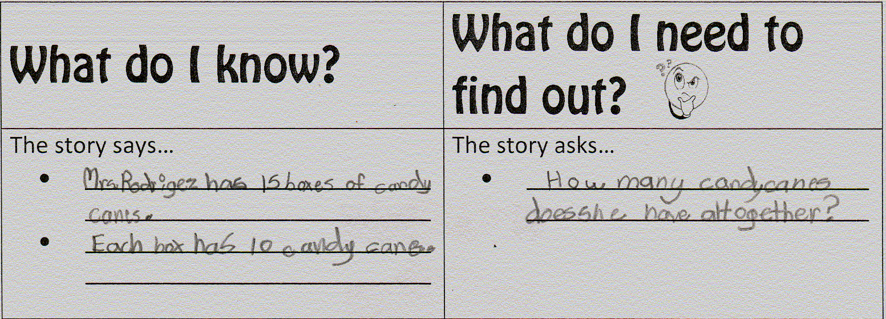
N: New Information
“When you solve real world
problems you use the same
type of perseverance you
use in solving math
problems. You don’t give up.”
“In math you use
what you know to help
you solve what you don’t
Summarizing and Note Taking know.”
Cues, Questions, and Advanced Organizers

Slide 6
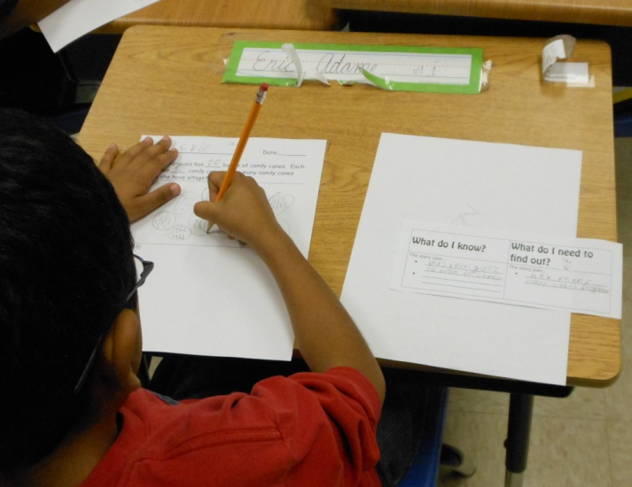
A: Application
CGI Multiplication
Problem Type
Mrs. Rodriguez has __
boxes of candy canes. Each
box has __ candy canes.
How many candy canes does
she have altogether?
(10, 10) (15, 10) (20, 10) (21, 10)
Homework and Practice
Non-Linguistic Representation
Generating and Testing Hypothesis

Slide 7
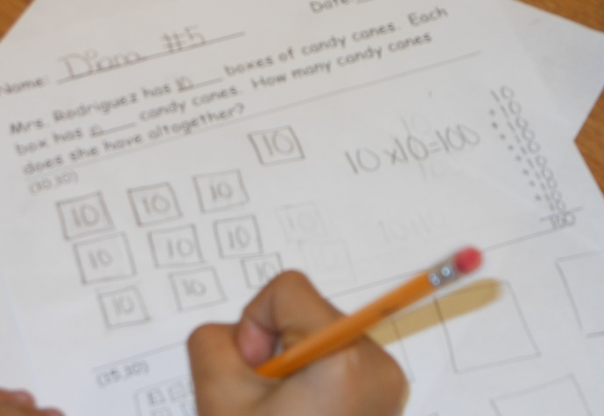
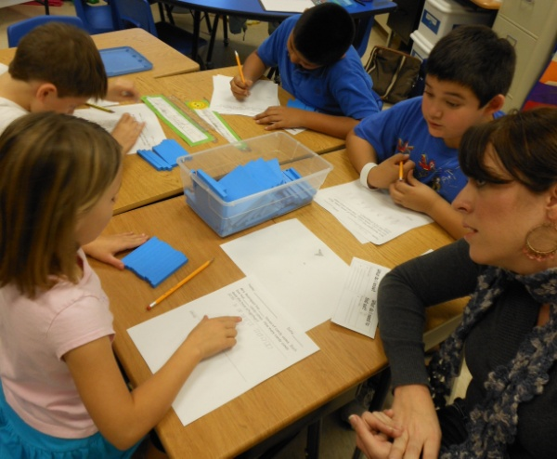
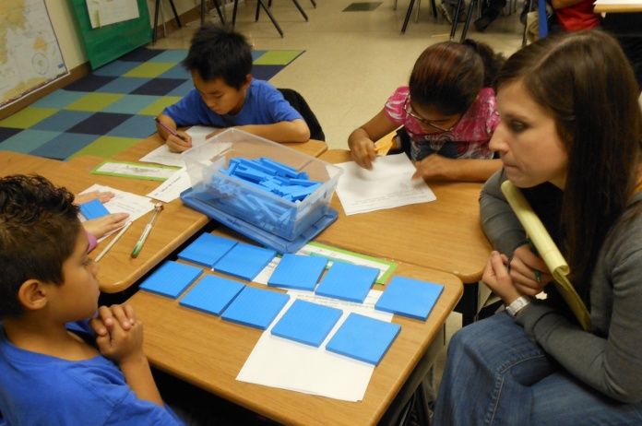
A.5.3.3 Finds the value of an unknown quantity in a number sentence. A.4.3.3 Indentifies a number that is more or less than any whole number using multiples of 10 and/or 100 up to 1000.
G: Content
Goal
\Summarizing and Note Taking
Reinforcing Effort and Providing Recognition

Slide 8
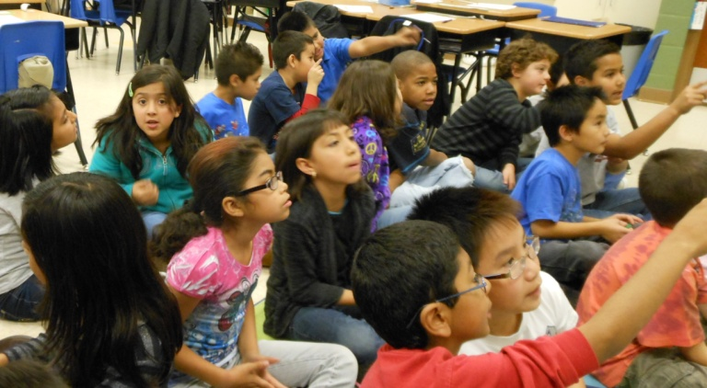
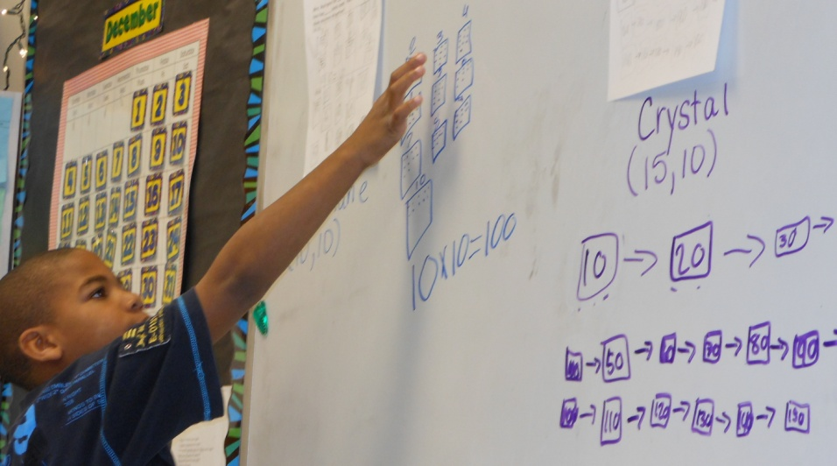
N: New Content Information
Discussion: Focus on understanding the story and
finding the unknown value.
Cooperative Learning
Identifying Similarities and Differences
Cues, Questions, and Advanced Organizers

Slide 9
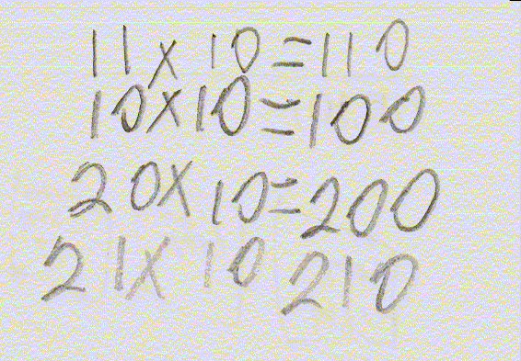
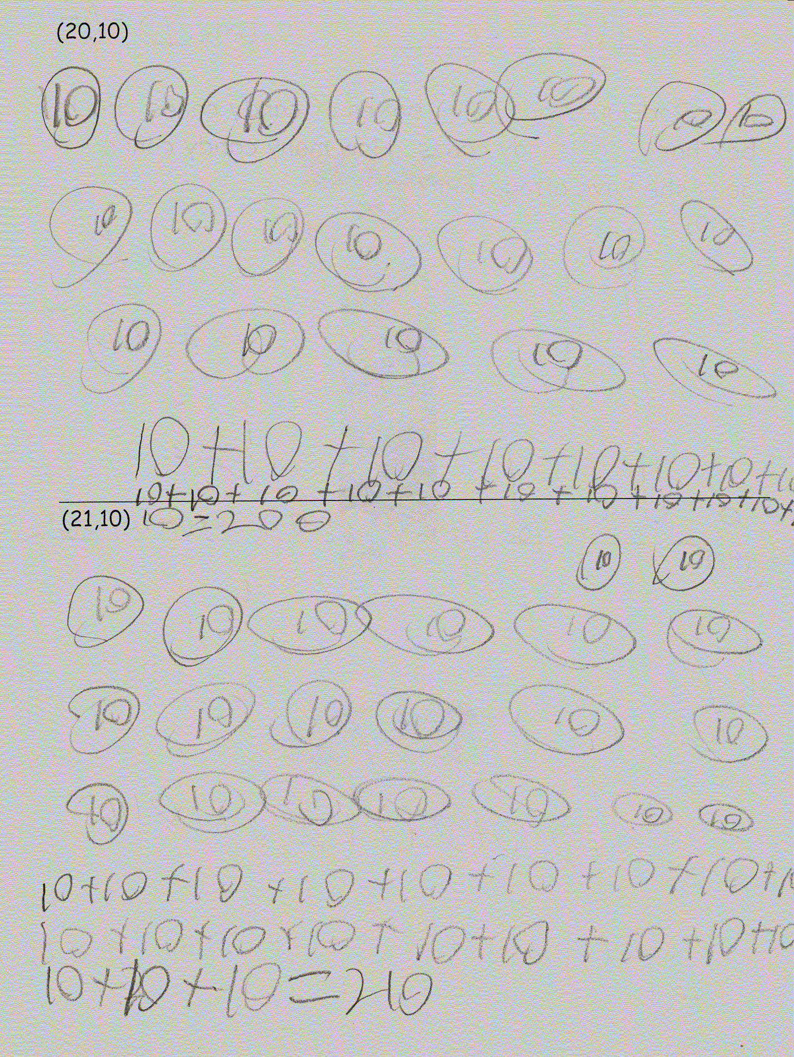
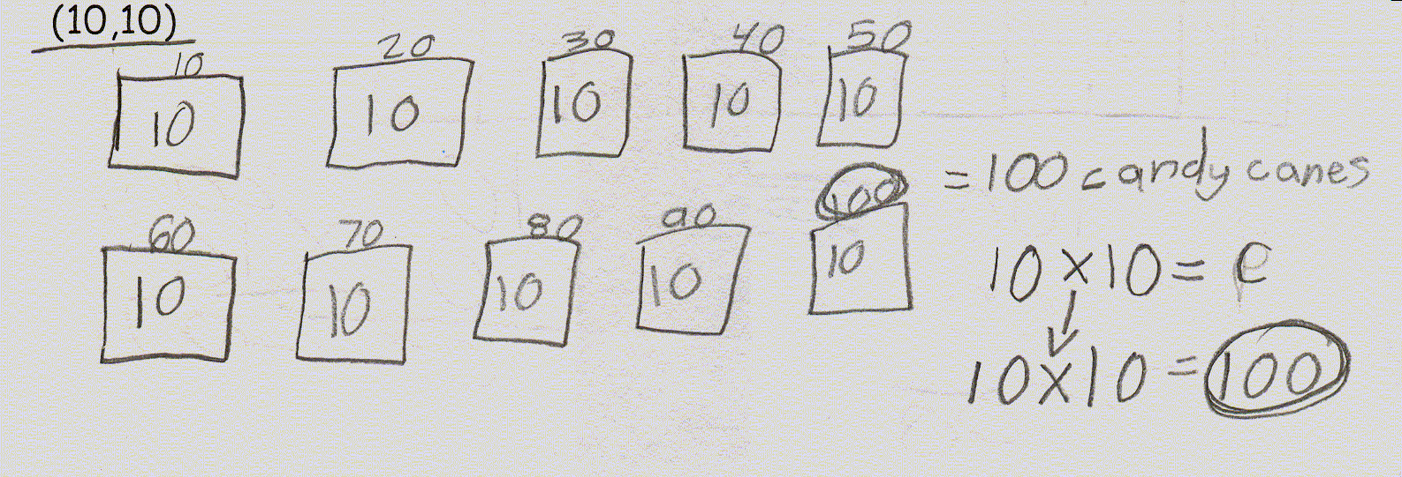
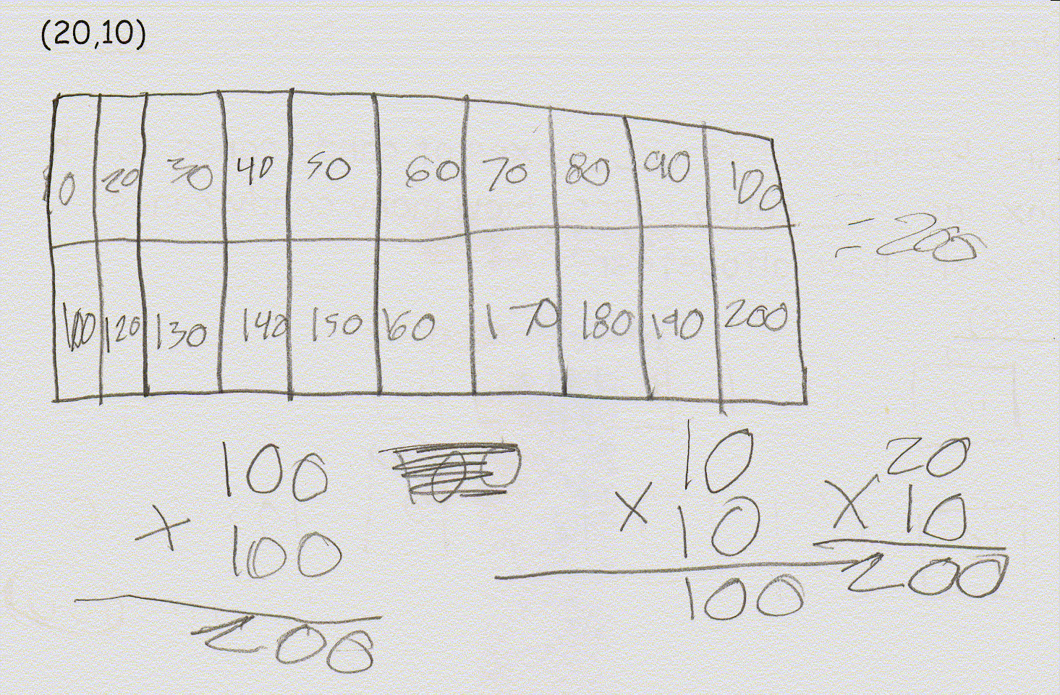
N: New Content Information
Discussion: Focus on the notation that goes with
the content standard objective.
Cooperative Learning
Identifying Similarities and Differences
Summarizing and Note Taking

Slide 10
G: Goal
Students will make sense of problems and persevere in solving them.
Students used a scoring
guide to rerate their
performance in
persevering in solving
the math story problem
independently.
Reinforcing Effort and Providing Recognition
Setting Objectives and Providing Feedback

