Slide 1

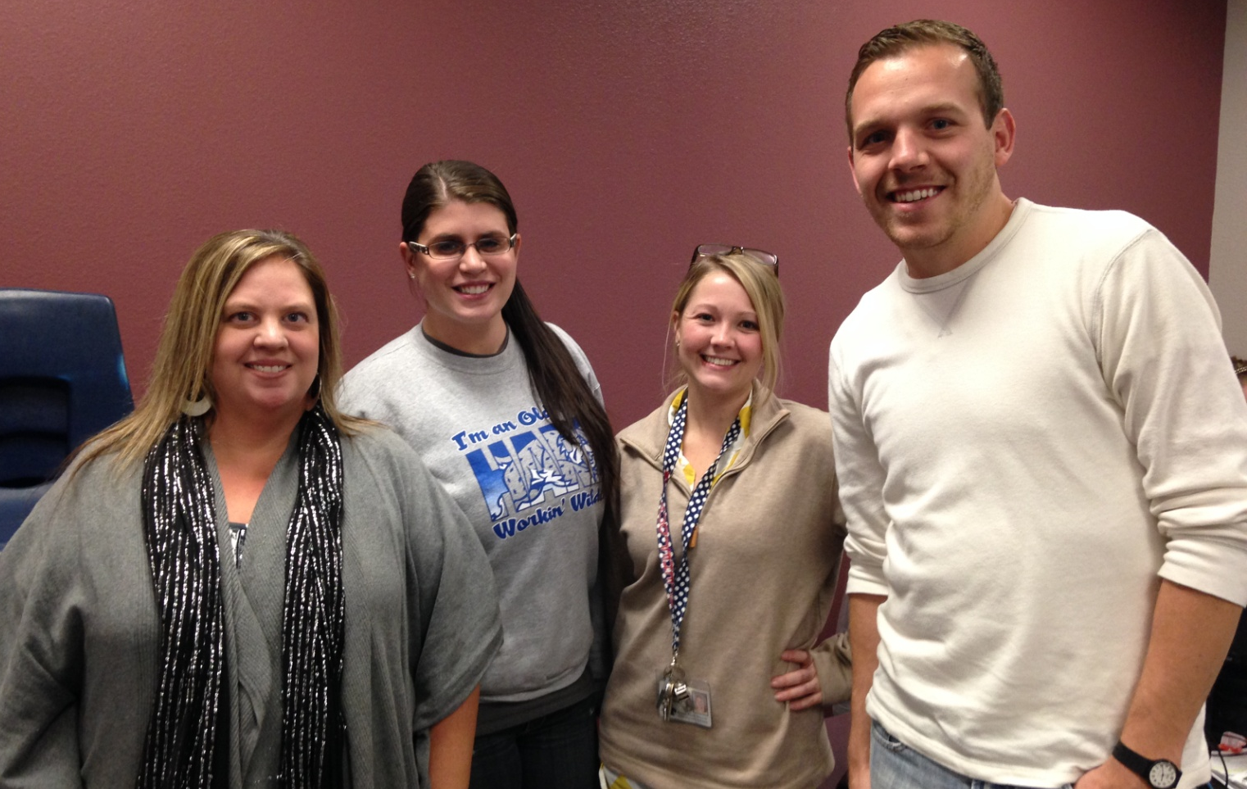

Kindergarten Unit 3
Composing and Decomposing Numbers;
Deepening Understanding of Addition & Subtraction
Unit Planning Team:
Kasey Benson (OW), Robin Dover (OW),
Danielle Audlehelm (JM), Jordan Bright (WS)

Slide 2
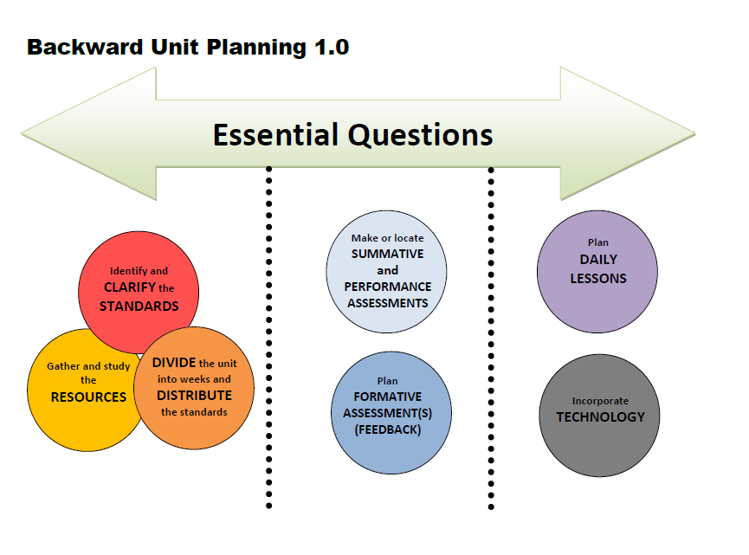
Notes:
This is a look at the unit planning process. We started by taking a look at the essential questions to make sure they were addressing the standards and the needs of our students. We then spent time……
You can find daily lesson plans on our district website as well as ways to incorporate technology into our math instruction.

Slide 3

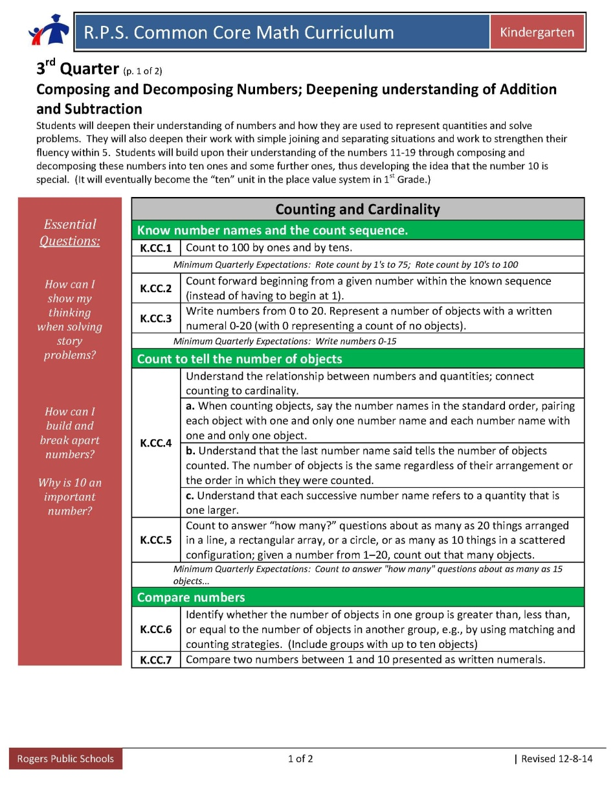
Essential Questions
Essential Questions
How can I show my thinking when solving story problems?
How can I build and break apart numbers ?
Why is 10 an
important number?
Notes:
We wanted to continue with kid friendly language so we kept the first essential question the same as 1st and 2nd quarter. (read) We changed the second question to read ____ because they are also breaking apart or decomposing numbers in addition to building them. Also, this quarter we noticed that the 3rd Quarter summary states that 10 is a special number and we need to build on students understanding of this concept. Example: we want our students to see numbers in 10 ones and some further ones. This quarter we would like teachers to start asking the question “Why is 10 an important number?” because we believe that it will promote important and valuable discussions in our classrooms. Students need lots of opportunities and experiences working with the number 10. Some examples would be building 10, finding 10 within a larger number, and counting on from 10, in addition to work with multiplication and measurement division story problems.

Slide 4
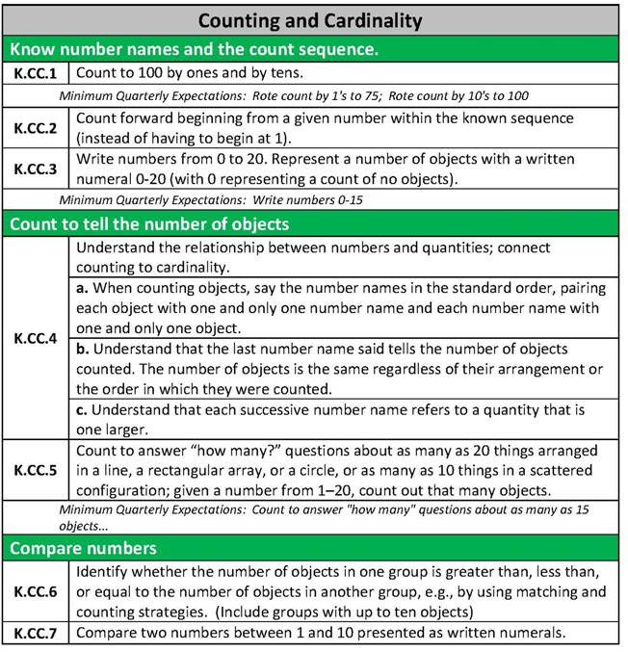
Identify and CLARIFY the
STANDARDS
K.CC.7
Before expecting students to be proficient with this standard they need to have ample experiences with sets of objects. (K.CC.3 & K.CC.5) Students should not be expected to be comfortable with this skill until the end of kindergarten.
Notes:
Just as a reminder, the third quarter expectation is to count by ones to 75 and by tens to 100
Students are also expected to write numbers from 0-15 by the end of the quarter.
We wanted to remind you about the clarification we received at the beginning of the year that within K.CC.6 the kindergarten expectation is to know greater than/less than and not how many more or less.
We also wanted to bring to your attention that K.CC.6 and K.CC.7 are scored together on the report card, and that K.CC.7 is a year end goal and at this point the comparisons should still involve sets of objects as a support for those students who need it.
K.CC.7 –As adults we know what number is bigger because we have been exposed to lots of experiences with numbers. Therefore this standard isn’t one that we teach separately but a standard that is accomplished from teaching the standards K.CC.3 (representing a set with a written numeral) and K.CC.6 (comparing sets of objects) and through compare story problems.

Slide 5
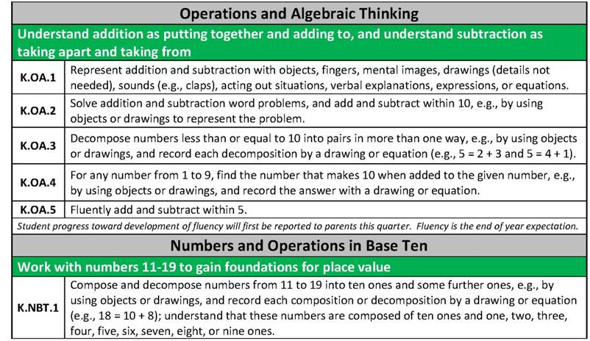
K.OA.2, KOA.3, K.OA.4, K.NBT.1
The big idea within these standards is the number 10.
This is what prompted us to add the new essential question—
Why is 10 an important number?
Identify and CLARIFY the
STANDARDS
K.OA.5
This standard is being assessed for the first time during 3rd quarter.
Notes:
K.oa.2, 3, and 4, as well as K.nbt.1 all have a strong focus on the number 10 in one way or another. These are the standards that prompted us to add the new essential question for this quarter– “why is 10 an important number”
K.OA.2-When assessing, make sure that the sum and difference are equal to or less than 10
K.OA.5-We wanted to point out that K.oa.5 (Fluency) is scored for the first time this quarter

Slide 6

Week | Standards | Structure/Resources
1 | K.CC.1, K.CC.3, K.CC.4, K.CC.2 K.OA.1/K.OA.2 K.OA.3/K.OA.4 K.OA.5 K.CC.5 K.CC.6/K.CC.7 K.NBT.1 | Counting Collections Games for early number sense Ten frames-It Makes Sense! CGI – JCU, SRU, PPW-WU, PPW-Both Parts unknown Dot images Comparing sets of objects CGI-Compare problem types It Makes Sense! CGI-Multiplication and measurement division
2 | K.CC.1, K.CC.3, K.CC.4 K.CC.2 K.OA.1/K.OA.2 K.OA.3/K.OA.4 K.OA.5 K.CC.5 K.NBT.1 | Counting Collections Games for early number sense Ten frames-It Makes Sense!-Games using Ten Frames CGI – JCU, SRU, PPW-WU, PPW-Both Parts unknown Dot images It Makes Sense! CGI-Multiplication and measurement division
3 | K.CC.1, K.CC.3, K.CC.4 K.CC.2 K.OA.1/K.OA.2 K.OA.3/K.OA.4 K.OA.5 K.CC.5 K.CC.6/K.CC.7 K.NBT.1 | Counting Collections Games for early number sense Ten frames-It Makes Sense!-Games using Ten Frames CGI – JCU, SRU, PPW-WU, PPW-Both Parts unknown Dot images Comparing sets of objects CGI-Compare problem types It Makes Sense! CGI-Multiplication and measurement division
DIVIDE the unit into weeks and DISTRIBUTE the standards
Assessed for first time during
3rd Quarter
K.OA.5-
Fluently add and subtract within 5
Notes:
After spending time reviewing and clarifying the standards, we distributed the standards into weekly plans. Since there isn’t a measurement focus this quarter, most of the weeks look the same. We wanted to point out that Counting Collections is now embedded within the structure & resources column, instead of it’s own, although we still feel it is a strong component of kindergarten math instruction and should continue to be implemented in our classrooms.
K.CC.2 Bus Stop/Leap Frog were two games that stood out to us in the Games for Early Number sense book. These games directly address standard K.CC.2

Slide 7
Week | Standards | Structure/Resources
4 | K.CC.1, K.CC.3, K.CC.4 K.CC.2 K.OA.1/K.OA.2 K.OA.3/K.OA.4 K.OA.5 K.CC.5 K.NBT.1 | Counting Collections Games for early number sense Ten frames-It Makes Sense!-Games using Ten Frames CGI – JCU, SRU, PPW-WU, PPW-Both Parts unknown Dot images It Makes Sense! CGI- Mutiplication and measurement division
5 | K.CC.1, K.CC.3, K.CC.4 K.CC.2 K.OA.1/K.OA.2 K.OA.3/K.OA.4 K.OA.5 K.CC.5 K.CC.6/K.CC.7 K.NBT.1 | Counting Collections Games for early number sense Ten frames-It Makes Sense!-Games using Ten Frames CGI – JCU, SRU, PPW-WU, PPW-Both Parts unknown Dot images Comparing sets of objects CGI-Compare problem types It Makes Sense! CGI- Multiplication and measurement division
6 | K.CC.1, K.CC.3, K.CC.4 K.CC.2 K.OA.1/K.OA.2 K.OA.3/K.OA.4 K.OA.5 K.CC.5 K.NBT.1 | Counting Collections Games for early number sense Ten frames-It Makes Sense!-Games using Ten Frames CGI – JCU, SRU, PPW-WU, PPW-Both Parts unknown Dot images It Makes Sense! CGI- Multiplication and measurement division
DIVIDE the unit into weeks and DISTRIBUTE the standards
You will notice that most weekly plans are the same.
Keep doing the great things you are already doing! The main difference is that we think focusing on comparing numbers every other week is sufficient.
Notes:
As stated previously, the weekly plans are very similar. The main difference is that we chose to focus on comparing numbers every other week.

Slide 8
Week | Standards | Structure/Resources
7 | K.CC.1, K.CC.3, K.CC.4 K.CC.2 K.OA.1/K.OA.2 K.OA.3/K.OA.4 K.OA.5 K.CC.6/K.CC.7 K.CC.5 K.NBT.1 | Counting Collections Games for early number sense Ten frames-It Makes Sense!-Games using Ten Frames CGI – JCU, SRU, PPW-WU, PPW-Both Parts unknown Comparing sets of objects CGI-Compare problem types Dot images It Makes Sense! CGI- Multiplication and measurement division
8 | K.CC.1, K.CC.3, K.CC.4 K.CC.2 K.OA.1/K.OA.2 K.OA.3/K.OA.4 K.OA.5 K.CC.5 K.NBT.1 | Counting Collections Games for early number sense Ten frames-It Makes Sense!-Games using Ten Frames CGI – JCU, SRU, PPW-WU, PPW-Both Parts unknown Dot images It Makes Sense! CGI- Multiplication and measurement division
9 | K.CC.1, K.CC.3, K.CC.4 K.CC.2 K.OA.1/K.OA.2 K.OA.3/K.OA.4 K.OA.5 K.CC.5 K.CC.6/K.CC.7 K.NBT.1 | Counting Collections Games for early number sense Ten frames-It Makes Sense!-Games using Ten Frames CGI – JCU, SRU, PPW-WU, PPW-Both Parts unknown Dot images Comparing sets of objects CGI-Compare problem types It Makes Sense! CGI- Multiplication and measurement division
DIVIDE the unit into weeks and DISTRIBUTE the standards
During 3rd Quarter we want to consistently pose problems that promote base ten. (Ex: multiplication and measurement division)
Click here for table of problem types
Click here for example problems to pose
Notes:
Since base 10 is such a big focus starting in kindergarten and moving forward for our students we want to make sure that we are consistently posing problems that promote base ten understanding. A couple of examples are multiplication and measurement division story problems. We have linked a chart of problem types and specific ideas for story problems to assist you in creating different scenarios for your students.

Slide 9
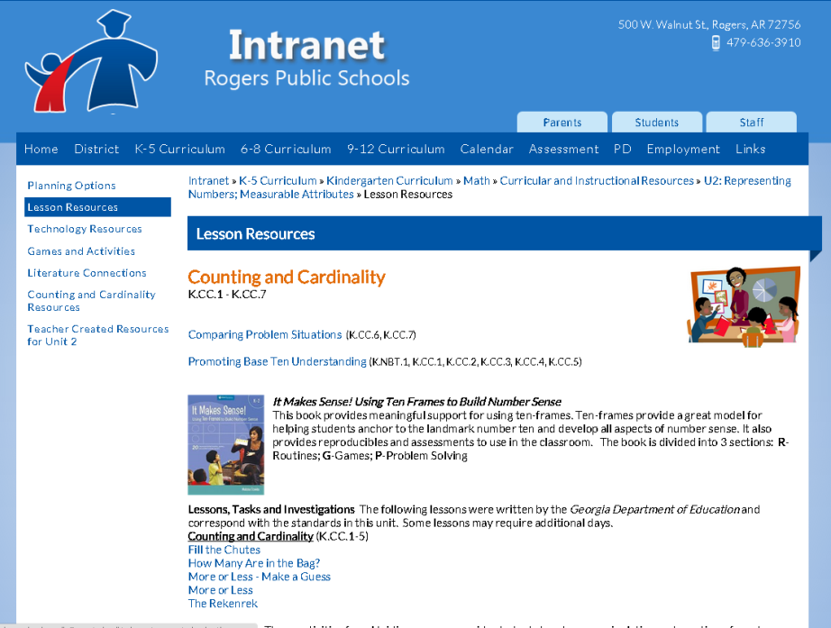
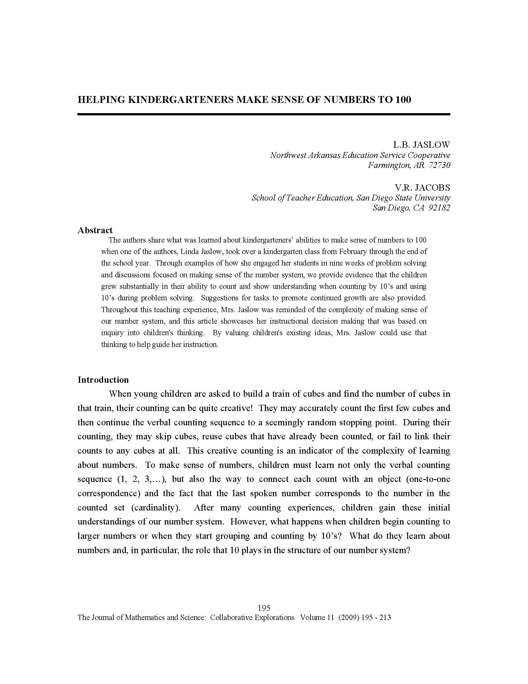



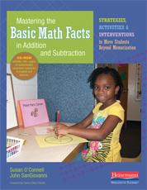
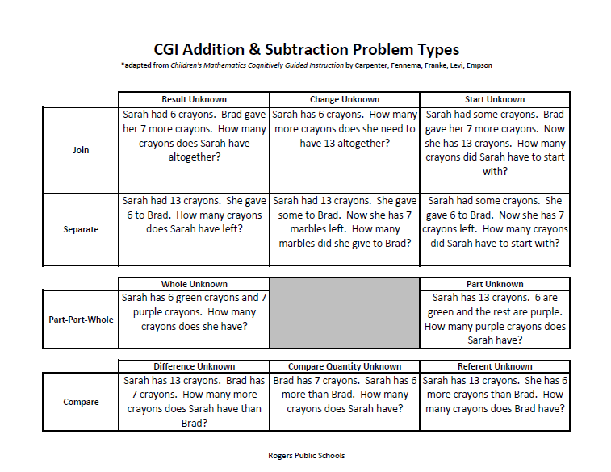
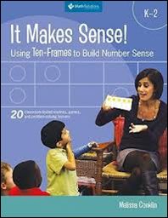
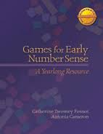
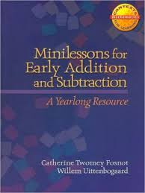
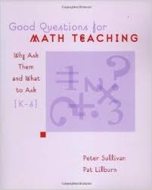
Gather and study the RESOURCES
Notes:
The next step was to gather and study the resources. We spent part of our day looking through the wonderful resources that have been provided for us by the district. Although we did not choose to specifically highlight a book or resource, we strongly encourage you to dig into them to find what will be most helpful in reaching the specific needs of your students. In addition to the books purchased for us, there are a plethora of additional resources located on the district website.

Slide 10
Linda Jaslow’s Article:
Helping Kindergarteners make sense of numbers to 100
Gather and study the RESOURCES
We need to:
*Inquire into children’s thinking
*Value existing ideas
*Challenge and extend understanding
*Support growth
Counting by tens (as a rote chant)
is often unconnected to any quantities. Therefore, we need to work to develop ten-to-ten correspondence among our students.
Click here to
view
article online
Notes:
Click on page for link to entire article.

Slide 11
Pose problems that promote base ten understanding:
Many students know that 20= 10+10,
but NOT that 11=10+1 or 24=10+10+4.
They need more experiences
working with purposeful problems.
We want our students to see ten as a group,
and then use that information to help
solve problems more effectively.
Pose problems that promote base ten understanding:
*Groups of 10’s problems
*Problems designed to help children compose
new numbers from a 10 and some 1’s
*Decompose numbers into 10’s and 1’s
*Mixing 10’s and 1’s
*Counting by 10’s from a non-decade number

Slide 12

Possible Activities to use for Resources
Click on book to view PowerPoint by
Denise Crutchfield
K.OA.4
Making Ten-Ten Apples up on Top (Page 95)
K.NBT.1
Understanding Ten Frames-Diary of a Worm
(Page 114 )
K.CC.2
Leap Frog (Page 15)
Bus Stop (Page 24)
Click here to access Unit 3 games & activities online
K.OA.1/K.OA.2
K.OA.3/K.OA.4 K.OA.5
Ten Frames- Games Using Base Ten-Frames (Page 64)
K.NBT.1
Routines Using Ten-Frames (starting on page 2)
Lesson resources
Notes:
We spent time reviewing additional resources and have provided a few helpful links here, including the powerpoint presentation that Denise Crutchfield created based on the book Mastering the Basic Math Facts in Addition and Subtraction. It is very detailed and informative. We also listed a few specific activities from other books as well as two separate links to lots of games, activities and lesson ideas.

Slide 13
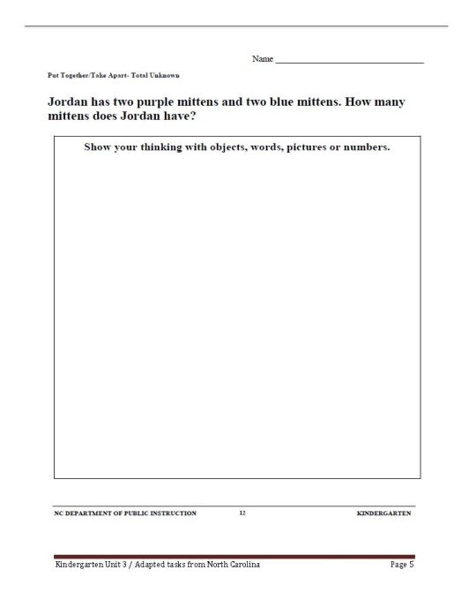
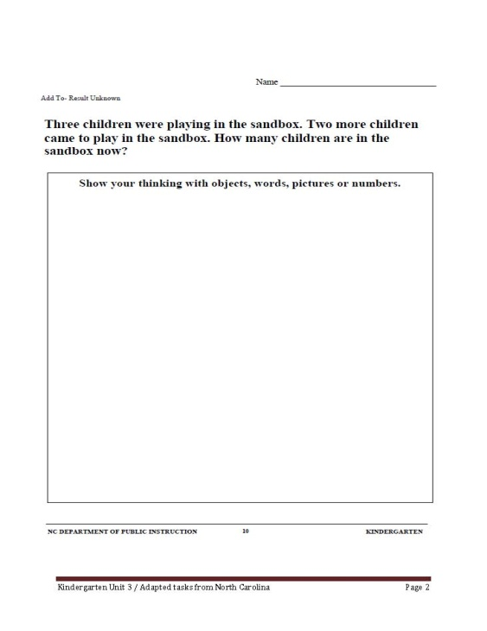
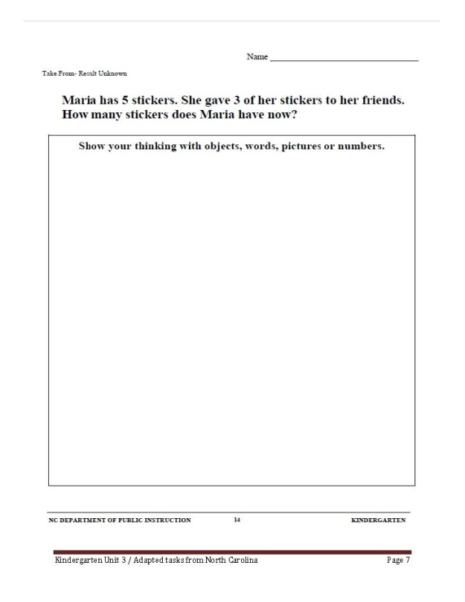

Options for Assessment – Available online for Unit 3
K.OA.1, 2 Assessment Options
Make or locate SUMMATIVE
and PERFORMANCE
ASSESSMENTS
Notes:
Here are a few examples of some assessments to be used to assess K.OA.1 & 2. There is a link to Unit 3 Assessments on the next slide.

Slide 14
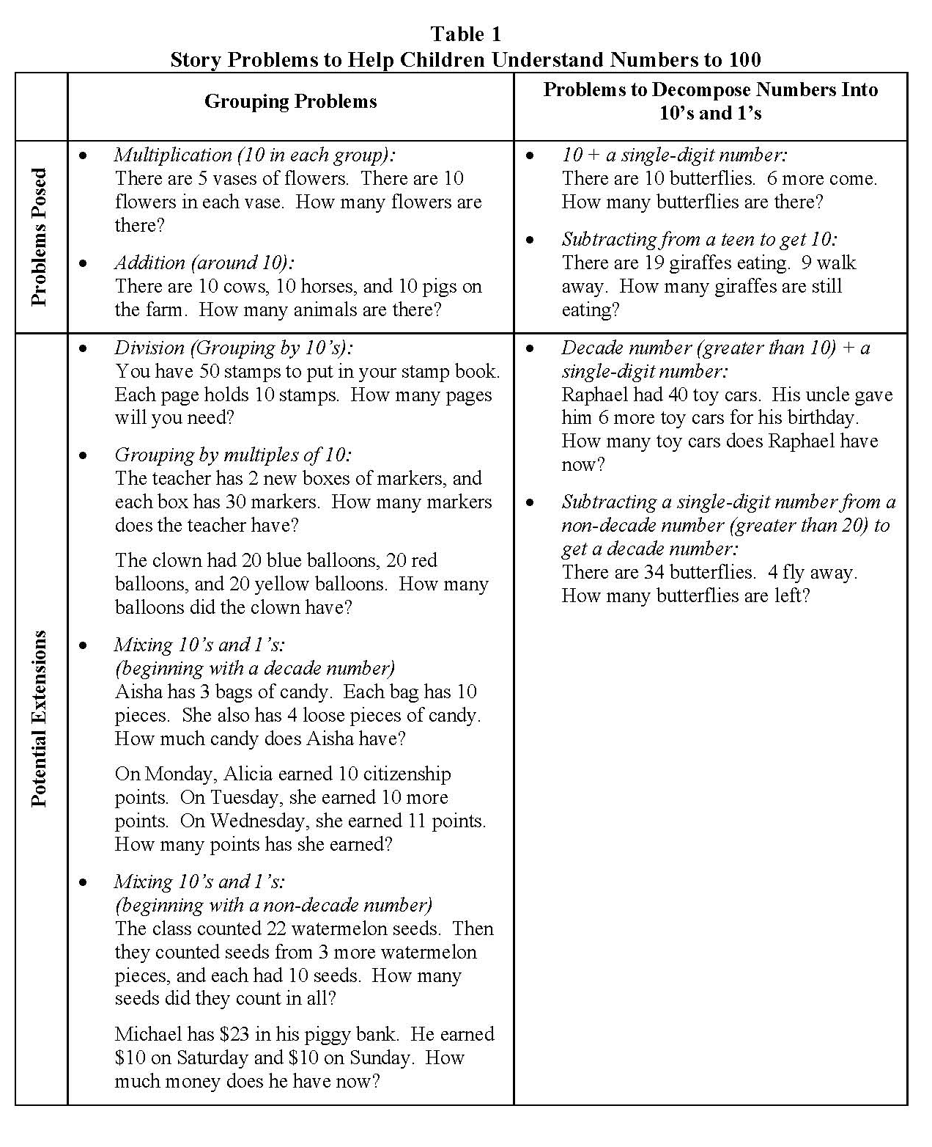
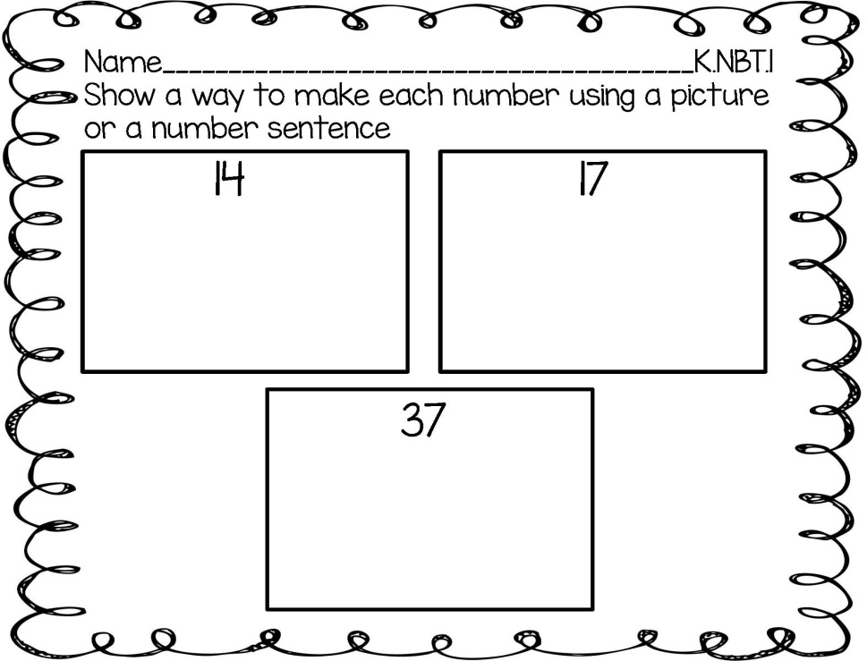
Options for Assessment – Available online for Unit 3
K.NBT.1 Assessment Options
Link to Unit 3 Assessments online
Make or locate SUMMATIVE
and PERFORMANCE
ASSESSMENTS
These problems are also listed in the Lesson resources for Unit 3 under Developing Base Ten Understanding.
Notes:
On this slide, you will find a chart of problem types that lend themselves to assessing base ten knowledge, as well as an assessment to see how children are thinking about numbers and how they choose to represent different quantities. There is a link that will take you to the assessments we have shown for Unit 3.

Slide 15

Lessons and resources are available online.
Plan DAILY LESSONS
Incorporate TECHNOLOGY
Notes:
The last step of the planning model includes planning daily lessons and incorporating technology. We weren’t able to plan specific lessons with the time that we had, but please make sure to explore the district webpage when you are planning your lessons. There are so many wonderful resources, ideas and assessments provided for us to access. There is a link here that will take you to the Unit 3 technology section as well.

Slide 16

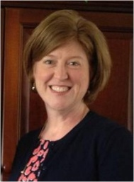

NEW Teacher Created Resources pages!!!
RESOURCES
Beth Pesnell
Elementary Curriculum Specialist
bpesnell@rps.k12.ar.us
Notes:
As mentioned previously, the Rogers website is amazing. Make sure to check out the new teacher created resources page. There are always new things being added. If you have resources to share, please send them to Beth Pesnell, our Elementary Math Curriculum Specialist.

