Slide 1
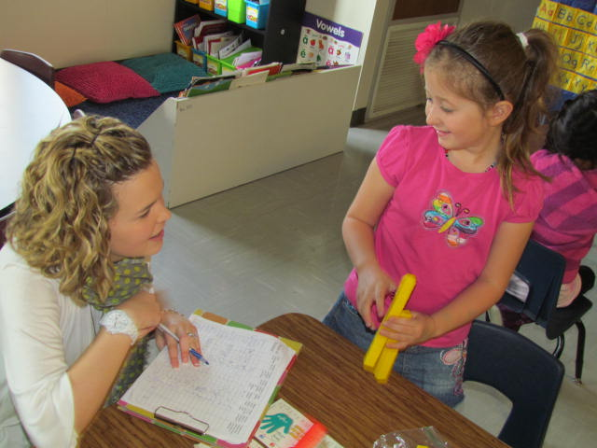
Finding Hidden
Tens
Mrs. McKeel’s
Kindergarten Class
Reagan Elementary
Rogers, Arkansas
3/14/12
R. Smith
Rogers Public Schools

Slide 2
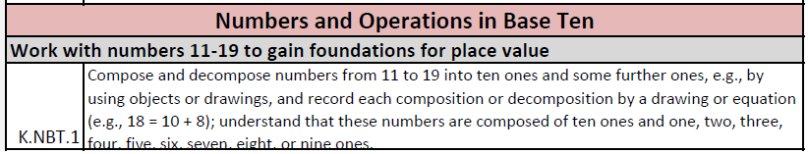
Kindergarten Common Core Standards

Slide 3
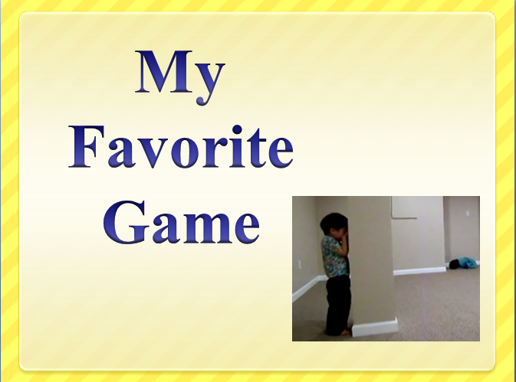
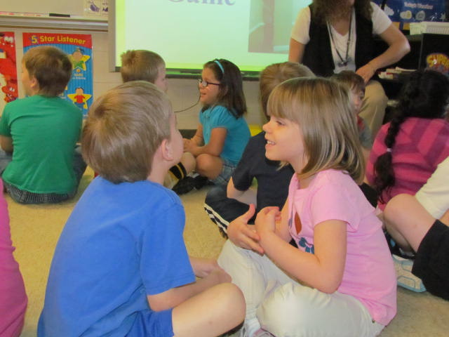
A ccess prior knowledge
Turn & talk
“Can you guess my favorite game? What clues helped you guess?”
(6) Nonlinguistic Representations
(7) Cooperative Learning
(10) Cues, Questions and Advance Organizers

Slide 4
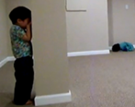
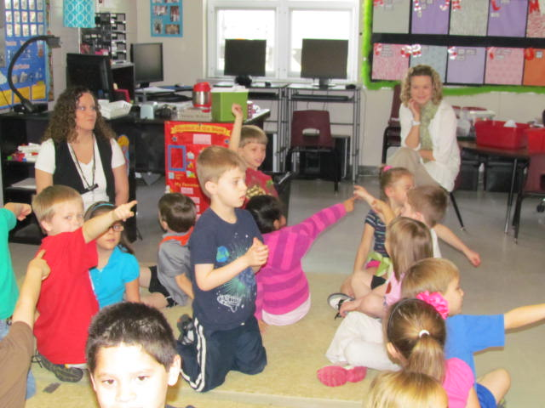
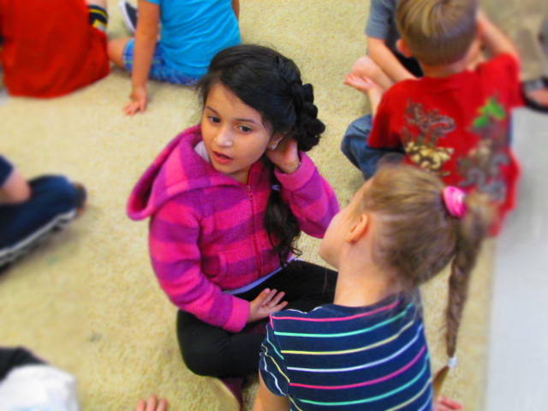
A ccess prior knowledge
Turn & talk
“What was silly about this video?”
“Imagine you were going to play hide-and-seek in this room. Point to where you would hide.”

Slide 5
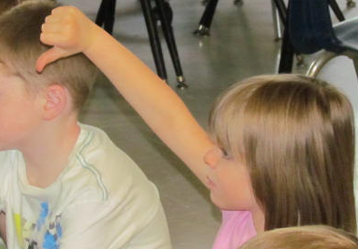
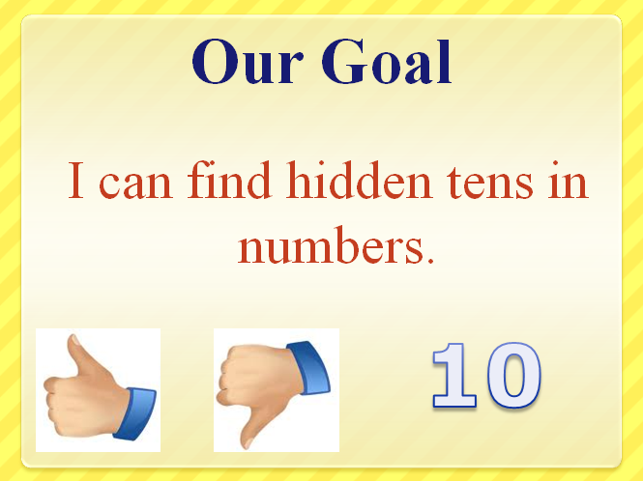

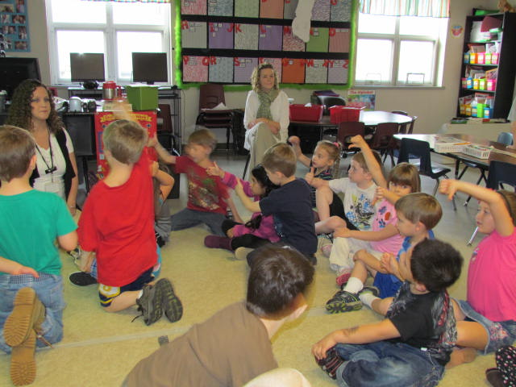
G oal
Score Yourself to the Goal
I know this so well I could teach someone else to do it.
I want to practice this.
(8) Setting Objectives and Providing Feedback

Slide 6

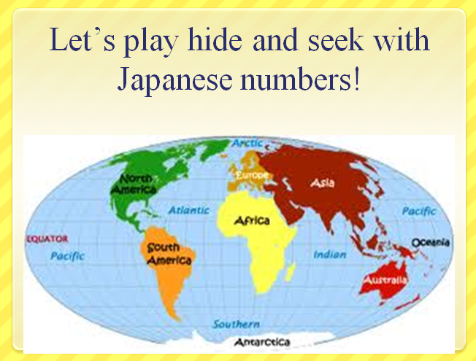
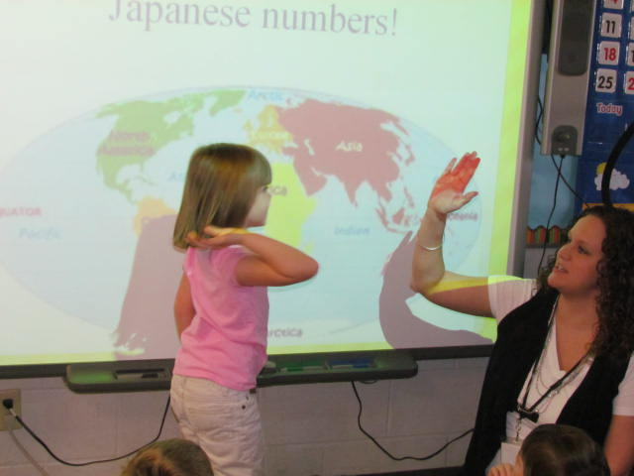

N ew information
We made a connection to the Kindergarten English Language Arts Unit – Students have been learning the continents.
(6) Nonlinguistic Representations
(9) Generating and Testing Hypotheses

Slide 7
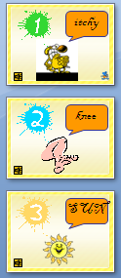




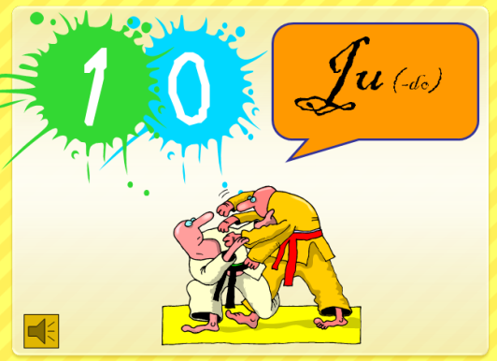


N ew information
(6) Nonlinguistic Representations

Slide 8
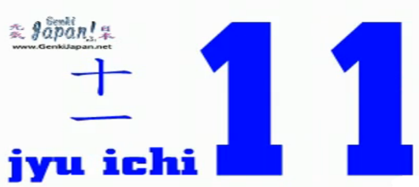



N ew information
“Did you find any hidden tens in these Japanese numbers?”
(6) Nonlinguistic Representations
(2) Identifying Similarities and Differences

Slide 9
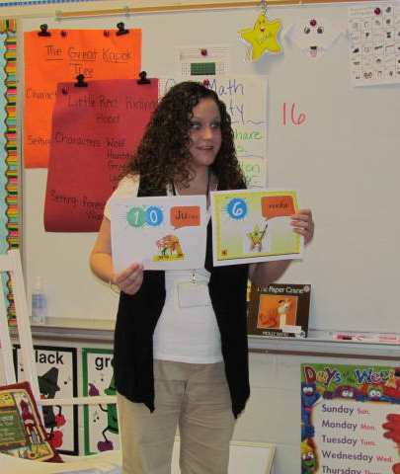
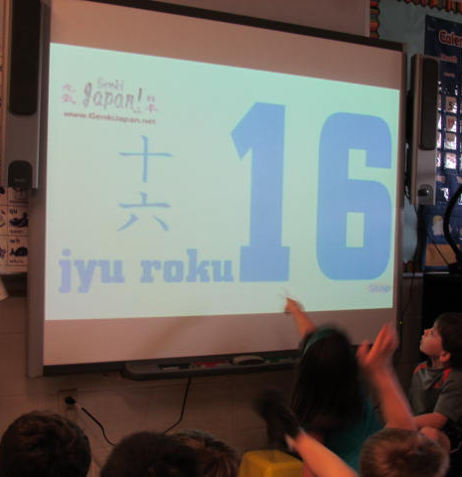
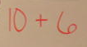
N ew information
“Can you find the hidden 10?”
(6) Nonlinguistic Representations
(2) Identifying Similarities and Differences

Slide 10
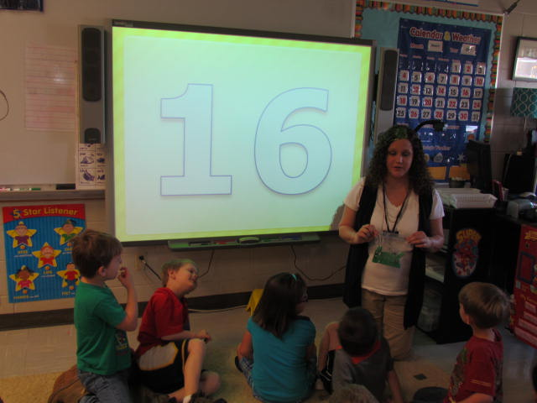
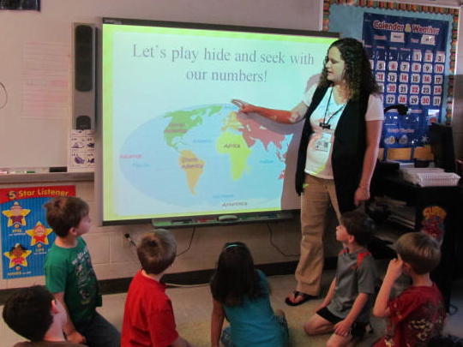
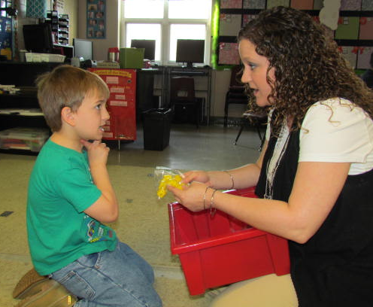
A pplication
(5) Homework and Practice
(4) Reinforcing Effort and Providing Recognition

Slide 11

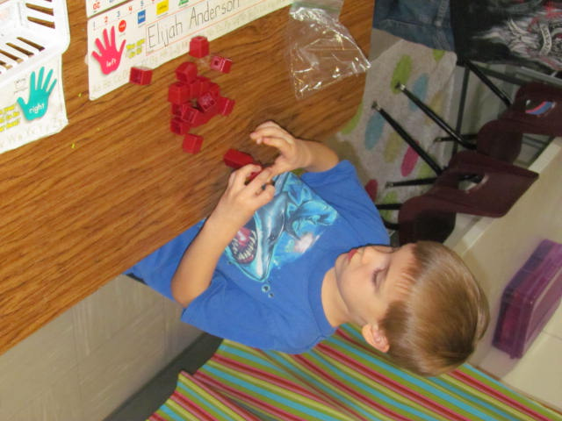
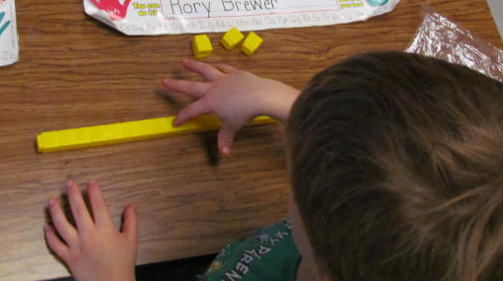
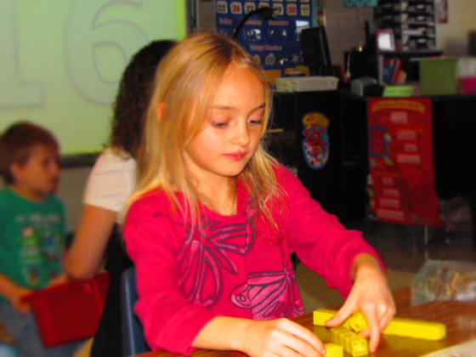
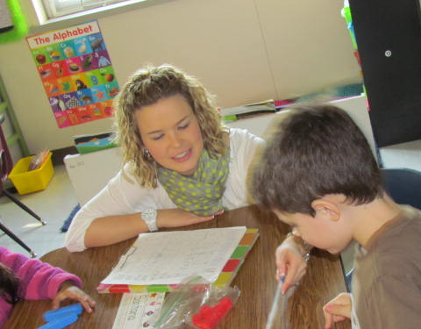
A pplication
(5) Homework and Practice
(4) Reinforcing Effort and Providing Recognition

Slide 12
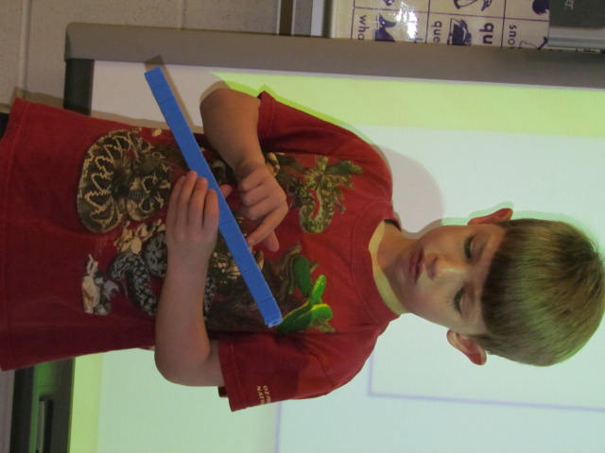
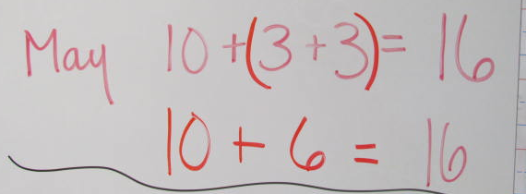
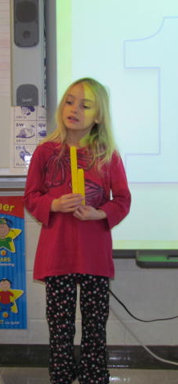
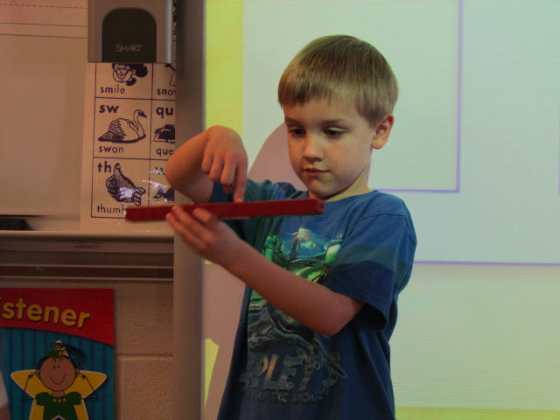
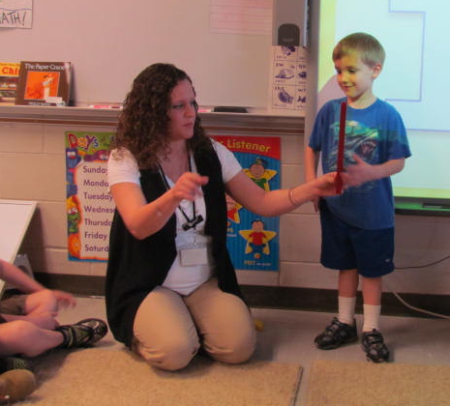
A pplication
(2) Identifying Similarities and Differences
(4) Reinforcing Effort and Providing Recognition

Slide 13

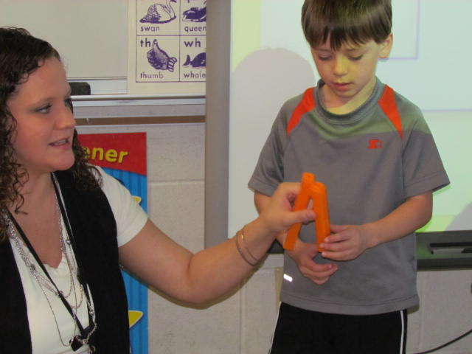
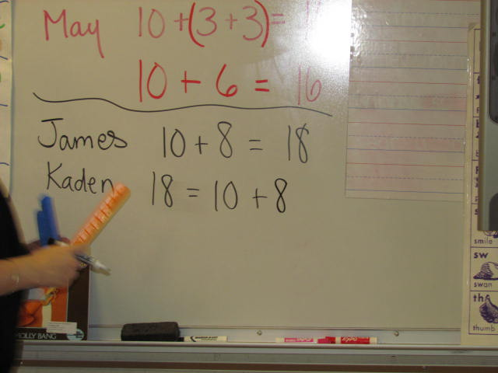
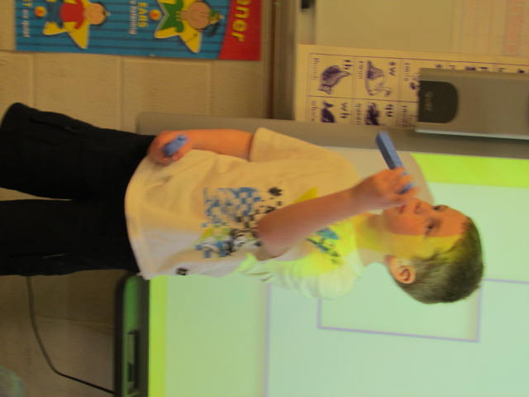
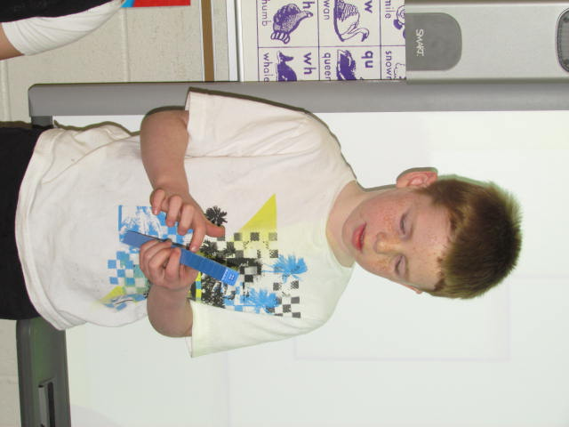
A pplication
(2) Identifying Similarities and Differences
(4) Reinforcing Effort and Providing Recognition

Slide 14

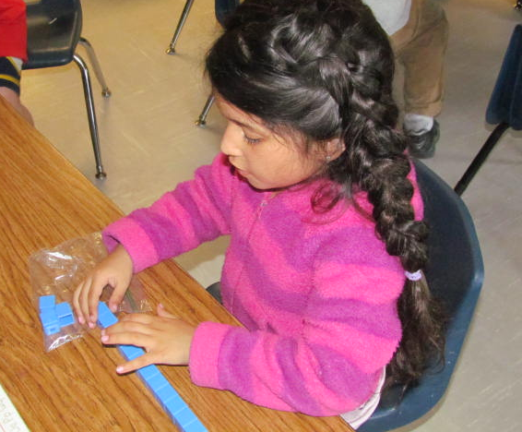
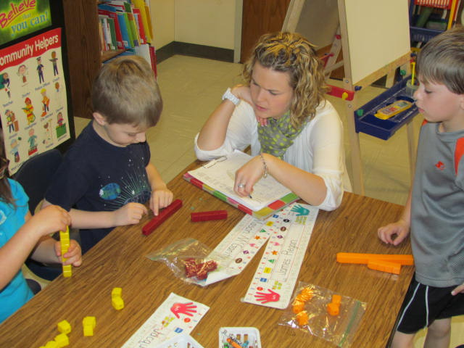
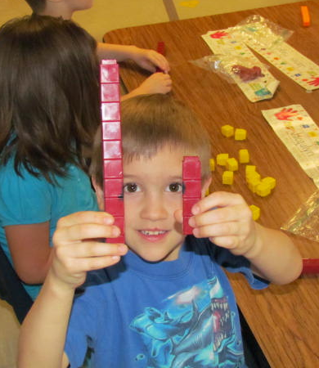
A pplication
(5) Homework and Practice
(4) Reinforcing Effort and Providing Recognition

Slide 15
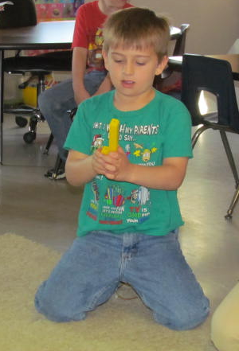
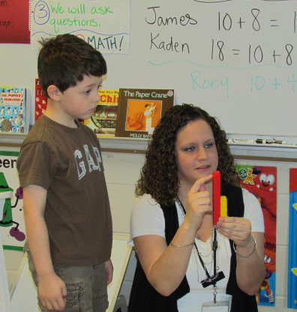
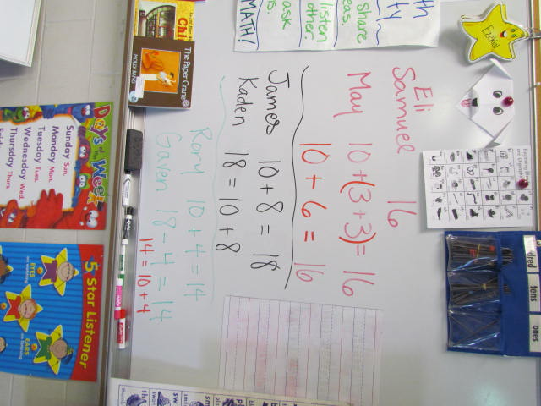
A pplication
(2) Identifying Similarities and Differences
(4) Reinforcing Effort and Providing Recognition

Slide 16
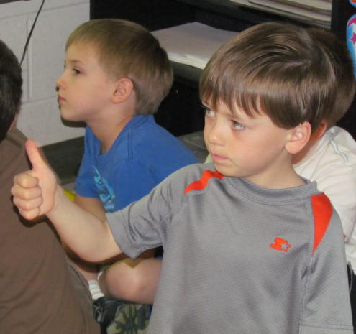
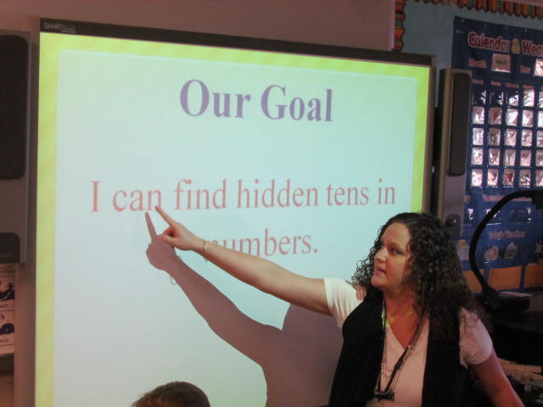
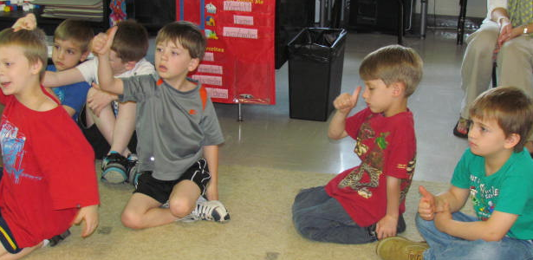
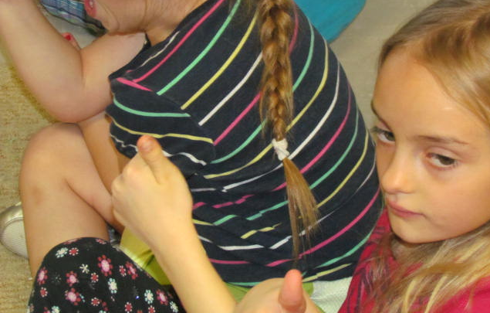
G eneralize the goal
Score Yourself Again
I know this so well I could teach someone else to do it.
I want to practice this more.
(8) Setting Objectives and Providing Feedback

