Slide 1
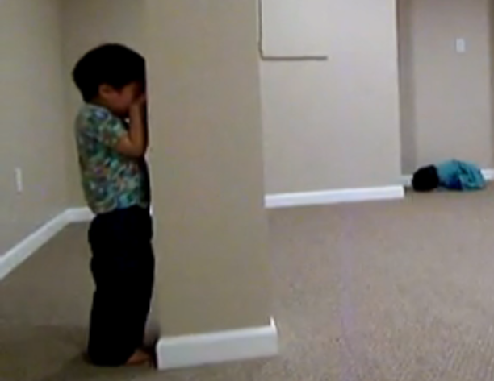
My
Favorite
Game
Click picture to watch video

Slide 2

I can find hidden tens in numbers.
10

Slide 3
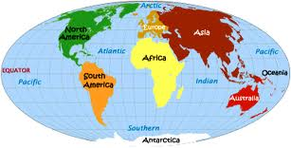
Let’s play hide and seek with
Japanese numbers!

Slide 4


itchy

Slide 5
knee

Slide 6

SUN

Slide 7

she

Slide 8
go

Slide 9

rocka

Slide 10
nana

Slide 11

hatch

Slide 12

queue
Q

Slide 13
Ju (-do)

Slide 14

Click to watch video

Slide 15
Did you find any hidden tens in the song?

Slide 16
Let’s play hide and seek with
our numbers!

Slide 17
16

Slide 18
18

Slide 19
14

Slide 20
11

Slide 21
Number | Number Sentence Showing the Hidden 10
16
18
14
11

Slide 22
Our Goal
I can find hidden tens in numbers.
10

