Slide 1


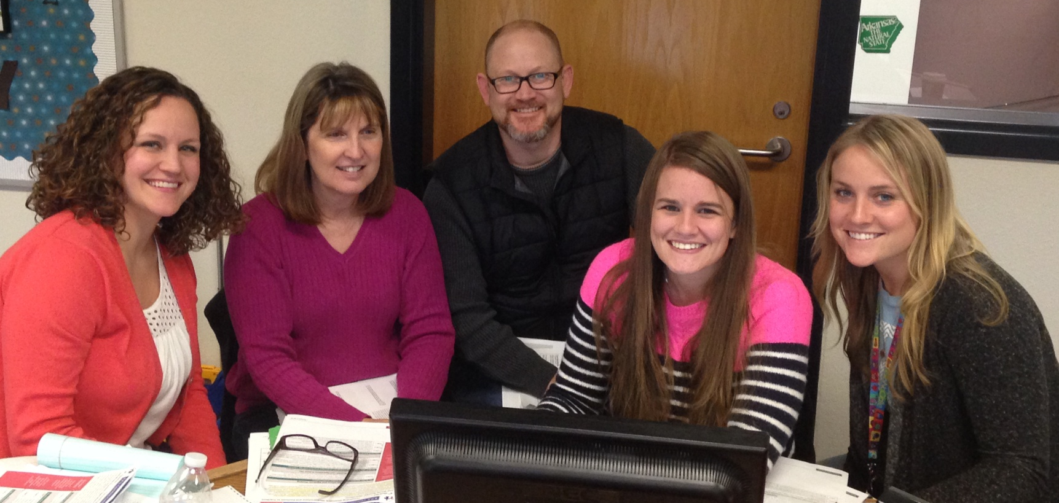
Connecting Geometric Measurement & Decimals to Fractions and Whole Number Operations
4th Grade Unit 4
Unit Planning Team:
Rea Smith (RG), Deborah Hales (RJ), Wes Faith (JM),
Rachel Watterson (ES), Megan Fawley (GH)
Notes:
Hi, My name is _________________________________ and I worked with (insert unit planning team teachers’ names) to plan unit 2.

Slide 2
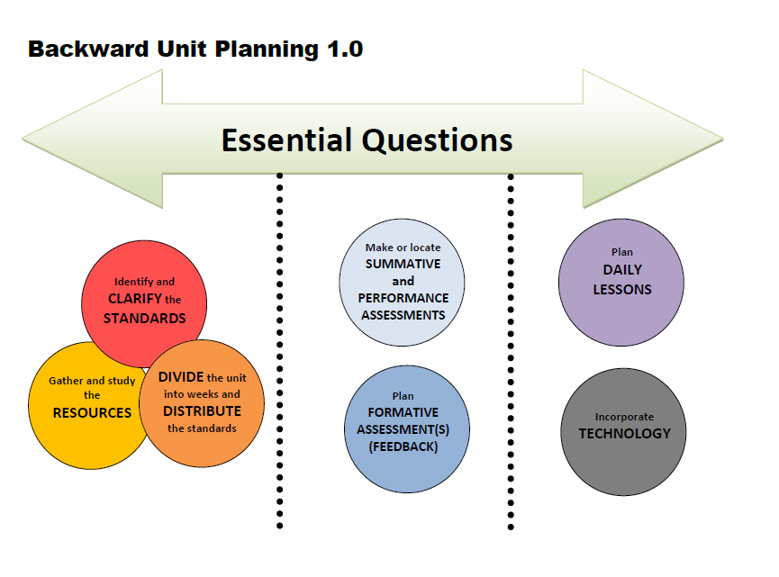
Notes:
We followed this unit planning process…

Slide 3

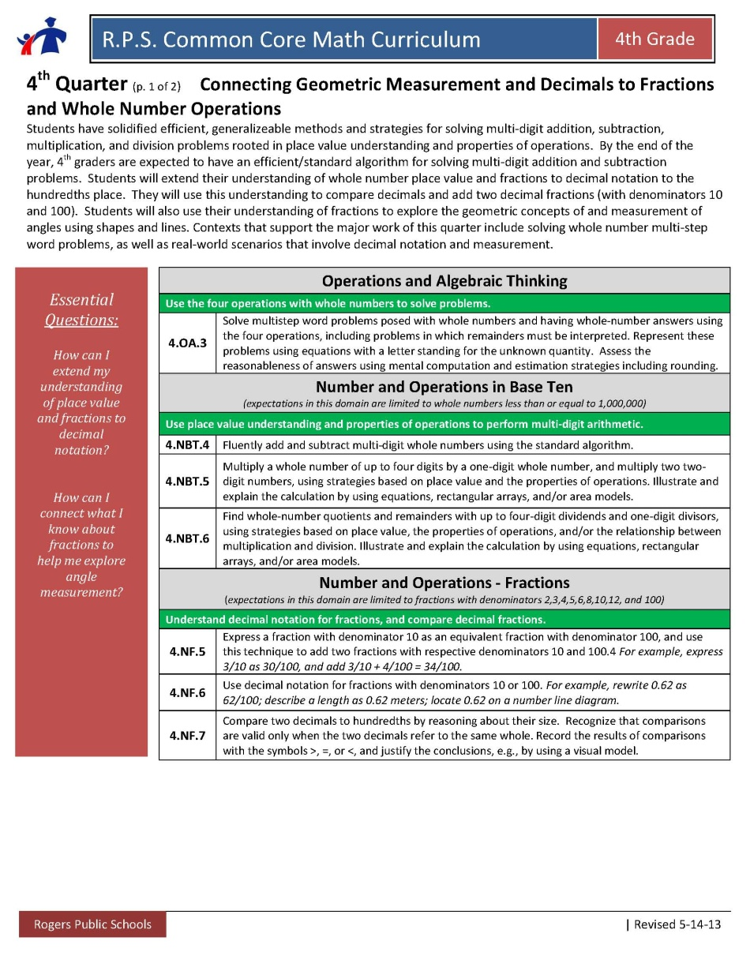
Essential Questions
How can I extend my understanding of place value and fractions to decimal notation?
How can I connect what I know about fractions to help me explore angle measurement?
The represents a new
standard this unit.

Slide 4
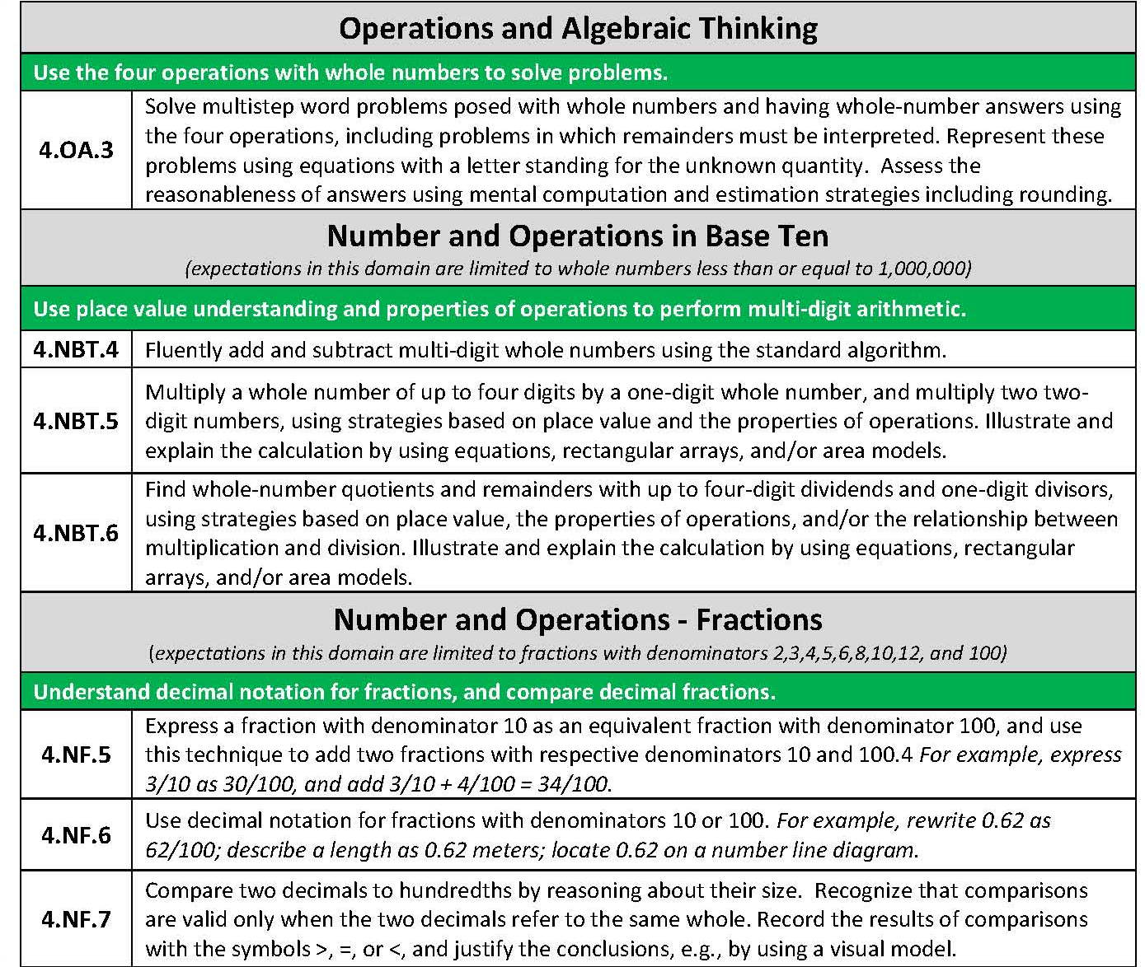
Identify and CLARIFY the STANDARDS
Clarifications
4.NF.6 and 4.NF.7 | Make the connection to fractions – decimals are just a new way to notate what we already know about fractions Ex: 0.3 = 3/10 Use this opportunity to attend to precision (SMP 6) when reading decimals – reading 0.3 as “three tenths” (rather than “zero point three”) will help students see the connection to fractions.
4.NF.1 and 4.NF.2 | These standards are not in the pacing for this quarter, however we wanted to reiterate their importance because they often occur in discussions when working with fractions
The represents a new
standard this unit.
Notes:
Next we identified and clarified the standards….
The highlighted standards are reoccurring from previous quarters. Our clarifications of how those standards have changed from previous quarters are in the blue table.

Slide 5
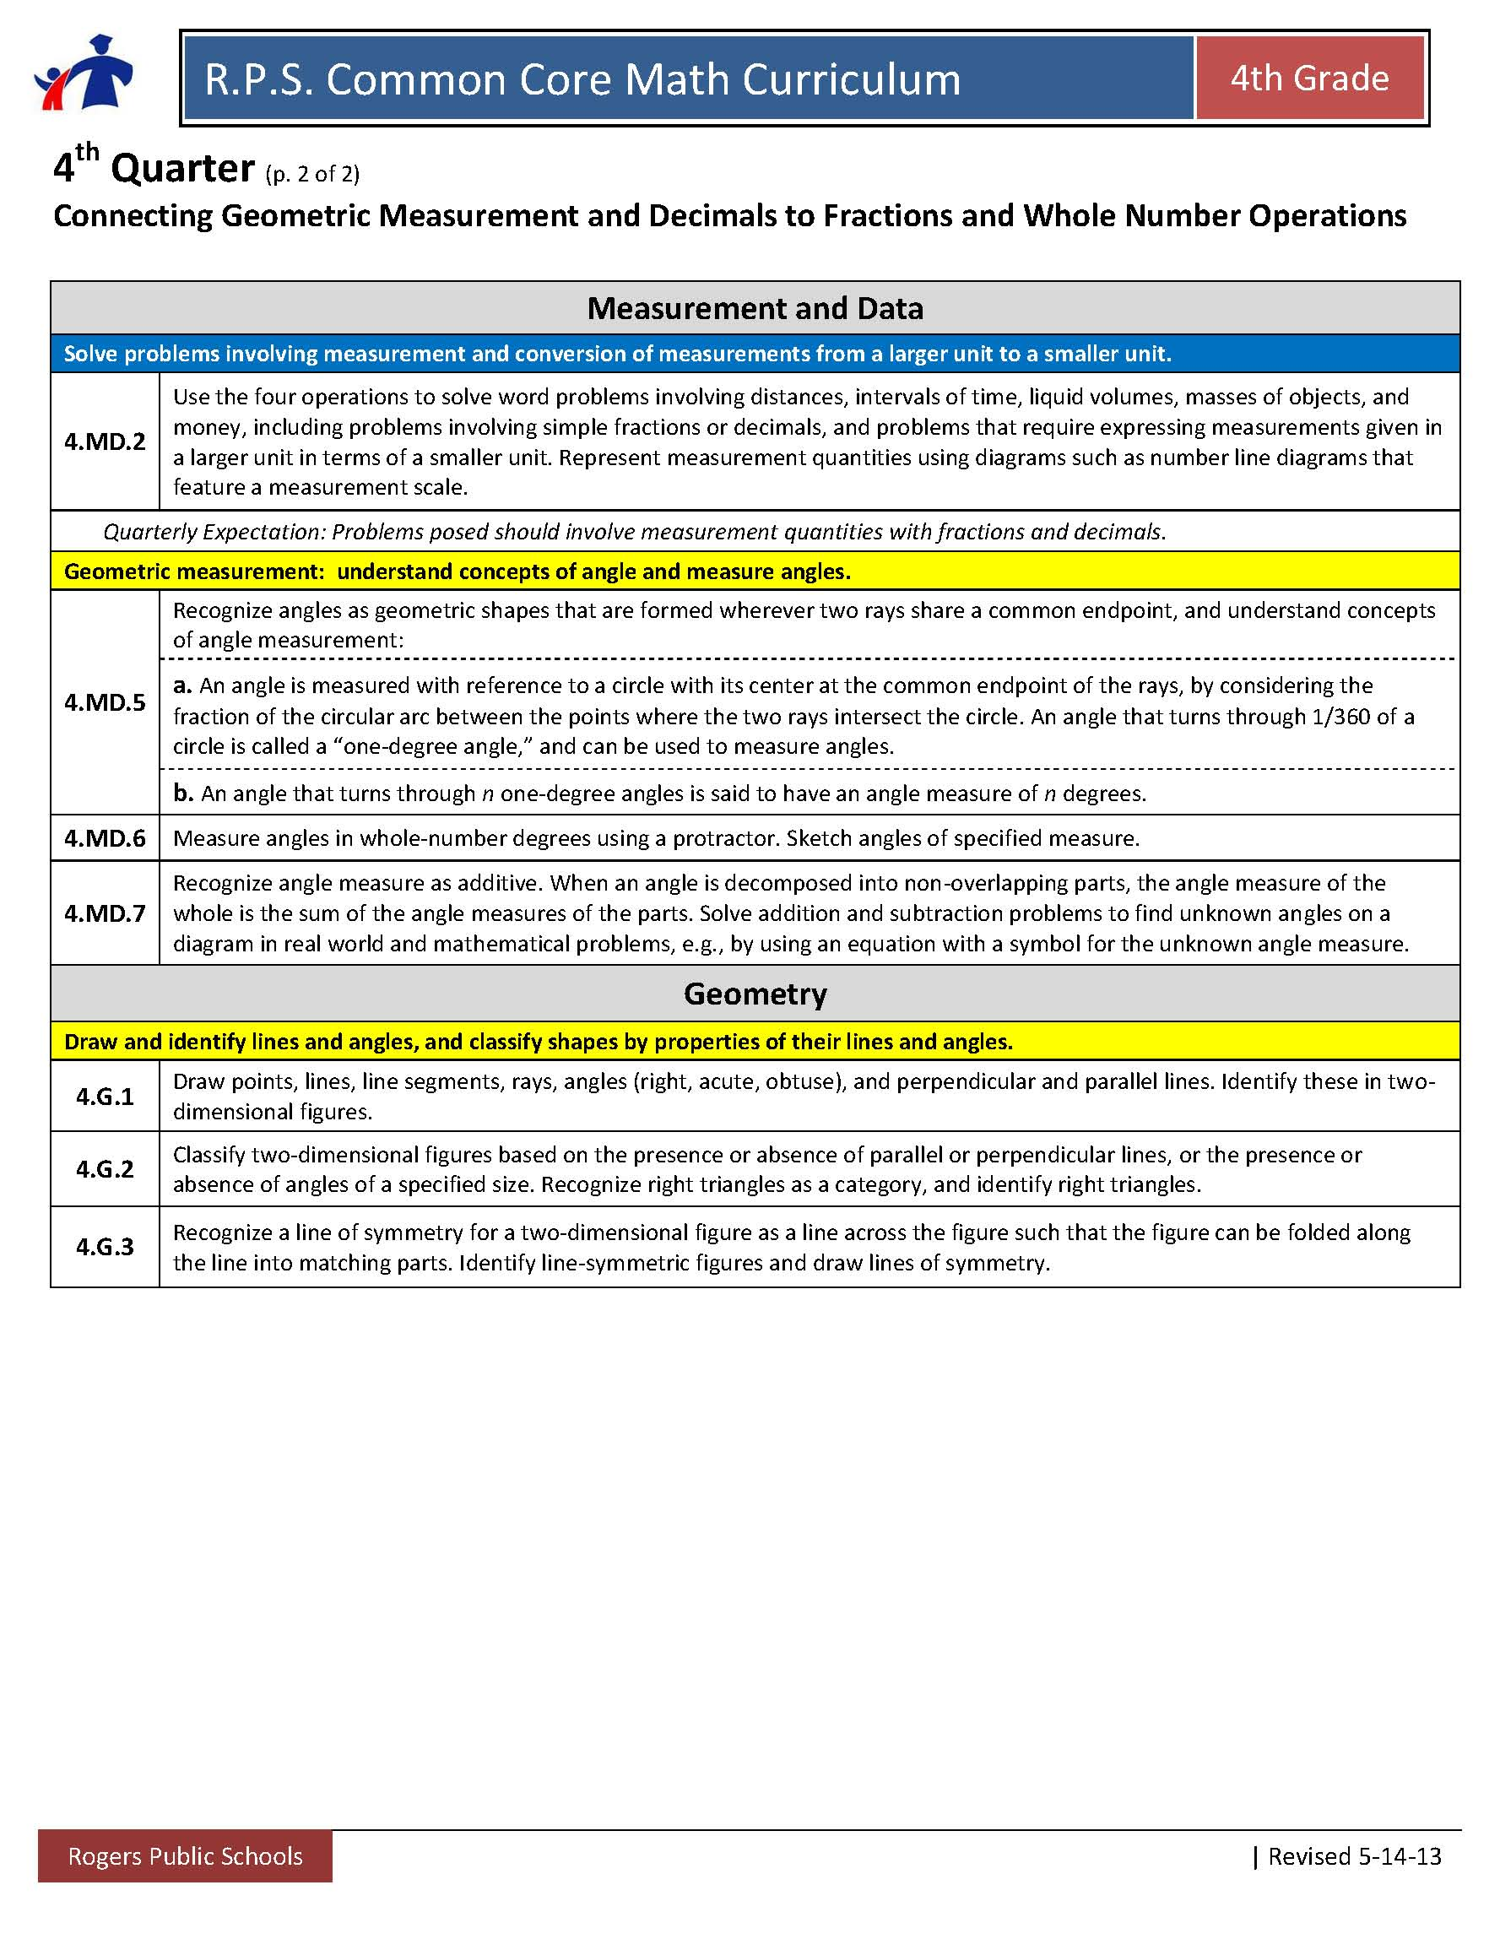
Identify and CLARIFY the STANDARDS
Clarifications
4.MD.5 4.MD.6 4.MD.7 | Angle measure connects nicely to fractions if you discuss them as part of a turn (as the standards show)
The represents a new
standard this unit.
Notes:
Continued

Slide 6
Identify and CLARIFY the STANDARDS
Emphasis on understanding decimals will be valuable! 5th Grade spends the majority of the year focusing on solidifying base 10 understanding (including decimals) and operations with fractions and decimals.
Vertical Exploration
Where are they going?
How does the work in your grade level extend into the grade level above?
What do you need to emphasize this quarter to ensure they are ready for the next grade level?

Slide 7

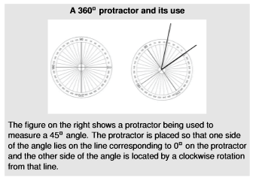
Week | Standards | Explanation/Clarification
1 | Focus 4.NF.5/4.NF.6/4.NF.7 Connection 4.MD.2 Continuous 4.OA.3 4.NBT.4/4.NBT.5/4.NBT.6 | Help students make the connection that decimals are just a new way to notate what you already know about fractions. ECM book—Chapter 7(pg. 148) “Understanding Decimals” 1-2 days focus on continuous standards
2 | Focus 4.MD.5/4.G.1 4.NF.5/4.NF.6/4.NF.7 Connection 4.MD.2 Continuous 4.OA.3 4.NBT.4/4.NBT.5/4.NBT.6 | 4.MD.5 - KEY WORD: Turn (We want kids to see angles as a turn (part of a circle) As students work on angles, we will be naturally be naming important geometric terms (4.G.1) 1-2 days focus on decimals from last week
3 | Focus 4.MD.5/4.MD.7/4.G.1 4.NF.5/4.NF.6/4.NF.7 Connection 4.MD.2 Continuous 4.OA.3 4.NBT.4/4.NBT.5/4.NBT.6 | Using 4.MD.5., make connections about what they know about whole number decomposing to angle decomposing (4.MD.7) Example: 45 + n = 90 *Draw a circle, and split it into 4^{ths}. If I turn a quarter turn, how many degrees did I turn? What if I turned half of a fourth? What degree is that? Rachel made a 140 degree turn. If she needed to turn 180 degrees, how many more degrees will she need to turn? *1-2 days focus on decimals from week 1 Working with Unit Angles This article provides instructional support to developing students' understanding of unit angles. 1-2 days focus on decimals
DIVIDE the unit into weeks and DISTRIBUTE the standards

Slide 8
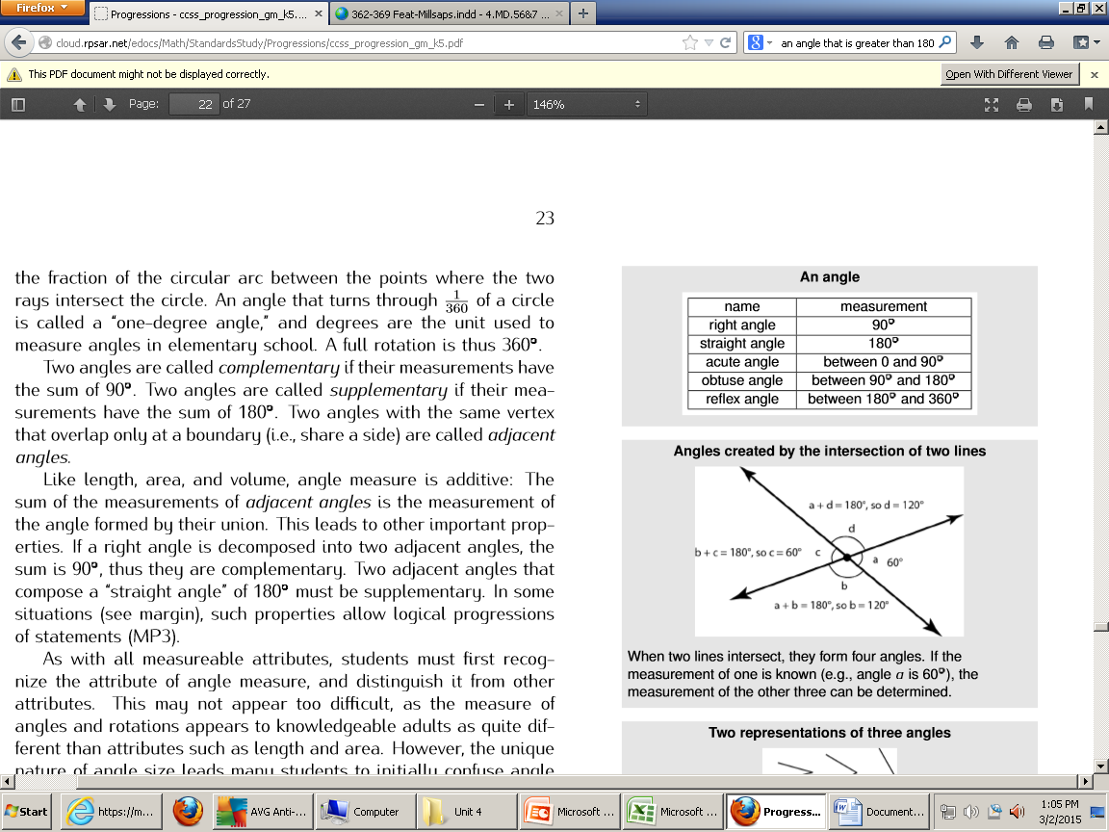
Week | Standards | Explanation/Clarification
4 | Focus 4.MD.6/4.MD.7/4.G.1 4.NF.5/4.NF.6/4.NF.7 Connection 4.MD.2 4.MD.5 Continuous 4.OA.3 4.NBT.4/4.NBT.5/4.NBT.6 | *Estimate what an angle that is 160 degrees would look like. How many more degrees would you need to go get to a full turn (What is the reflex angle)? What would 47 degrees look like? Bring the vocabulary (points, lines, line segments, rays, angles-right, acute, obtuse) into discussion. *1-2 days focus on decimals
5 | Focus 4.G.2 4.NF.5/4.NF.6/4.NF.7 Connection 4.MD.2 4.MD.5/4.MD.6/4.MD.7 Continuous 4.OA.3 4.NBT.4/4.NBT.5/4.NBT.6 | A Look at Triangles In this lesson, students will classify triangles based on their properties. This lesson format can also be used when discussing squares and other rectangles. (4.G.2) *Identify the properties of types of triangles (Right, Isosceles, scalene) in order to cross classify. For example: naming a shape as a right isosceles triangle. See progression document (Geometry K-6) page 15. *1-2 days focus on decimals (if time)
DIVIDE the unit into weeks and DISTRIBUTE the standards

Slide 9
Week | Standards | Explanation/Clarification
6 | Focus 4.G.2/4.G.3 4.NF.5/4.NF.6/4.NF.7 Connection 4.MD.2 4.MD.5/4.MD.6/4.MD.7 Continuous 4.OA.3 4.NBT.4/4.NBT.5/4.NBT.6 | Decoding ABC Symmetry- Introduction lesson on symmetry (4.G.3) *give one half a figure and the line of symmetry and accurately draw the other half (4.G.3) *1-2 days on decimal ideas *1-2 days on whole number multiplication/division multi-step problem
7
DIVIDE the unit into weeks and DISTRIBUTE the standards
End of the geometry section. Reteach any standard students are still struggling with as noted by formative assessments.
Geometry Town (culminating task)

Slide 10
Week | Standards | Explanation/Clarification
8 | Focus 4.NF.5/4.NF.6/4.NF.7 Connection 4.MD.2 Continuous 4.OA.3 4.NBT.4/4.NBT.5/4.NBT.6 | As you come to the end of the year, please begin to consider the standards that would best prepare your students for the beginning of 5th grade. -Any multi digit multiplication or division multi-step problems. -bring in 4.MD.2 (distance, time, money, liquid volume, etc.) though problems relating to decimals and fractions.
9 | Focus 4.NF.5/4.NF.6/4.NF.7 Connection 4.MD.2 Continuous 4.OA.3 4.NBT.4/4.NBT.5/4.NBT.6 | Continue to consider the standards that would best prepare your students for the beginning of 5th grade. -Any multi digit multiplication or division multi-step problems. -bring in 4.MD.2 (distance, time, money, liquid volume, etc.) though problems relating to decimals and fractions.
DIVIDE the unit into weeks and DISTRIBUTE the standards

Slide 11
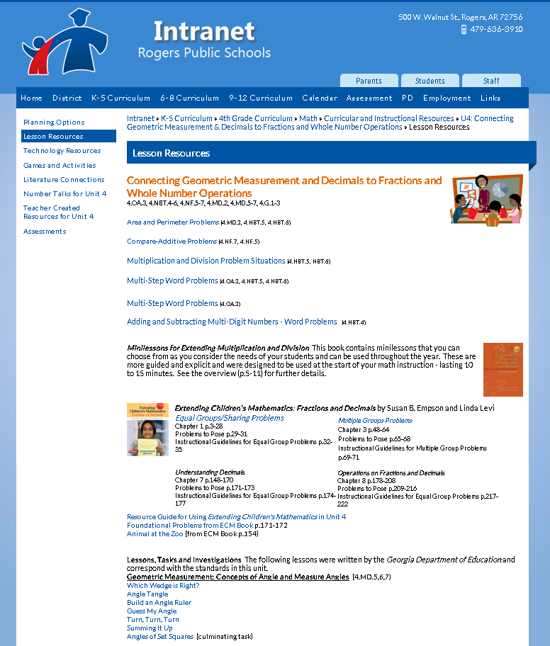
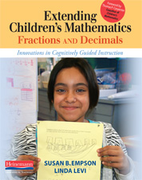
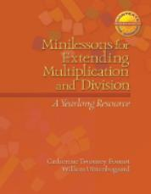
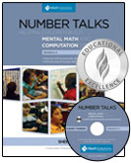
Gather and study the RESOURCES

Slide 12
Options for Assessment – available online for Unit 4
Essential Question 1
How can I extend my understanding of place value and fractions to decimal notation?
Make or locate SUMMATIVE
and PERFORMANCE
ASSESSMENTS
4th Grade Decimals Assessment from OCSD
Using Place Value (4.NF.7)
4th Grade Decimals Assessment

Slide 13
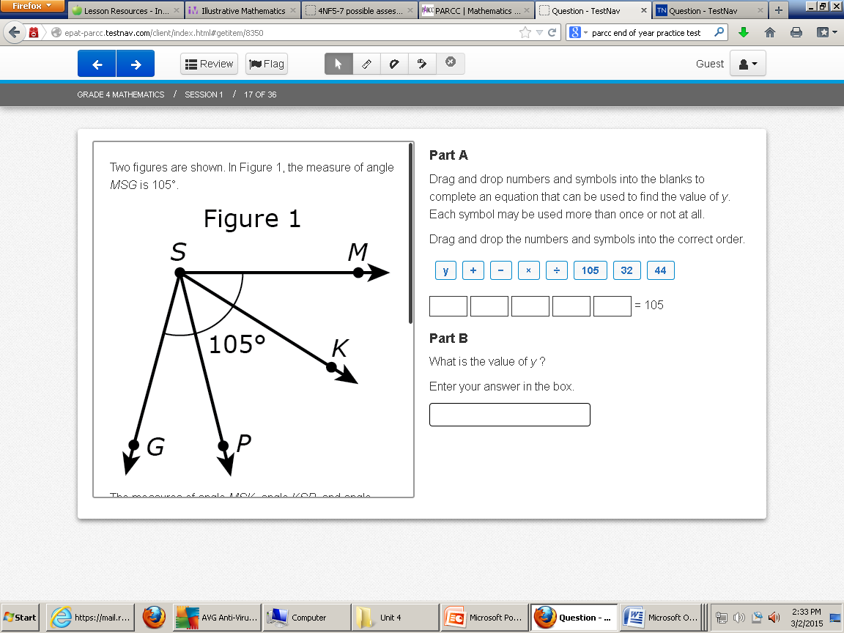
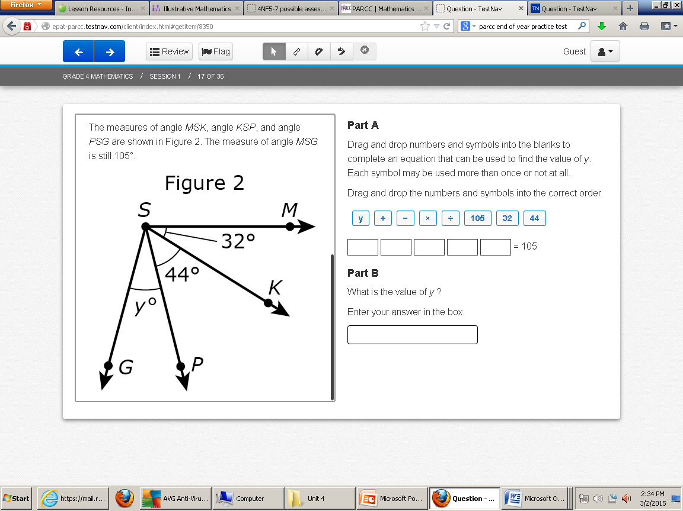
Options for Assessment – available online for Unit 3
Essential Question 2
How can I connect what I know about fractions to help me explore angle measurement?
Make or locate SUMMATIVE
and PERFORMANCE
ASSESSMENTS
EOY PARCC Computer Based Test

Slide 14

Lessons and resources are available online.
Plan DAILY LESSONS
Incorporate TECHNOLOGY
Notes:
Lessons and resources are available online for Unit 3.

Slide 15



Teacher Created Resources pages!!!
RESOURCES
Beth Pesnell
Elementary Curriculum Specialist
bpesnell@rps.k12.ar.us
Notes:
We have NEW Teacher Created Resources pages in Math! Please share any resources you create with your math facilitator or Beth Pesnell.
We hope these resources will help you in your unit planning journey this quarter.

