Slide 1
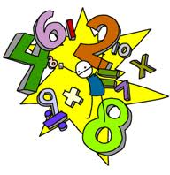
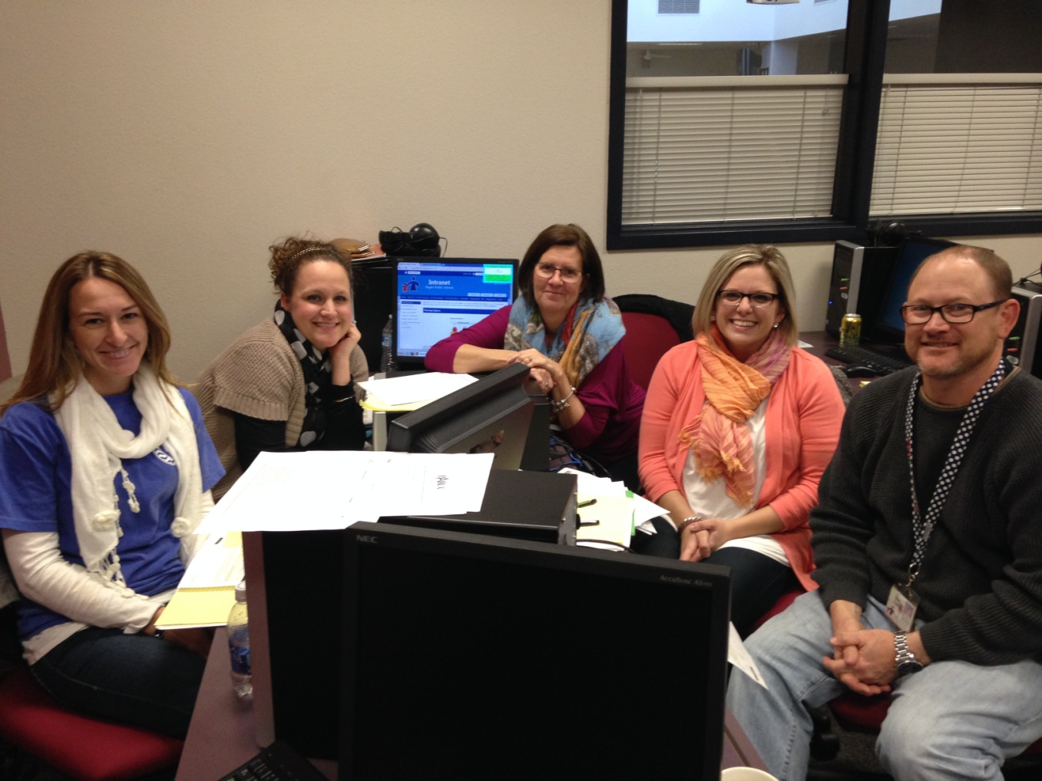

Connecting Whole Number Operations Addition & Subtraction of Mixed Numbers;
Multiplicative Comparison
4th Grade Unit 3
Unit Planning Team:
Angela Black (ES), Rea Smith (RG), Susan Harp (JD),
Haylee Pierce (JM), Wes Faith (JM)
Notes:
Hi, My name is _________________________________ and I worked with (insert unit planning team teachers’ names) to plan unit 2.

Slide 2
Connecting Whole Number Operations Addition & Subtraction of Mixed Numbers;
Multiplicative Comparison
4th Grade Unit 3
The main focus of third quarter involves the introduction of multiplicative comparisons. In third grade, students studied multiplication as equal groups, arrays, and area; in fourth grade, students extend this understanding using multiplicative comparisons. They will use their understanding of multiplicative comparison to solve problems involving measurement and conversions from a larger unit to a smaller unit. Students continue to work with all four operations using whole numbers. They will extend multiplication to multiplying two two-digit numbers and division up to a four-digit dividend by a one-digit divisor. Students continue to develop strategies using their base-ten understanding along with meanings and properties of operations, to compute with whole numbers. Students build on their work from second quarter to add and subtract fractions with like denominators, as well as multiply fractions by a whole number. They extend this knowledge to include adding and subtracting mixed numbers with like denominators. Contexts for problem-solving that support the major work of this quarter include solving whole number multi-step problems and real-world scenarios with simple fractions, as well as measurement conversions.

Slide 3
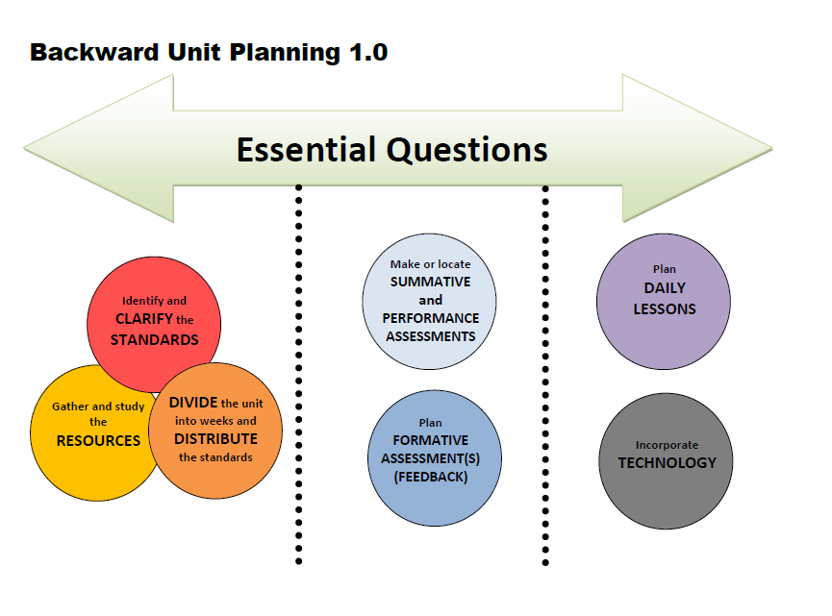
Notes:
We followed this unit planning process…

Slide 4

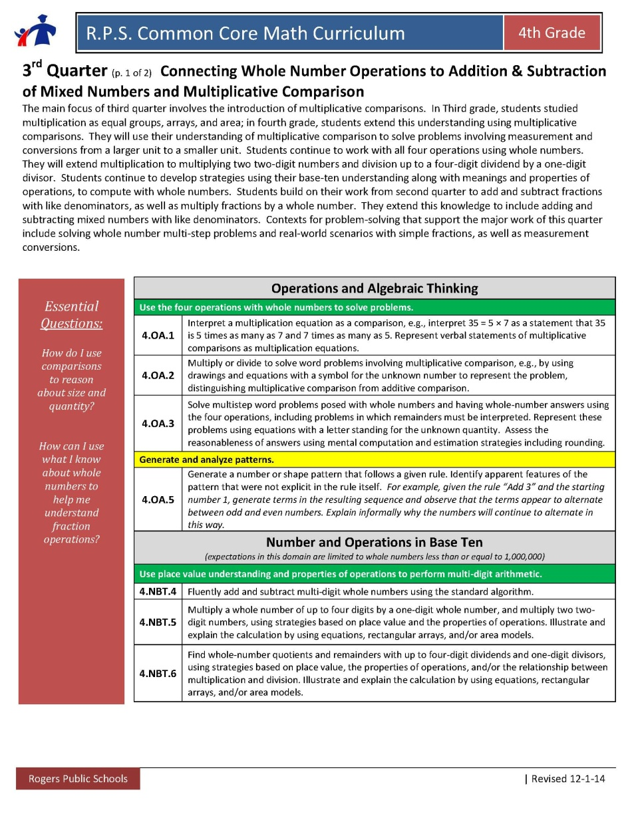
Essential Questions
New Essential Questions:
How do I use comparisons to reason about size and quantity?
How can I use what I know about whole numbers to help me understand fraction operations?
Notes:
First we revised our essential questions by looking at this unit’s big ideas…
We chose to reword the summary for Unit 3 to highlight the importance of multiplicative comparison.

Slide 5
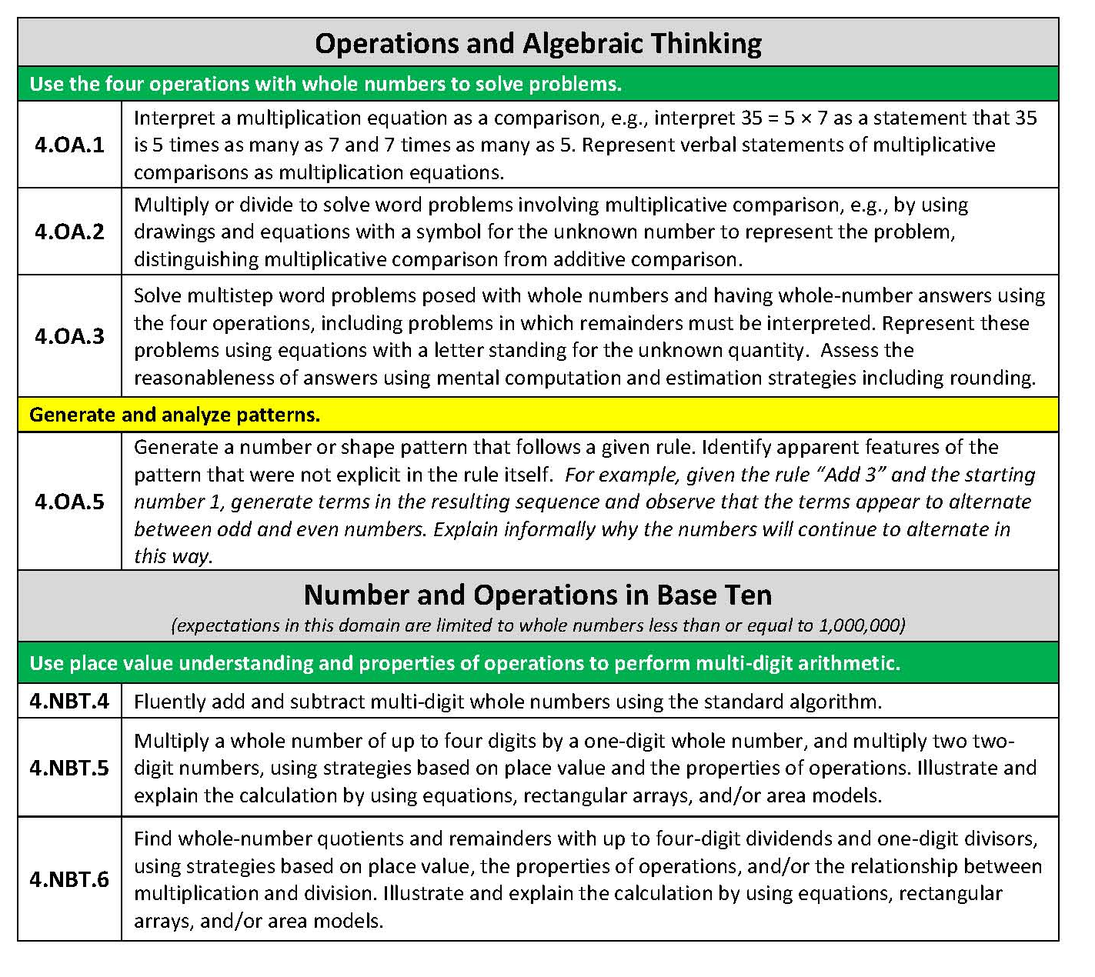
 | Clarifications of Reoccurring Standards
4.OA.3 | Ongoing throughout the year; Include division with remainders; Equations need to include letters standing for unknown quantities; Connect to problems types that involve comparison
4.NBT.4 | Continued maintenance with addition and subtraction; Small group instruction for students who struggle; Work with base ten and counting within base ten; Students should be working toward a standard algorithm by the end of the year; Use problem types involving additive comparison
4.NBT.5 | 4 x 1 and 2 x 2; Illustrate through equations, rectangular arrays, and area models based on place value and properties of operations
4.NBT.6 | Up to 4 divided by 1; inverse of 4.NBT.5
Identify and CLARIFY the STANDARDS
Notes:
Next we identified and clarified the standards….
The highlighted standards are reoccurring from previous quarters. Our clarifications of how those standards have changed from previous quarters are in the blue table.

Slide 6
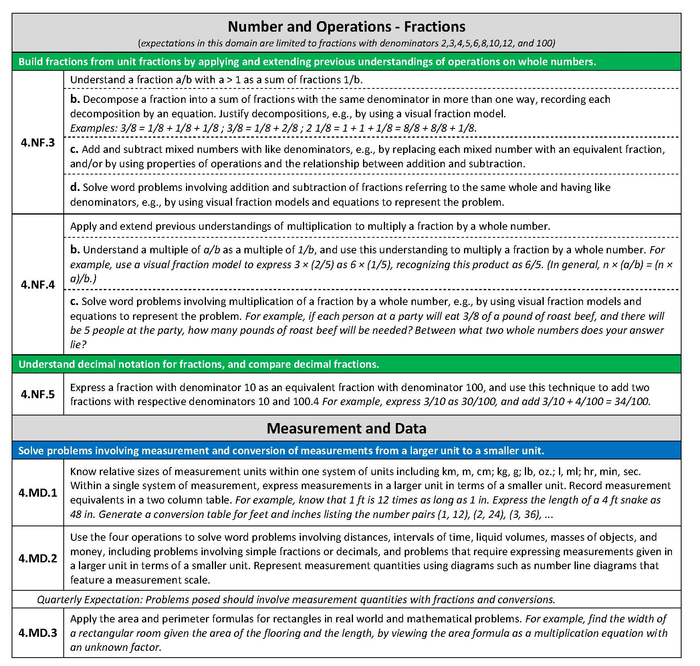
 | Clarifications of Reoccurring Standards
4.NF.3 | Part “a” has dropped off and “c” has been added (+/- mixed numbers); Involves flexibility and decomposing fractions different ways; All work involves like denominators
4.NF.1/4.NF.2 | Fraction equivalence and comparison are not in the pacing for this quarter, but will need to be continued as you work with fractions
4.NF.4 | “a” has dropped off; “b” deals with the distributive and associative properties- fraction by a whole number; “c” pertains to multiple groups problems
4.MD.2 | Involves all four operations; bring in conversions and fractions to solve within measurement contexts; Measurement scale refers to number lines
Identify and CLARIFY the STANDARDS
Notes:
Continued
4.NF.1 and 4.NF.2 – these standards are not in the pacing for this quarter, however we chose to include them in our clarifications because they often occur in discussions when working with fractions

Slide 7
 | Clarifications of New Standards
4.OA.1 | “as much as” and “times as many” vocabulary from progressions; moving from equal groups in previous grades to multiplicative comparison (connects to 4.NBT.1 standard of 10xs as many with place value); Use Problem Types Chart
4.OA.2 | Multiplication and division word problems that involve multiplicative comparison; Distinguish multiplicative from additive comparison when beginning work with comparison this quarter
4.OA.5 | Involves number and shape patterns; Number patterns can connect to additive and multiplicative comparison, making sure to address the rule when working with patterns
Identify and CLARIFY the STANDARDS
Notes:
The next two slides address the standards new in this quarter. Clarifications for the new standards are in the blue table.

Slide 8
 | Clarifications of New Standards
4.NF.5 | Refer to Chapter 7 in the ECM book; ties to 4.NF.1 with equivalent fractions; could tie into money using pennies and dimes; can tie into multiplicative comparisons with converting between tenths and hundredths; Use base-ten blocks and equal sharing to reinforce this idea
4.MD.1 | Conversions; Idea- Use a two column table to show conversions connecting to 4.OA.5; Metric and customary units; Ties into multiplicative comparison when converting
4.MD.3 | Area and perimeter formula in real world problems; Could have missing side lengths; Rich Lehrer area measure resource
Identify and CLARIFY the STANDARDS

Slide 9

Week | Standards | Explanation/Clarification
1 | Focus 4.OA.1 / 4.OA.2 4.NF.4 Connection 4.NBT.1 (not actually paced for this quarter) Continuous 4.NBT.5/4.NBT.6 4.OA.3 | Understanding the difference between multiplicative and additive comparison Relating multiplicative comparison to the relationship to base ten (4.NBT.1 Recognize that in a multi-digit whole number, a digit in one place represents 10xs what it represents in the place to its right) Continue to develop strategies based on place value and properties of operations
2 | Focus 4.OA.1 / 4.OA.2 4.NF.4 Connection 4.NBT.1 (not actually paced for this quarter) Continuous 4.NBT.5/4.NBT.6 4.OA.3 | Continue with same focus as week 1
3 | Focus 4.MD1/4.MD.2 4.OA.5 Connection 4.OA.1/4.OA.2 Continuous 4.NBT.4/4.NBT.5/4NBT.6 4.OA.3 | Use understanding of multiplicative comparisons in the context of problems involving measurement conversions… connect to 4.OA.5 in working with the patterns that evolve from measurement conversions
DIVIDE the unit into weeks and DISTRIBUTE the standards
Notes:
Once the standards were clarified, we divided the unit into weeks and distributed the standards throughout those 9 weeks…

Slide 10
Week | Standards | Explanation/Clarification
4 | Focus 4.MD1/4.MD.2 4.OA.5 Connection 4.OA.1/4.OA.2 Continuous 4.NBT.4/4.NBT.5/4NBT.6 4.OA.3 | Continue work from week 3 4.OA.5- extend pattern work to other shape and number patterns with rules
5 | Focus 4.NF.5 4.MD.1 Connection 4.OA1/4.OA.2 Continuous 4.NBT.1 (not in this quarter pacing) 4.NBT.4/4.NBT.5/4.NBT.6 4.OA.3 | In order to understand the multiplicative relationship between 3/10 and 30/100 (4.NF.5), you must understand the multiplicative nature of our base ten system (4.NBT.1)… 1 is ten times as much as 1/10 and 1/10 is ten times as much as 1/100 This understanding can connect to 4.MD.1 when converting in the metric system
6 | Focus 4.NF.5 4.MD.1 Connection 4.OA.1/4.OA.2 Continuous 4.NBT.1 (not in this quarter pacing) 4.NBT.4/4.NBT.5/4.NBT.6 4.OA.3 | Same as week 5
DIVIDE the unit into weeks and DISTRIBUTE the standards

Slide 11
Week | Standards | Explanation/Clarification
7 | Focus 4.NF.3/4.NF.4 Continuous 4.NBT.4/4.NBT.5/4NBT.6 4.OA.3 4.OA.1/4.OA.2 | 4.NF.3 could be used to push additive comparison with fractional amounts; mixed numbers have been added to this quarter; subtraction of fractions should be a focus, if it hasn’t been yet 4.NF.4 relates to multiplicative comparison as in ¾ is the same as 3 times as much as ¼; should also focus on multiple groups problems as in ¾ is the same as 3 groups of ¼
8 | Focus 4.NF.3/4.NF.4 Continuous 4.NBT.4/4.NBT.5/4NBT.6 4.OA.3 4.OA.1/4.OA.2 | Same as week 8
9 | Focus 4.MD.3 Connection 4.MD.2 Continuous 4.NBT.4/4.NBT.5/4NBT.6 4.OA.3 | 4.MD.3 is an application of the area and perimeter formulas for rectangles and assumes that students have had sufficient time exploring and building understanding of those formulas… if you feel that your students do not have this understanding, you may need to devote more time throughout the quarter to explore these ideas Comparison can be a context when comparing area and perimeter of different rectangles
DIVIDE the unit into weeks and DISTRIBUTE the standards

Slide 12

Suggested Weekly Posing of Problems:
This is one way to think about clustering the standards. These ideas would be repeated each week.
Essential Questions
How do I use comparisons to reason about size and quantity?
How can I use what I know about whole numbers to help me understand fraction operations?
1-2 days a week- (4.NBT.4, 4.NF.3, 4.OA.3)
Focus on additive comparison problems to revisit whole number addition and subtraction (EQ 1) as well as adding and subtracting fractions (EQ 2). Include multi-step problems.
2-3 days a week- Focus on multiplicative comparison problems (EQ 1). Connections should be made to base 10 understanding and measurement conversions. Pose multiplication of a fraction by a whole number.
(4.OA.1, 4.OA.2, 4.MD.1, 4.MD.2, 4.OA.5, 4.NBT.5, 4.NBT.6, 4.NF.5)
1-2 days a week- Compare rectangular areas (EQ 1)
(4.MD.3)
DIVIDE the unit into weeks and DISTRIBUTE the standards
Suggested Weekly Posing of Problems: This is one way to think about clustering the standards. These ideas would be repeated each week. Essential Questions: What do the digits in a number represent? How does money relate to place value? 2.NBT.1, 2.NBT.2, 2.NBT.3, 2.MD.8- 1-2 days a week pose problems with groups of 10 in multiplication and measurement division problems. Use money (2.MD.8) as a context for place value problems. 2.NBT.2, 2.NBT.3 – Daily counting and writing number embedded. Essential Question: What strategies can I use to find sums and differences of two-digit numbers? 2.OA.1, 2.NBT.5, 2.NBT.6, 2.NBT.9 3-4 days a week posing multiple problem types and discussing student strategies. 2.OA.2 Fluency within 20 daily or 1 focused day with number talks daily
Week | Standards | Structure/Resource Type
1 | Building culture 2.NBT.2 Count within 1000, skip-count by 5s, 10s, and 100s 2.NBT.3 Read and write numbers to 1000 2.OA.2 Fluency within 20 2.OA.1 Addition and Subtraction within 100 – various problem types | Counting Collections Fluency Number Talks Daily Pose JRU and SRU to see where students are (as a formative assessment) Administer Pre-Assessment (could be the summative)
2 | 2.NBT.1 Understand 3-digit numbers 2.NBT.2 Count within 1000, skip-count by 5s, 10s, and 100s 2.NBT.3 Read and write numbers to 1000 2.OA.2 Fluency within 20 2.OA.1 Addition and Subtraction within 100 – various problem types 2.NBT.5 Fluently add and subtract within 100, using properties, place value, and relationship between addition and subtraction. | Pose Multiplication and Measurement Division problems in groups of 10 (1-2 days that week) Give students a number (100-999). Have them build the number with base 10 blocks. Have them write the number name and write the expanded form. Fluency Number Talks Daily Pose problem types to students based on student needs (3-4 days a week). Look for invented strategies to pull out in discussion.
3 | 2.NBT.1 Understand 3-digit numbers 2.NBT.2 Count within 1000, skip-count by 5s, 10s, and 100s 2.NBT.3 Read and write numbers to 1000 2.OA.2 Fluency within 20 2.OA.1 Addition and Subtraction within 100 – various problem types 2.NBT.5 Fluently add and subtract within 100, using properties, place value, and relationship between addition and subtraction. | Pose Multiplication and Measurement Division problems in groups of 10 (1-2 days that week) Fluency Number Talks Daily Pose problem types to students based on student needs (3-4 days a week). Look for invented strategies to pull out in discussion.
4 | 2.NBT.1 Understand 3-digit numbers 2.NBT.2 Count within 1000, skip-count by 5s, 10s, and 100s 2.NBT.3 Read and write numbers to 1000 2.OA.2 Fluency within 20 2.OA.1 Addition and Subtraction within 100 – various problem types 2.NBT.5/6 Fluently add and subtract within 100, using properties, place value, and relationship between addition and subtraction. | Pose Multiplication and Measurement Division problems in groups of 10 (1-2 days that week) Fluency Number Talks Daily Pose problem types to students based on student needs (3-4 days a week). Look for invented strategies to pull out in discussion.
5 | 2.NBT.1 Understand 3-digit numbers 2.NBT.2 Count within 1000, skip-count by 5s, 10s, and 100s 2.NBT.3 Read and write numbers to 1000 2.MD.8 Solve word problems involving dollar bills, quarters, dimes, nickels, and pennies. 2.OA.2 Fluency within 20 (2.OA.1)2.NBT.5/6 Fluently add and subtract within 100, using properties, place value, and relationship between addition and subtraction. 2.NBT.9 Explain why addition and subtraction strategies work. | Pose Multiplication and Measurement Division problems in groups of 10 (1-2 days that week) Use money as a context. i.e. You have 8 dimes and 4 pennies, how much money do you have? Fluency Number Talks Daily Pose problem types to students based on student needs (3-4 days a week). Look for invented strategies to pull out in discussion. Focus on students fully explaining their thinking.
6 | 2.NBT.1 Understand 3-digit numbers 2.NBT.2 Count within 1000, skip-count by 5s, 10s, and 100s 2.NBT.3 Read and write numbers to 1000 2.MD.8 Solve word problems involving dollar bills, quarters, dimes, nickels, and pennies. 2.OA.2 Fluency within 20 (2.OA.1)2.NBT.5/6 Fluently add and subtract within 100, using properties, place value, and relationship between addition and subtraction. 2.NBT.9 Explain why addition and subtraction strategies work. | Pose Multiplication and Measurement Division problems in groups of 10 (1-2 days that week) Use money as a context. i.e. You have 8 dimes and 4 pennies, how much money do you have? Fluency Number Talks Daily Pose problem types to students based on student needs (3-4 days a week). Look for invented strategies to pull out in discussion. Focus on students fully explaining their thinking.
7 | 2.NBT.1 Understand 3-digit numbers 2.NBT.2 Count within 1000, skip-count by 5s, 10s, and 100s 2.NBT.3 Read and write numbers to 1000 2.MD.8 Solve word problems involving dollar bills, quarters, dimes, nickels, and pennies. 2.OA.2 Fluency within 20 (2.OA.1)2.NBT.5/6 Fluently add and subtract within 100, using properties, place value, and relationship between addition and subtraction. 2.NBT.9 Explain why addition and subtraction strategies work. | Pose Multiplication and Measurement Division problems in groups of 10 (1-2 days that week) Use money as a context. i.e. You have 8 dimes and 4 pennies, how much money do you have? Fluency Number Talks Daily Pose problem types to students based on student needs (3-4 days a week). Look for invented strategies to pull out in discussion. Focus on students fully explaining their thinking.
8 | 2.NBT.1 Understand 3-digit numbers 2.NBT.2 Count within 1000, skip-count by 5s, 10s, and 100s 2.NBT.3 Read and write numbers to 1000 2.MD.8 Solve word problems involving dollar bills, quarters, dimes, nickels, and pennies. 2.OA.2 Fluency within 20 (2.OA.1)2.NBT.5/6 Fluently add and subtract within 100, using properties, place value, and relationship between addition and subtraction. 2.NBT.9 Explain why addition and subtraction strategies work. | Pose Multiplication and Measurement Division problems in groups of 10 (1-2 days that week) Use money as a context. i.e. You have 8 dimes and 4 pennies, how much money do you have? Fluency Number Talks Daily Pose problem types to students based on student needs (3-4 days a week). Look for invented strategies to pull out in discussion. Focus on students fully explaining their thinking.
9 | 2.NBT.1 Understand 3-digit numbers 2.NBT.2 Count within 1000, skip-count by 5s, 10s, and 100s 2.NBT.3 Read and write numbers to 1000 2.MD.8 Solve word problems involving dollar bills, quarters, dimes, nickels, and pennies. 2.OA.2 Fluency within 20 (2.OA.1)2.NBT.5/6 Fluently add and subtract within 100, using properties, place value, and relationship between addition and subtraction. 2.NBT.9 Explain why addition and subtraction strategies work. | Pose Multiplication and Measurement Division problems in groups of 10 (1-2 days that week) Use money as a context. i.e. You have 8 dimes and 4 pennies, how much money do you have? Fluency Number Talks Daily Pose problem types to students based on student needs (3-4 days a week). Look for invented strategies to pull out in discussion. Focus on students fully explaining their thinking.
Notes:
Here is another option for a weekly planning guide to use throughout the 9 weeks of this unit

Slide 13
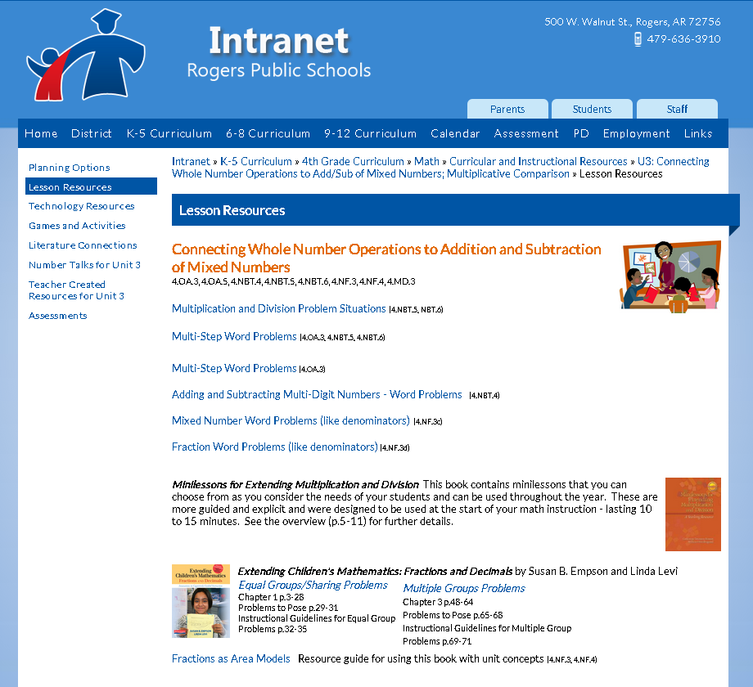
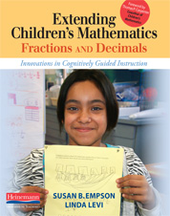
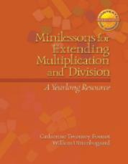

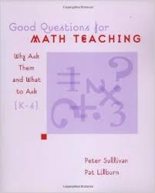
Gather and study the RESOURCES
Notes:
Once we had the standards clarified and they were distributed throughout the unit, it was time to gather and study our resources….
The main resources we discussed are the books shown on this page as well as the district website.

Slide 14
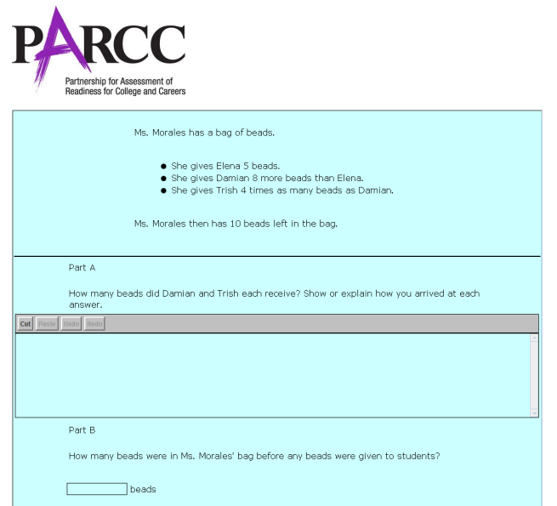
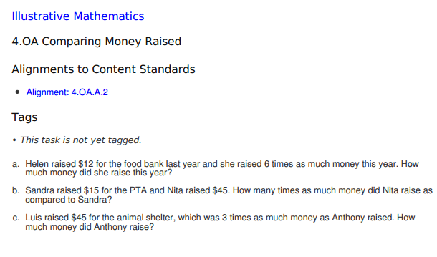
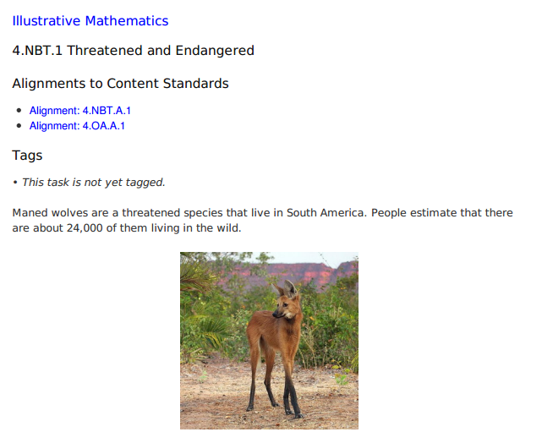
Options for Assessment – available online for Unit 3
Essential Question 1
How do I use comparisons to reason about size and quantity?
(specifically 4.OA.1 and 4.OA.2)
Make or locate SUMMATIVE
and PERFORMANCE
ASSESSMENTS
Notes:
Three Friends’ Beads - PARCC Sample question that addresses 4.OA.1, 4.OA.2, and 4.OA.3
http://www.parcconline.org/sites/parcc/files/Grade4-ThreeFriends%27Beads.pdf
Comparing Money Raised - Question from Illustrative Mathematics that is aligned to 4.OA.2
http://s3.amazonaws.com/illustrativemathematics/illustration_pdfs/000/000/263/original/illustrative_mathematics_263.pdf?1390748860
Threatened & Endangered - Task from Illustrative Mathematics that is aligned to 4.OA.1 and also brings in the connection with 4.NBT.1
http://s3.amazonaws.com/illustrativemathematics/illustration_pdfs/000/001/809/original/illustrative_mathematics_1809.pdf?1392693091

Slide 15
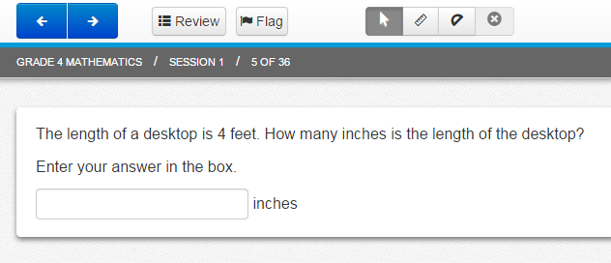
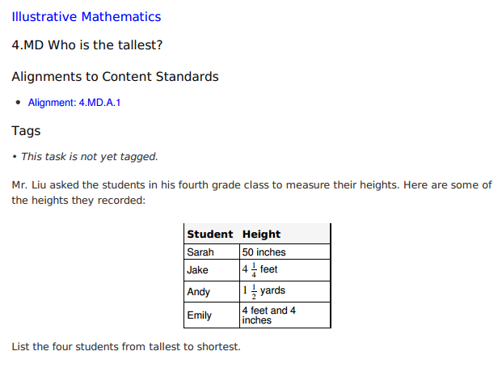
Options for Assessment – available online for Unit 3
Essential Question 1
How do I use comparisons to reason about size and quantity?
(specifically 4.MD.1 and 4.MD.2)
Make or locate SUMMATIVE
and PERFORMANCE
ASSESSMENTS
Notes:
Desktop Length Conversion – This is a question from the PARCC End Of Year Practice Test for 4th Grade
http://epat-parcc.testnav.com/client/index.html#getitem/8338 (question 5 of 36 – if this link won’t work)
Who is the Tallest? - This task is from Illustrative Mathematics and aligns to 4.MD.1
http://s3.amazonaws.com/illustrativemathematics/illustration_pdfs/000/001/508/original/illustrative_mathematics_1508.pdf?1390748792

Slide 16
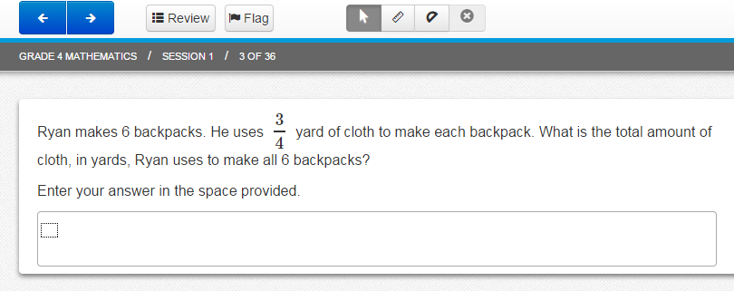
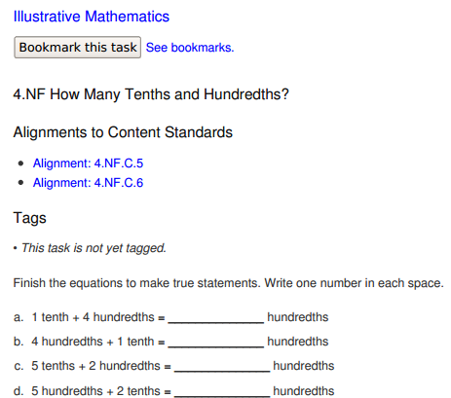
Options for Assessment – available online for Unit 3
Essential Question 2
How can I use what I know about whole numbers to help me understand fraction operations?
Make or locate SUMMATIVE
and PERFORMANCE
ASSESSMENTS
Notes:
Cloth for Backpacks – This is a question from the PARCC End Of Year Practice Test for 4th Grade and aligns to 4.NF.4c – connections could be made to strategies based on properties of operations similar to those students use for 4.NBT.5 (connection to whole numbers)
http://epat-parcc.testnav.com/client/index.html#getitem/8336 (question 3 of 36 – if this link won’t work)
How Many Tenths & Hundredths – Task from Illustrative Mathematics that is aligned to 4.NF.5 – connections could be made to whole number standards 4.NBT.1 and 4.OA.1 (knowing that 1 tenth is ten times as much as 1 hundredth the same way we understand that 10 is 10 times as much as 1) as well as 4.MD.1 (converting from tenths to hundredths is the same thought process as converting from feet to inches – or any measurement units)
http://s3.amazonaws.com/illustrativemathematics/illustration_pdfs/000/000/103/original/illustrative_mathematics_103.pdf?1412879528

Slide 17

Lessons and resources are available online.
Plan DAILY LESSONS
Incorporate TECHNOLOGY
Notes:
Lessons and resources are available online for Unit 3.

Slide 18

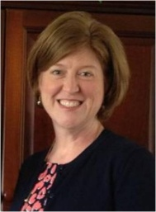

NEW Teacher Created Resources pages!!!
RESOURCES
Beth Pesnell
Elementary Curriculum Specialist
bpesnell@rps.k12.ar.us
Notes:
We have NEW Teacher Created Resources pages in Math! Please share any resources you create with your math facilitator or Beth Pesnell.
We hope these resources will help you in your unit planning journey this quarter.

