Slide 1
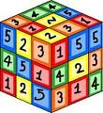
Area and Multiplication; Equivalent Fractions; Time & Volume
3rd Grade Unit 3
Unit Planning Team:
Kyla Trammell (BG), Emily Westphal (JD), Audrey King (ET)
Kendra Bookout (ES), Dawn Buchanan (WS/BV)

Slide 3
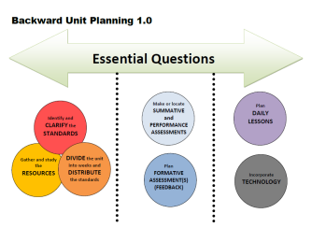
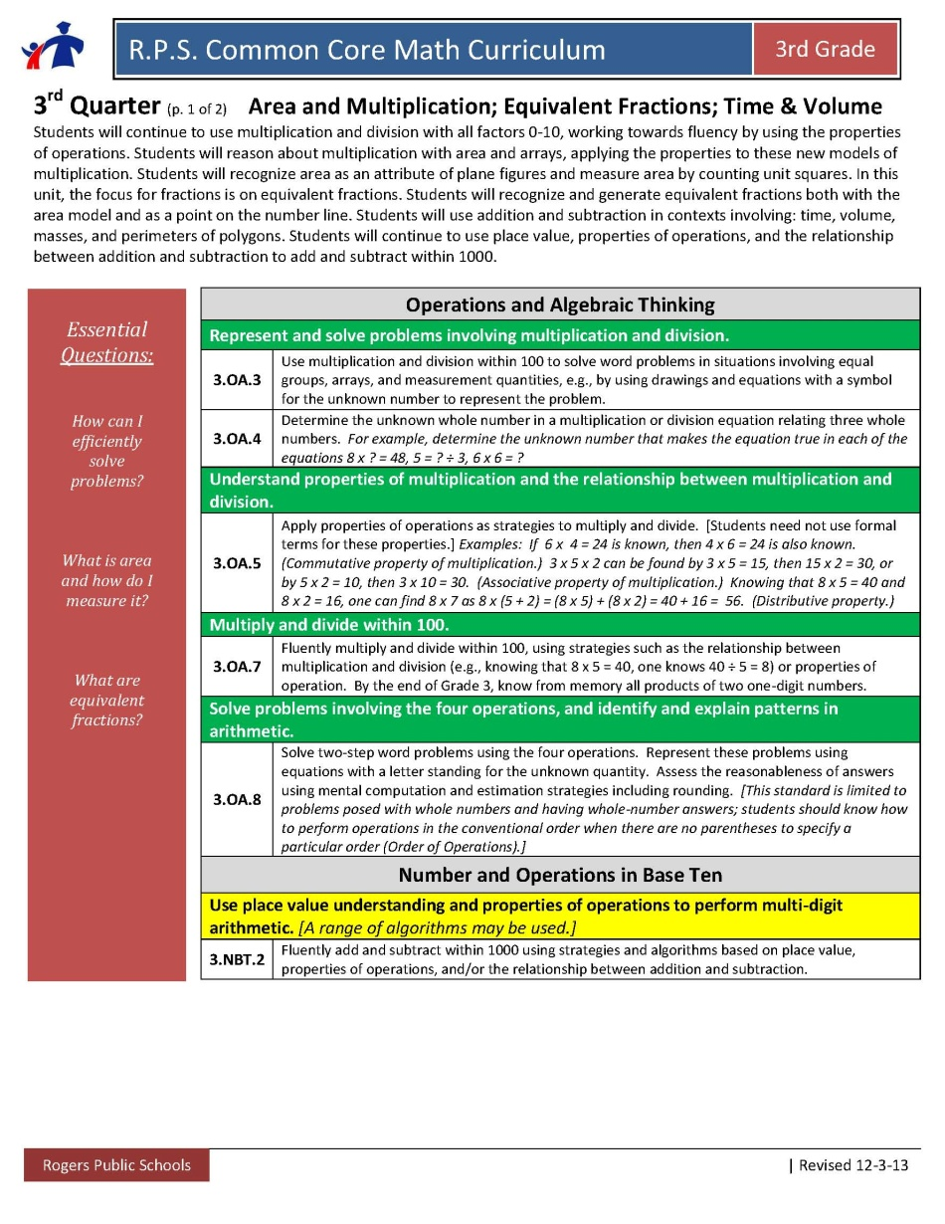
Essential Questions

Slide 4
Identify and CLARIFY the
STANDARDS

Slide 5
Identify and CLARIFY the
STANDARDS

Slide 6
Identify and CLARIFY the
STANDARDS

Slide 7
Suggested Weekly Posing of Problems:
This is one way to think about clustering the standards. These ideas would be repeated each week.
Essential Question: How Can I Efficiently Solve Problems?
1-2 days a week- Work on addition and subtraction multi-digit fluency and 2-step problems with all four operations. (3.NBT.2 and 3.OA.8)
Essential Question: How are Multiplication and Division related?
2-3 days a week- Work on multiplication and division problems and fluency. Focusing on properties of operations and the relationship between multiplication and division. (3.OA.3, 3.OA.4, 3.OA.5, 3.OA.6, 3.OA.7, 3.NBT.3)
Essential Questions: How can I represent and explain fractions as a part of our number system?
How do I represent and interpret data?
2-3 days a week- Work on fraction concepts, equal sharing and fractions on a number line (3.NF.1, 3.NF.2, 3.G.2). Use line plot as an application of fractions on a number line (3.MD.4).
Left this slide in case you want to continue offering this suggestion.
DIVIDE the unit into weeks and DISTRIBUTE the standards
Suggested Weekly Posing of Problems: This is one way to think about clustering the standards. These ideas would be repeated each week. Essential Questions: What do the digits in a number represent? How does money relate to place value? 2.NBT.1, 2.NBT.2, 2.NBT.3, 2.MD.8- 1-2 days a week pose problems with groups of 10 in multiplication and measurement division problems. Use money (2.MD.8) as a context for place value problems. 2.NBT.2, 2.NBT.3 – Daily counting and writing number embedded. Essential Question: What strategies can I use to find sums and differences of two-digit numbers? 2.OA.1, 2.NBT.5, 2.NBT.6, 2.NBT.9 3-4 days a week posing multiple problem types and discussing student strategies. 2.OA.2 Fluency within 20 daily or 1 focused day with number talks daily
Week | Standards | Structure/Resource Type
1 | Building culture 2.NBT.2 Count within 1000, skip-count by 5s, 10s, and 100s 2.NBT.3 Read and write numbers to 1000 2.OA.2 Fluency within 20 2.OA.1 Addition and Subtraction within 100 – various problem types | Counting Collections Fluency Number Talks Daily Pose JRU and SRU to see where students are (as a formative assessment) Administer Pre-Assessment (could be the summative)
2 | 2.NBT.1 Understand 3-digit numbers 2.NBT.2 Count within 1000, skip-count by 5s, 10s, and 100s 2.NBT.3 Read and write numbers to 1000 2.OA.2 Fluency within 20 2.OA.1 Addition and Subtraction within 100 – various problem types 2.NBT.5 Fluently add and subtract within 100, using properties, place value, and relationship between addition and subtraction. | Pose Multiplication and Measurement Division problems in groups of 10 (1-2 days that week) Give students a number (100-999). Have them build the number with base 10 blocks. Have them write the number name and write the expanded form. Fluency Number Talks Daily Pose problem types to students based on student needs (3-4 days a week). Look for invented strategies to pull out in discussion.
3 | 2.NBT.1 Understand 3-digit numbers 2.NBT.2 Count within 1000, skip-count by 5s, 10s, and 100s 2.NBT.3 Read and write numbers to 1000 2.OA.2 Fluency within 20 2.OA.1 Addition and Subtraction within 100 – various problem types 2.NBT.5 Fluently add and subtract within 100, using properties, place value, and relationship between addition and subtraction. | Pose Multiplication and Measurement Division problems in groups of 10 (1-2 days that week) Fluency Number Talks Daily Pose problem types to students based on student needs (3-4 days a week). Look for invented strategies to pull out in discussion.
4 | 2.NBT.1 Understand 3-digit numbers 2.NBT.2 Count within 1000, skip-count by 5s, 10s, and 100s 2.NBT.3 Read and write numbers to 1000 2.OA.2 Fluency within 20 2.OA.1 Addition and Subtraction within 100 – various problem types 2.NBT.5/6 Fluently add and subtract within 100, using properties, place value, and relationship between addition and subtraction. | Pose Multiplication and Measurement Division problems in groups of 10 (1-2 days that week) Fluency Number Talks Daily Pose problem types to students based on student needs (3-4 days a week). Look for invented strategies to pull out in discussion.
5 | 2.NBT.1 Understand 3-digit numbers 2.NBT.2 Count within 1000, skip-count by 5s, 10s, and 100s 2.NBT.3 Read and write numbers to 1000 2.MD.8 Solve word problems involving dollar bills, quarters, dimes, nickels, and pennies. 2.OA.2 Fluency within 20 (2.OA.1)2.NBT.5/6 Fluently add and subtract within 100, using properties, place value, and relationship between addition and subtraction. 2.NBT.9 Explain why addition and subtraction strategies work. | Pose Multiplication and Measurement Division problems in groups of 10 (1-2 days that week) Use money as a context. i.e. You have 8 dimes and 4 pennies, how much money do you have? Fluency Number Talks Daily Pose problem types to students based on student needs (3-4 days a week). Look for invented strategies to pull out in discussion. Focus on students fully explaining their thinking.
6 | 2.NBT.1 Understand 3-digit numbers 2.NBT.2 Count within 1000, skip-count by 5s, 10s, and 100s 2.NBT.3 Read and write numbers to 1000 2.MD.8 Solve word problems involving dollar bills, quarters, dimes, nickels, and pennies. 2.OA.2 Fluency within 20 (2.OA.1)2.NBT.5/6 Fluently add and subtract within 100, using properties, place value, and relationship between addition and subtraction. 2.NBT.9 Explain why addition and subtraction strategies work. | Pose Multiplication and Measurement Division problems in groups of 10 (1-2 days that week) Use money as a context. i.e. You have 8 dimes and 4 pennies, how much money do you have? Fluency Number Talks Daily Pose problem types to students based on student needs (3-4 days a week). Look for invented strategies to pull out in discussion. Focus on students fully explaining their thinking.
7 | 2.NBT.1 Understand 3-digit numbers 2.NBT.2 Count within 1000, skip-count by 5s, 10s, and 100s 2.NBT.3 Read and write numbers to 1000 2.MD.8 Solve word problems involving dollar bills, quarters, dimes, nickels, and pennies. 2.OA.2 Fluency within 20 (2.OA.1)2.NBT.5/6 Fluently add and subtract within 100, using properties, place value, and relationship between addition and subtraction. 2.NBT.9 Explain why addition and subtraction strategies work. | Pose Multiplication and Measurement Division problems in groups of 10 (1-2 days that week) Use money as a context. i.e. You have 8 dimes and 4 pennies, how much money do you have? Fluency Number Talks Daily Pose problem types to students based on student needs (3-4 days a week). Look for invented strategies to pull out in discussion. Focus on students fully explaining their thinking.
8 | 2.NBT.1 Understand 3-digit numbers 2.NBT.2 Count within 1000, skip-count by 5s, 10s, and 100s 2.NBT.3 Read and write numbers to 1000 2.MD.8 Solve word problems involving dollar bills, quarters, dimes, nickels, and pennies. 2.OA.2 Fluency within 20 (2.OA.1)2.NBT.5/6 Fluently add and subtract within 100, using properties, place value, and relationship between addition and subtraction. 2.NBT.9 Explain why addition and subtraction strategies work. | Pose Multiplication and Measurement Division problems in groups of 10 (1-2 days that week) Use money as a context. i.e. You have 8 dimes and 4 pennies, how much money do you have? Fluency Number Talks Daily Pose problem types to students based on student needs (3-4 days a week). Look for invented strategies to pull out in discussion. Focus on students fully explaining their thinking.
9 | 2.NBT.1 Understand 3-digit numbers 2.NBT.2 Count within 1000, skip-count by 5s, 10s, and 100s 2.NBT.3 Read and write numbers to 1000 2.MD.8 Solve word problems involving dollar bills, quarters, dimes, nickels, and pennies. 2.OA.2 Fluency within 20 (2.OA.1)2.NBT.5/6 Fluently add and subtract within 100, using properties, place value, and relationship between addition and subtraction. 2.NBT.9 Explain why addition and subtraction strategies work. | Pose Multiplication and Measurement Division problems in groups of 10 (1-2 days that week) Use money as a context. i.e. You have 8 dimes and 4 pennies, how much money do you have? Fluency Number Talks Daily Pose problem types to students based on student needs (3-4 days a week). Look for invented strategies to pull out in discussion. Focus on students fully explaining their thinking.
Notes:
Share your team’s thinking/process…

Slide 8
Week | Standards | Structure/Resources
1
2
3
DIVIDE the unit into weeks and DISTRIBUTE the standards

Slide 9
Week | Standards | Structure/Resources
4
5
6
DIVIDE the unit into weeks and DISTRIBUTE the standards

Slide 10
Week | Standards | Structure/Resources
7
8
9
DIVIDE the unit into weeks and DISTRIBUTE the standards

Slide 11
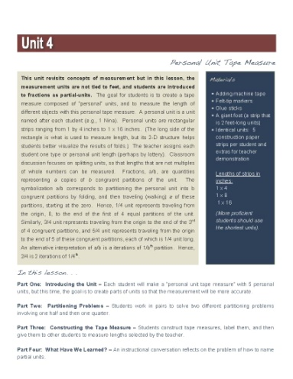
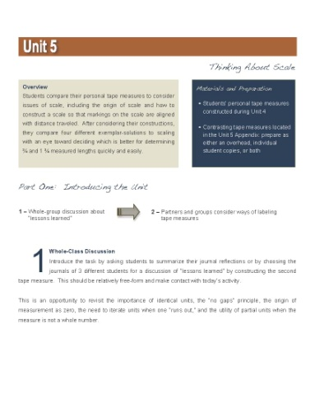
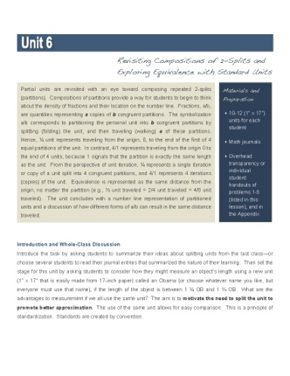
Gather and study the RESOURCES
Notes:
Are you highlighting any specific resource in this quarter?

Slide 12
Options for Assessment – available online for Unit 2
Essential Question:
Make or locate SUMMATIVE
and PERFORMANCE
ASSESSMENTS

Slide 13
Options for Assessment – available online for Unit 2
Essential Question:.
Make or locate SUMMATIVE
and PERFORMANCE
ASSESSMENTS

Slide 14
Options for Assessment – available online for Unit 2
Essential Question:
Make or locate SUMMATIVE
and PERFORMANCE
ASSESSMENTS

Slide 15
Options for Assessment – available online for Unit 2
Essential Question:
Make or locate SUMMATIVE
and PERFORMANCE
ASSESSMENTS

Slide 16
Options for Assessment – available online for Unit 2
Essential Question:
Make or locate SUMMATIVE
and PERFORMANCE
ASSESSMENTS

Slide 17
Incorporate
TECHNOLOGY
Plan
DAILY LESSONS
Week
Possible Lesson

Slide 18
Week
Possible Lesson
Plan DAILY LESSONS
Incorporate TECHNOLOGY
Notes:
If you get here…

Slide 19
Incorporate
TECHNOLOGY
Plan
DAILY LESSONS
Week
Possible Lesson

Slide 20
Week
Possible Lesson
Plan DAILY LESSONS
Incorporate TECHNOLOGY

Slide 21
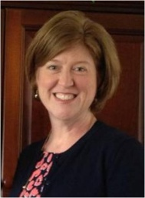
NEW Teacher Created Resources pages!!!
RESOURCES
Beth Pesnell
Elementary Curriculum Specialist
bpesnell@rps.k12.ar.us

