Slide 1
Final s-Family Blends
Unit 4

Slide 2
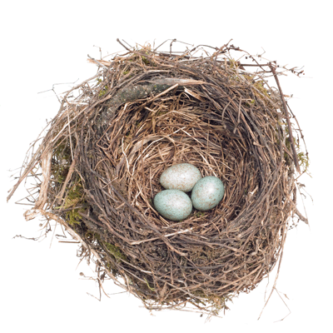
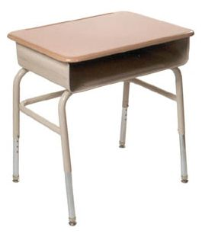
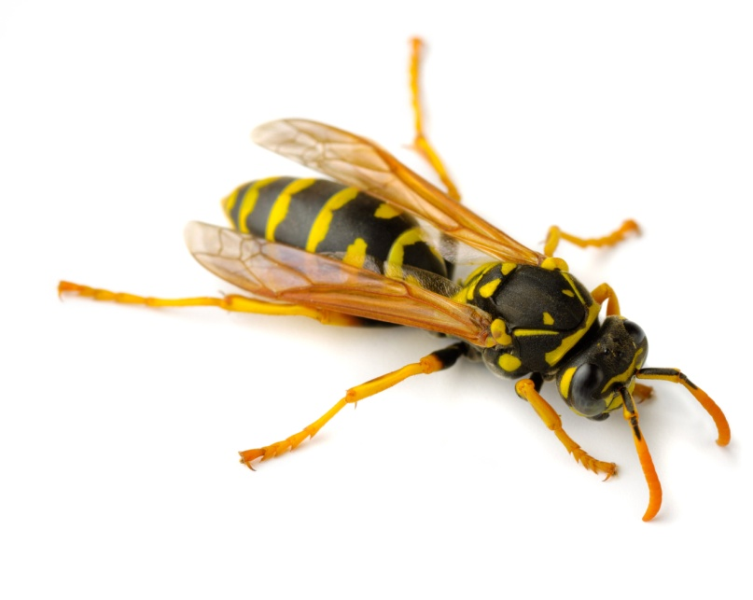
nest
desk
wasp

Slide 3
nest

Slide 4
desk

Slide 5
wasp

