Slide 1
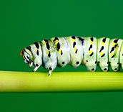
Wonders of Nature: Plants, Bugs, and Frogs
Kindergarten Unit 6
Planning Team
Mary Aylce Madden, Jordon Bright, Tori Hunt, Krista Roth, & Jenifer Pastore

Slide 3
Wonders of Nature:
Plants, Bugs, and Frogs
Essential Question
How does nature inspire us as readers, writers, and researchers?

Slide 4
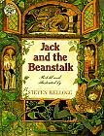
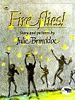
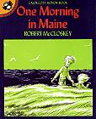
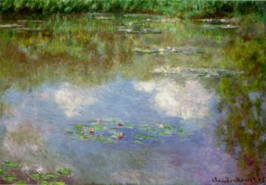
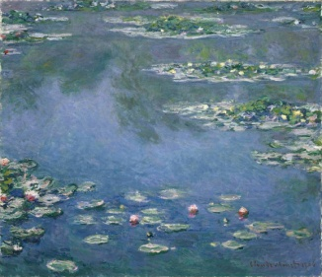
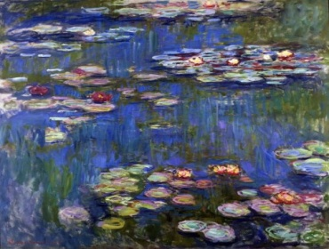
Literature
Kindergarten
Print Resources
Unit 6
Picture Books
(Read Aloud)
Poems (Read Aloud)
“Little Black Bug”
“The Caterpillar”
“Trees”
“Over in the Meadow”
Poems (Read Along)
“Wouldn’t You?”
Nursery Rhymes (Read Along)
“Mary, Mary Quite Contrary”
“Ladybug, Ladybug”
Music & Songs
Picture Books
(Read Aloud/Independent)
“The Ants Go Marching One by One”
“Isty Bitsy Spider”
Art

Slide 5
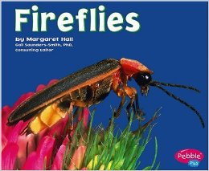
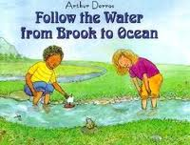
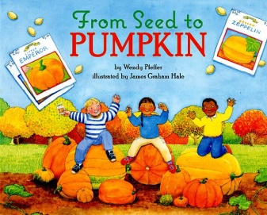
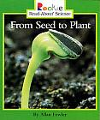
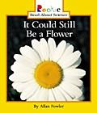
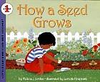
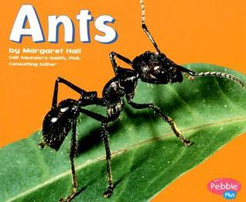
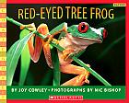
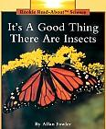
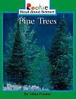
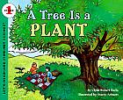
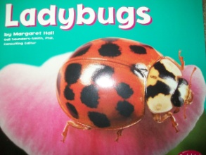
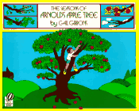
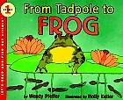
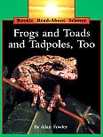
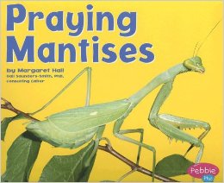
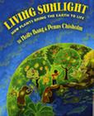
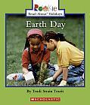
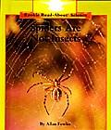
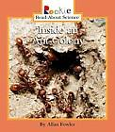
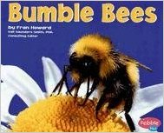
Informational Text
(4 copies )
(Read Aloud)
(Read Aloud/Independent)

Slide 6
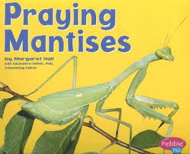
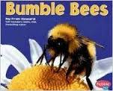
New Texts
5 copies each

Slide 7
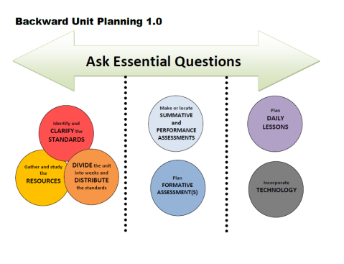
Week | Standards | Texts
1
2
3
4
5
6
DIVIDE the unit into weeks and DISTRIBUTE the standards
Notes:
Story kit tutorial
https://www.youtube.com/watch?v=RSWQkUS4kXk

Slide 8
Week | ELA Standards | Science Standards | Resources and Suggested Instruction
1 | RI.K.1 With prompting and support, ask and answer questions about key details in a text. RI.K.2 With prompting and support, identify the main topic and retell key details of a text. RI.K.4 With prompting and support, ask and answer questions about unknown words in a text. RI.K.7 With prompting and support, describe the relationship between illustrations and the text in which they appear (e.g.., illustrations, descriptions, or procedures). RI.K.8 Identify the reasons an author gives to support points in a text. | ESS.8.K.4 Reuse and recycle | Earth Day Book, Smart Notebook Lesson, Graphic Organizer & Video- Teacher Created Resources Taking Care of the Earth’s Resources- https://www.engageny.org/search-site/Taking%20Care%20of%20the%20Earth?solrsort=score%20desc

Slide 9
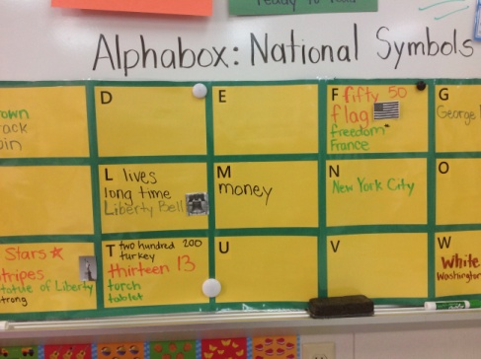
Week | ELA Standards | Science Standards | Resources and Suggested Instruction
1 | L.K.6 Use words and phrases acquired through conversations, reading and being read to, and responding to texts. W.K.2 Use a combination of drawing, dictating, and writing to compose informative/explanatory texts in which they name what they are writing about and supply some information on the topic. |  | Alpha Boxes for Vocabulary- Teacher Created Resources Example:

Slide 10
Week | ELA Standards | Science Standards | Resources and Suggested Instruction
2 | RI.K.3 With prompting and support, describe the connection between two individuals, events, ideas, or pieces of information in a text. RI.K.7 With prompting and support, describe the relationship between illustrations and the text in which they appear (e.g.., illustrations, descriptions, or procedures). RI.K.9 With prompting and support, identify basic similarities in and differences between two texts on the same topic (e.g.., in illustrations, descriptions, or procedures). W.K.2 Use a combination of drawing, dictating, and writing to compose informative/explanatory texts in which they name what they are writing about and supply some information on the topic. | LS.2.K.4 Basic Needs of Plants LS.3.K.1 Plant Development and Growth | Smart Notebook Lesson on Seeds- Teacher Created Resources Compare How A Seed Grows and From Seed to Plant (graphic organizer on Teacher Created Resources)

Slide 11
Week | ELA Standards | Science Standards | Resources and Suggested Instruction
2 | W.K.6 With guidance and support from adults, use a variety of digital tools to produce and publish writing, including in collaboration with peers. L.K.4 Determine or clarify the meaning of unknown and multiple-meaning words and phrases based on kindergarten reading and content. Identify new meanings for familiar words and apply them accurately (e.g., knowing duck is a bird and learning the verb to duck). b. Use frequently occurring inflections and affixes (e.g., -ed,-s,re-,un-, pre-, -ful, -less) as a clue to the meaning of an unknown word. |  | LK4- “The Caterpillar” on Teacher Created Resources

Slide 12
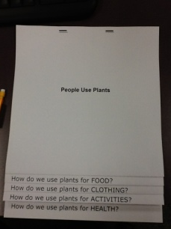
Week | ELA Standards | Science Standards | Resources and Suggested Instruction
3 | RL.K.1 With prompting and support, ask and answer questions about key details in a text. RL.K.2 With prompting and support, retell familiar stories, including key details. RL.K.4 Ask and answer questions about unknown words in a text. RL.K.7 With prompting and support, describe the relationship between illustrations and the story in which they appear (e.g., what moment in a story the illustration depicts). RL.K.9 With prompting and support, compare and contrast the adventures and experiences of characters in familiar stories. | LS.2.K.4 Basic Needs of Plants LS.3.K.1 Plant Development and Growth | Text talks- Soak lima beans and investigate inside How to Make A Flip Book- http://www.readwritethink.org/files/resources/interactives/flipbook/

Slide 13
Week | ELA Standards | Science Standards | Resources and Suggested Instruction
3 | W.K.3 Use a combination of drawing, dictating, and writing to narrate a single event or several loosely linked events, tell about the events in the order in which they occurred, and provide a reaction to what happened. W.K.5 With guidance and support from adults, focus on a topic, respond to questions and suggestions from peers, and add details to strengthen writing as needed. L.K.6 Use words and phrases acquired through conversations, reading and being read to, and responding to texts. |  | If time permits, you may choose to read From Seed to Pumpkin. This is also a great resource for Unit 2 when measuring pumpkins.

Slide 14
Week | ELA Standards | Science Standards | Resources and Suggested Instruction
4 | RI.K.1 With prompting and support, ask and answer questions about key details in a text. RI.K.2 With prompting and support, identify the main topic and retell key details of a text. RI.K.4 With prompting and support, ask and answer questions about unknown words in a text. RI.K.5 Identify the front cover, back cover, and title page of a book. RI.K.7 With prompting and support, describe the relationship between illustrations and the text in which they appear (e.g.., illustrations, descriptions, or procedures). W.K.2 Use a combination of drawing, dictating, and writing to compose informative/explanatory texts in which they name what they are writing about and supply some information on the topic. |  | Alpha Boxes with Insect Books on Teacher Created Resources Brain Pop on Insects

Slide 15
Week | ELA Standards | Science Standards | Resources and Suggested Instruction
4 | RF.K.4. Read emergent reader text with purpose and understanding. L.K.6 Use words and phrases acquired through conversations, reading and being read to, and responding to texts.

Slide 16
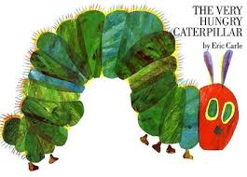
Week | ELA Standards | Science Standards | Resources and Suggested Instruction
5 | RL.K.3 With prompting and support, identify characters, settings, and major events in a story. RL.K.4 Ask and answer questions about unknown words in a text. RL.K5 Recognize common types of texts (e.g., storybooks, poems). RL.K.6 With prompting an support, name the author and illustrator of a story and define the role of each in telling the story. L.K.1.f f. Produce and expand complete sentences in shared language activities. L.K.6 Use words and phrases acquired through conversations, reading and being read to, and responding to texts. |  | Youtube video on Teacher Created Resources- RL.K.4- Activity on Teacher Created Resources The Very Hungry Caterpillar- Lessons on Teacher Created Resources

Slide 17
Week | ELA Standards | Science Standards | Resources and Suggested Instruction
6 | RL.K.2 With prompting and support, retell familiar stories, including key details. RL.K.3 With prompting and support, identify characters, settings, and major events in a story. RI.K.2 With prompting and support, identify the main topic and retell key details of a text. RI.K.3 With prompting and support, describe the connection between two individuals, events, ideas, or pieces of information in a text. RI.K.9 With prompting and support, identify basic similarities in and differences between two texts on the same topic (e.g.., in illustrations, descriptions, or procedures).

Slide 18
Week | ELA Standards | Science Standards | Resources and Suggested Instruction
6 | W.K.2 Use a combination of drawing, dictating, and writing to compose informative/explanatory texts in which they name what they are writing about and supply some information on the topic. W.K.6 With guidance and support from adults, use a variety of digital tools to produce and publish writing, including in collaboration with peers. W.K.7 Participate in shared research and writing projects (e.g., explore a number of books by a favorite author and express opinions about them). W.K.8 With guidance and support from adults, recall information from experiences or gather information from provided sources to answer a question. | LS3.K.2 Illustrate metamorphosis | Life Cycle of a Frog & Life Cycle of a Butterfly- activities on Teacher Created Resources Learn 360 video- Life Cycle of a Frog and Toad You can use the Story Kit app or EduCreations app to take notes and dictate from the notes onto a digital journal (the life cycles of a frog and butterfly).

Slide 19
Week | ELA Standards |  | Resources and Suggested Instruction
On-Going Standards | RF.K.2 Demonstrate understanding of spoken words, syllables, and sounds (phonemes). e. Add or substitute individual sounds (phonemes) in simple, one-syllable words to make new words. RF.K.3 Know and apply grade-level phonics and word analysis skills in decoding words. b. Associate the long and short sounds with common spellings (graphemes) for the five major vowels. c. Read common high frequency words by sight (e.g., the, of, to, you, she, my, is, are, do, does). d. Distinguish between similarly spelled words by identifying the sounds of the letters that differ. RF.K.4. Read emergent reader text with purpose and understanding. SL.K.2 Confirm understanding of a text read aloud or information presented orally or through other media by asking and answering questions about key details and requesting clarification if something is not understood. SL.K.3 Ask and answer questions in order to seek help, get information, or clarify something that is not understood. SLK.4 Describe familiar people, places, things, and events and with prompting and support, provide additional detail. SL.K.5 Add drawings or other visual displays to descriptions as desired to provide additional detail. SL.K.6 Speak audibly and express thoughts, feeling, and ideas clearly.

Slide 20
Week | ELA Standards |  | Resources and Suggested Instruction
On-Going Standards | L.K.1 Demonstrate command of the conventions of standard English grammar and usage when writing or speaking. f. Produce and expand complete sentences in shared language activities. L.K.2 Demonstrate command of the conventions of standard English capitalization, punctuation, and spelling when writing. a. Capitalize the first word in a sentence and the pronoun I. c. Write a letter or letters for most consonant and short-vowel sounds (phonemes). d. Spell simple words phonetically, drawing on knowledge of letter-sound relationships. L.K.4 Determine or clarify the meaning of unknown and multiple-meaning words and phrases based on kindergarten reading and content. a. Identify new meanings for familiar words and apply them accurately (e.g., knowing duck is a bird and learning the verb to duck). b. Use frequently occurring inflections and affixes (e.g., -ed,-s,re-,un-, pre-, -ful, -less) as a clue to the meaning of an unknown word. L.K.5 With guidance and support from adults, explore word relationships and nuances in word meanings. a. Sort common objects into categories (e.g., shapes, foods) to gain a sense of the concepts the categories represent. b. Demonstrate understanding of frequently occurring verbs and adjectives by relating them to their opposites(antonyms). c. Identify real-life connections between words and their use (e.g., note places at school that are colorful). d. Distinguish shades of meaning among verbs describing the same general action (e.g., walk, march, strut, prance) by acting out the meanings. L.K.6 Use words and phrases acquired through conversations, reading and being read to, and responding to texts.

Slide 21
Week | Standards | Essential Questions
1 |  | How does nature inspire us as readers, writers, and researchers?
2
3
4
5
6 |  | How does nature inspire us as readers, writers, and researchers?

Slide 22
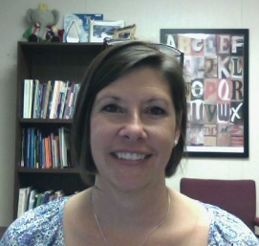
RESOURCES
Susan Hensley
Elementary Curriculum Specialist
shensley@rps.k12.ar.us

