Slide 1
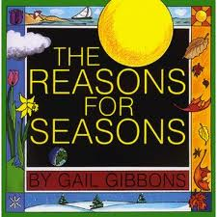
Text Talk-Kindergarten – Unit 6
Old Wire Elementary School

Slide 2
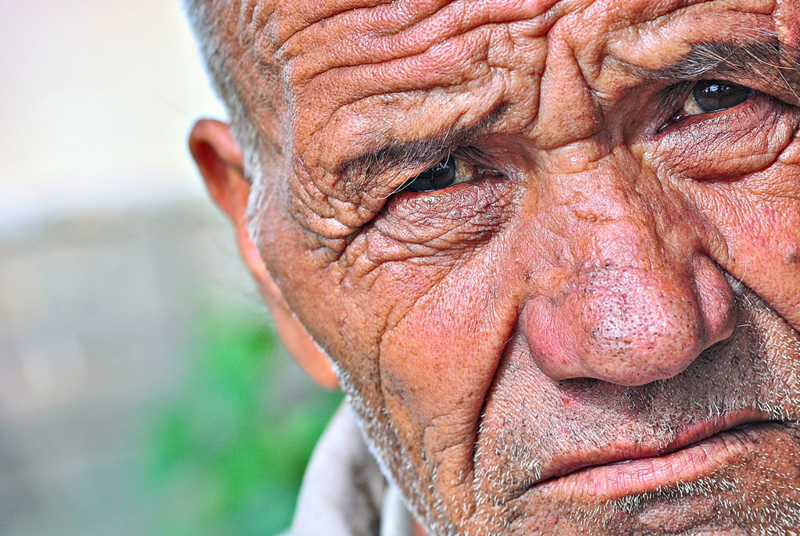
ancient very old
This man is old, some would even say he looked ancient.

Slide 3
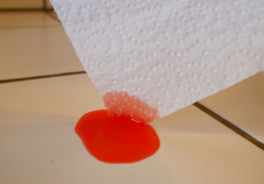
absorbing- soaking up something
The paper towel is absorbing the juice on the floor.

Slide 4
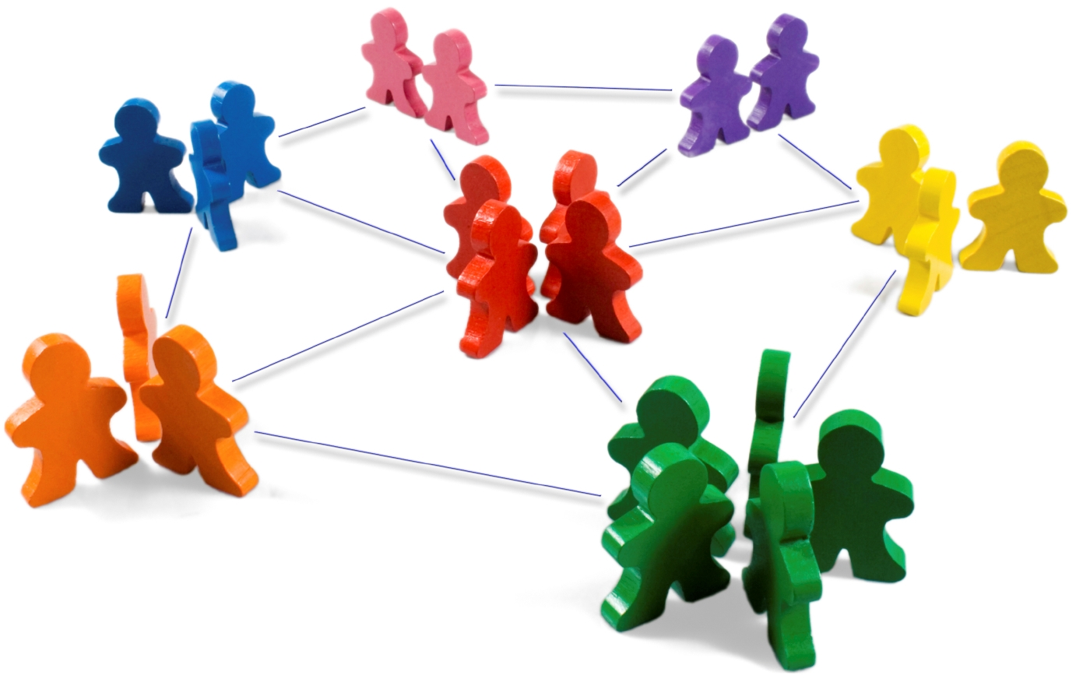
relationship the connection between things
A relationship shows how things or people are connected.

Slide 5
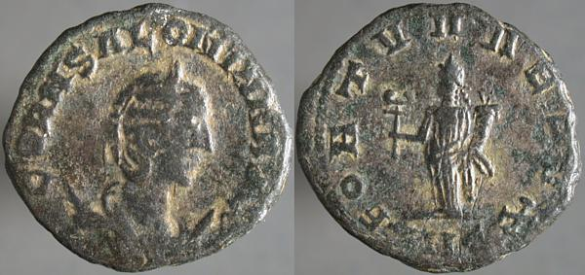
Which picture shows ancient?

Slide 6
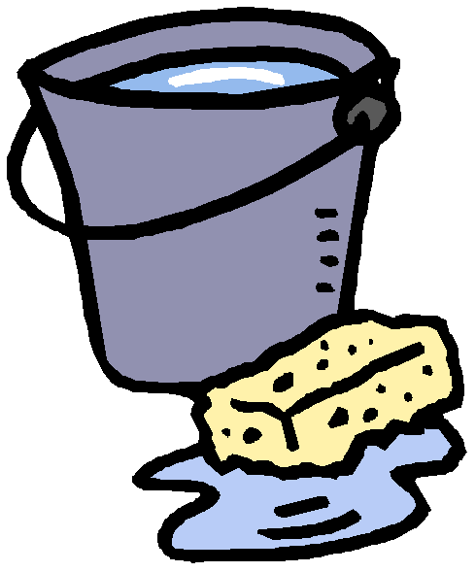
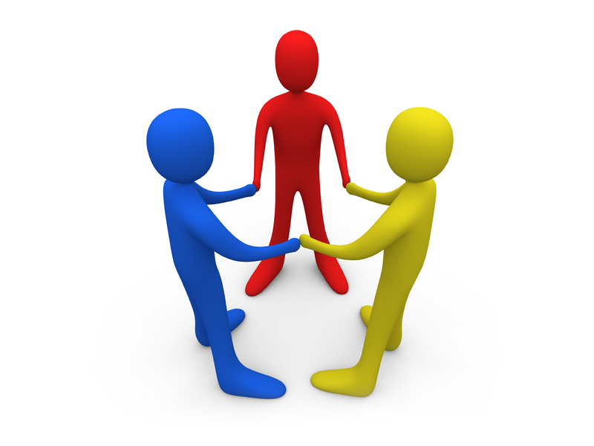
Which picture shows absorbing?

Slide 7
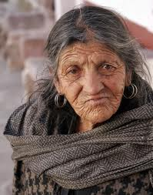
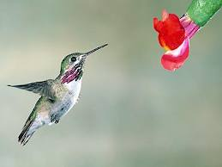
Which picture shows relationship?

Slide 8
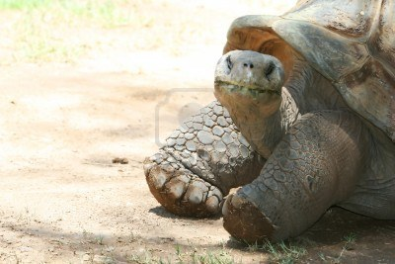
Which word goes with this picture: ancient, absorbing, or relationship?

Slide 9
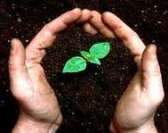
Which word goes with this picture: ancient, absorbing, or relationship?
(soil, seed, water, sunlight—
work together)

Slide 10
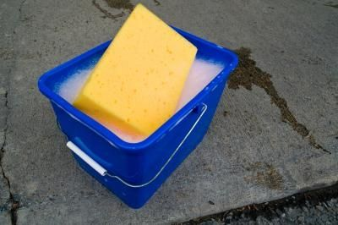
Which word goes with this picture: ancient, absorbing, or relationship?

