Slide 1
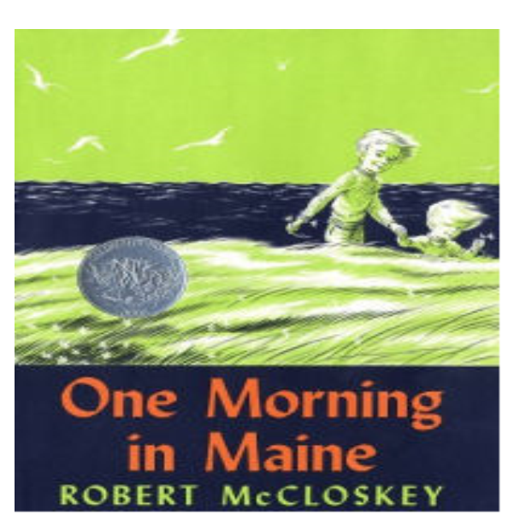
Text Talk
Unit 6

Slide 2
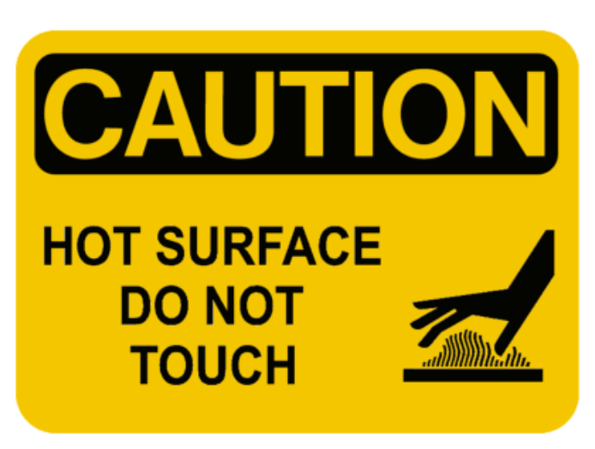
cautioned to warn about danger
The sign cautioned us to not touch the hot stove.

Slide 3
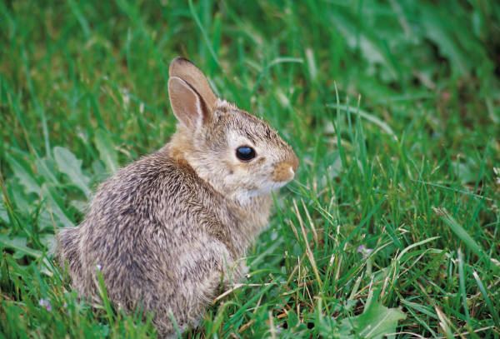
Which picture shows cautioned?

Slide 4
cautioned
Have you ever seen a caution sign before? What was it warning you about? What did you do?
What kinds of signs do we have at school that are caution signs?
Which of these would caution you? Why/why not?
  Free ice cream
  Slippery roads
  Wet floors
  Pizza party

Slide 5
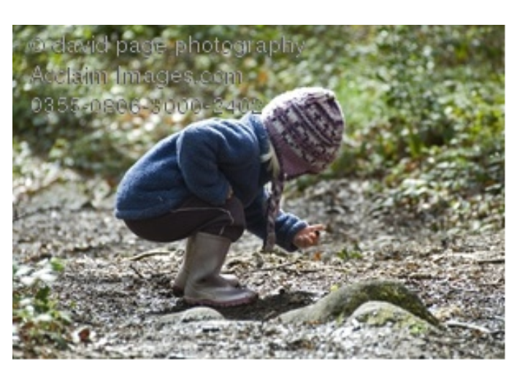
stooping to bend down at the waist to get a closer look
The girl was stooping to look at the
interesting rock she had found.

Slide 6
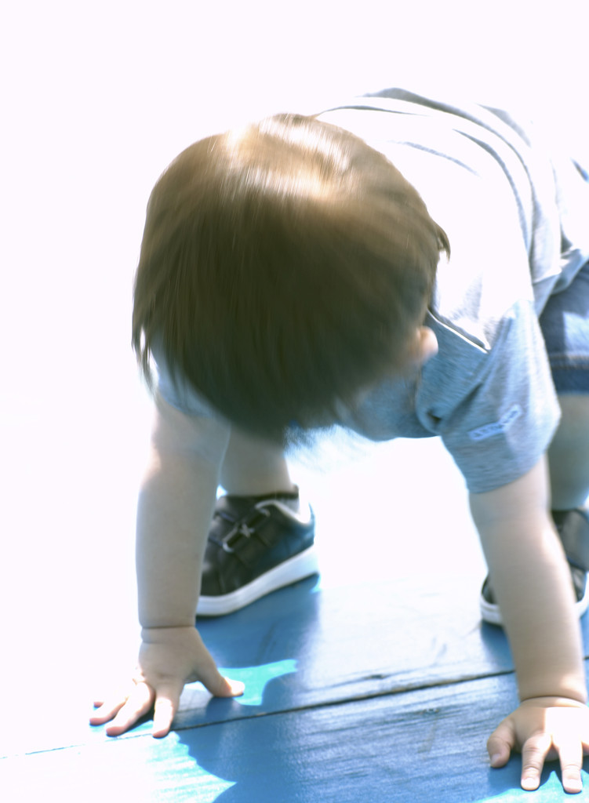
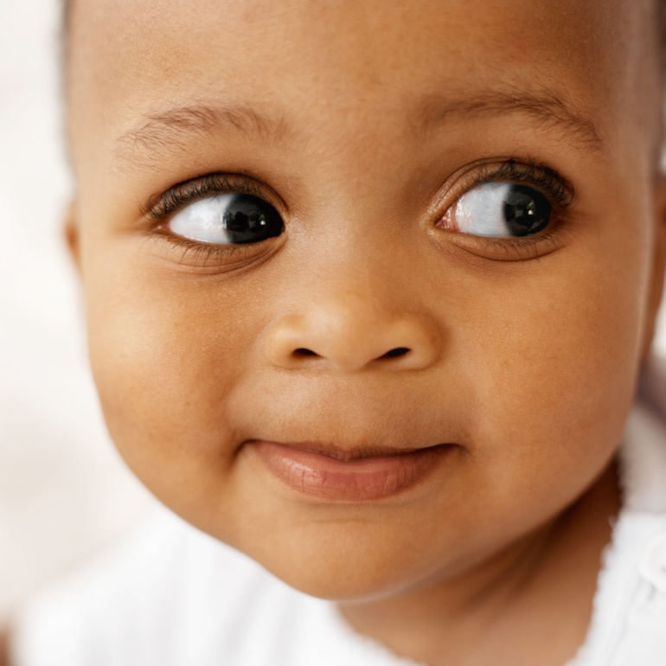
Which picture shows stooping?

Slide 7
stooping
  Pretend like you are stooping. What are you looking at?
  In the story, who was stooping? What were they looking at?
  If you were on the playground, what kinds of things would you be stooping to look at?
  Thumbs up/down: Does this word mean to….
    Stand up straight and tall?
    Slither like a snake?
    Bend over?
    Run around the playground?
    Kneel down so you can see something?

Slide 8
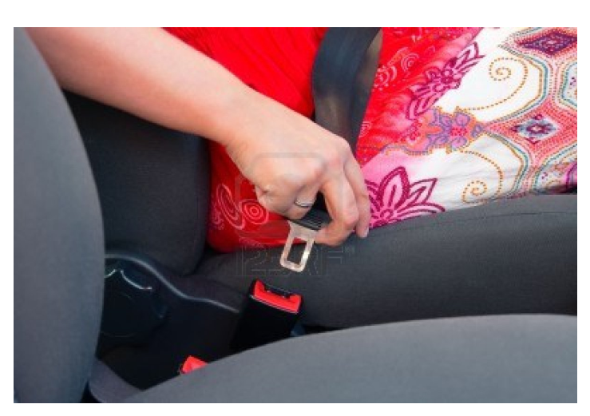
fastened to close up
Before driving the car, the lady fastened her seat belt.

Slide 9
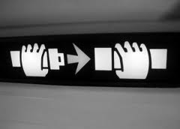
Which picture shows fastened?

Slide 10
fastened
  Pretend like you fastened your seatbelt in the car. Why is this important to do?
  What other kinds of things do you fasten so that it will stay closed? Turn and talk.
  What is the opposite of fastened?
  What if?
    What could happen if you didn’t fasten your papers together and it was windy outside?
    What could happen if you didn’t fasten your shoes?

