Slide 1
One Morning In Maine Text Talk Kindergarten, Unit 6 Old Wire Road Elementary School

Slide 2
cautioned
To warn about danger

Slide 3
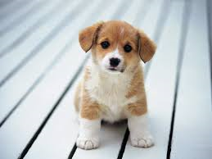
Which one would your teacher caution you about?

Slide 4
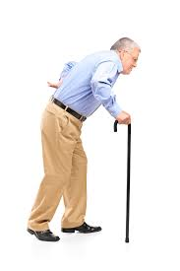
stooping
To bend down at the waist.

Slide 5
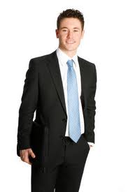
Which person is stooping?

Slide 6
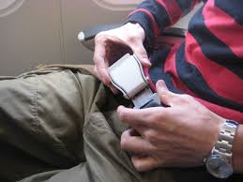
fastened
To close up

Slide 7
Which one would you fasten?

Slide 8
Pick the word that goes with this picture: fastened, stooped, cautioned

Slide 9
Pick the word that goes with this picture: fastened, stooped, cautioned

Slide 10
Pick the word that goes with this picture: fastened, stooped, cautioned

