Slide 1
Text Talk
Unit 6

Slide 2
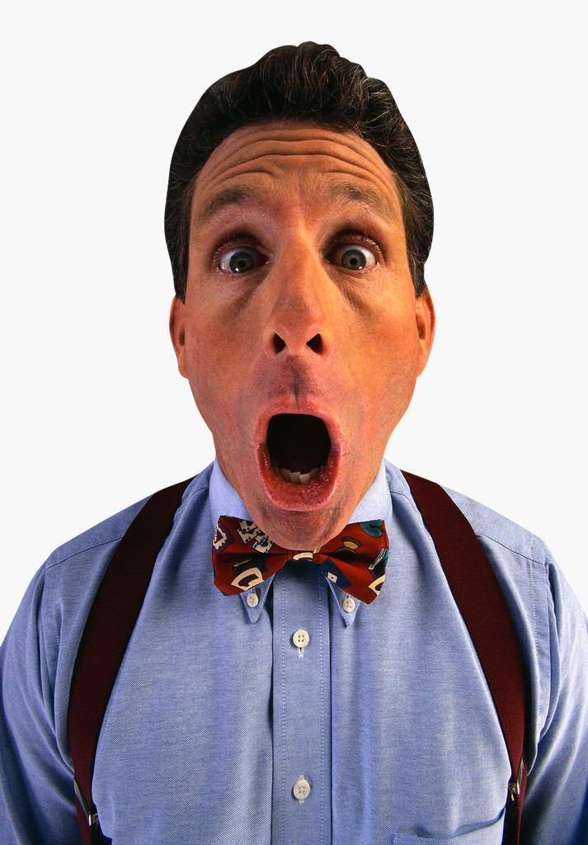
astonished to be surprised
The man was astonished by the good news he heard.

Slide 3
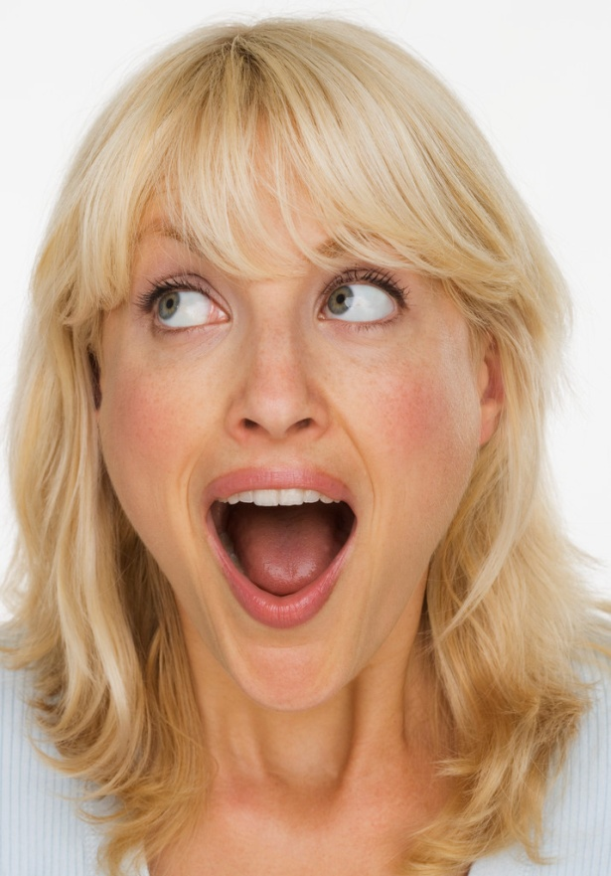
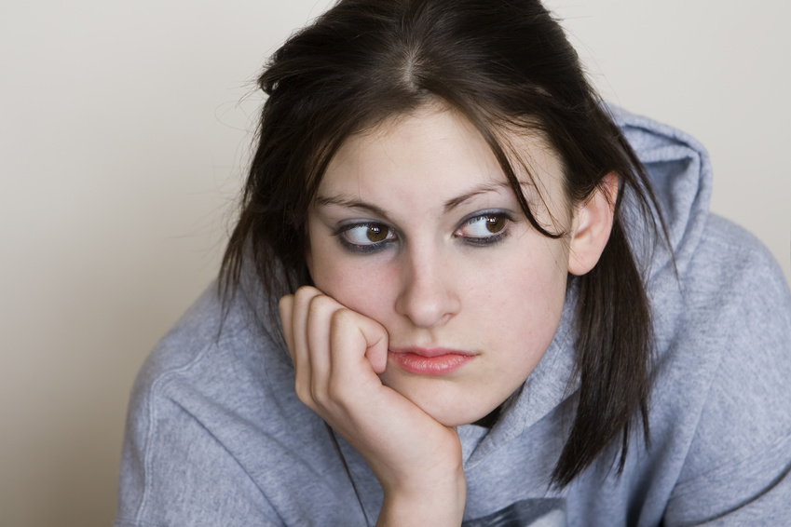
Which picture shows astonished?

Slide 4
astonished
Turn and talk. What has astonished you? Act it out and show what it looks like to be astonished.
If this would make you astonished, say “Awesome!”
Opening up a Christmas gift of new toys
Your parents took you to Chuck E. Cheese
Your mom told you to clean your room
There was $100 dollars in your lunch box
You had to do your homework

Slide 5
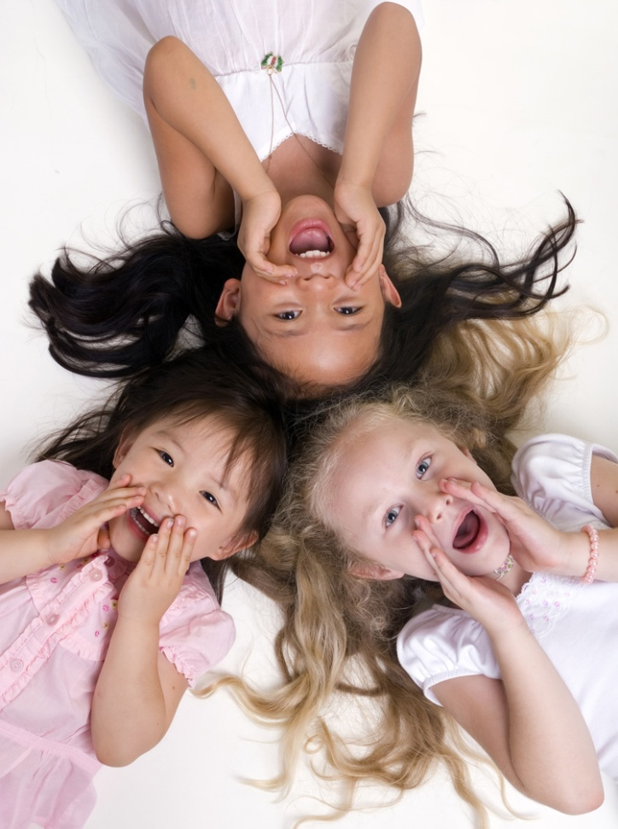
bellowing shouting or making noise loudly
The girls were bellowing because they
wanted more candy.

Slide 6
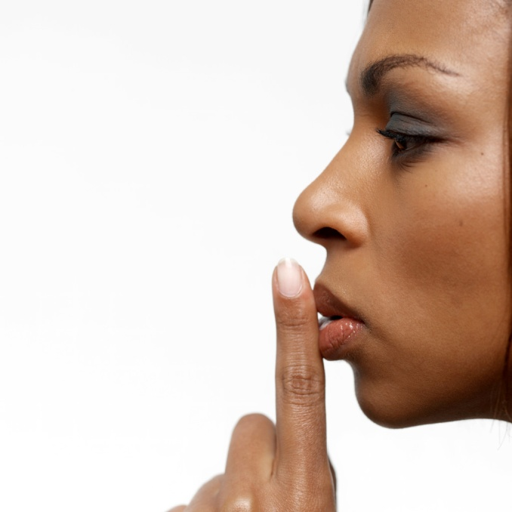
Which picture shows bellowing?

Slide 7
bellowing
Has anyone ever asked you to stop bellowing? Why? What were you bellowing about? Turn and talk. Share out with the class.
What kinds of animals can you think of that would bellow?
Is this the opposite or the same as bellowing?
Yelling
Whispering
Screaming
Quiet
Try this analogy: Bellowing is to Loud as
Whispering is to________

Slide 8
approached walk closely to someone or something
The girl approached the flowers in the garden so she could smell them.

Slide 9
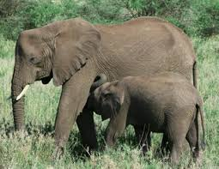
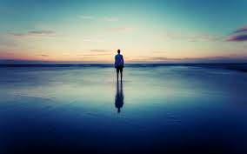
Which picture shows approached?

Slide 10
approached
Give an example to show what it looks like to approach something/someone.
Why would you approach something or someone?
You would approach a flower, so that __________.
You would approach an ocean, so that __________.
You would approach a friend, so that ___________.
You would approach the window, so that ________.

