Slide 1
Kate and the Beanstalk
By Mary Pope Osborne

Slide 2
horrified
Notes:
Feeling shocked or disgusted based on something seen or heard

Slide 3
In the text…
Notes:
But to Kate’s surprise, her mother was horrified! “Our only hope is gone!” she cried. “Now we will surely starve!”

Slide 4
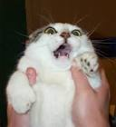
horrified
The cat was horrified when I tried
putting her into the bathtub.

Slide 5
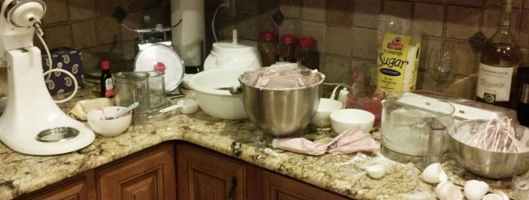
Which picture shows something that would horrify your mom?
1
2
horrified

Slide 6
astonishing
Notes:
Amazing, impressive, brilliant

Slide 7
In the text…
Notes:
Through the misty haze she saw the most astonishing sight: Above the clouds was a countryside with fine woods, a crystal stream, a rolling sheep meadow, and a mighty castle.

Slide 8
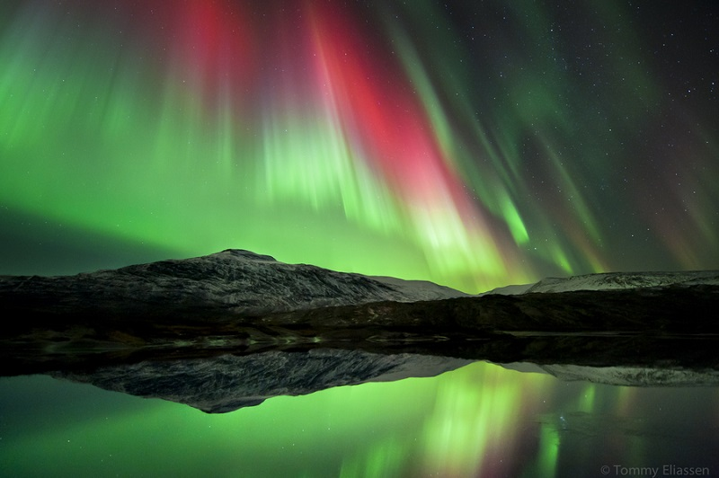
astonishing
The northern lights of Alaska are an astonishing!

Slide 9
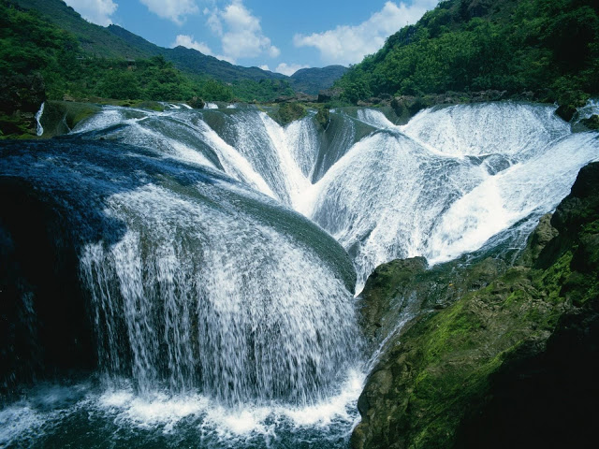
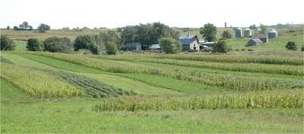
Which picture shows an astonishing sight?
1
2
astonishing

Slide 10
magnificent
Notes:
Extremely beautiful, grand, elegant

Slide 11
In the text…
Notes:
The giantess brought out a magnificent harp, the only one of its kind in the world.

Slide 12
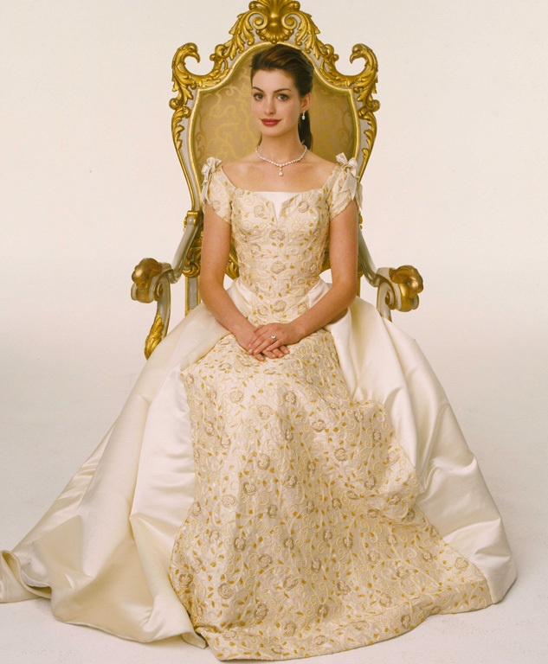
magnificent
The princess wore a magnificent dress to the ball.

Slide 13
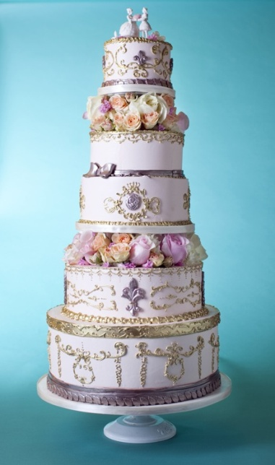
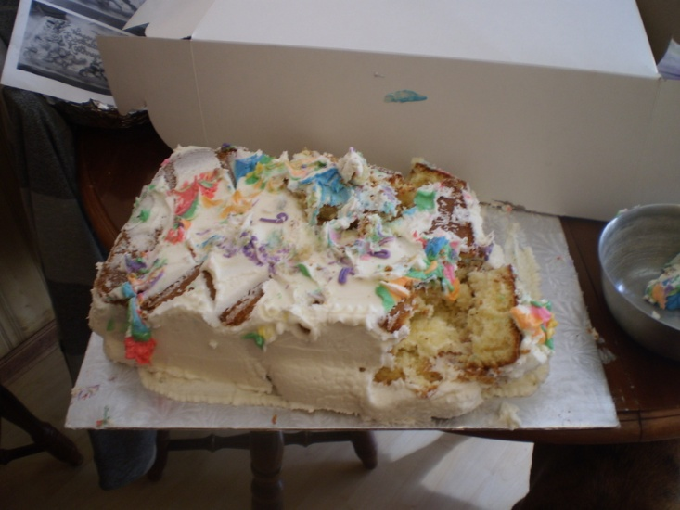
Which picture shows a magnificent cake?
1
2
magnificent

