Slide 1
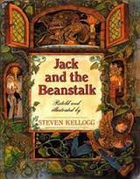
Text Talk
Unit 6

Slide 2
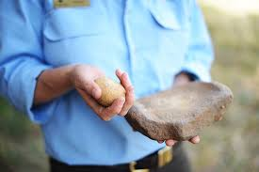
grind to make into small pieces or powder by rubbing
The man is going to grind the rocks together.

Slide 3
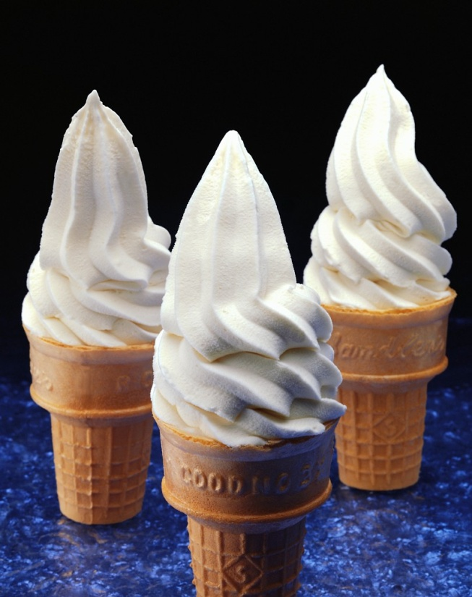
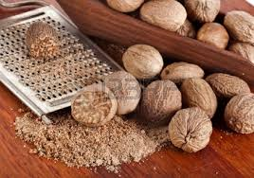
Which picture shows grind?

Slide 4
grind
Pretend like you are going to grind 2 rocks together. What sound would you hear? What would happen?
What else could you grind together?
In the story, what does the giant say he will grind? Why does he say this?

Slide 5
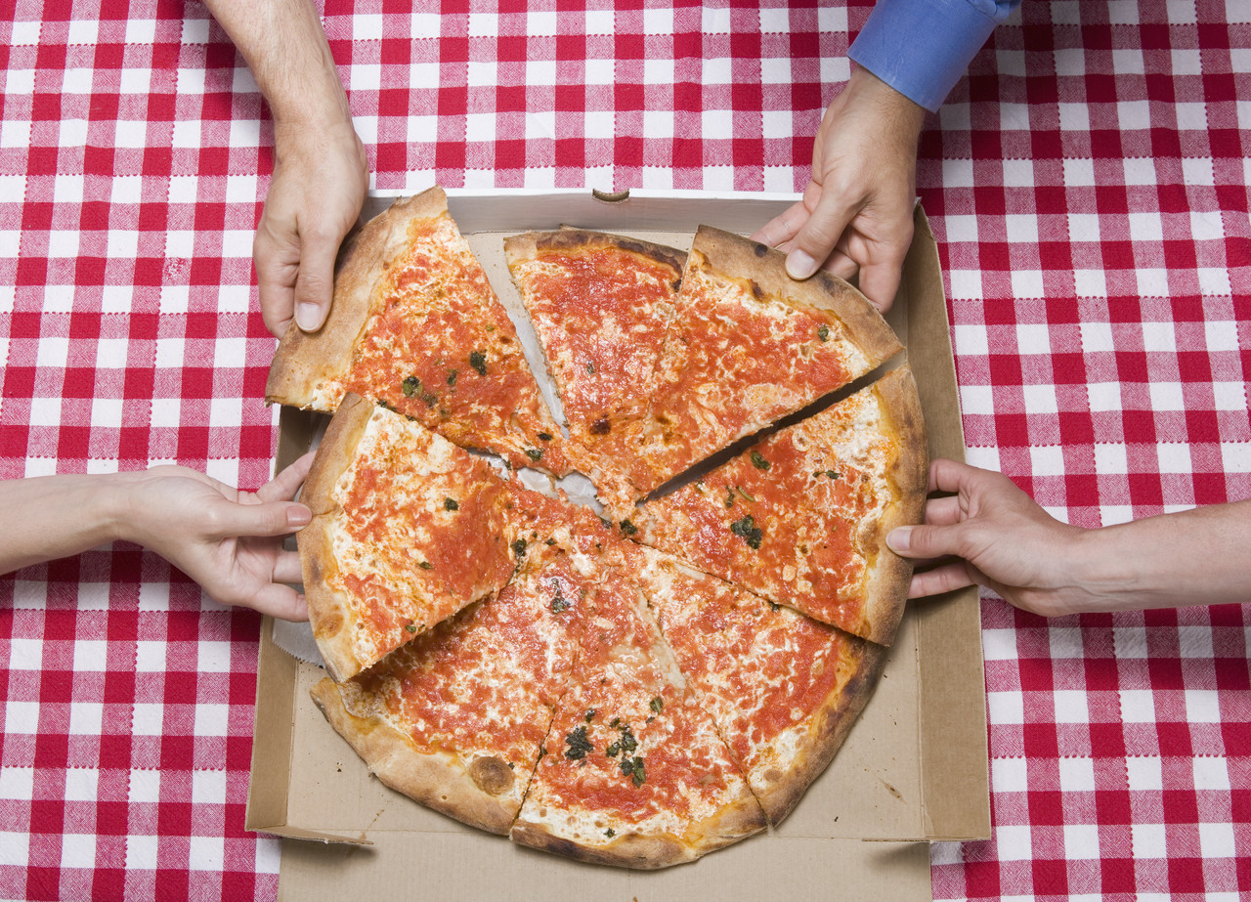
nabbed to grab or capture
Everyone nabbed a slice of pizza
because they were so hungry.

Slide 6

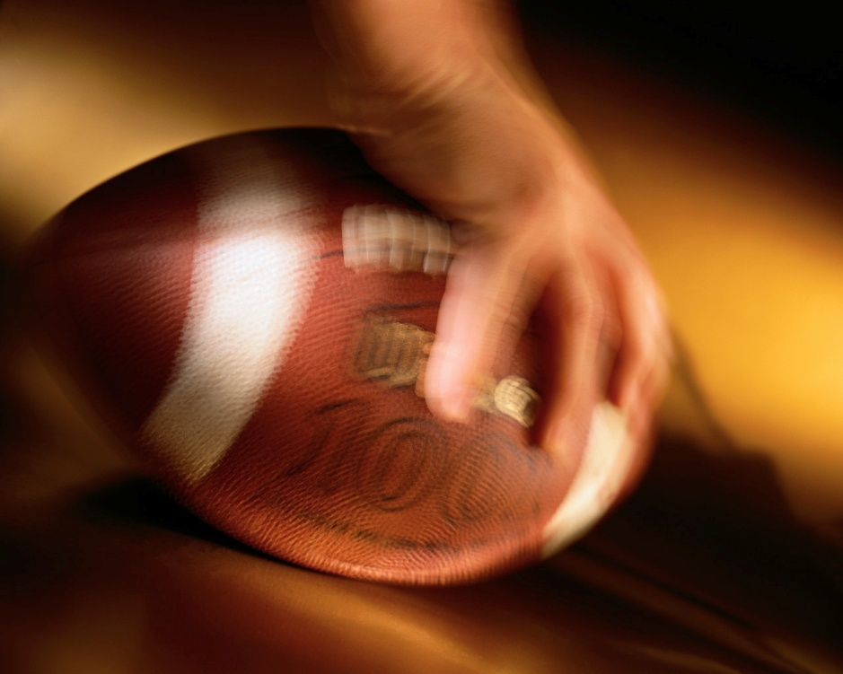
Which picture shows nabbed?

Slide 7
nabbed
What would you do if someone…
  Nabbed your favorite toy?
  Nabbed the last cookie?
  Nabbed your slice of pizza?
  Nabbed your money?
How do you think an animal might feel if they were nabbed? What would they try to do?
Show what it looks like to nab something. What was nabbed in our story?

Slide 8
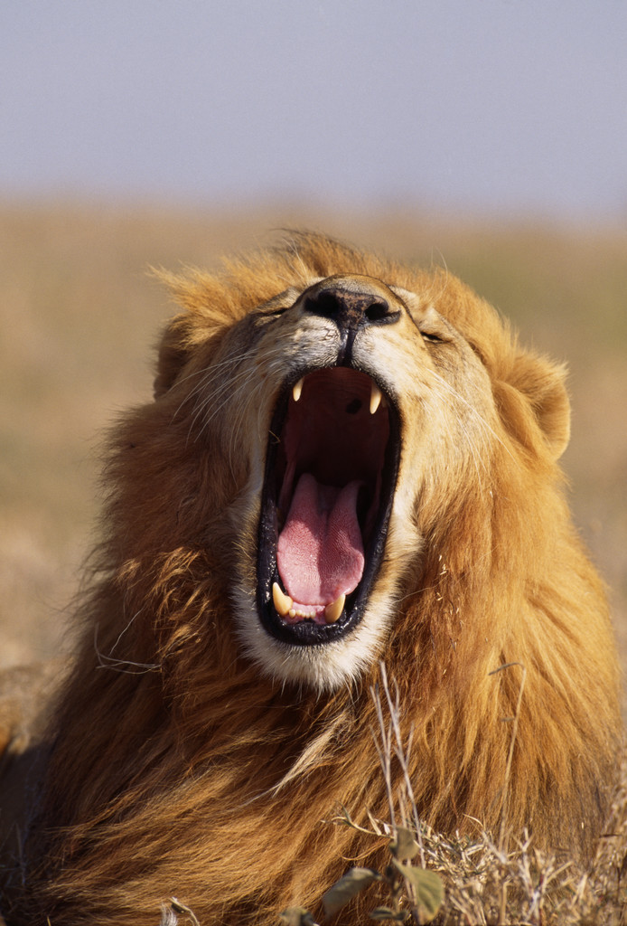
roaring to make a loud scary sound
The roaring lion was looking for his family.

Slide 9
Which picture shows roaring?

Slide 10
roaring
Pretend like you are a lion, and give me your best “ROAR”!!
What other kinds of animals could roar?
Why would an animal roar? Name 3 reasons why they might do this.
Try this analogy: Loud is to roaring as
Quiet is to _________.

