Slide 1
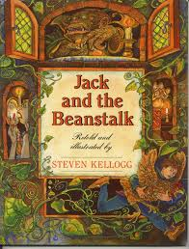
Jack and the Beanstalk
Jack and the Beanstalk
By Stephen Kellogg

Slide 2
precious
Notes:
Valuable and should not be wasted/ precious objects are worth a lot of money because they are rare
Adored beloved cherished

Slide 3
In the text…
Notes:
And as for your precious beans, here they go out the window.

Slide 4
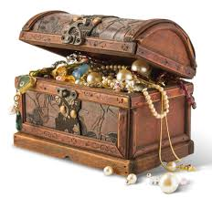
precious
The treasure chest was filled with
precious stones and jewels.

Slide 5
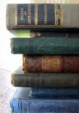
What is precious to you?
Notes:
Turn and talk

Slide 6
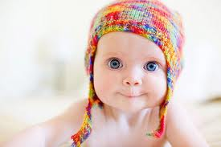
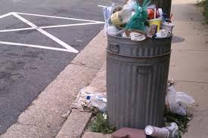
Which picture shows something that may be precious to someone?
1
2
precious

Slide 7
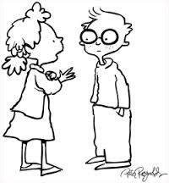
Can you think of something that would be precious to your mom?
Turn and Talk

Slide 8
tremble
Notes:
If something trembles, it shakes.
If you tremble you shake slightly because you are cold or afraid.

Slide 9
In the text…
Notes:
Thump! Thump! Thump! The whole house began to tremble with the noise of someone coming.

Slide 10
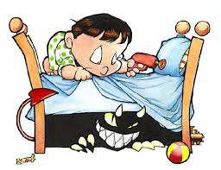
trembled
The boy trembled as he pulled the cover off the bed and discovered a monster!

Slide 11
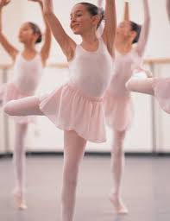
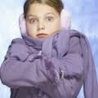
Which goes with tremble?
1
2
tremble

Slide 12
Describe a person, thing, or situation that might cause you to tremble.
Turn and Talk
Notes:
Make a list of cozy places.

