Slide 1
Text Talk- Kindergarten – Unit 6
Old Wire Elementary School

Slide 2
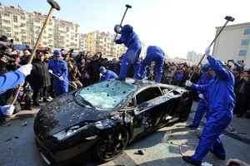
destroy to ruin
The men worked to destroy the car.

Slide 3
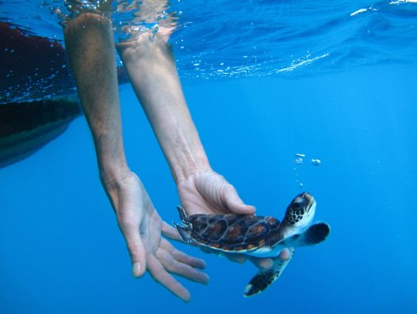
released let go
The boy released the turtle into the ocean.

Slide 4
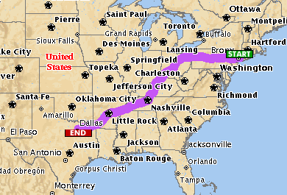
journey a long trip from one place to another
My family took a journey from New York to Texas.

Slide 5
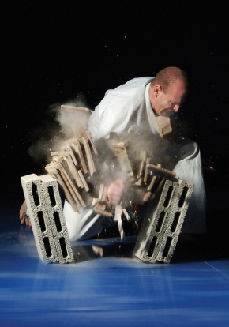
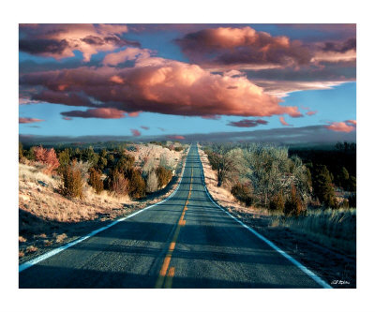
Which picture shows destroy?

Slide 6
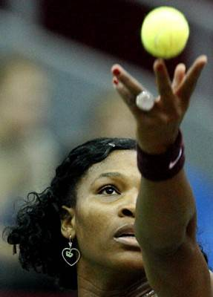
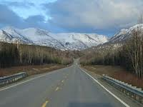
Which picture shows released?

Slide 7
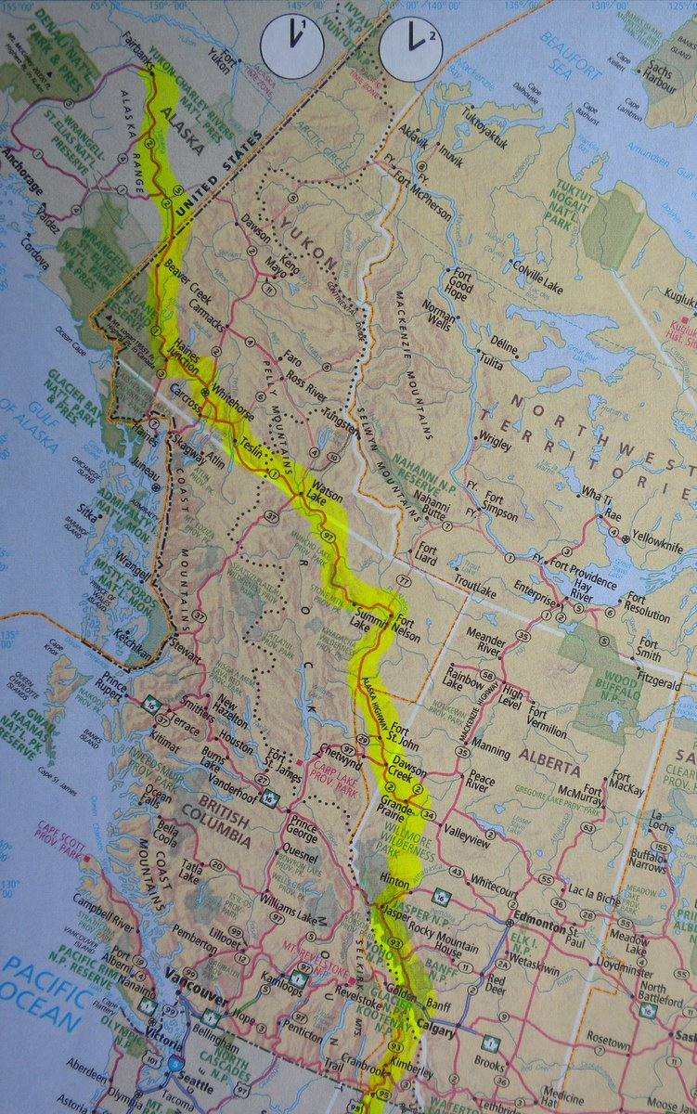
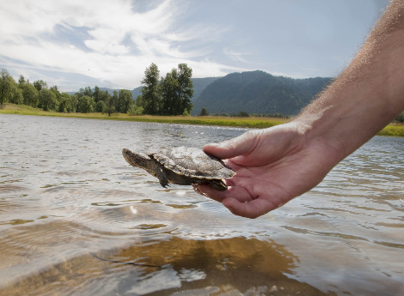
Which picture shows journey?

Slide 8
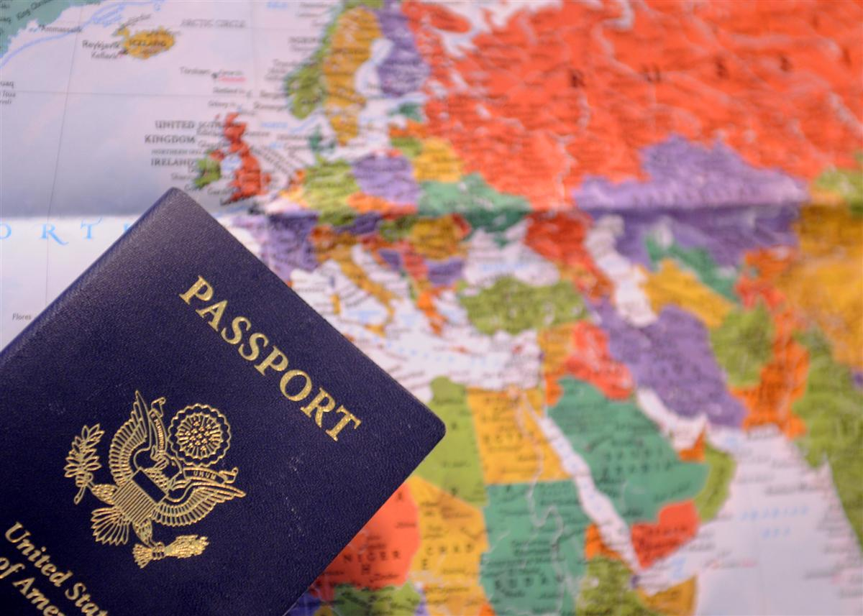
Which word goes with this picture: destroy, released or journey?

Slide 9
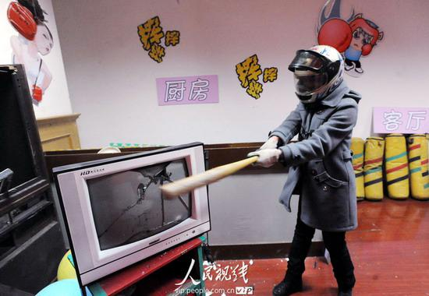
Which word goes with this picture: destroy, released or journey?

Slide 10
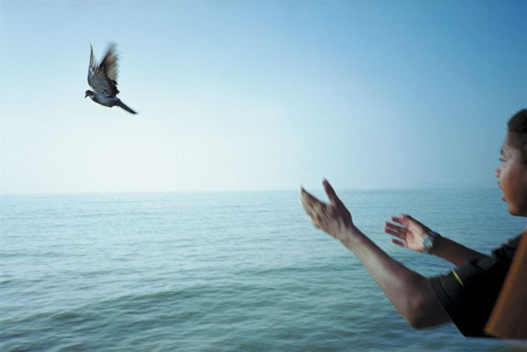
Which word goes with this picture: destroy, released or journey?

