Slide 1
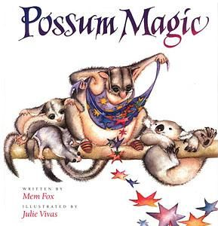
Possum Magic
by Mem Fox and Julie Vivas
Updated
January, 2013
Old Wire Road Elementary Kindergarten -Unit 5

Slide 2
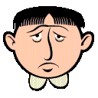
miserable- very sad

Slide 3
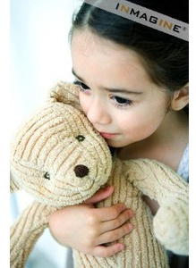
precious- loved or dear to a person

Slide 4
visible- can be seen

Slide 5

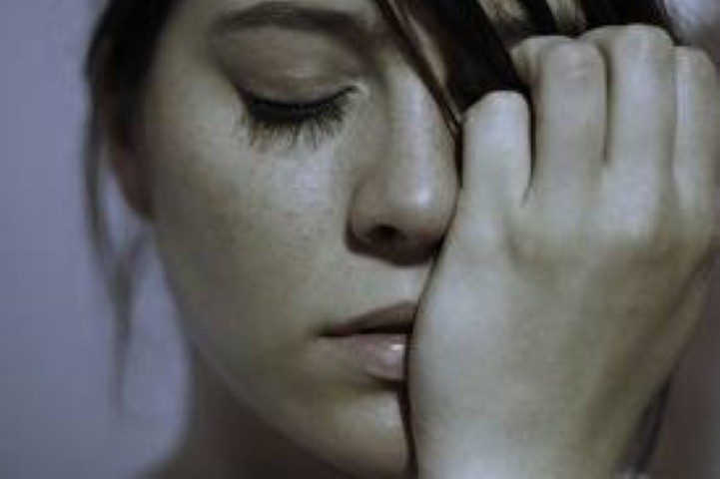
Which picture goes with miserable?

Slide 6
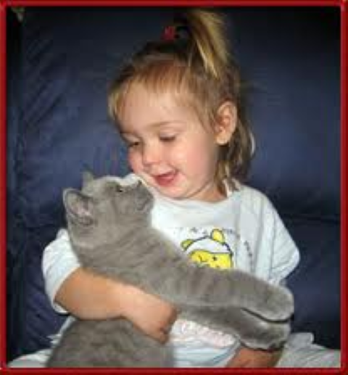
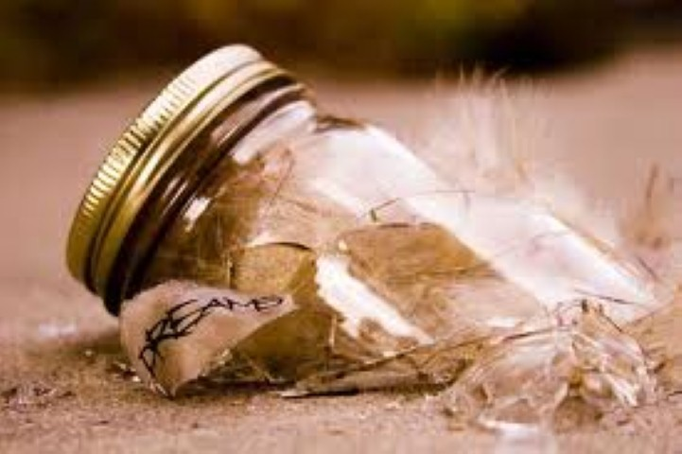
Which picture goes with precious?

Slide 7

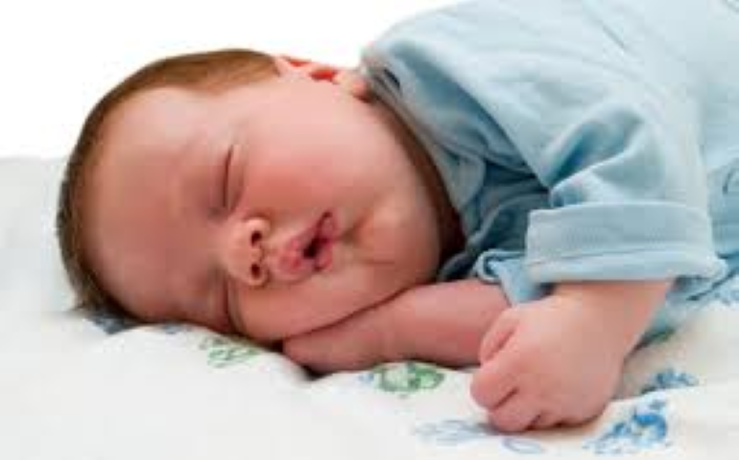
Which picture goes with visible?

Slide 8
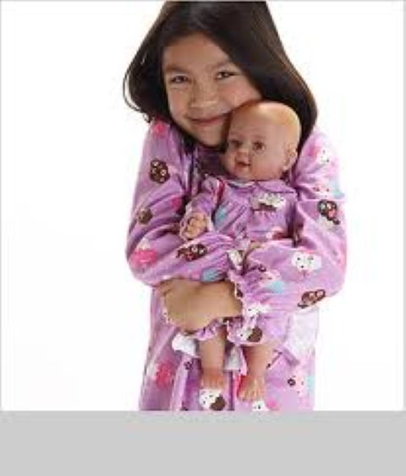
Which word goes with this picture? miserable, precious, visible

Slide 9
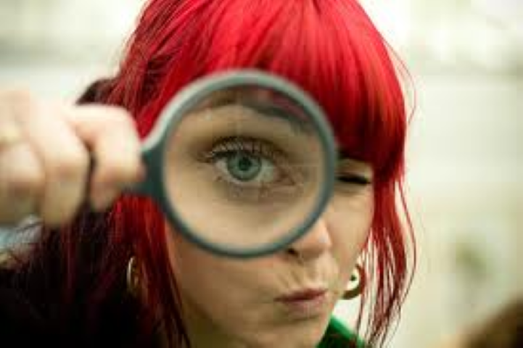
Which word goes with this picture? miserable, precious, visible

Slide 10
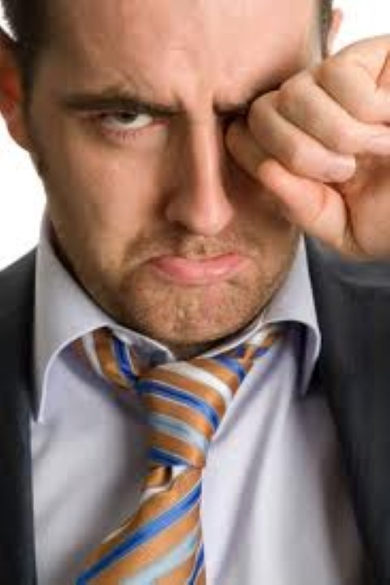
Which word goes with this picture? miserable, precious, visible

