Slide 1
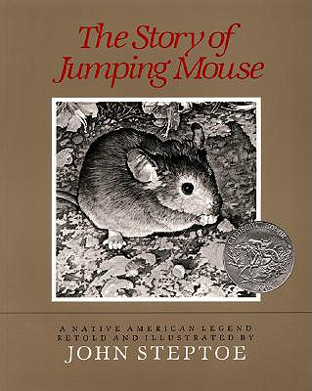
The Story of Jumping Mouse by: John Steptoe

Slide 2
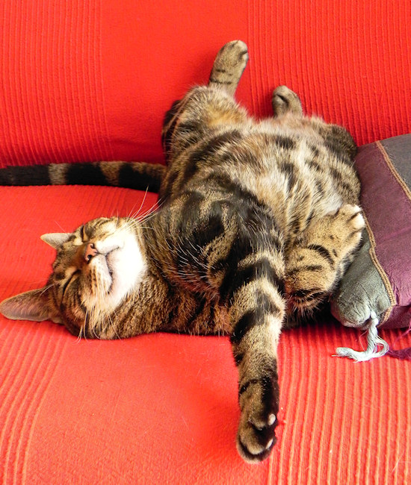
content
-happy with
something

Slide 3
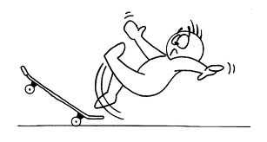
perilous
-dangerous

Slide 4
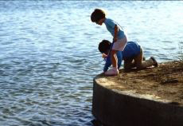
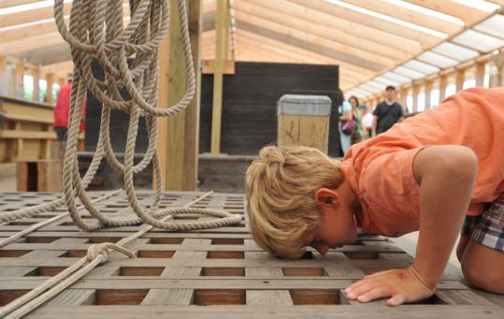
peered
-take a long
slow look

