Slide 1
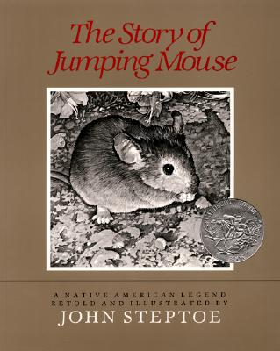
Text Talk
Unit 5
Old Wire Elementary School-Rogers, Arkansas

Slide 2
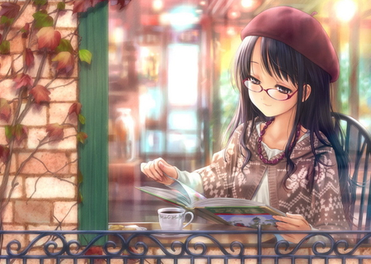
content happy with something
The lady was content sitting with her hot cocoa and a book.

Slide 3
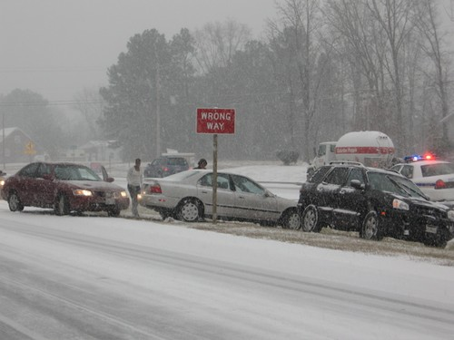
perilous dangerous
After the snow, the roads were in
perilous condition.

Slide 4
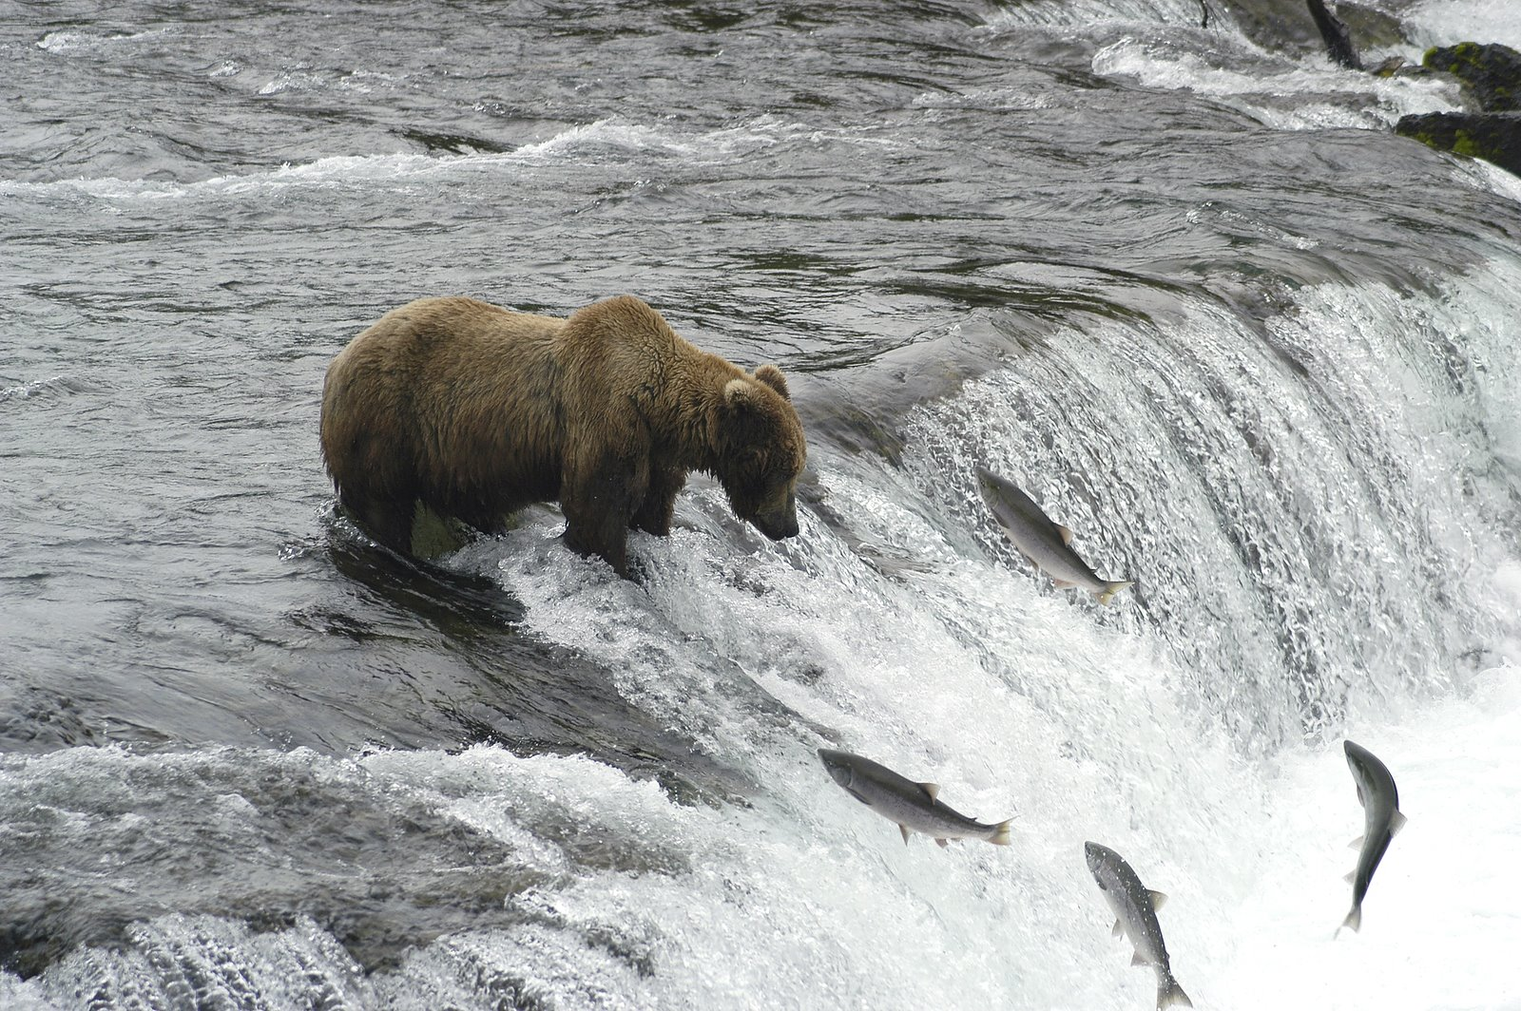
peered to take a long slow look
The bear peered at the fish, waiting to pounce.

Slide 5

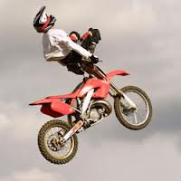
Which picture shows content?

Slide 6
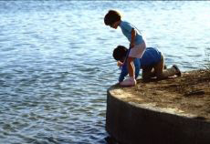
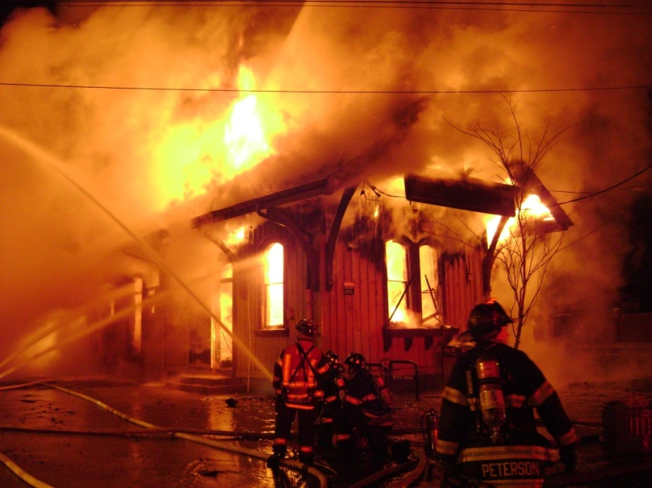
Which picture shows perilous?

Slide 7
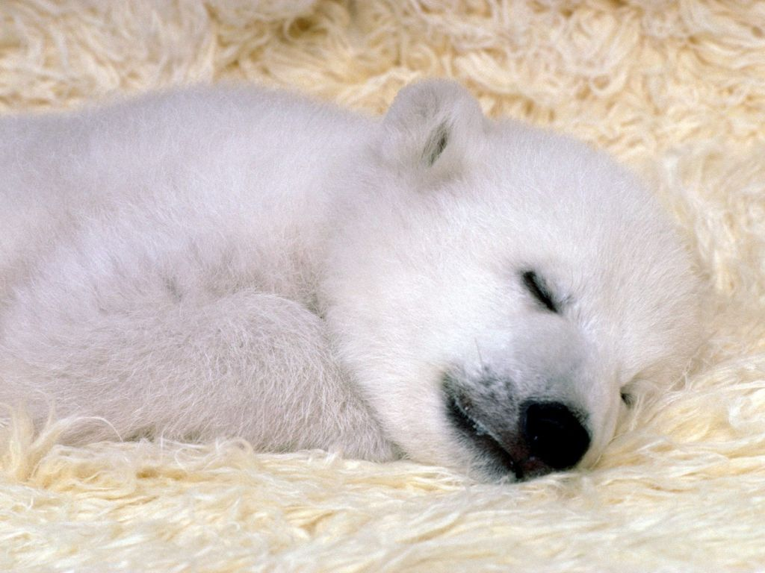
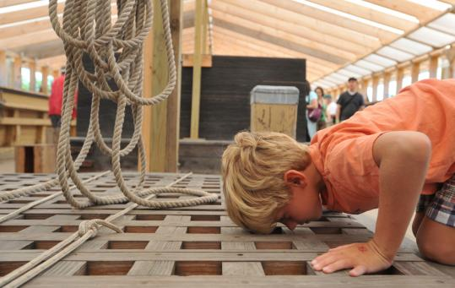
Which picture shows peered?

Slide 8
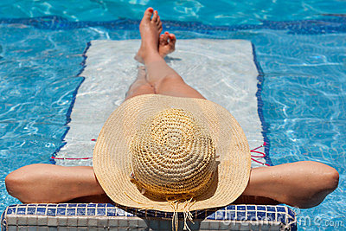
Which word goes with this picture: content, perilous, or peered?

Slide 9

Which word goes with this picture: content, perilous, or peered?

Slide 10
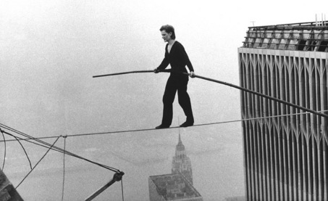
Which word goes with this picture: content, perilous, or peered?

