Slide 1
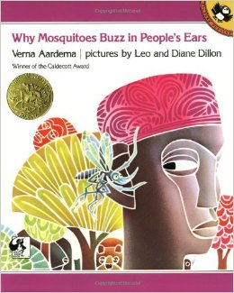
Why Mosquitoes Buzz in People’s Ears
By: Verna Aardema

Slide 2
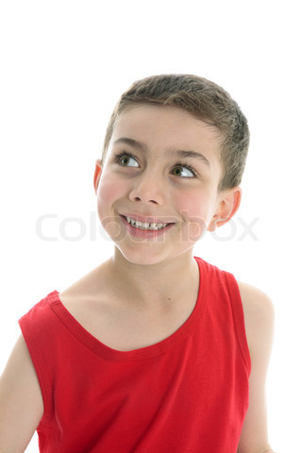
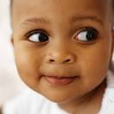
glancing- a brief or quick look
He was glancing at his friend on the carpet.

Slide 3
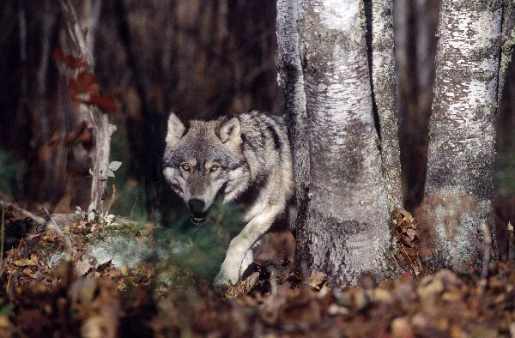
prowling – to move around restlessly in search
of something
The hungry wolf was prowling close by.

Slide 4
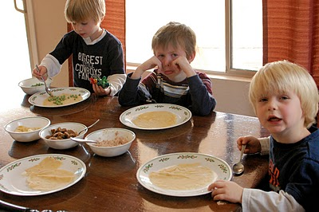
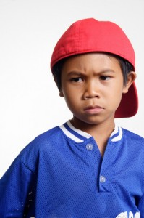
grumbling – to softly complain about something in a bad way
He was grumbling about his dinner.

Slide 5
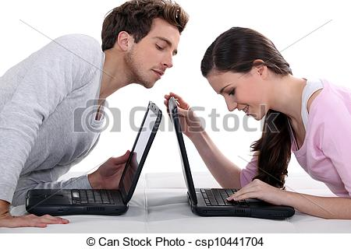
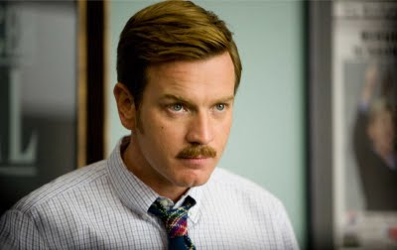
Which picture goes with glancing?

Slide 6
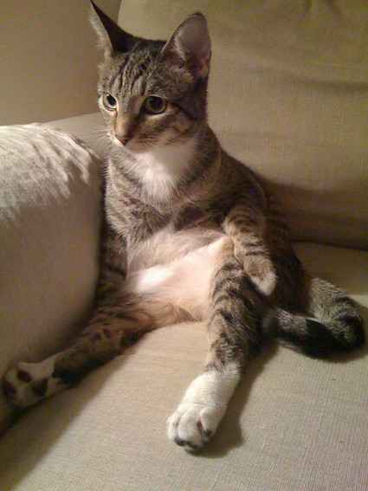
Which picture goes with prowling?

Slide 7
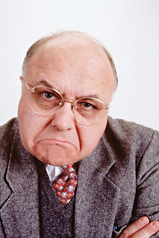
Which picture goes with grumbling?

Slide 8
Does this picture show glancing, prowling, or grumbling?

Slide 9
Does this picture show glancing, prowling, or grumbling?

Slide 10
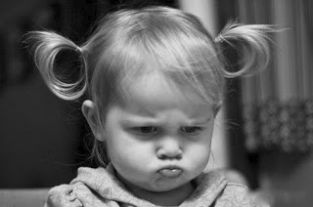
Does this picture show glancing, prowling, or grumbling?

