Slide 1
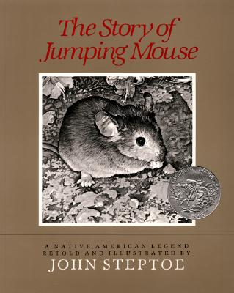
Text Talk
Unit 5

Slide 2
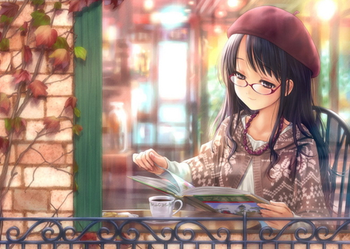
content happy with something
The lady was content sitting with her hot cocoa and a book.

Slide 3
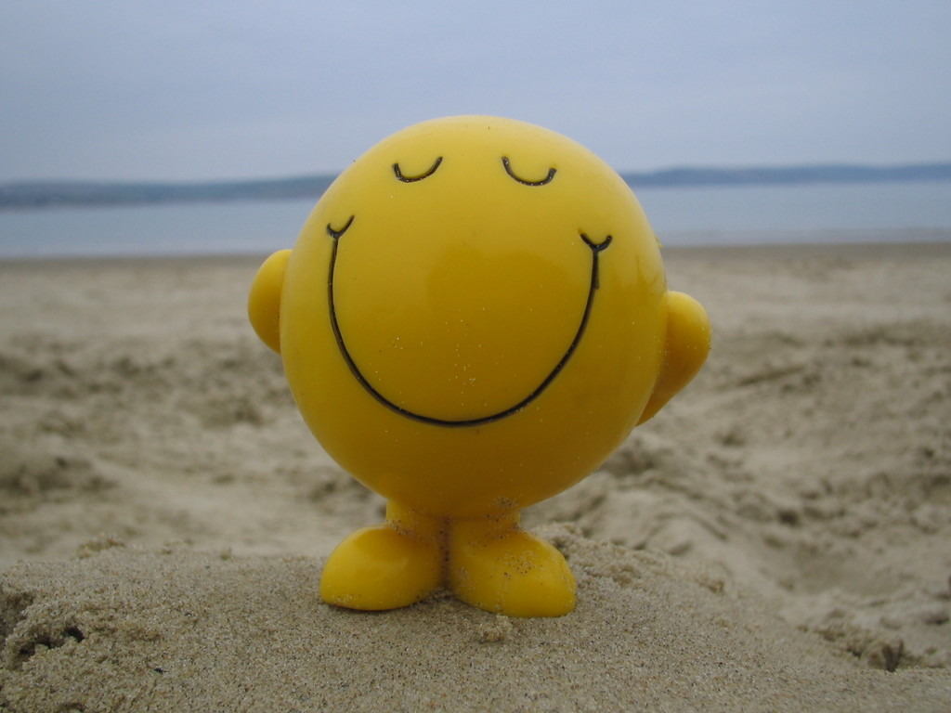
Which picture shows content?

Slide 4
content
Turn and talk. What makes you content? Why does it make you feel this way?
Share your opinion. Would this make you content? Thumbs up/down.
  Going to Chuck E. Cheese
  Playing football
  Going to the park
  Watching a movie
  Playing with your friends
  Eating your vegetables
  Playing with your dolls

Slide 5
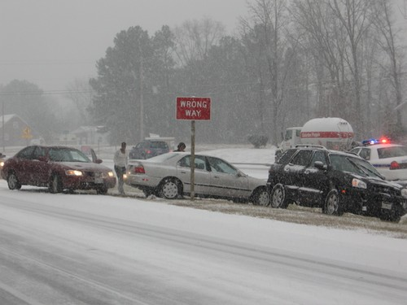
perilous dangerous
After the snow, the roads were in
perilous condition.

Slide 6
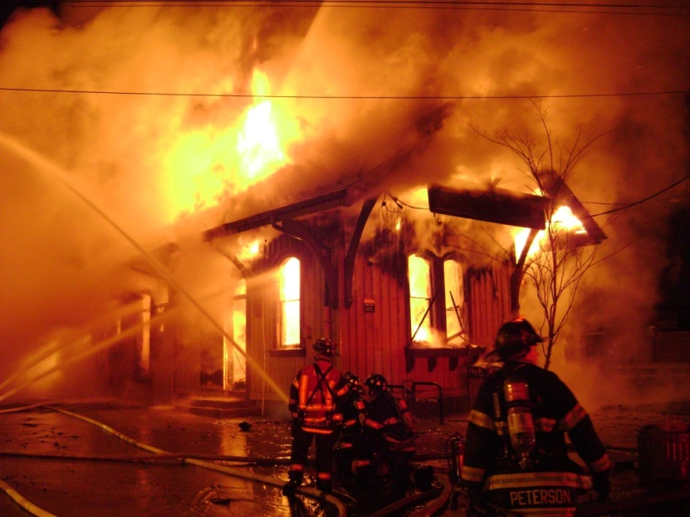

Which picture shows perilous?

Slide 7
perilous
Have you ever been in a perilous situation? What happened and how did it make you feel? Turn and talk. Share out with the class.
If this would be perilous, say “Ahhhhh!”
  A shark was chasing you in the water.
  Your teacher gave you a hug.
  Someone’s house was on fire.
  You were eating french fries.
  A boy got lost in a big store and didn’t know where his parents were.
  A girl picked up a huge spider.

Slide 8
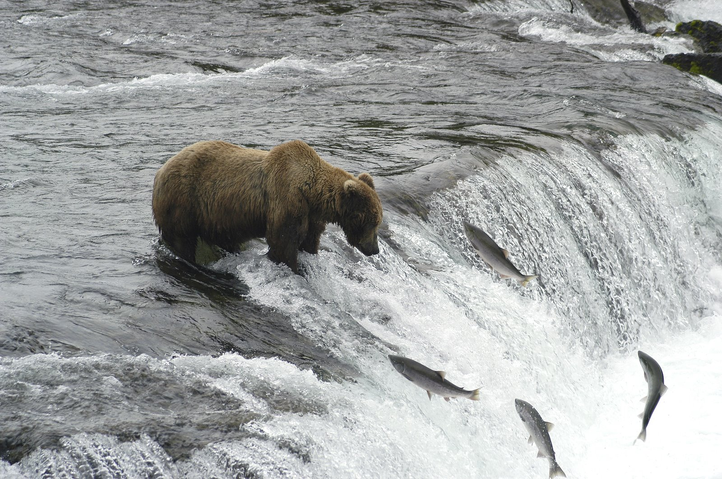
peered to take a long slow look
The bear peered at the fish, waiting to pounce.

Slide 9
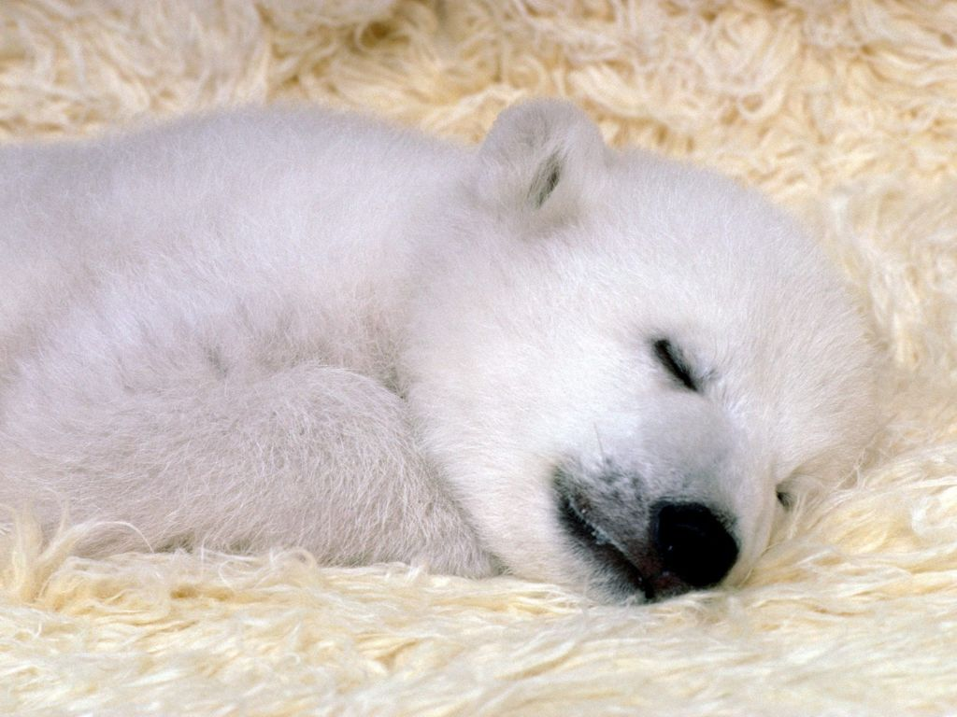
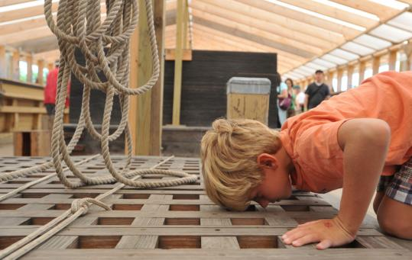
Which picture shows peered?

Slide 10
peered
Act it out! Imagine that you are sitting on the slide, and you are peering out over the edge to see if any one is below you.
Go back to the 2 previous pictures in the powerpoint. Why was the bear peering at the fish? Why was the boy peering into the hole? Share and discuss ideas.
What would a __________ peer at? (cat, dog, tiger, baby, bird) Why?

