Slide 1

Rain Player
David Wisniewski

Slide 2
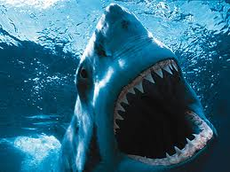
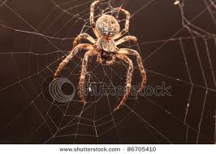
dreadful- terrible, frightening

Slide 3
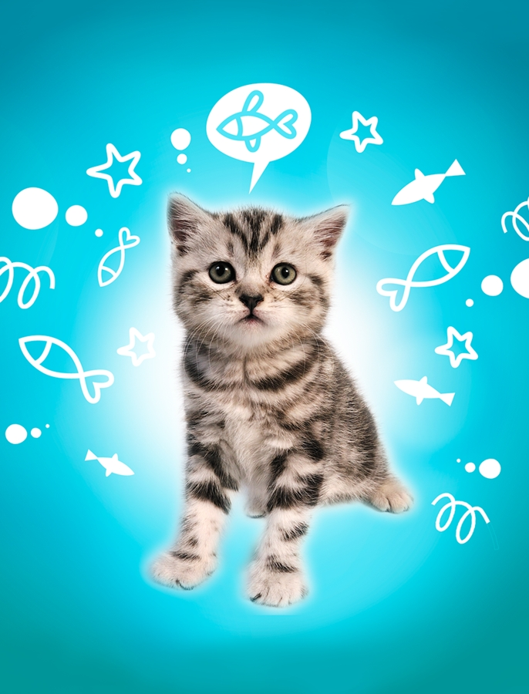
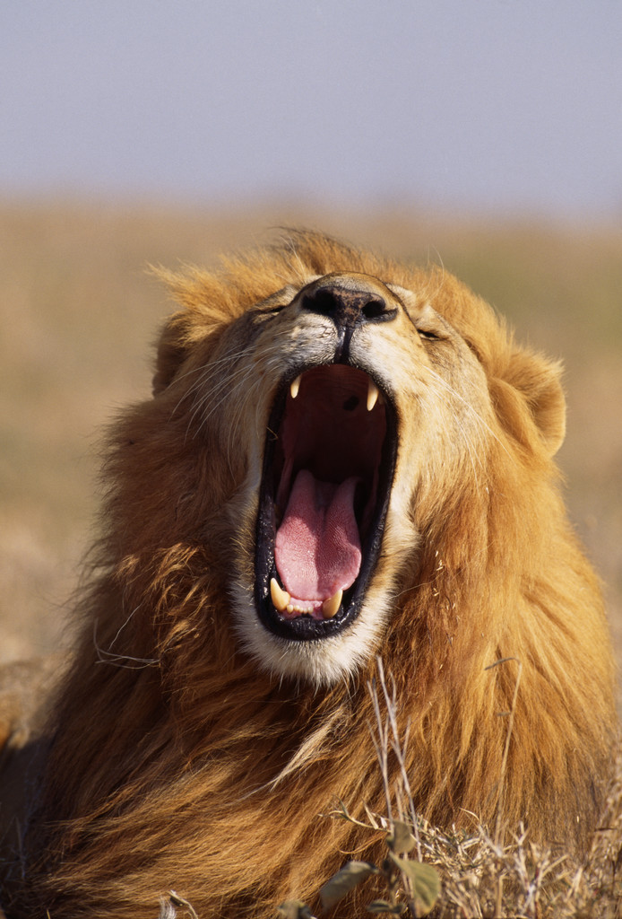
Which picture is dreadful?

Slide 4
dreadful
Have you ever seen something that was dreadful? Turn and talk. What was it? How did it make you feel?
Tell your partner about something that would be dreadful.
Act it out! Show what your face would look like if you saw something that was dreadful.

Slide 5
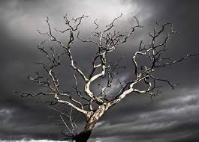
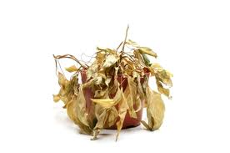
perish – to die

Slide 6
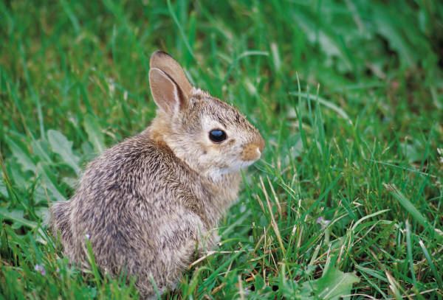
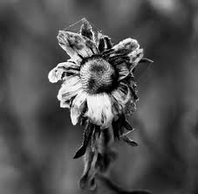
Which picture shows perish?

Slide 7
perish
What does a _________ need so that it won’t perish? (fish, flower, dog, bird)
If this means that something is perishing, put your thumbs up.
  A baby bird hatched from the egg.
  The flower did not have any water.
  The dog was drinking water from his bowl.
  The elephant couldn’t find any food.

Slide 8
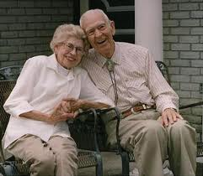
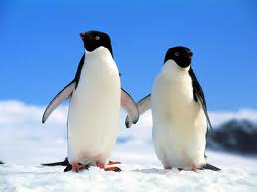
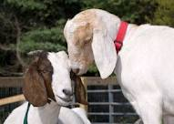
companions – someone who you spend a lot of time with

Slide 9
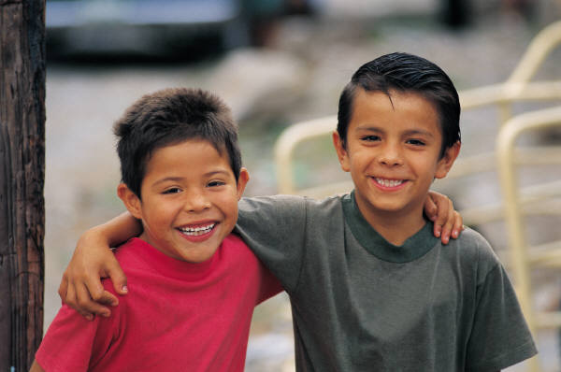
Which picture shows companions?

Slide 10
companions
Turn and talk. Who is your companion? Why do you like to spend time with them? What do you like to do? Share with the class.
If this could be a companion, say “Hey, friend!”
  A squirrel
  Someone in your class
  An alligator
  Your mom or dad
  Your cousin
  A pencil

