Slide 1
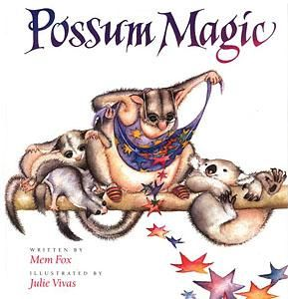
Possum Magic
by Mem Fox and Julie Vivas

Slide 2
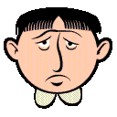
miserable- very sad

Slide 3

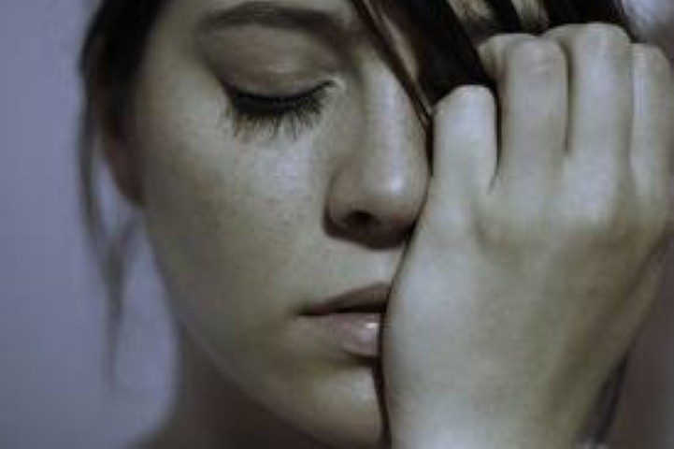
Which picture goes with miserable?

Slide 4
miserable
Turn and talk. Tell your partner about a time that you were miserable.
What would make you feel better if you were miserable? Share.
If this would make you miserable, make a sad face.
  Your dog got very sick
  You got a new Ipad
  Your best friend called you a name
  All of your favorite toys were stolen

Slide 5
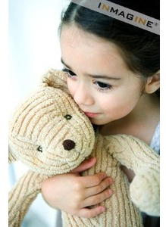
precious- loved or dear to a person

Slide 6
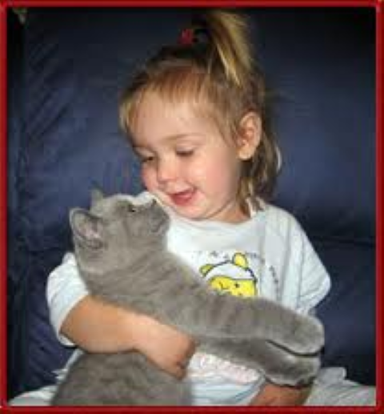
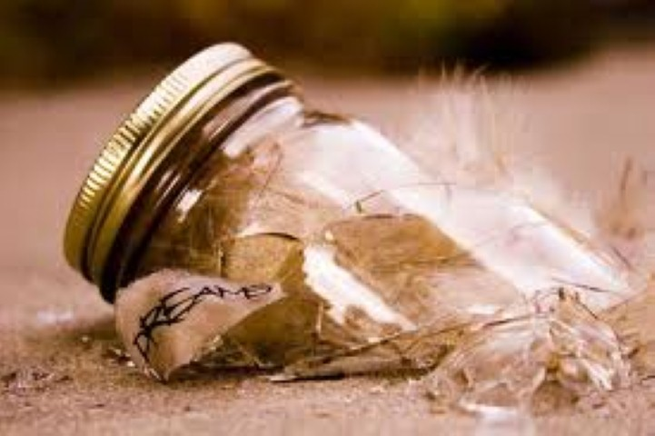
Which picture goes with precious?

Slide 7
precious
Turn and talk. Tell your partner about someone or something that is precious to you. Why is it precious to you?
Which would be more precious to someone?
  A pencil or an Ipad
  A friend or a piece of paper
  A car or play dough
  A sticker or a home

Slide 8
visible- can be seen

Slide 9
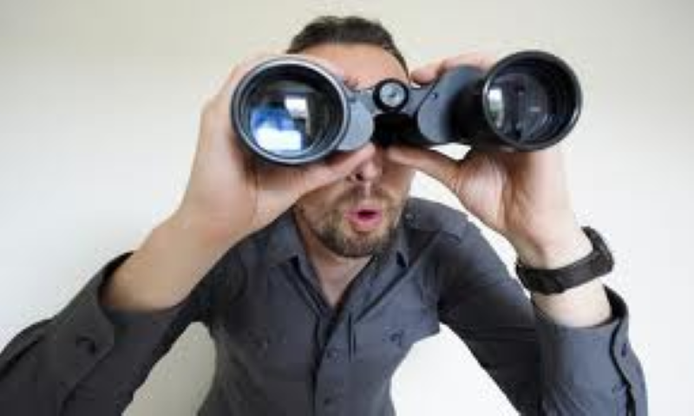
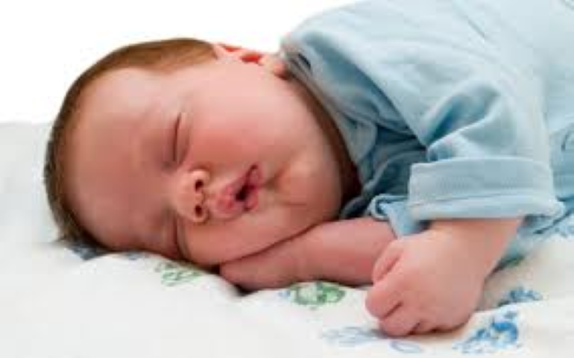
Which picture goes with visible?

Slide 10
visible
Play “I Spy”- These things are visible to us in the classroom.
What kinds of things are visible to you when you are on the playground?
Have you ever wanted to be invisible? Invisible means “not visible”; you cannot be seen. What would you do if you were invisible?

