Slide 1

A Red Riding Hood Story from China by Ed Young

Slide 2
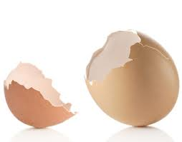
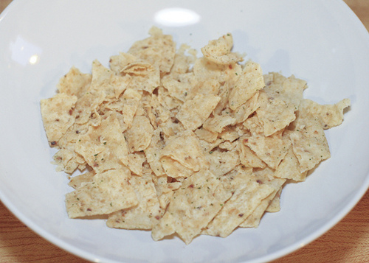
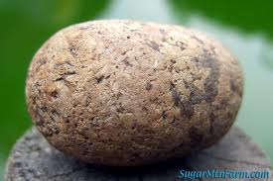
A rock is not brittle like a potato chip.
Brittle- easily broken.

Slide 3
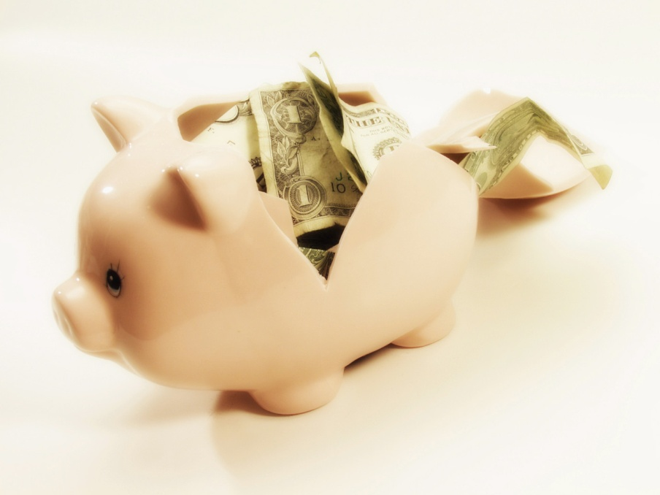
Which one shows “brittle”?

Slide 4
brittle
Show what it would look like if you were holding something that was brittle.
What are some things in our classroom/at home that are brittle?
If this is brittle, say “Careful!!”
  Egg
  Glass
  Book
  crackers

Slide 5
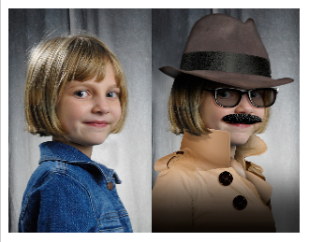
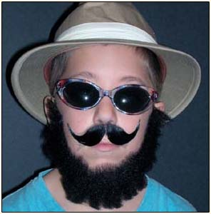
The girl was disguised so she could sneak into the party.
Disguised- put on a costume to cover up who you really are.

Slide 6
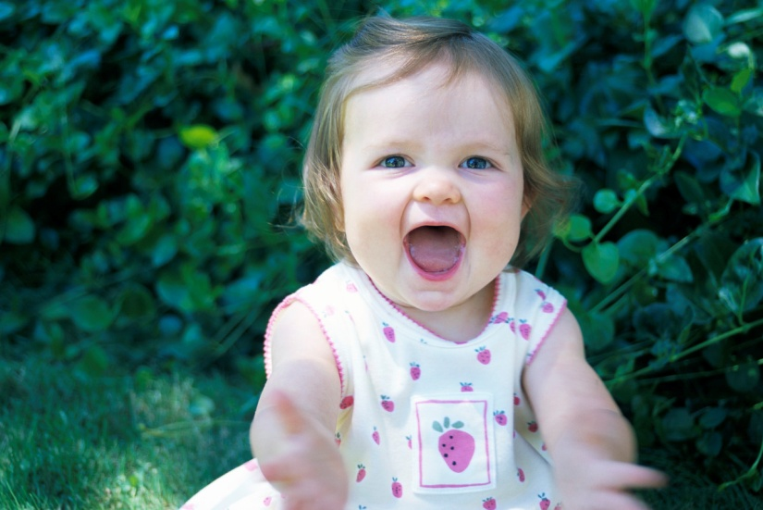
Which one shows “disguised”?

Slide 7
disguised
When have you been disguised? What did you wear? Turn and talk.
Which of these has a disguise? Thumbs up if it is, thumbs down if it is not.
  Clown
  Chuck E. Cheese
  Your dad/mom
  Your teacher

Slide 8
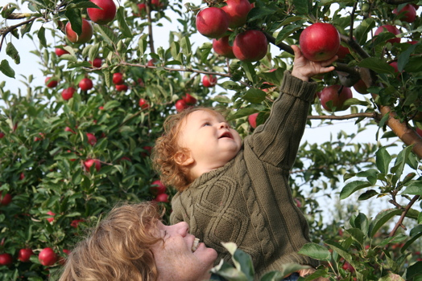
I plucked an apple from the tree.
Plucked- pulled out quickly.

Slide 9
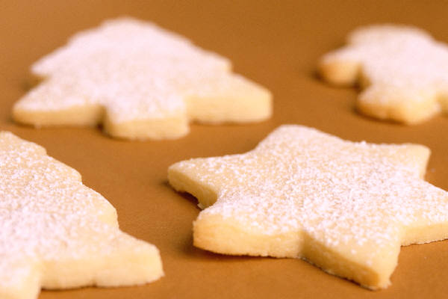
Which shows “plucked”?

Slide 10
plucked
What did the 3 kids from Lon Po Po pluck out of the tree? What did they tell the wolf to do? Why?
Practice plucking something out of a tub. Give an example and let students try.
Would you want someone to pluck a hair out of your head? Why or why not?
Would you want someone to pluck your loose tooth out? Why or why not?

